Slide 1
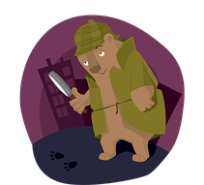

Expanding Noun Phrases using Prepositional Phrases
We can expand noun phrases by adding adjectives, adverbs and determiners.
the rather ingenious detective bear
We can also expand noun phrases by adding a prepositional phrase after the head noun.
the bear with a rather helpful magnifying glass

Slide 2
Prepositions
Prepositions tell us how words are related.
above
of
on
with
over
outside
Prepositions are useful for adding extra information about a noun.
without
between
from
inside
by
under
from
below

Slide 3
Expanded Noun Phrases
You can develop an expanded noun phrase by adding a
prepositional phrase.
an old, cloudy bottle
an old, cloudy bottle with a message in
an old, cloudy bottle on the beach
Prepositions
with, of
by, from
on, under, below, between, inside, next to, over, by, in
an old, cloudy bottle from foreign shores
The prepositional phrase modifies the noun.

Slide 4
Examples
Building Expanded Noun Phrases
an old and crumpled treasure map
in the trunk
the wooden planks
from a wrecked ship
a gold coin
with strange markings
slimy seaweed
Prepositions
with, of
by, from
on, under, below, between, inside, next to, over, by, in
below the waves
Choose a noun phrase. Expand it using a preposition.

