Slide 1

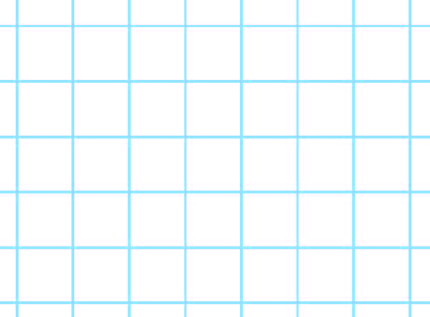
Find the perimeter of rectangles.
We call the distance round the outside of a shape its perimeter.
5cm
3cm
3cm
This rectangle measures 3cm by 5cm.
5cm
If we found 5cm + 3cm + 5cm + 3cm, it would give us the perimeter of the rectangle, but there is a more efficient way…
We know opposite sides of the rectangle are the same length.

Slide 2
Find the perimeter of rectangles.
We can double the width, and double the length, then add the two together to find the perimeter. Or add the width and the length and then double the total.
5cm
3cm
3cm
5cm
(5cm × 2) + (3cm × 2) = 16cm
Or
(5cm + 3cm) × 2 = 16cm

Slide 3
Find the perimeter of rectangles.
Try both strategies to find the perimeter of this rectangle. Either add 4 and 8 then double or double each number then add.
4cm
8cm
The perimeter is 24cm.

