Slide 1
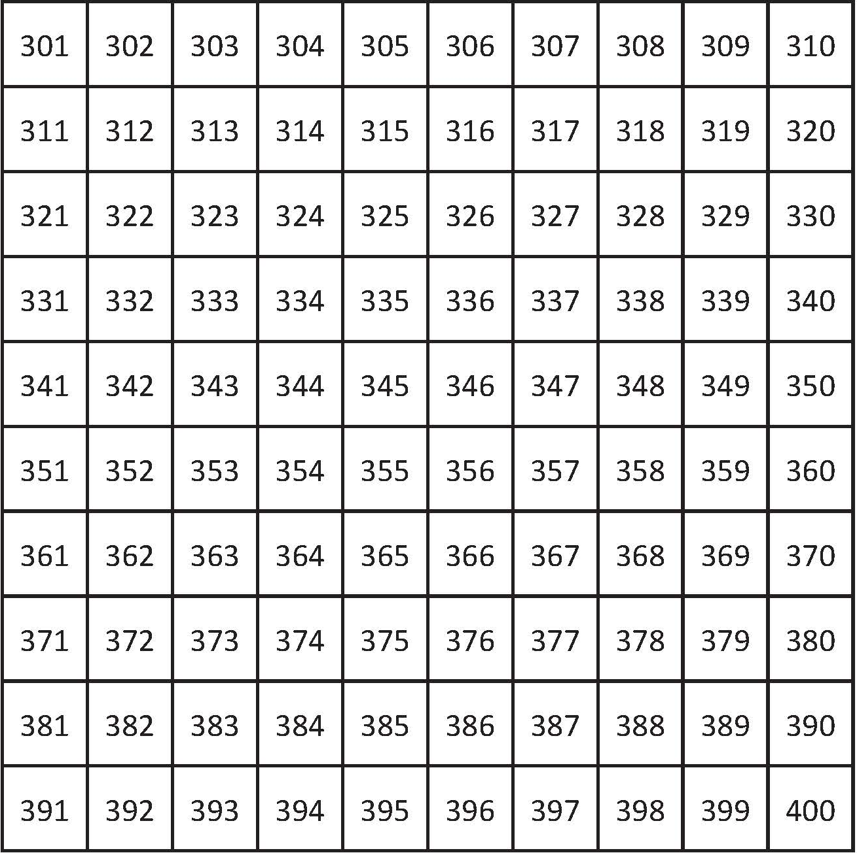


Add multiples of 10.
We can use this grid to find
356 + 40.
Start at 356 and count on 4 tens down the grid.
Do you remember spider counting?

Slide 2
Subtract multiples of 10.
We can also use this grid to calculate
356 - 40.
This time, start at 356 and count back 4 tens.
356 - 40 = 316

Slide 3
Add near multiples of 10.
How could we use the grid to find
356 + 41?
We could add the 40 then 1 more, watch carefully.
356 + 41 = 397

Slide 4
Add near multiples of 10.
How could we use the grid to find
356 + 39?
We could add the 40 then subtract 1.
39 is 1 less than 40.
356 + 39 = 395

Slide 5
Subtract near multiples of 10.
How could we use the grid to calculate
356 - 41?
Start at 356 and count back 4 tens.
Now we need to subtract another 1 to subtract 41.
356 - 341 = 315

Slide 6
Subtract near multiples of 10.
How could we use the grid to find
356 - 39?
Start at 356 and count back 4 tens.
But 40 is 1 more than 39 so we add 1 to adjust.
356 - 39 = 317

