Slide 1
Comprehension
Tuesday 23rd November 2021

Slide 2
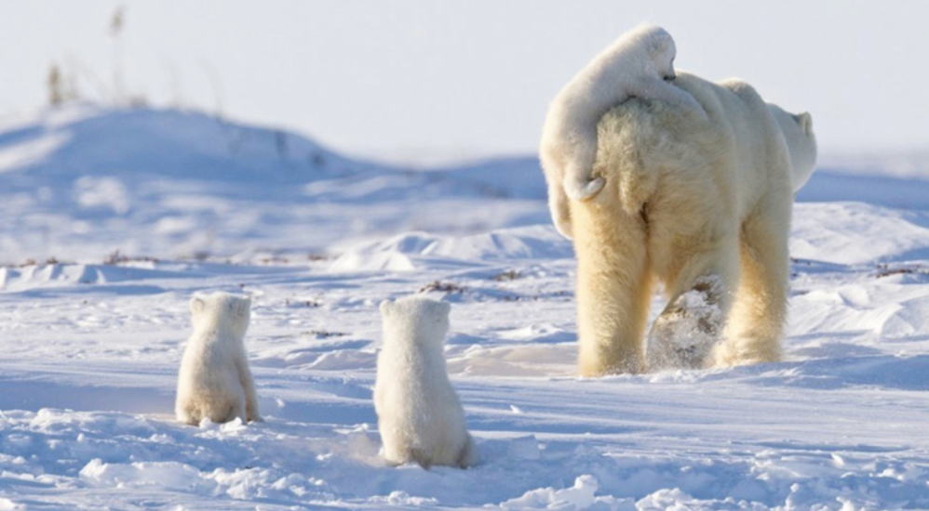

Slide 3
Question time Discuss the questions
Will they encounter any dangers along the way? What qualities will they have to show in order to survive?
Where is the mother leading her cubs do you think?
If the polar bears could speak, what would they be saying to each other?
If polar bears ruled the world, what changes would we see?
Is it harder to survive in a really cold place or a really hot place?
Do polar bears have conversations with each other?

