Slide 1
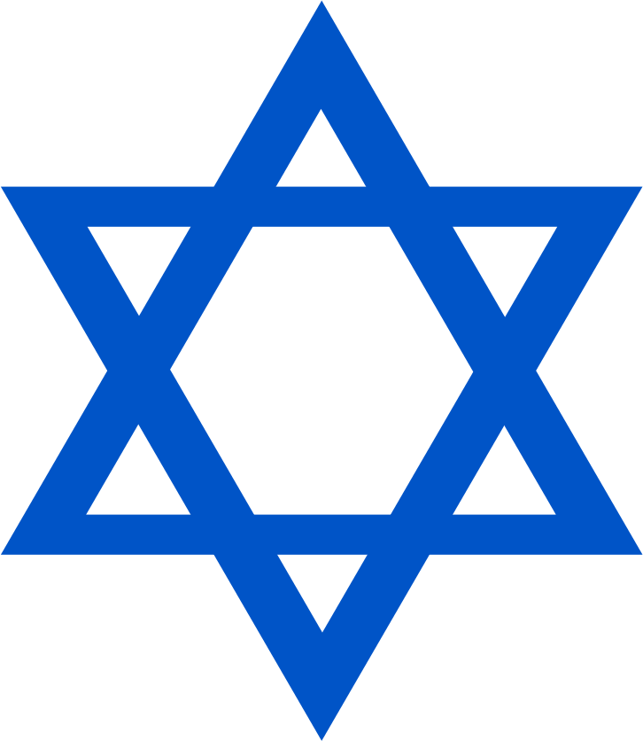

LO: To understand the meaning of some Jewish symbols.
w/c 11th January 2020

Slide 2
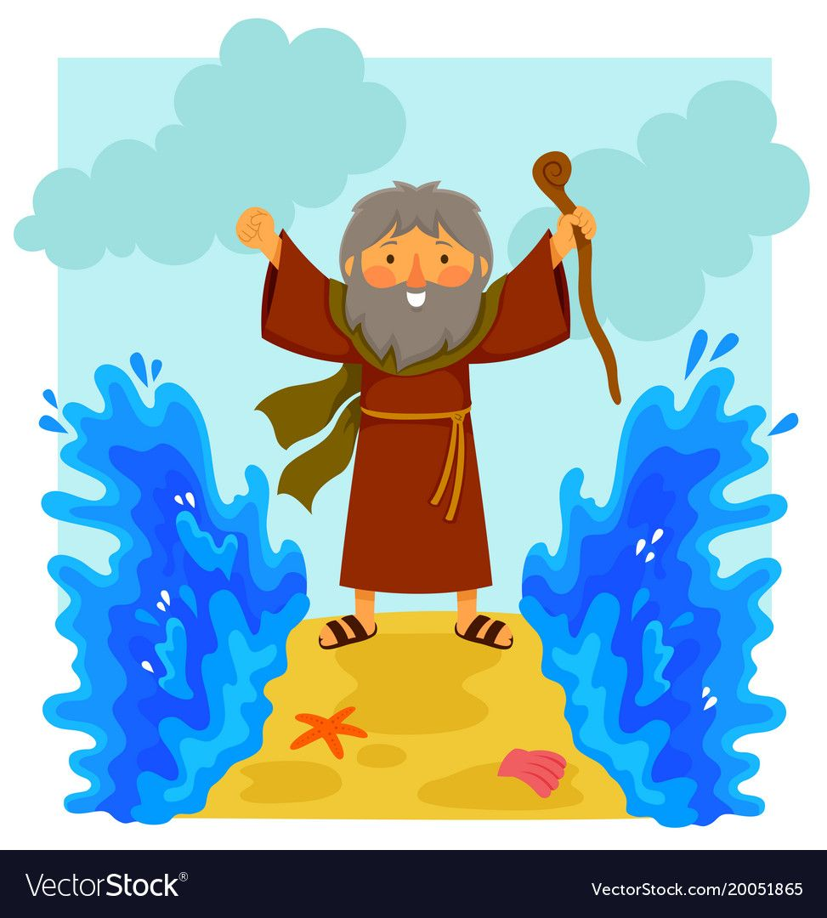
Starter: Can you remember what happened in the story of Moses?

Slide 3
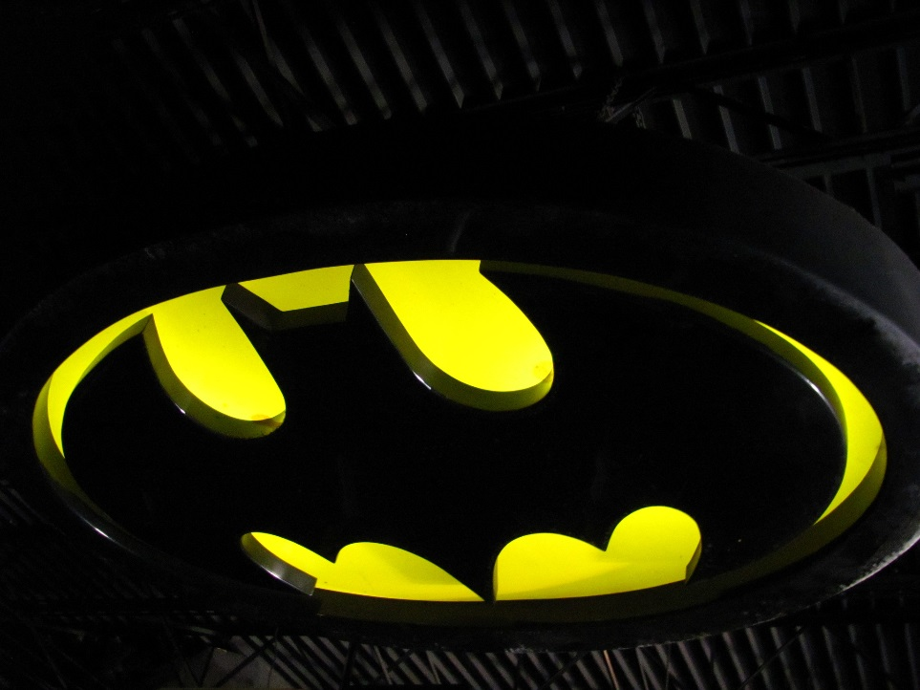

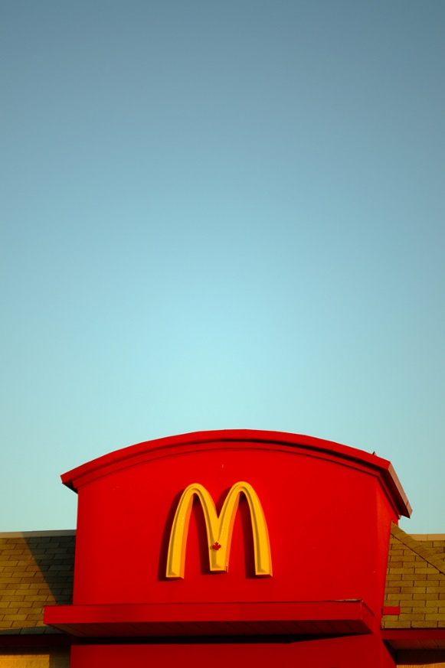
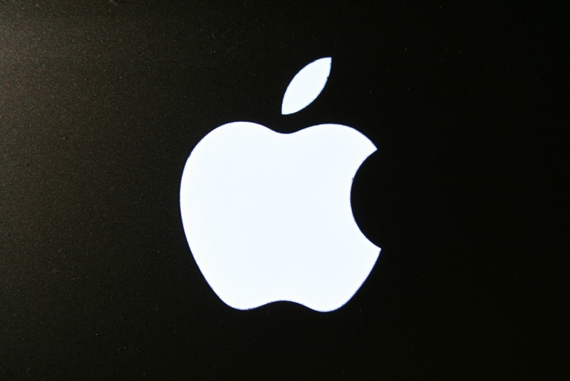
What is a Symbol?
A symbol is a mark or character.
Have you seen any of these symbols before?
Photos courtesy of Ian Muttoo, Roller Coaster Philosophy, Free Grunge Textures and Contando Estrelas (@flickr.com) - granted under creative commons licence - attribution

Slide 4
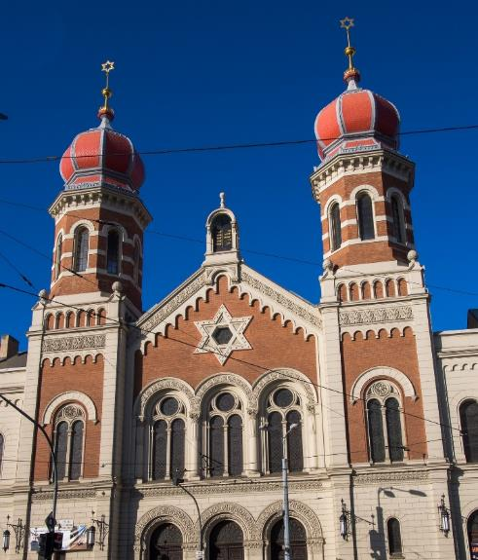
Where Do Jews Go to Worship?
A synagogue is a sacred building where Jewish people go to worship.
Did You Know…?
The word synagogue means ‘meeting place’ in Greek.

Slide 5
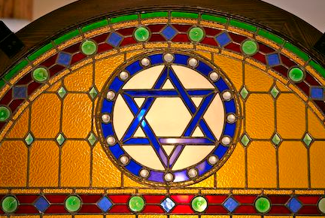
Jewish Symbols
The Star of David, known in Hebrew as the Shield of David, is a generally recognized symbol Judaism.
It is an important symbol in the Jewish faith and is often seen in windows of synagogues.

Slide 6
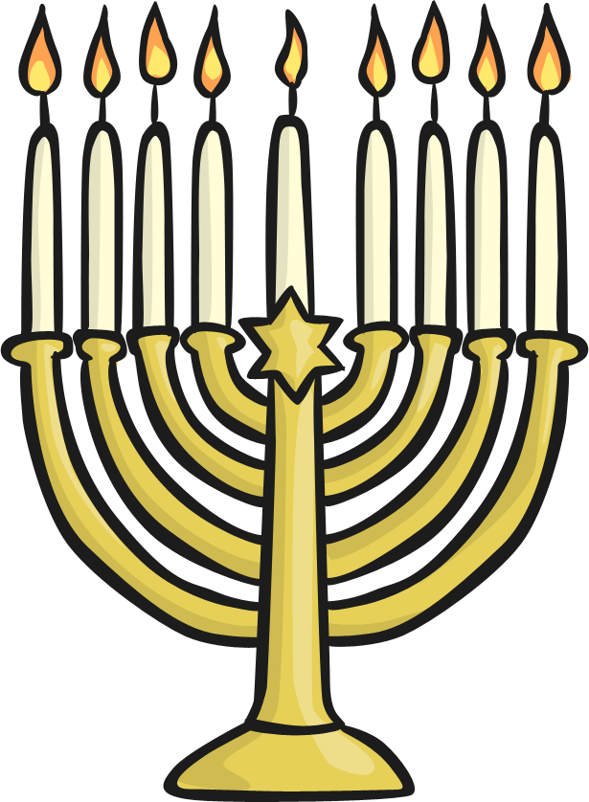
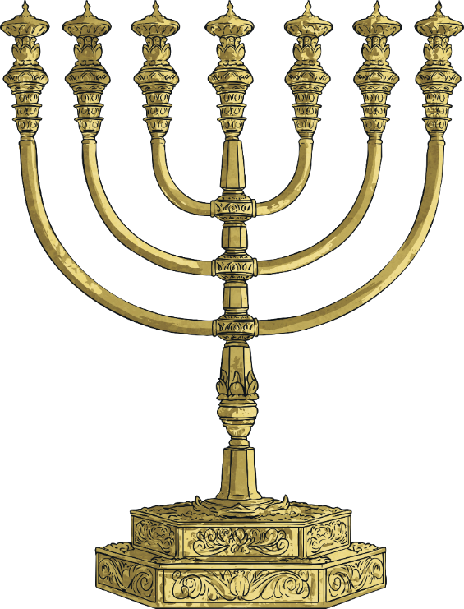
Jewish Symbols
Here is a menorah which is used during a special Jewish festival called Hanukkah.
Moses created the first Menorah according to God’s instructions, while out in the wilderness.

Slide 7
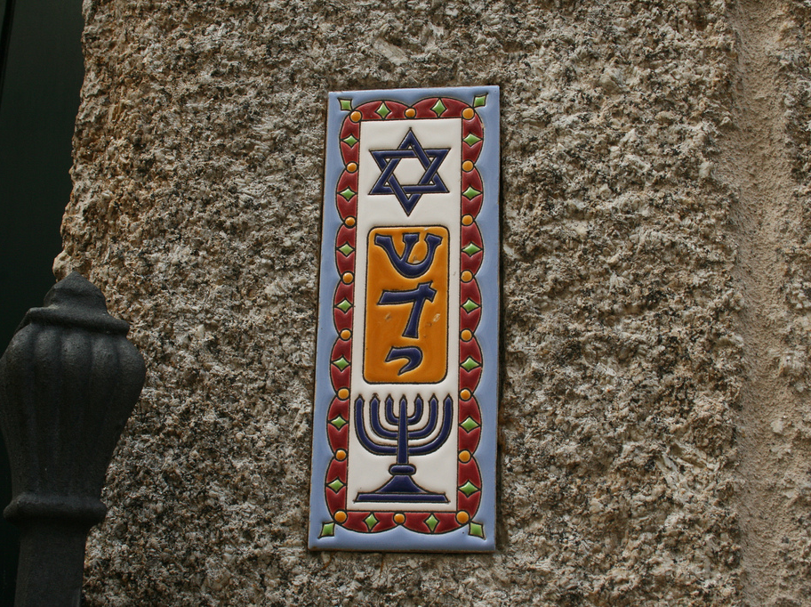
This is a mezuzah which is found by the doorway of many Jewish homes to complete the biblical commandment to write the word of God on doorways of your house.
Photos courtesy of Contando Estrelas (@flickr.com) - granted under creative commons licence - attribution

Slide 8
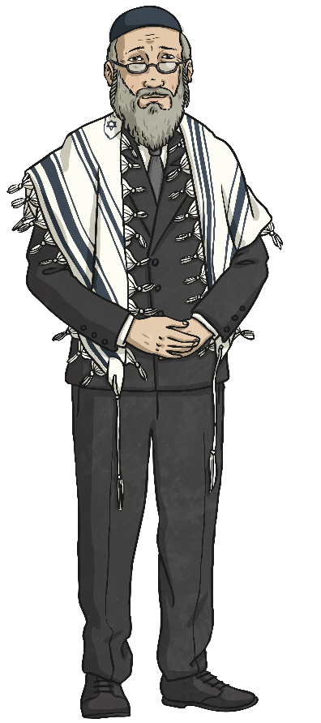
Who Leads the Synagogue Service?
Rabbi
A Rabbi is a Jewish spiritual leader who will often lead services at the synagogue on the holy day (Shabbat) and during festivals.
Did You Know…?
Rabbi means ‘teacher’
in Hebrew.

Slide 9
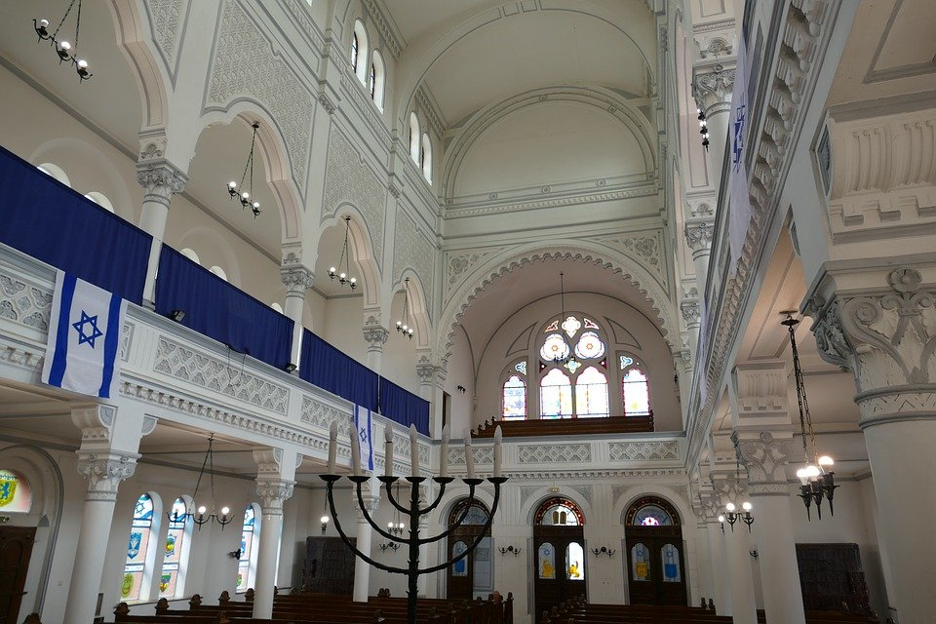
Can You Find Some Jewish Symbols in This Synagogue?
Star of David
menorah

Slide 10
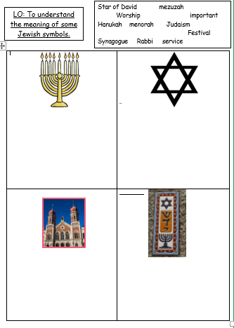
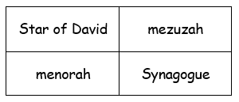
Task:
Can you label the symbols using the word bank to help you?

