Slide 1

Barriers to learning
Year 6 Growth Mindset: To identify how we should respond to mistakes and describe how mistakes can help us to learn

Slide 2
Making mistakes
In this growth mindset lesson, you will be doing a lot of thinking and reflecting.
On the next two slides are mathematical calculations.
Look at the calculations and see if you can identify my errors.
Think about the questions that are under each calculation.

Slide 3
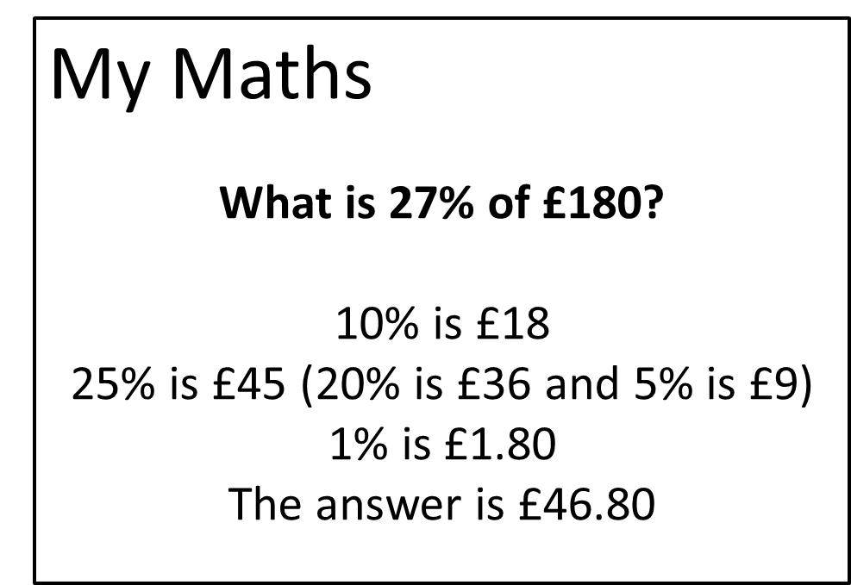
Where did I go wrong?
What mistake did I make?
Why do you think I got the wrong answer?
How could this help you as a learner?
How could it help a teacher?

Slide 4
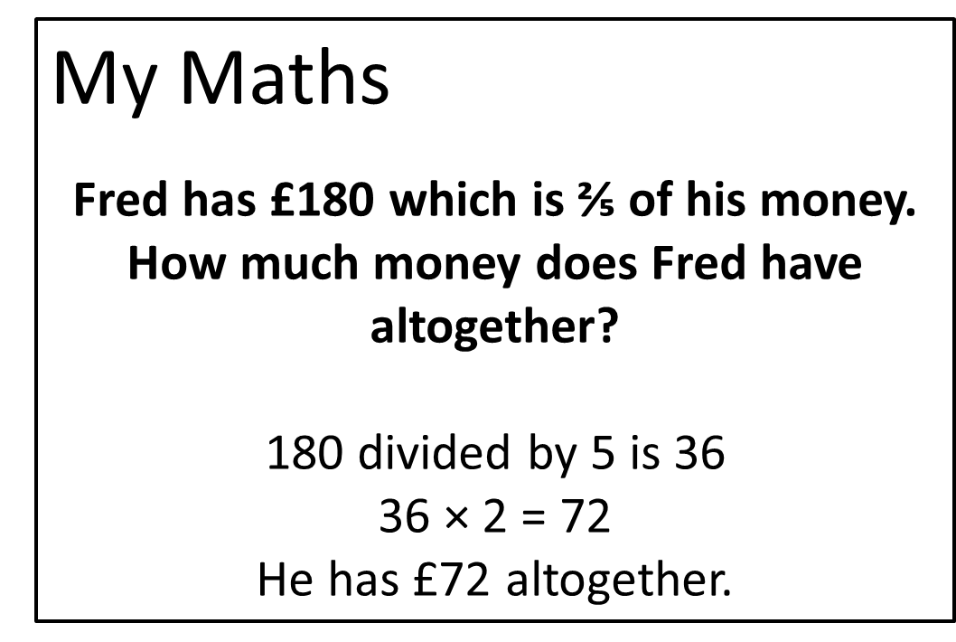
Where did I go wrong?
What mistake did I make?
Why do you think I got the wrong answer?
How could this help you as a learner?
How could it help a teacher?

Slide 5
Helping to develop mathematical mindsets
Watch this video clip of Dr Jo Boaler discussing maths and mistakes.
Think about your answers to the following questions:
  What did you learn from the clip?
  Do you think that you are born to be good at maths?
  Do your parents believe that they were better at one subject at school?
  Do your parents say there was a subject they found hard at school?
  How do you feel about making mistakes?
  Does your attitude towards making mistakes change depending on the subject?

Slide 6

Learning from mistakes
Revisit my mathematical mistakes on the earlier slides; were my mistakes part of the learning process or were they careless mistakes?
Which type of mistakes do you make?
Which type of mistakes helps us to develop as a learner?
What can we do to avoid making careless mistakes?

Slide 7
What can you do to help?
Research shows that mistakes are an important part of the learning process and, depending on how we respond, they can help us learn.
How can we ensure that our classroom culture and how we act allows us to make mistakes and learn from them?
Your task is to create something that helps to promote a classroom/school culture that supports making mistakes as part of the learning process.
Your creation might encourage individual action, it could be to encourage change or be something that helps teachers to develop this.
You could write a poem or song, create a poster, record a video or present your work in an alternative creative way.
We would love to see what you come up with so please upload your work to Tapestry.

