Slide 1
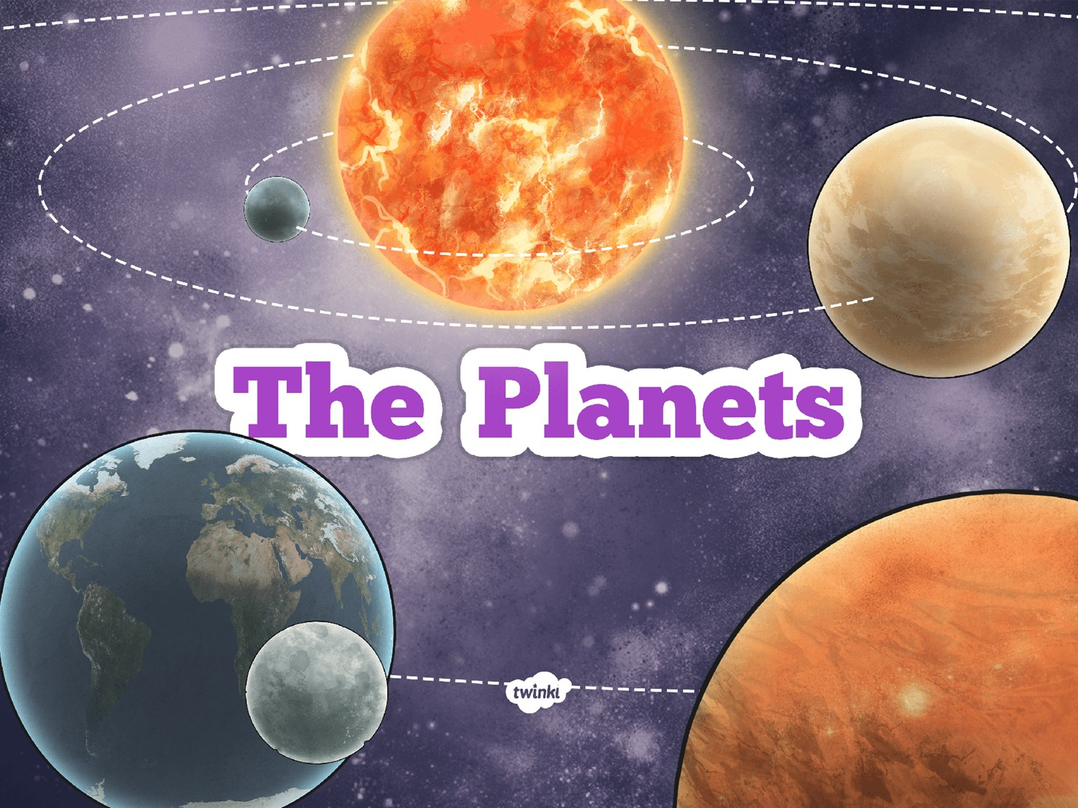

Slide 2

LO: I can name and describe features of our solar system.
Success Criteria
I can name the planets in the solar system.
I can place the planets in the solar system in the correct order.
I can describe some features of the planets

Slide 3



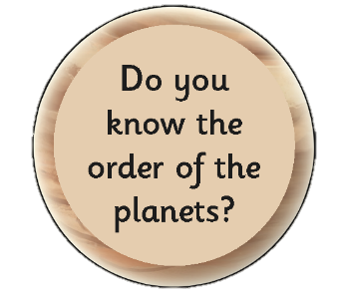
Ideas about the Planets
Let’s find out and share what we already know.
In groups answer the following questions:

Slide 4

Solar System Vocabulary
Sun
star
planet
Mercury
Venus
Earth
Mars
Jupiter
Saturn
Uranus
Neptune
rotate
axis
sphere /
spherical
orbit

Slide 5
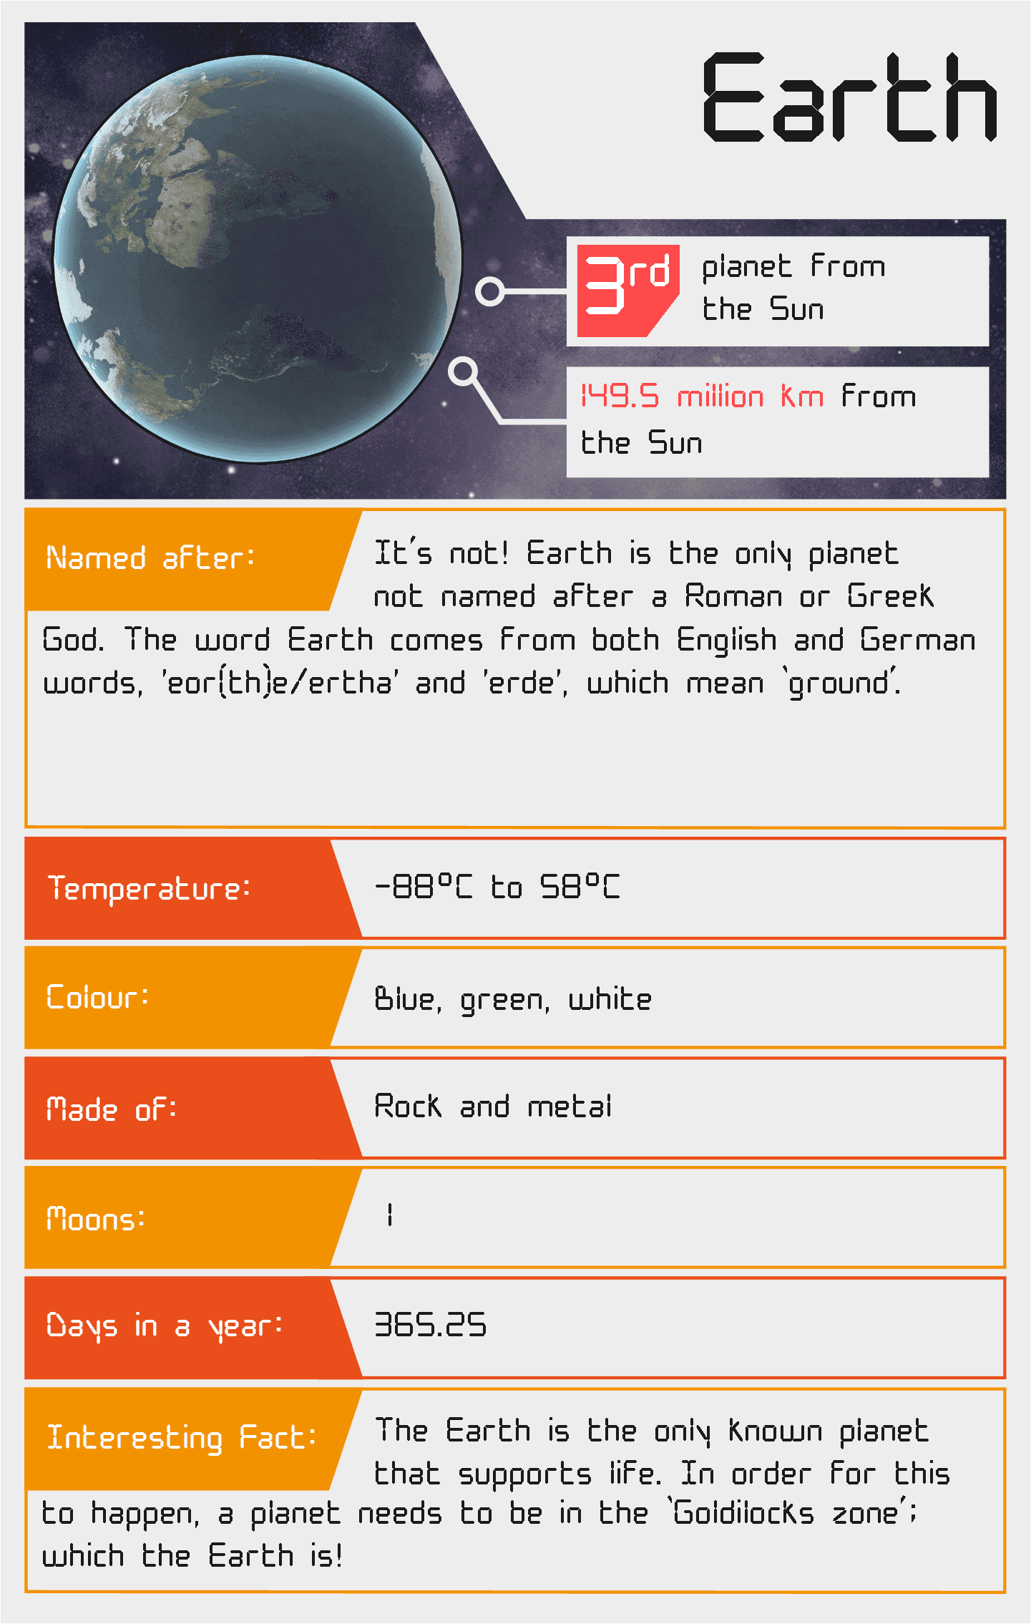
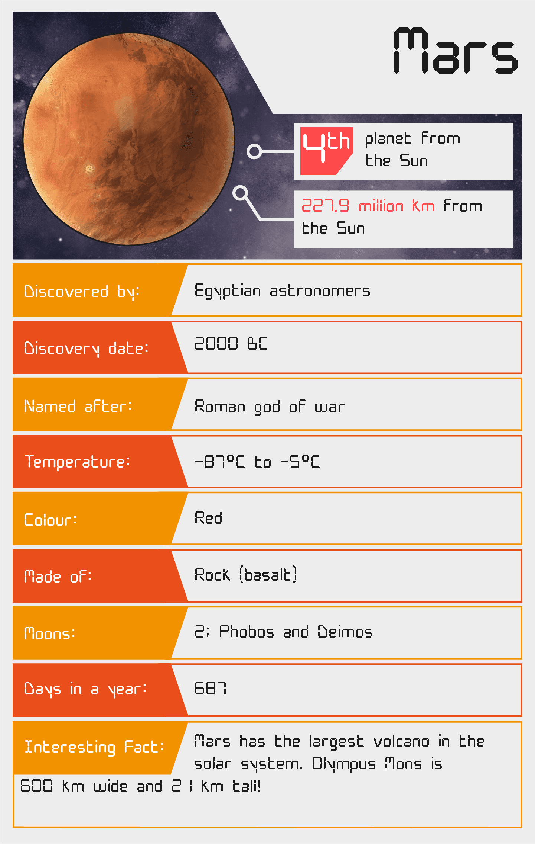
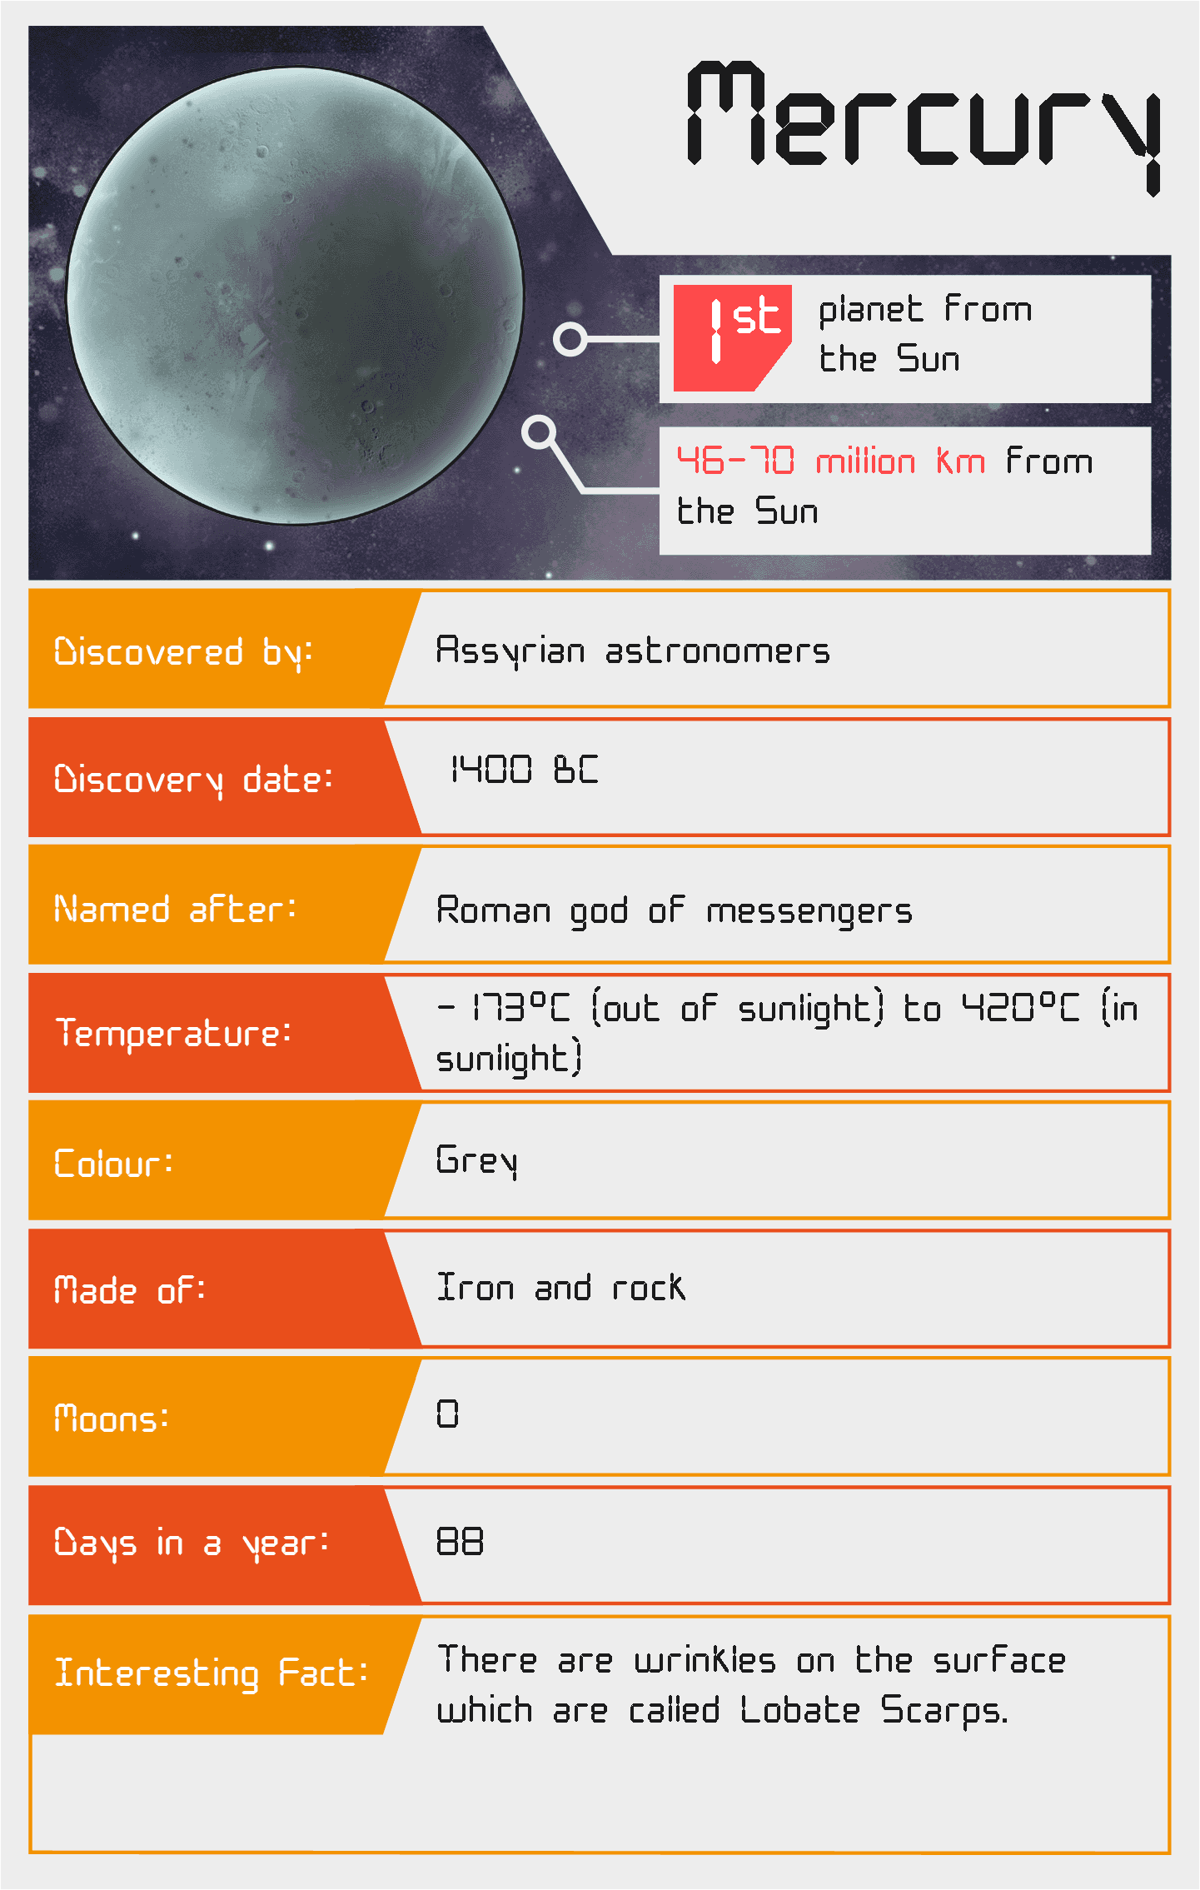
Meet the Planets: Solar System Speed Dating!
You will all receive a card with information about a planet. You will have 5 minutes to ‘date’ each of the other planets to find out as much information about them as you can.

Slide 6

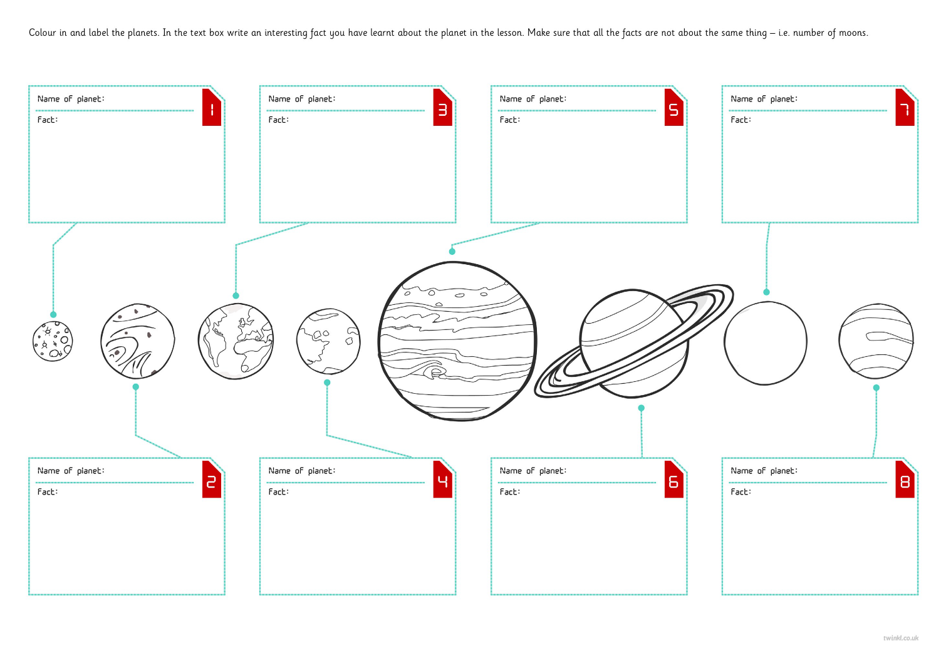
Planetary Poster

Slide 7

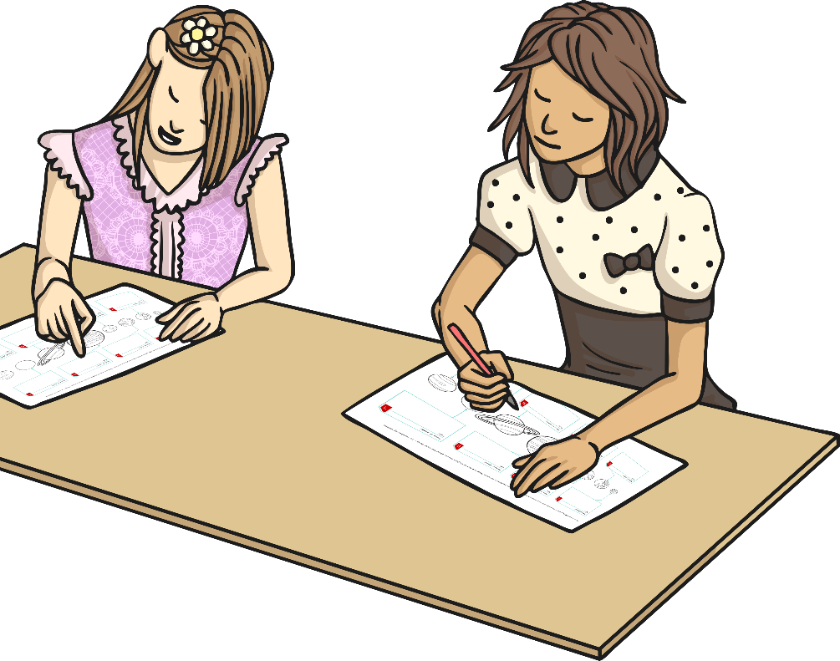
Peer Review
Swap your poster with a partner.
Give them feedback about two things you liked about the poster and one thing they could change.
Note: Focus your feedback on the science and language they have used rather than colours or the look of the poster.

Slide 8
