Slide 1
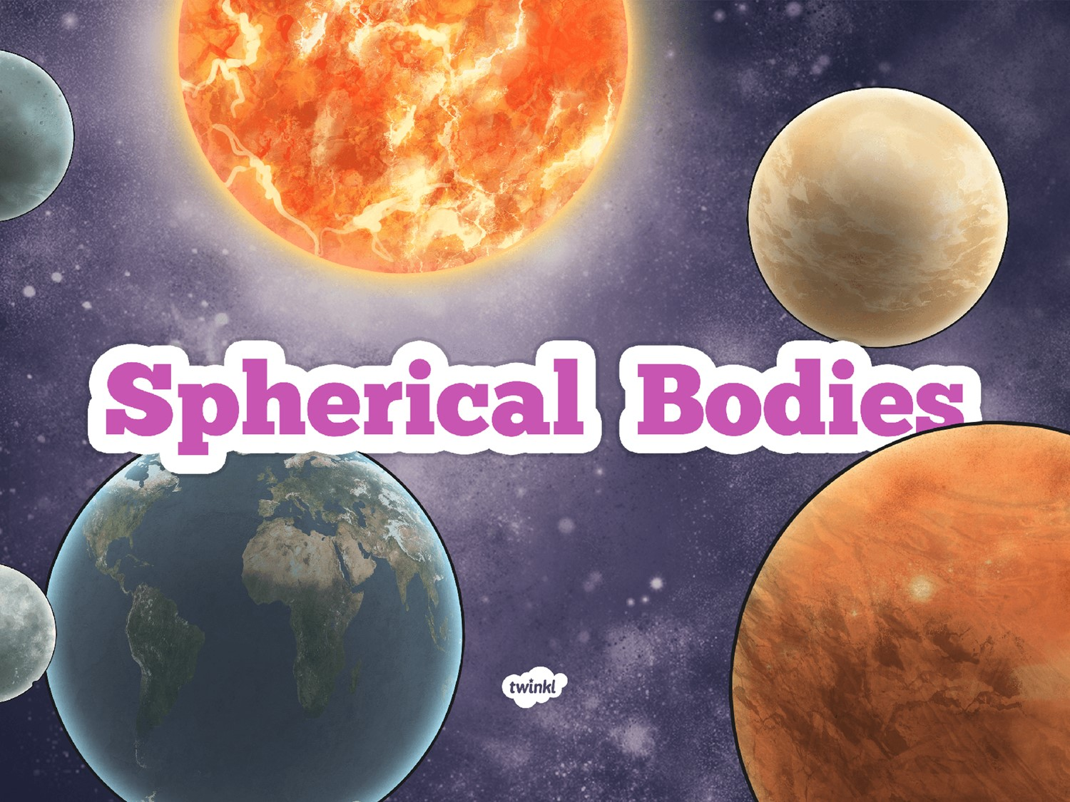

Slide 2
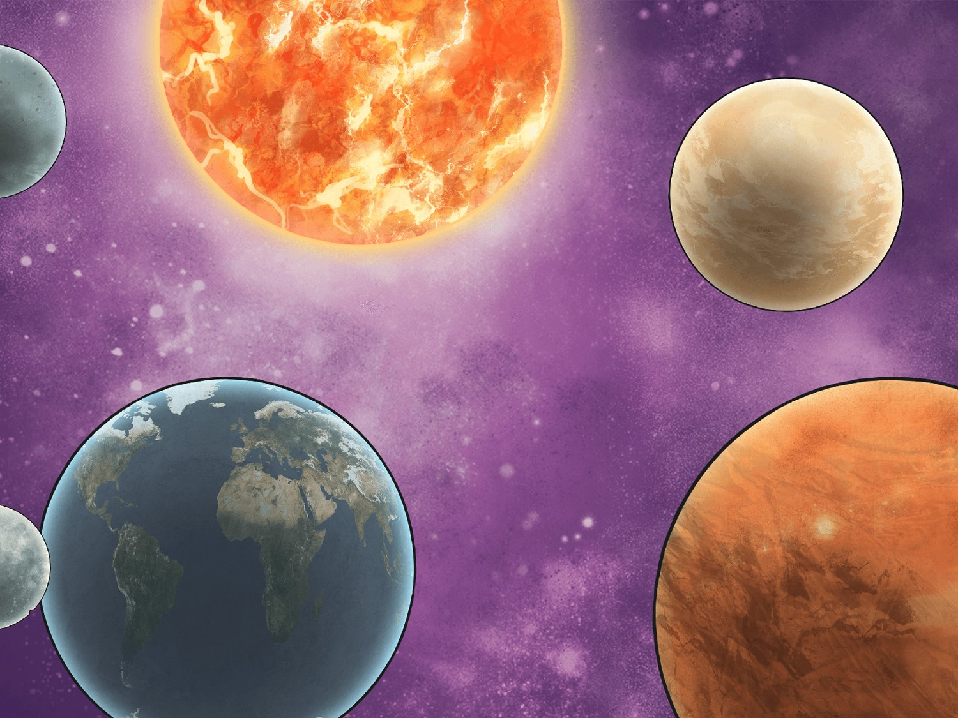
LO: I can explain why we know the sun, earth and moon are spherical.
Success Criteria
I can describe the Sun, Earth and Moon as spherical.
I can name at least two different shapes the Earth was thought to be.
I can identify scientific evidence that has been used to support or refute ideas.

Slide 3

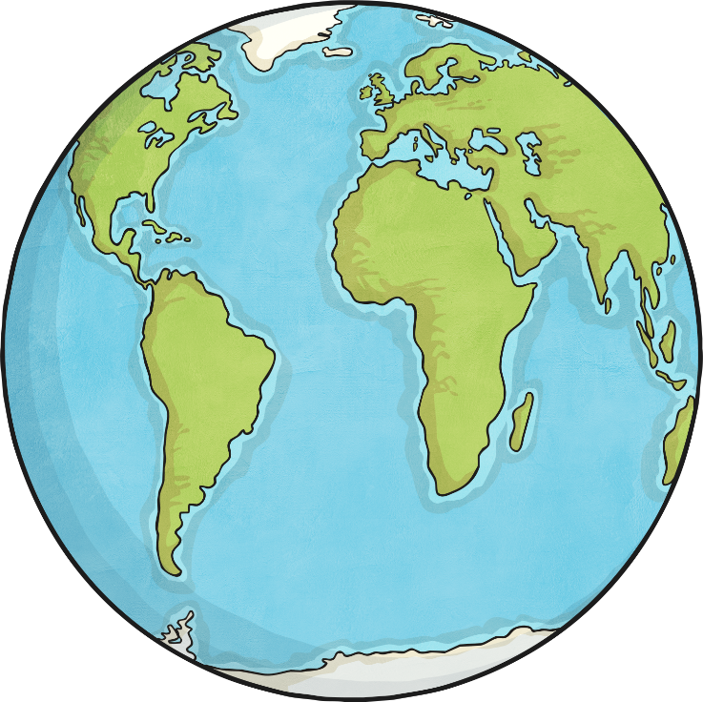
Ideas and Evidence
What shape is hidden under this globe?
What is your evidence?

Slide 4
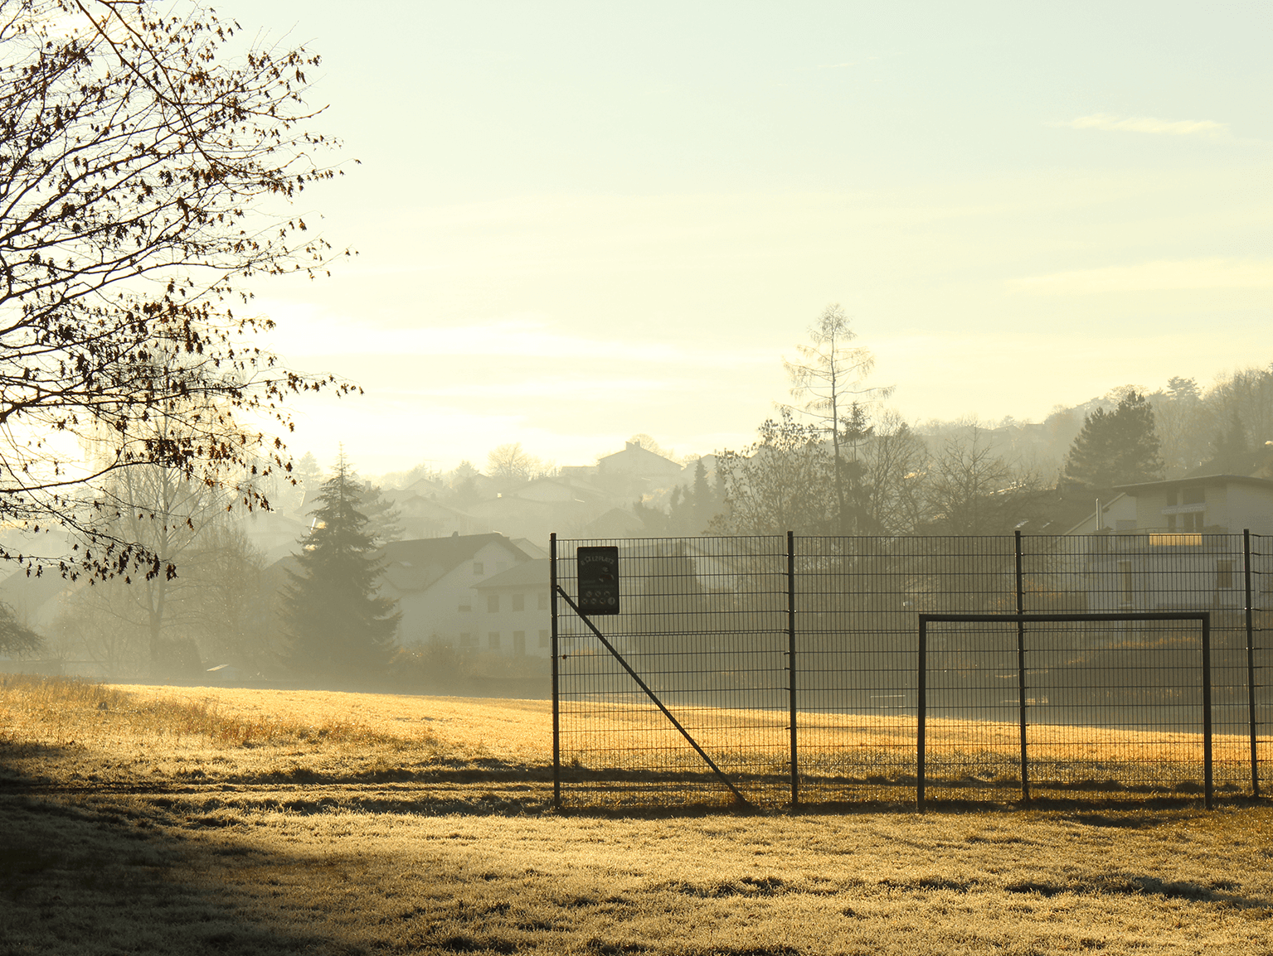
Shape of the Earth
Let’s take this outside!!
Photo courtesy of .tafo. (@flickr.com) - granted under creative commons licence - attribution

Slide 5

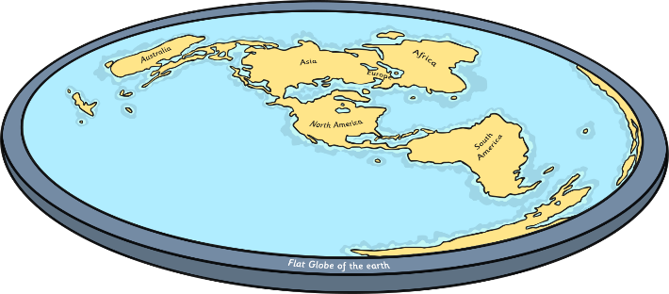
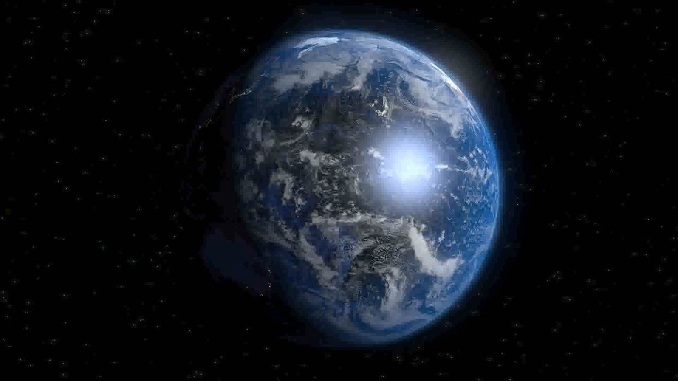
Flat Earth Versus Spherical Body
What are the arguments for a flat Earth?
What are the arguments for a spherical Earth?
Read through the Shape Of The Earth Evidence Cards.
Sort the evidence into two groups – one that supports the idea that the Earth is flat and the other that supports the idea that the Earth is a sphere.
Video courtesy of Stephan Deutsch (@vimeo.com) – granted under creative commons licence - attribution

Slide 6

Identifying Evidence
Which idea has the most evidence to support it?
What do you think based on the evidence?
Video courtesy of Stephan Deutsch (@vimeo.com) – granted under creative commons licence - attribution

Slide 7

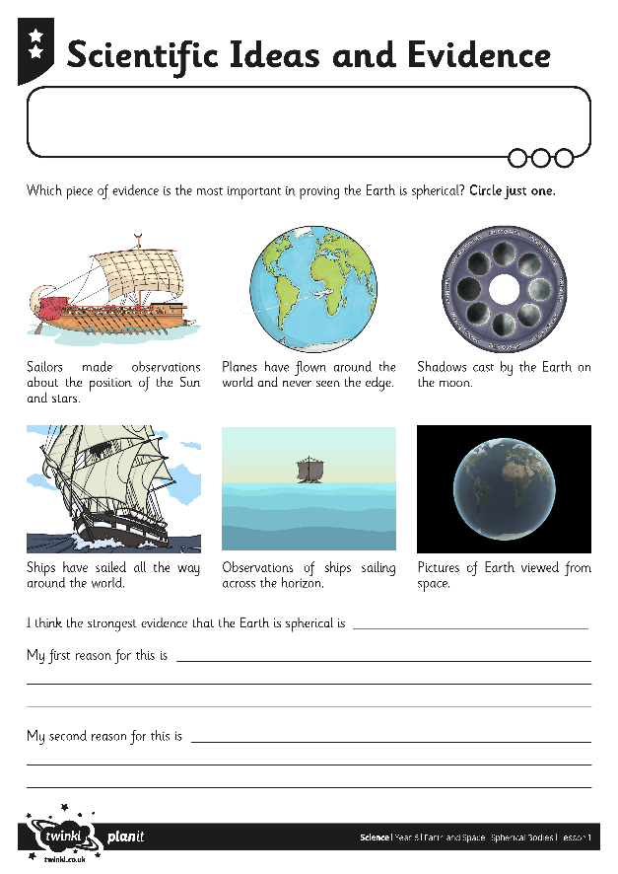
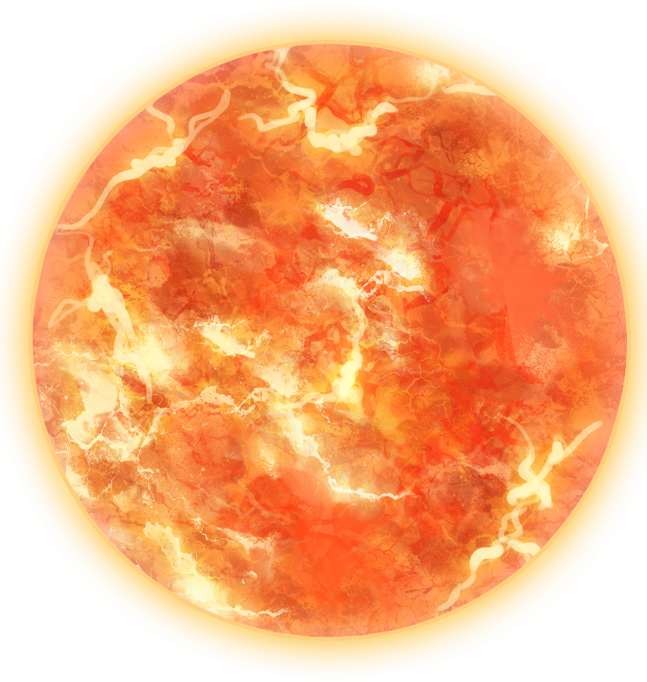
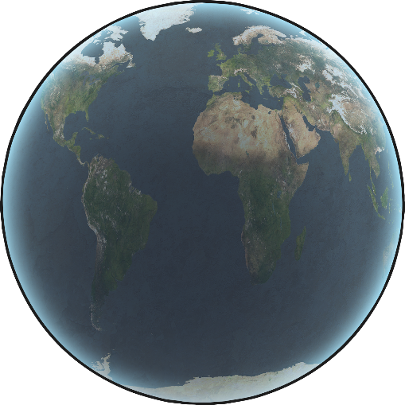
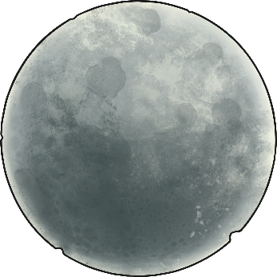
Scientific Ideas and Evidence
Complete the Scientific Ideas and Evidence Activity Worksheet

Slide 8
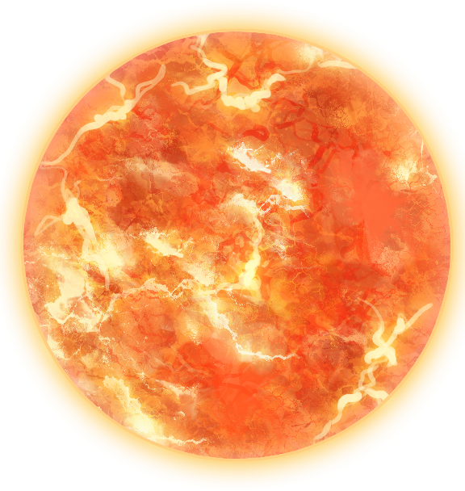

Sun and Moon
It is a bit more complicated to find out who discovered the Sun and Moon were spherical.
We know that according to the Ancient Greek beliefs, the ‘heavens’ were perfect as was the sphere. Therefore, they came to the conclusion that the Sun and Moon must be spherical rather than flat.

