Slide 1
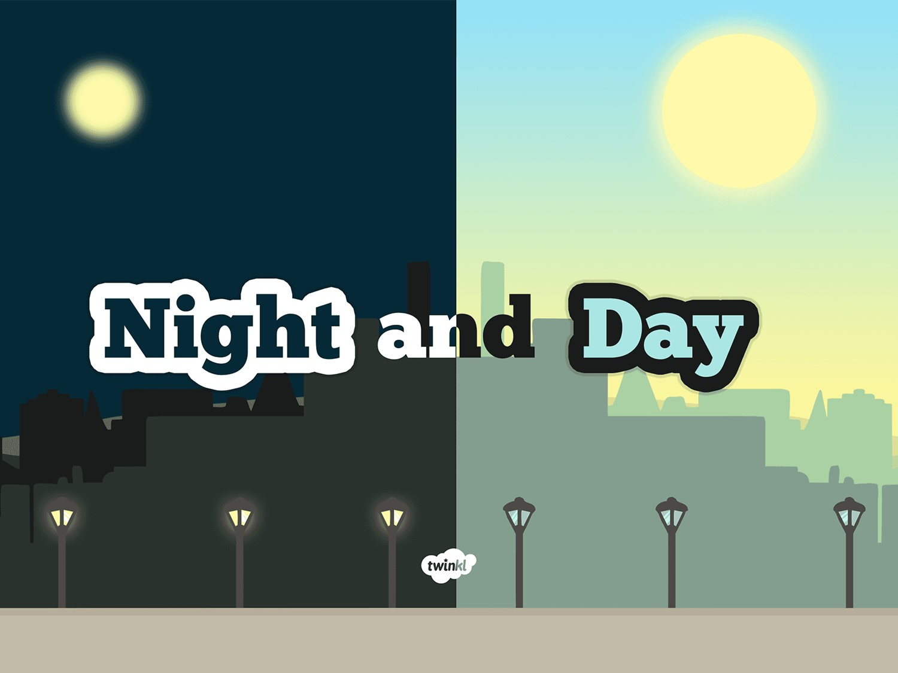

Slide 2
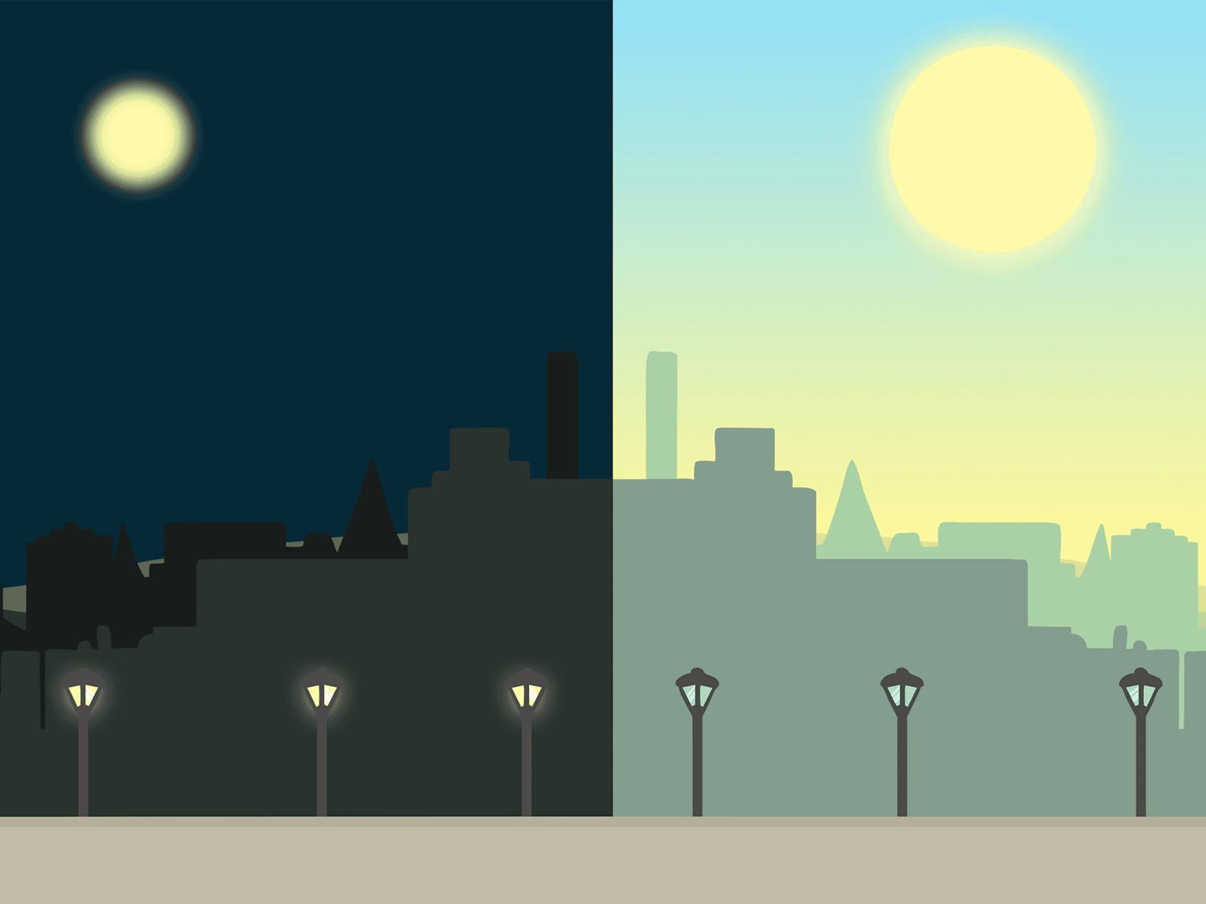
Aim
To explain day and night and the apparent movement of the sun across the sky.
Success Criteria
I can explain that day and night is due to rotation of the Earth.
I can explain using evidence how night and day occur.

Slide 3

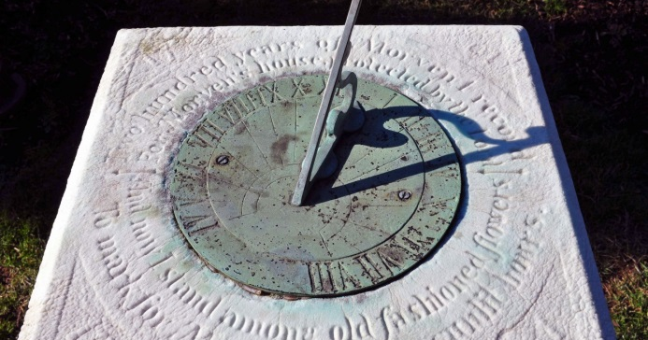
Sun and Shadows
When?
How?
What?
Why?
Where?
Photo courtesy of PMillera4 (@flickr.com)- granted under creative commons licence - attribution

Slide 4


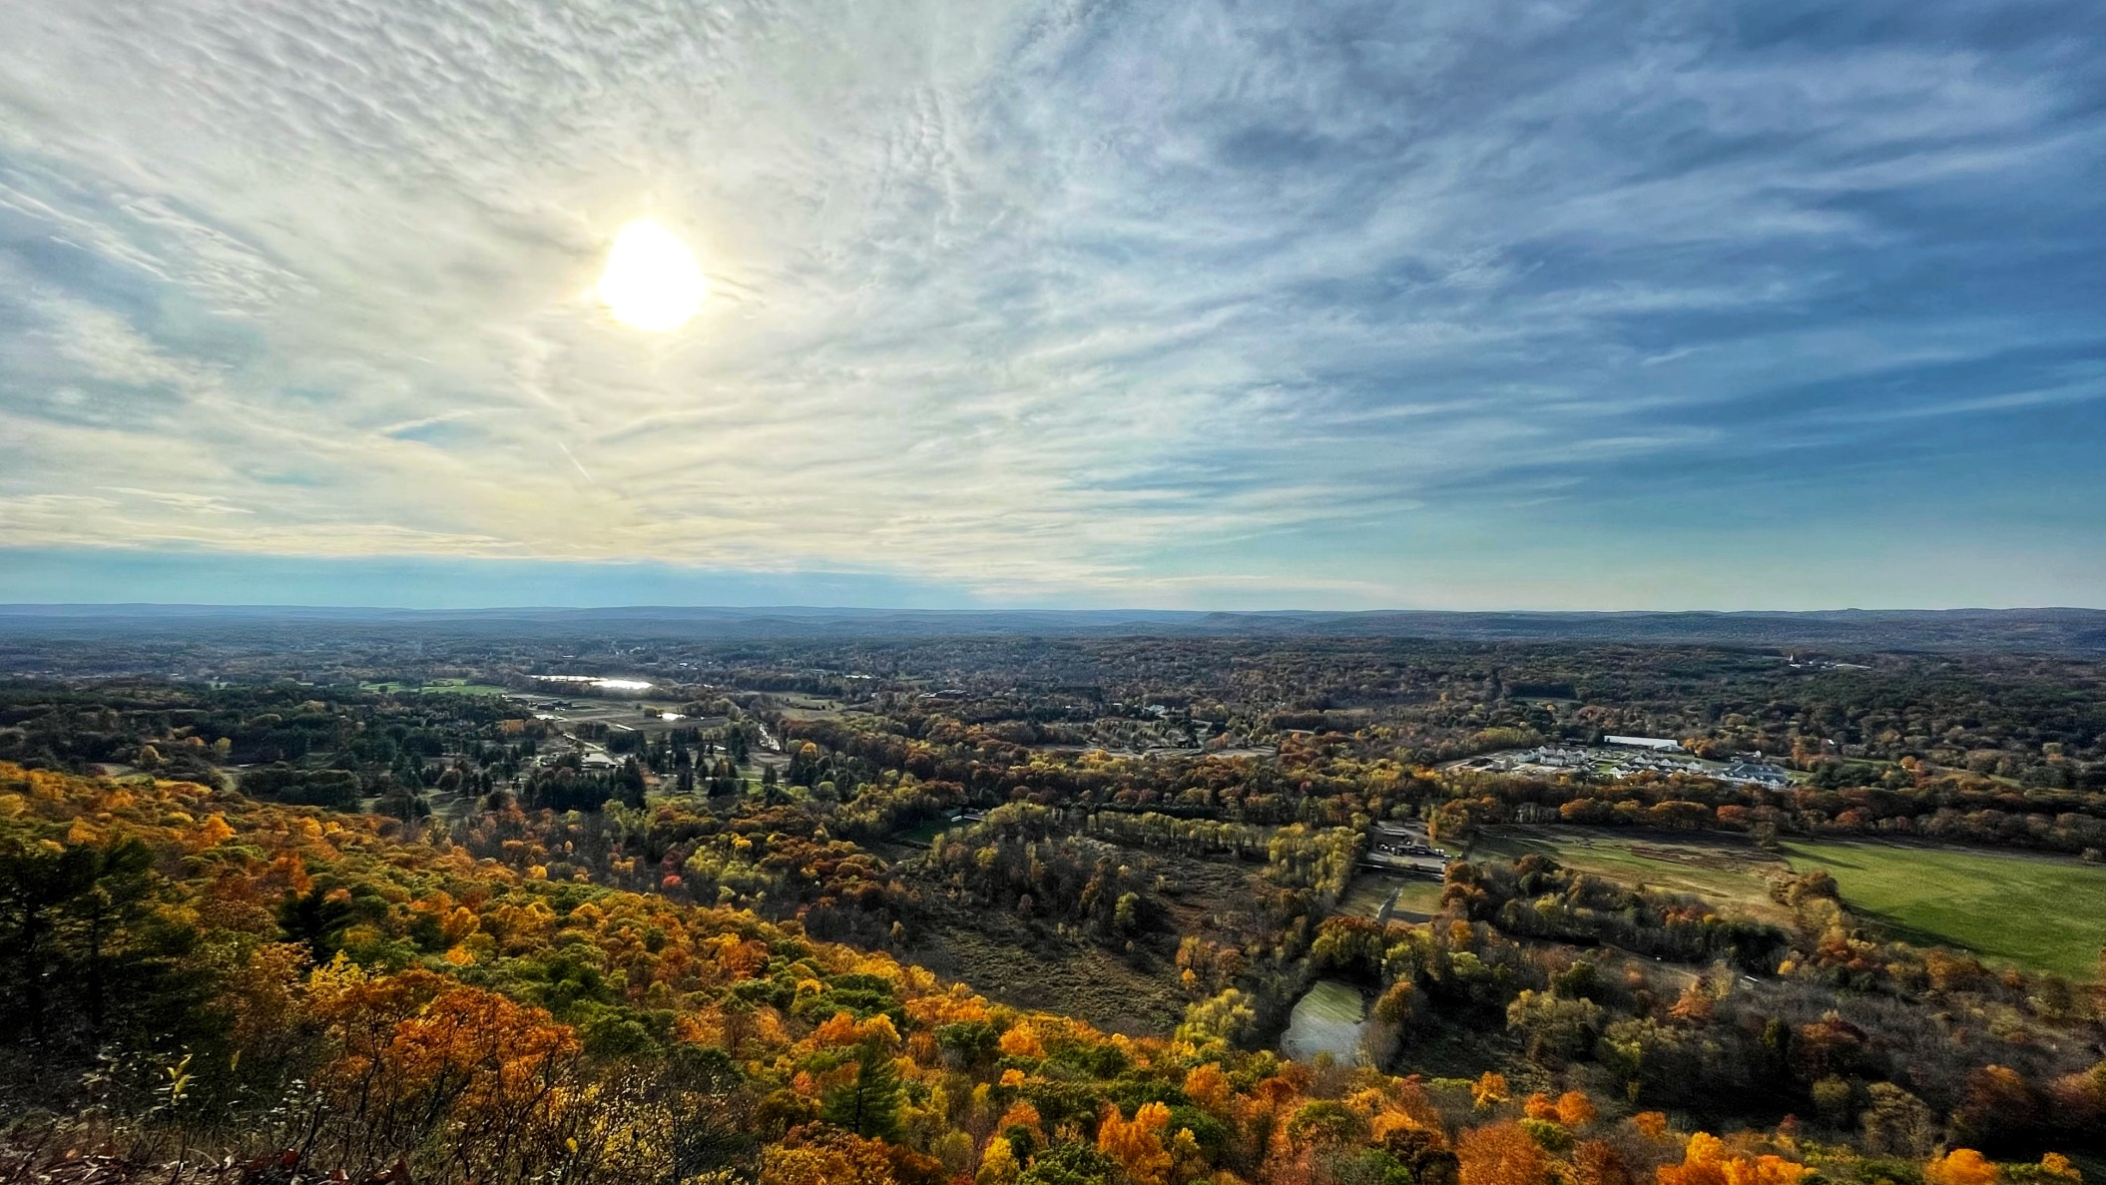
Night and Day
Does the position of the sun change over the course of the day? How do you know?
Investigating observations.
When?
What?
Why?
How?
Evidence?
Where?
Click here if the video does not work
Video courtesy of FreeSwissVideo (@youtube.com) - granted under creative commons licence - attribution

Slide 5

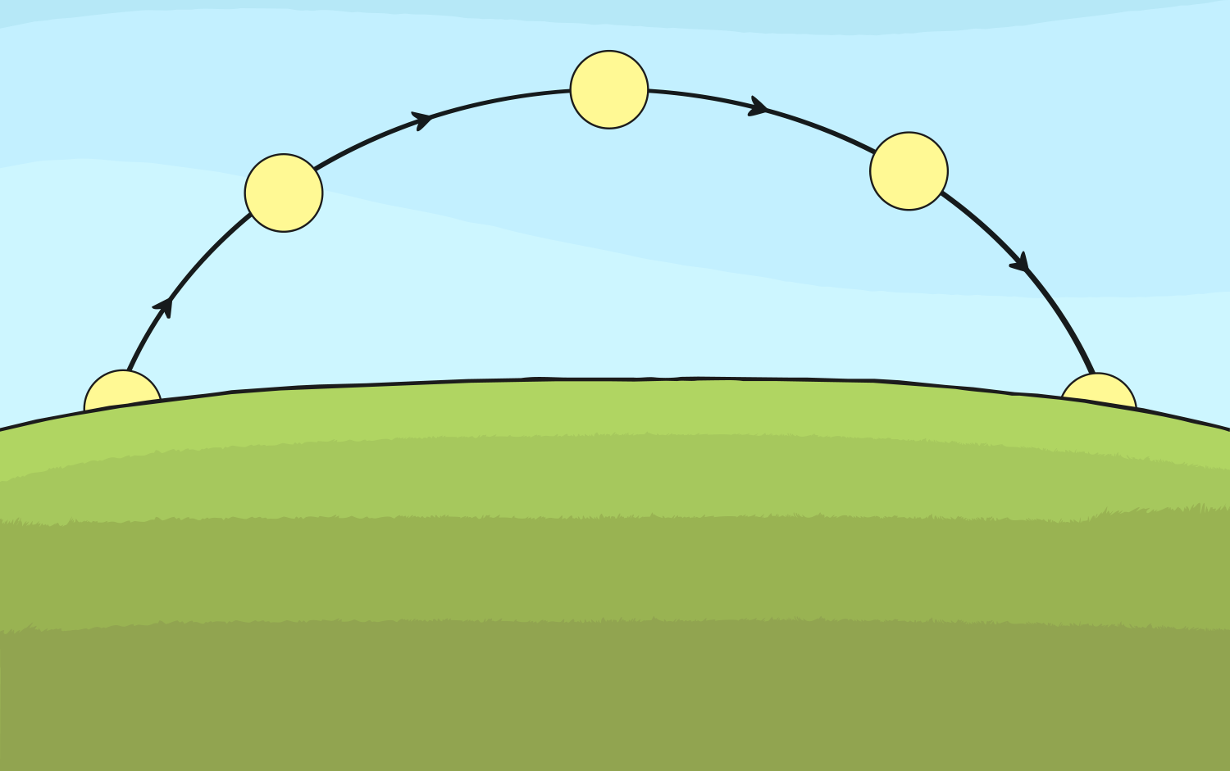
Explaining Night and Day

Slide 6
Why do you think the sun appears to move across the sky?
Working with your partner, come up with an explanation of how the sun appears to move across the sky and disappear at night. Using a torch and a round object such as a balloon, ball or globe, explain to the class your understanding of how we experience day and night.
Watch the below video to check if your theory is correct!
https://www.bbc.co.uk/bitesize/clips/zkynvcw
https://www.bbc.co.uk/bitesize/clips/zrd9wmn

Slide 7
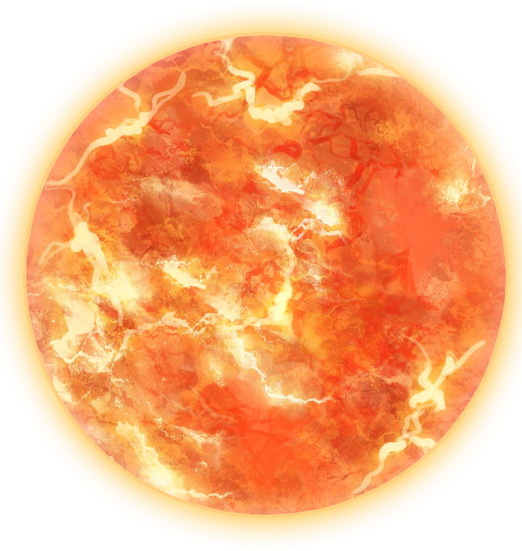
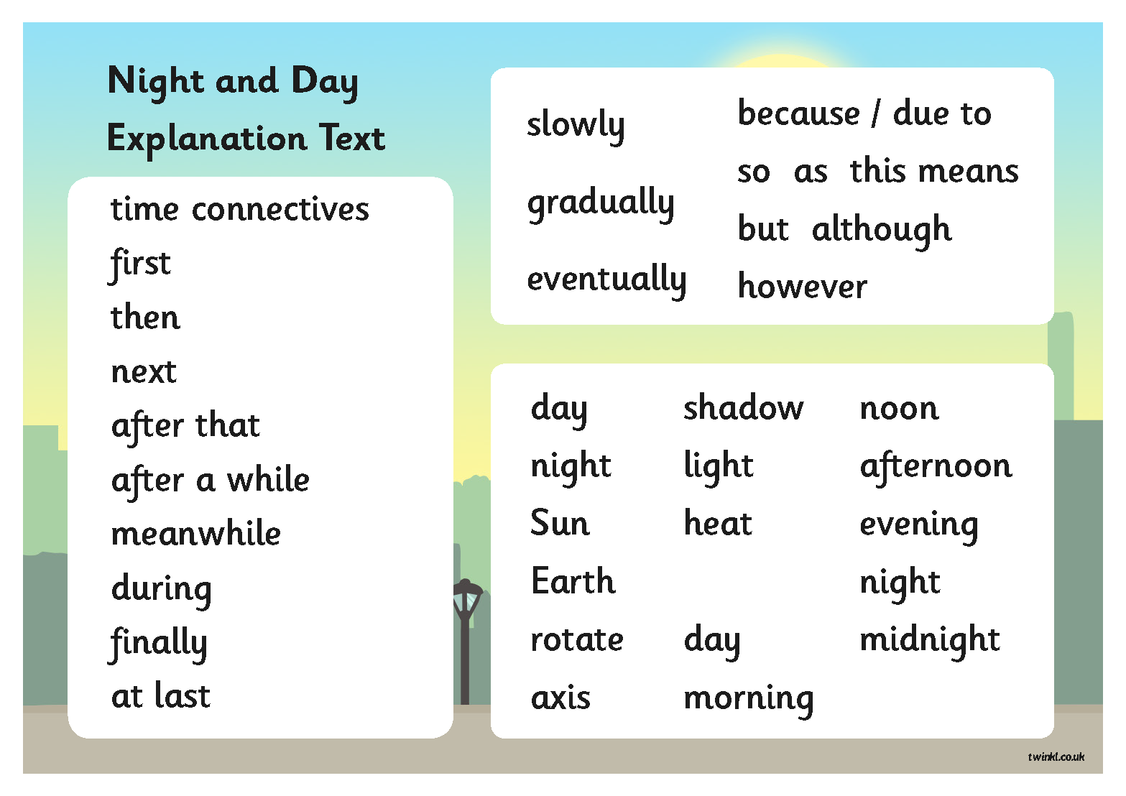
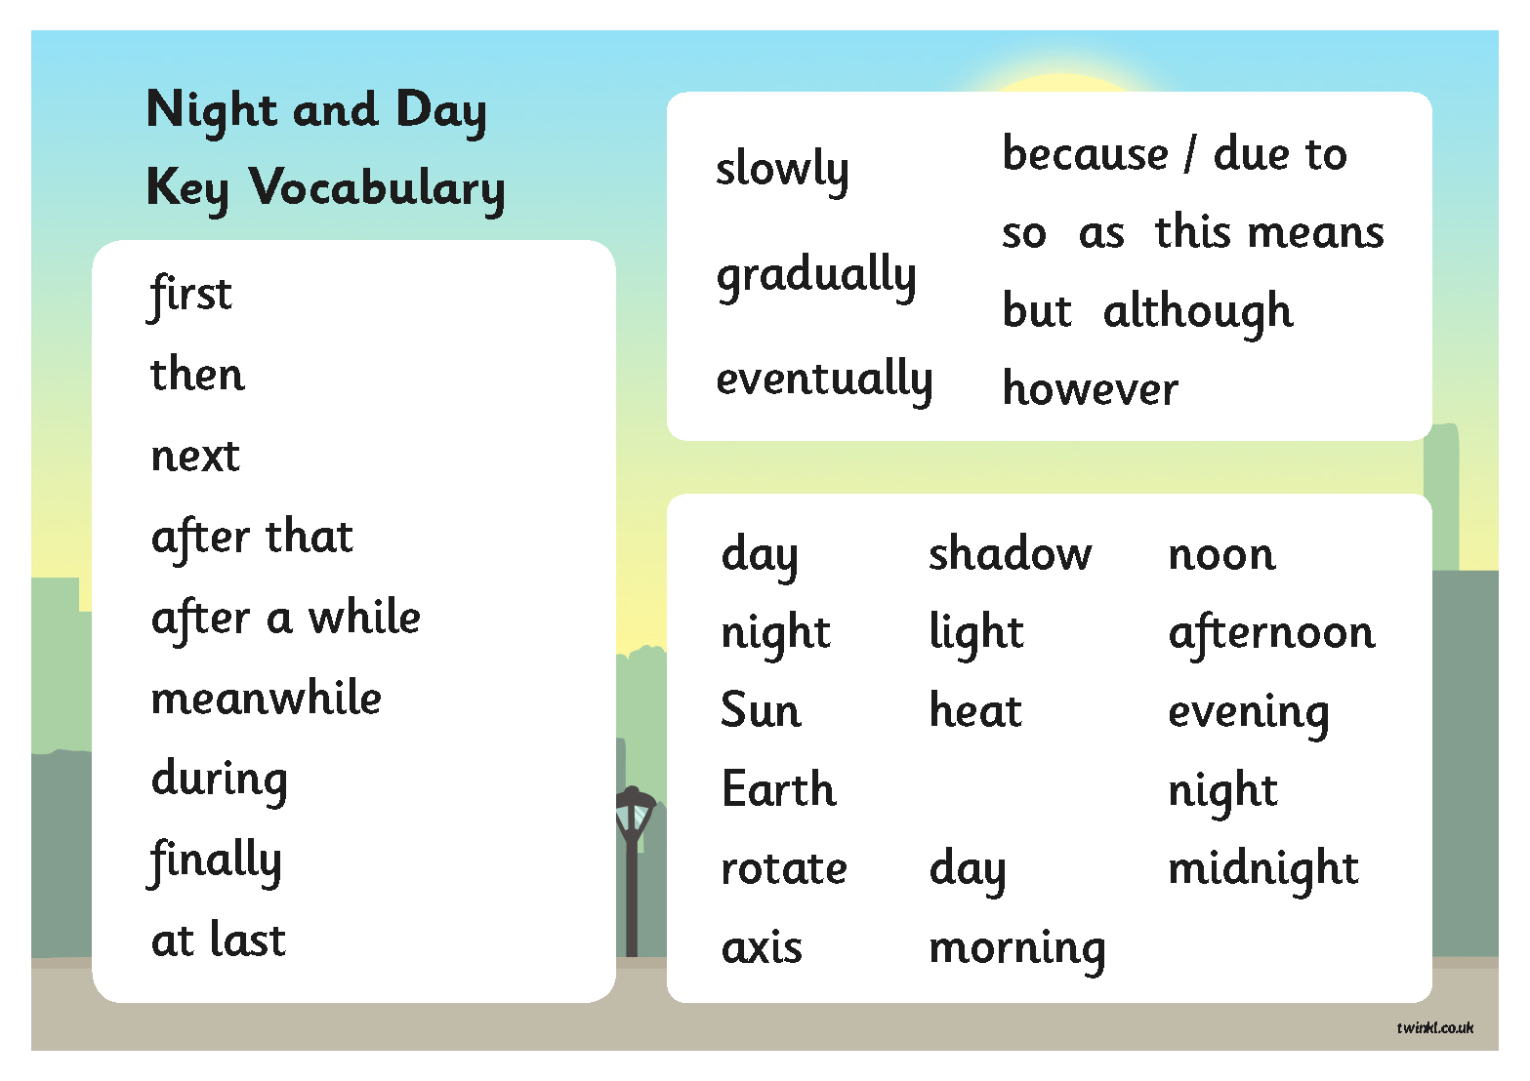
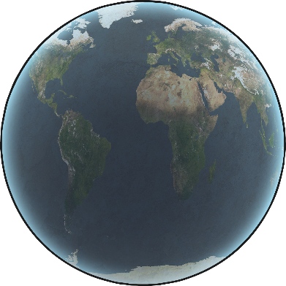
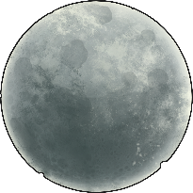
Night and Day – Explanation Text
Write a short explanation text to find out

Slide 8











Peer Assess –
Explanation Text
Listen to your partner’s explanation text.
Give 2 bits of positive feedback.
Swap roles.
Give 1 next step.
After you have both given feedback, make changes to your work to show that you have understood what improvement you had to make.

Slide 9
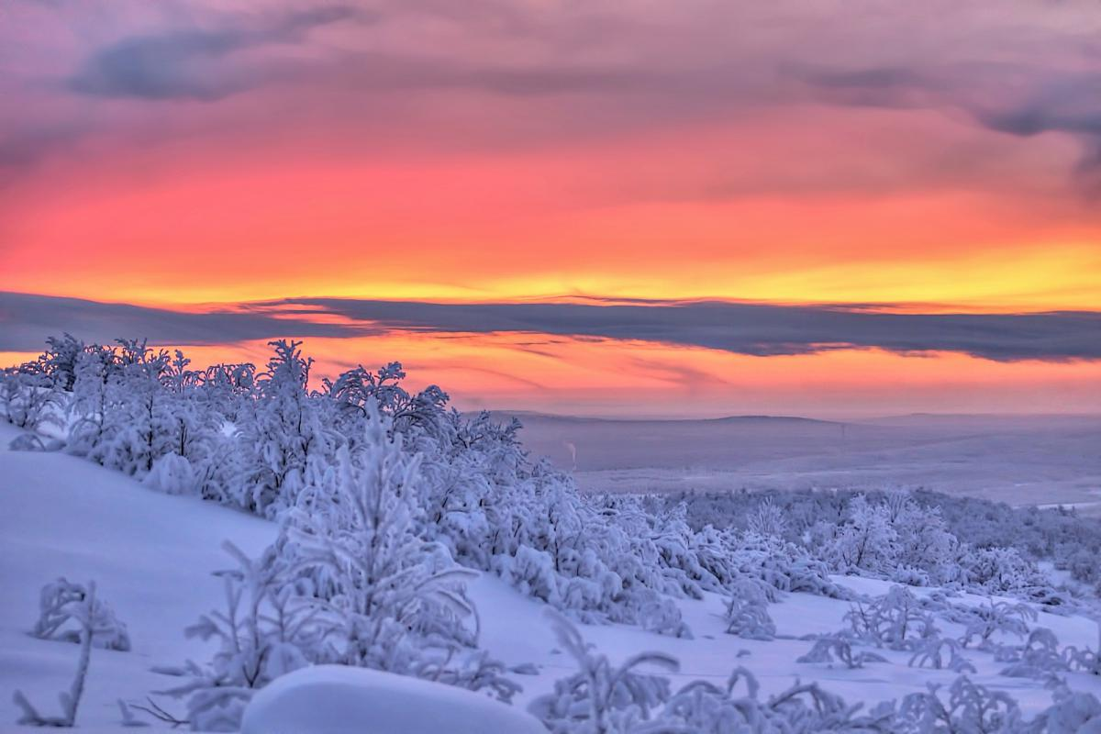
Plenary research question.
I have heard that the day is shorter in the winter than in the summer. I have also heard that some countries have longer days than others.
Can you explain how these things happen?
Can you also think of a new question to research?

