Slide 1
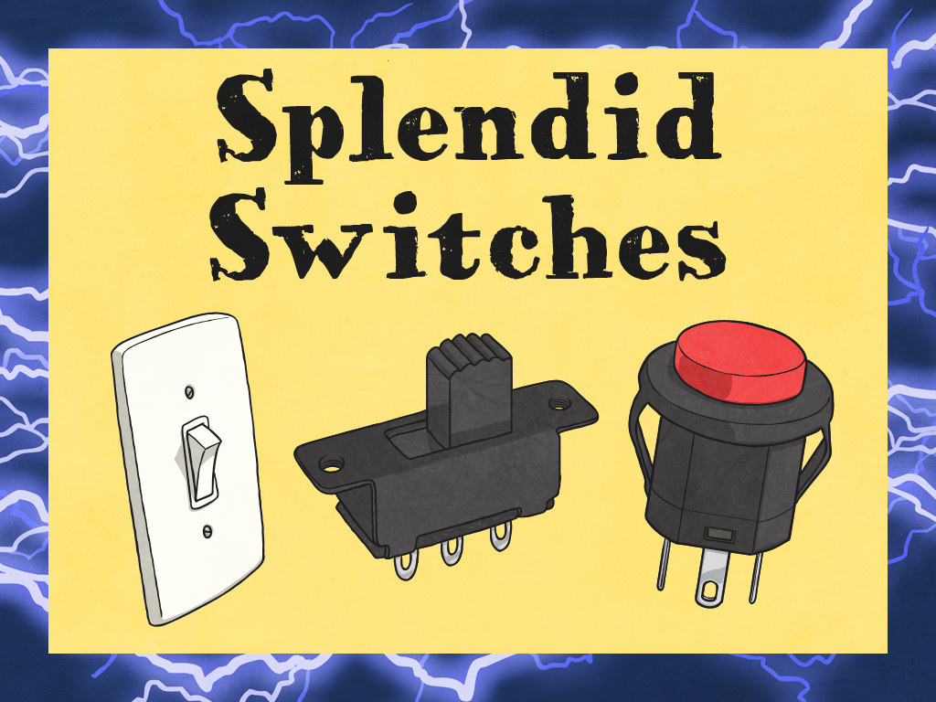


Slide 2

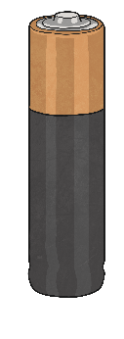
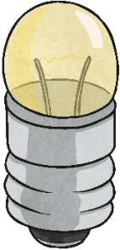
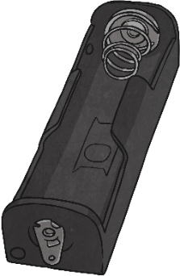
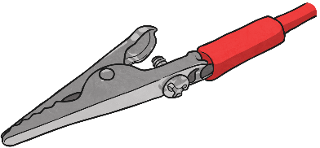
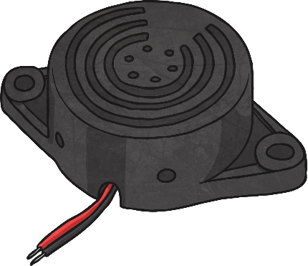
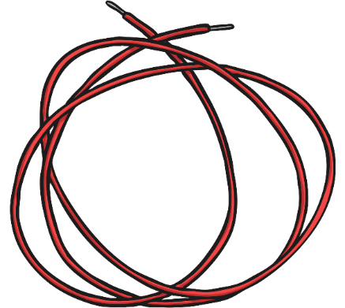
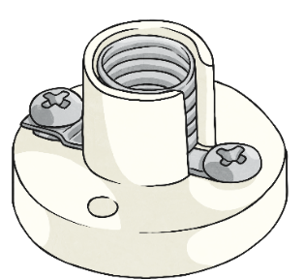
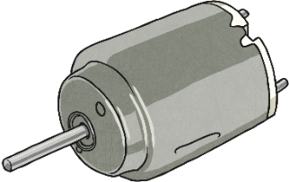
Parts of a Circuit
crocodile clip
motor
bulb
wires
battery (cell)
Which cards are new to you? What do those parts do?

Slide 3

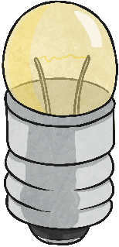



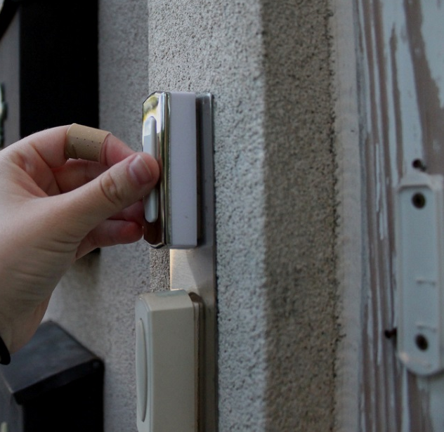
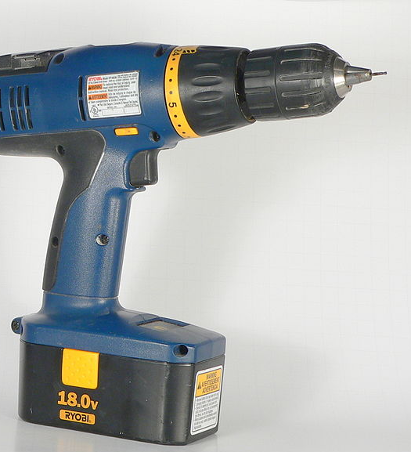
Bulbs, Buzzers and Motors
What examples of circuits which include bulbs/buzzers/motors do you know?
Photo courtesy of Paragon Apartments and alexa fades away (@flickr.com) and Greg Hume @Wikimedia Commons - granted under creative commons licence - attribution

Slide 4

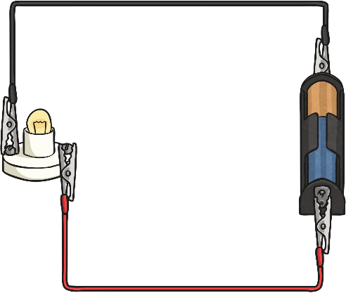
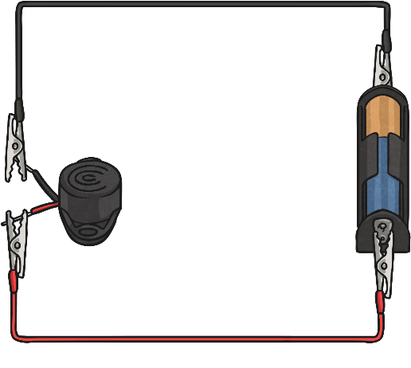
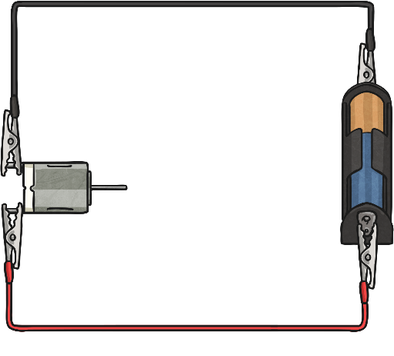
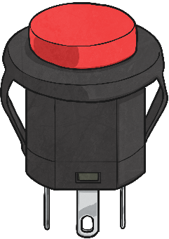
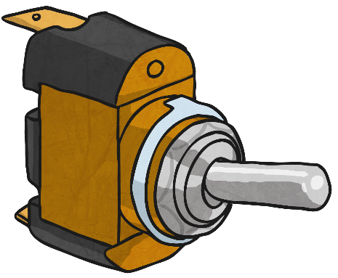
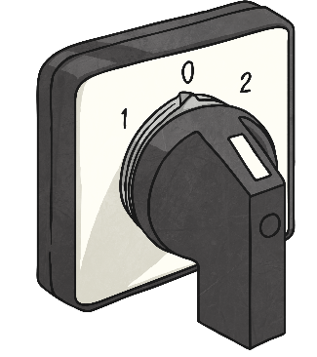
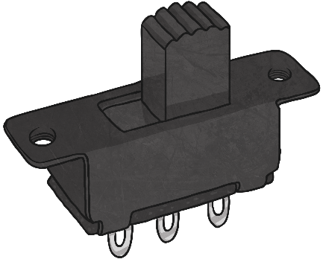
Complete Circuits
Do you want your doorbell ringing constantly?
Switches!
Would you want the lights in your house to be on all the time?
Why is it a problem for the drill to be on all the time?
What are the practical problems of complete circuits in everyday life?
What is the solution? (Remember, an incomplete circuit will not work at all)

Slide 5
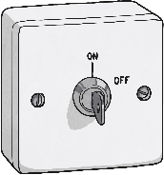
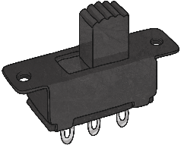


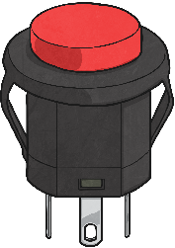
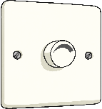


Switches
There are a wide variety of switches that can be used.
Match the type of switch and its name.
slide switch
push button switch
pull switch
dimmer switch
paddle switch
selector switch
key switch
toggle switch

Slide 6
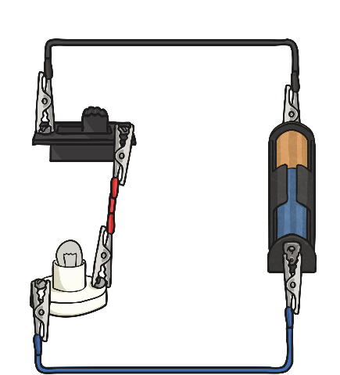
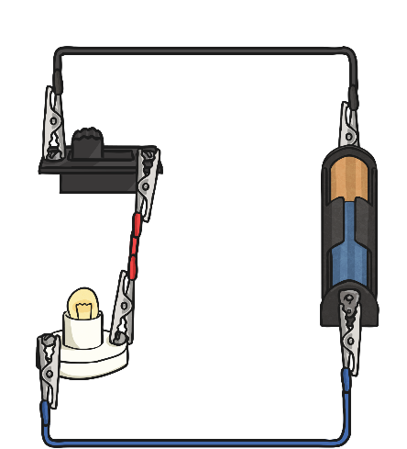
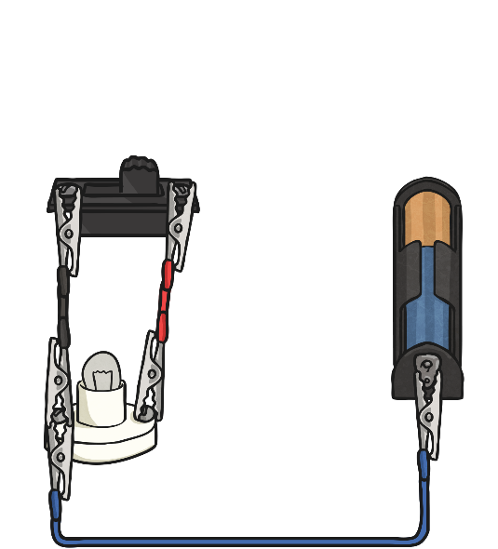
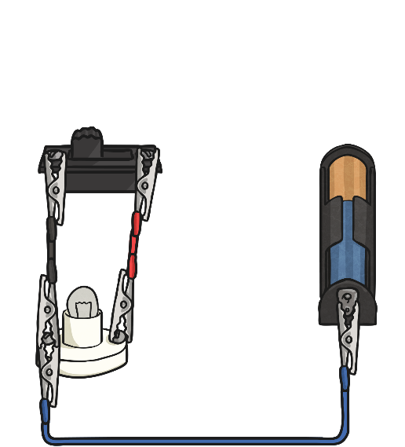
How Switches Work
A switch ‘breaks’ a complete circuit on purpose to stop the flow of electrons when it is off.
When the switch is on, the circuit is complete and so the electrons are able to flow around the circuit.
A circuit with a switch is not the same as an incomplete circuit. In an incomplete circuit, the electrons are unable to flow at all whether the switch is on or off.

