Slide 1
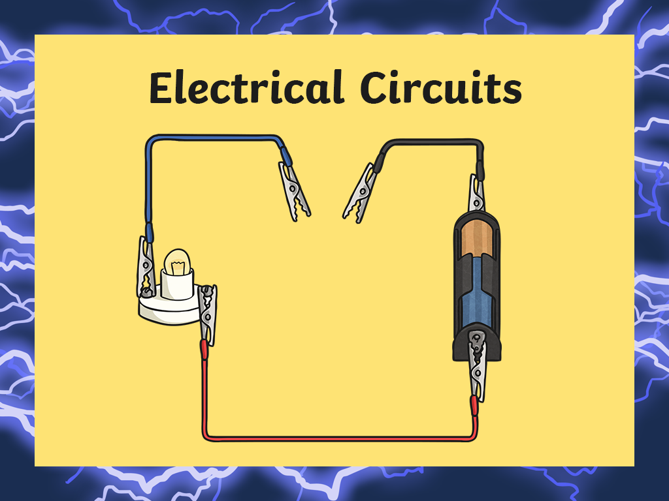


Slide 2

Electricity
Think about the following questions about electricity. Click each answer box to reveal the answers!
Can you give an example of how electricity is found naturally?
Lightning, static electricity and bioelectricity.
What is 'current electricity'?
The flow of electrical charge through a material.
Mains electricity is one type of electrical current. Can you name another type?
Battery powered electricity.
Can you name a non-renewable method of generating electricity?
Burning fossil fuels such as coal, oil or natural gas.

Slide 3
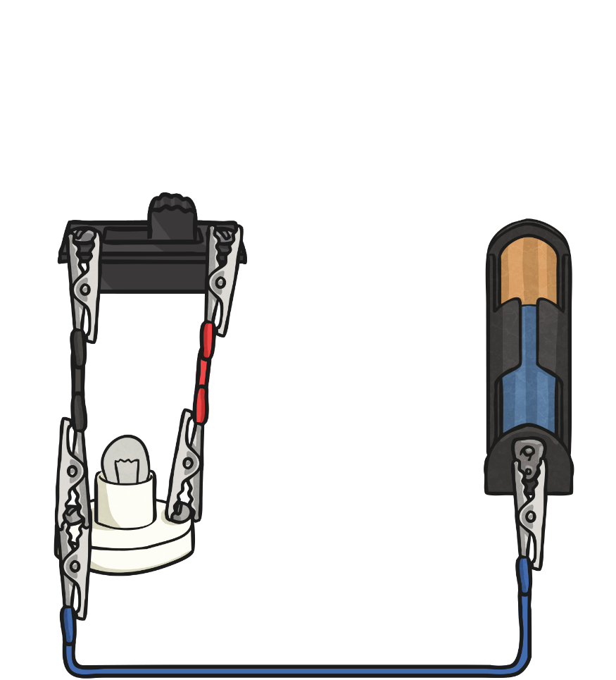
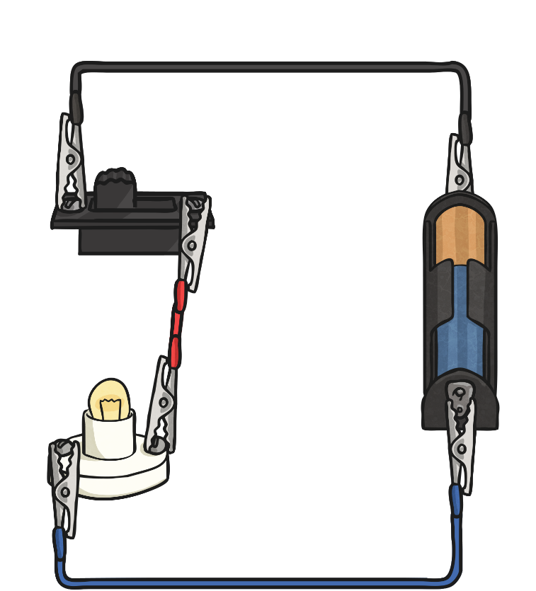
Complete and Incomplete Circuits
An electrical circuit can be complete or incomplete.
Incomplete Circuit
Complete Circuit

Slide 4
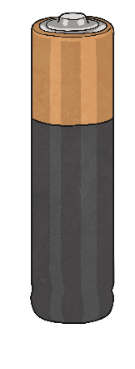
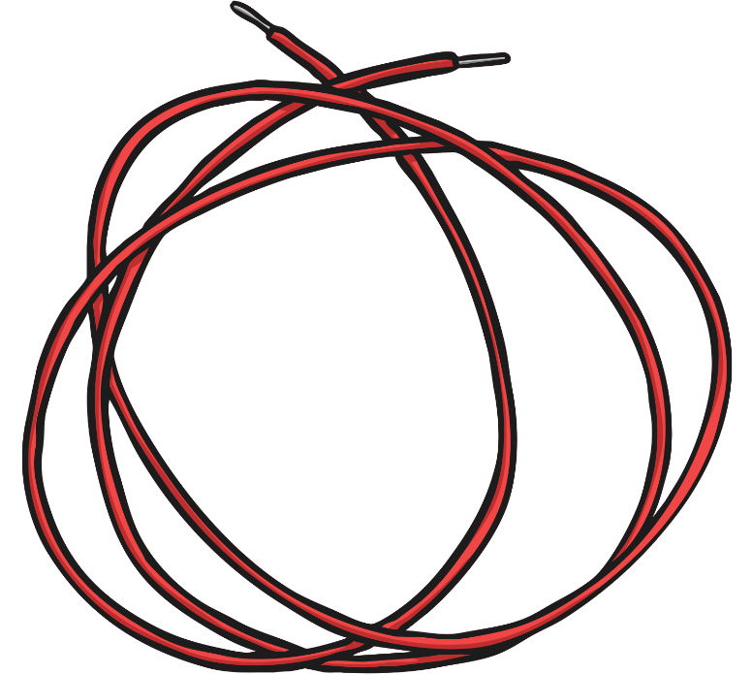
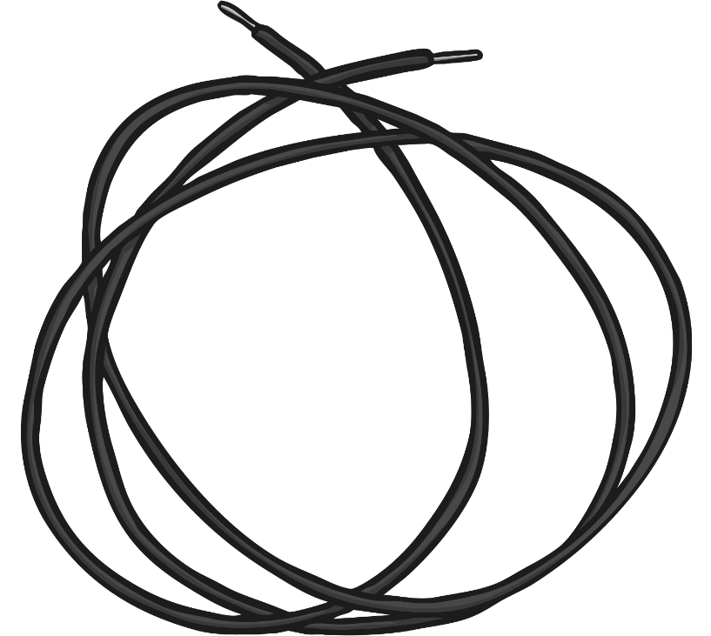
Complete and Incomplete Circuits
Current electricity is the flow of electrical charge though materials.
Every complete circuit must have a power supply. The power supply could be the mains, or it could be a battery.
For a circuit to be complete, there must be wires connected to both the positive and negative ends of the power supply.
Electricity can only flow around a complete circuit that has no gaps.

Slide 5
Complete and Incomplete Circuits
Incomplete Circuit
This circuit is incomplete.
There is a gap in the circuit, so the electrical current cannot flow around it.
The wires do not connect to the positive and negative ends of the power supply (the battery).

Slide 6
Complete and Incomplete Circuits
Complete Circuit
This is a complete circuit.
There is a power supply (the battery).
There are no gaps anywhere, so the electrical current can flow around the entire circuit.
The wires connect to both the positive and negative ends of the battery.

Slide 7

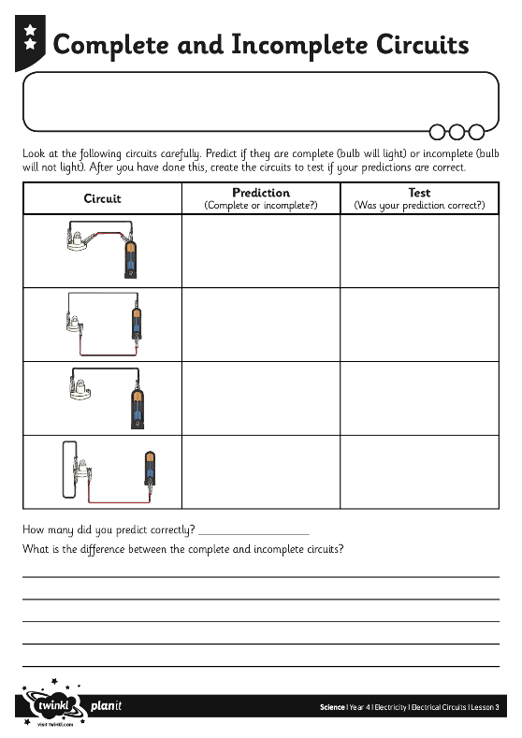
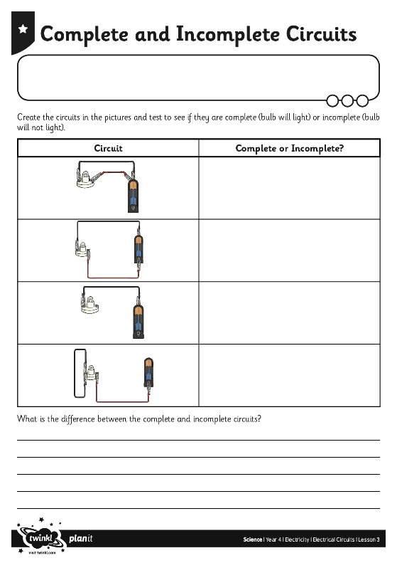

Complete or
Incomplete Circuit?
Task Instructions:
On your activity sheets, you will see pictures of circuits.
You will need to think about whether the circuit will be complete or incomplete.
What are you reasons for thinking this? What do you think will happen to the bulb in each of the circuits?
Lastly, click through the remaining slides to see whether you are correct!

Slide 8

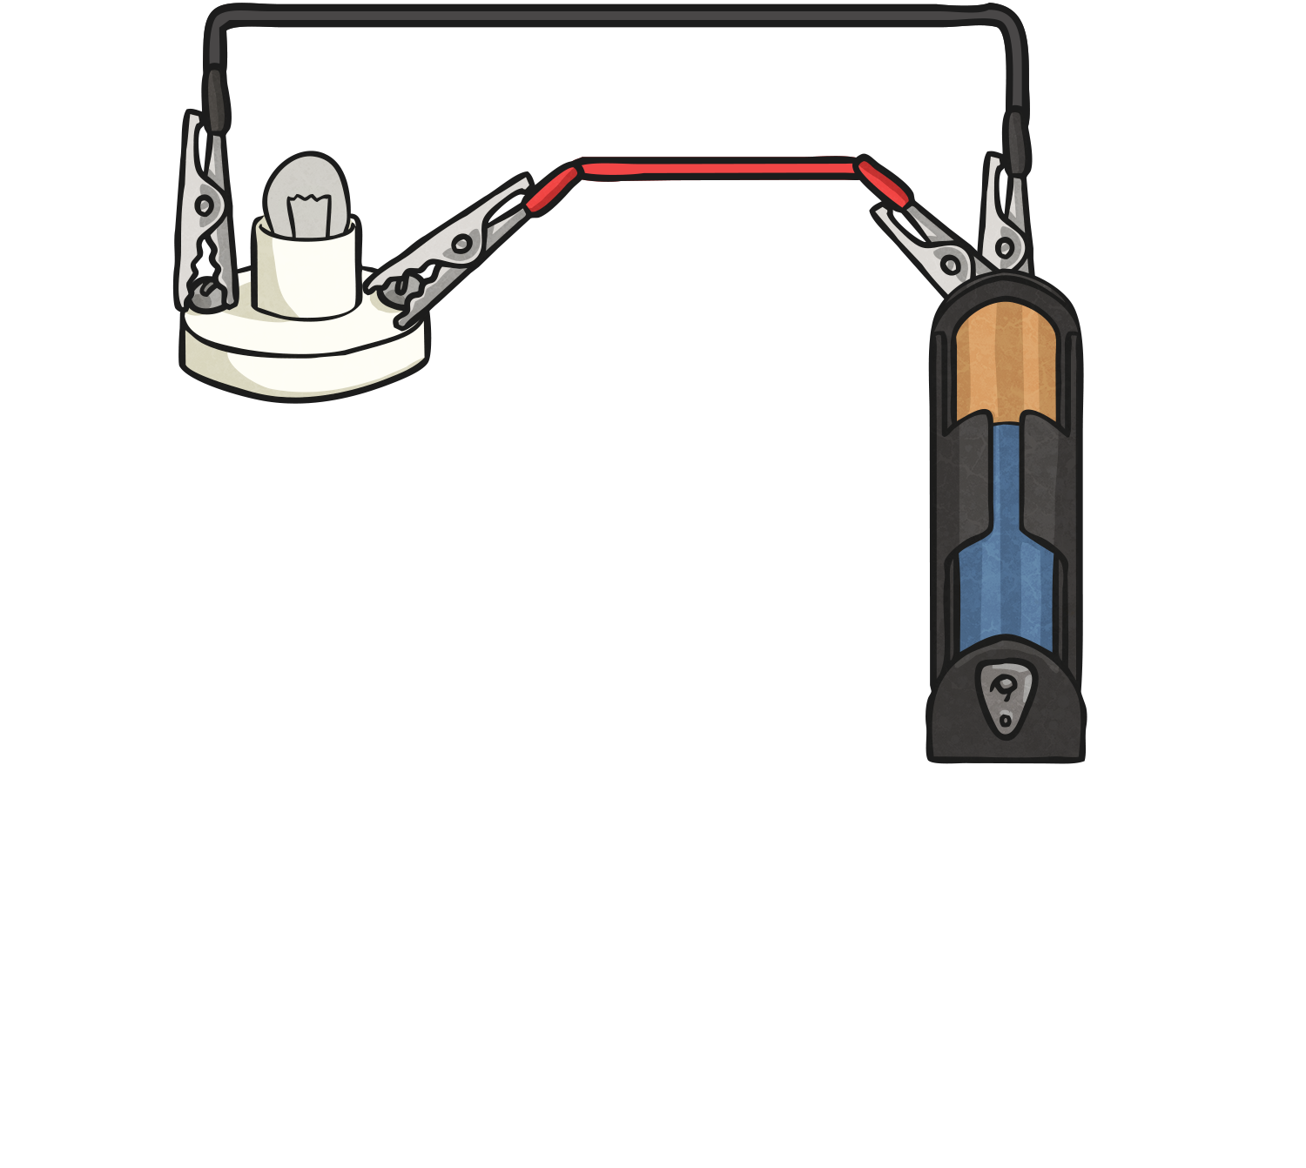
Complete or Incomplete?
This circuit is incomplete as the negative terminal of the battery is not connected.

Slide 9
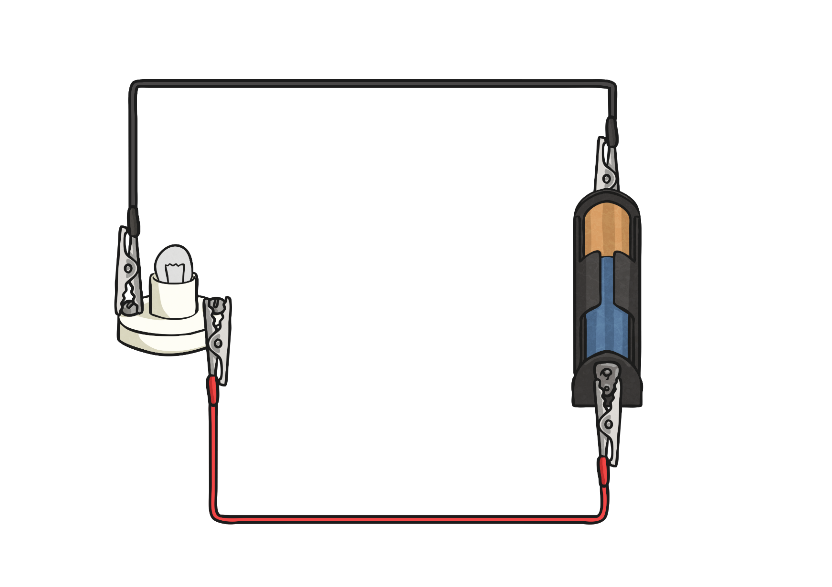
Complete or Incomplete?
This is a complete circuit because there are no gaps in it and both terminals on the battery are connected to the bulb. This means that the bulb will light up.

Slide 10
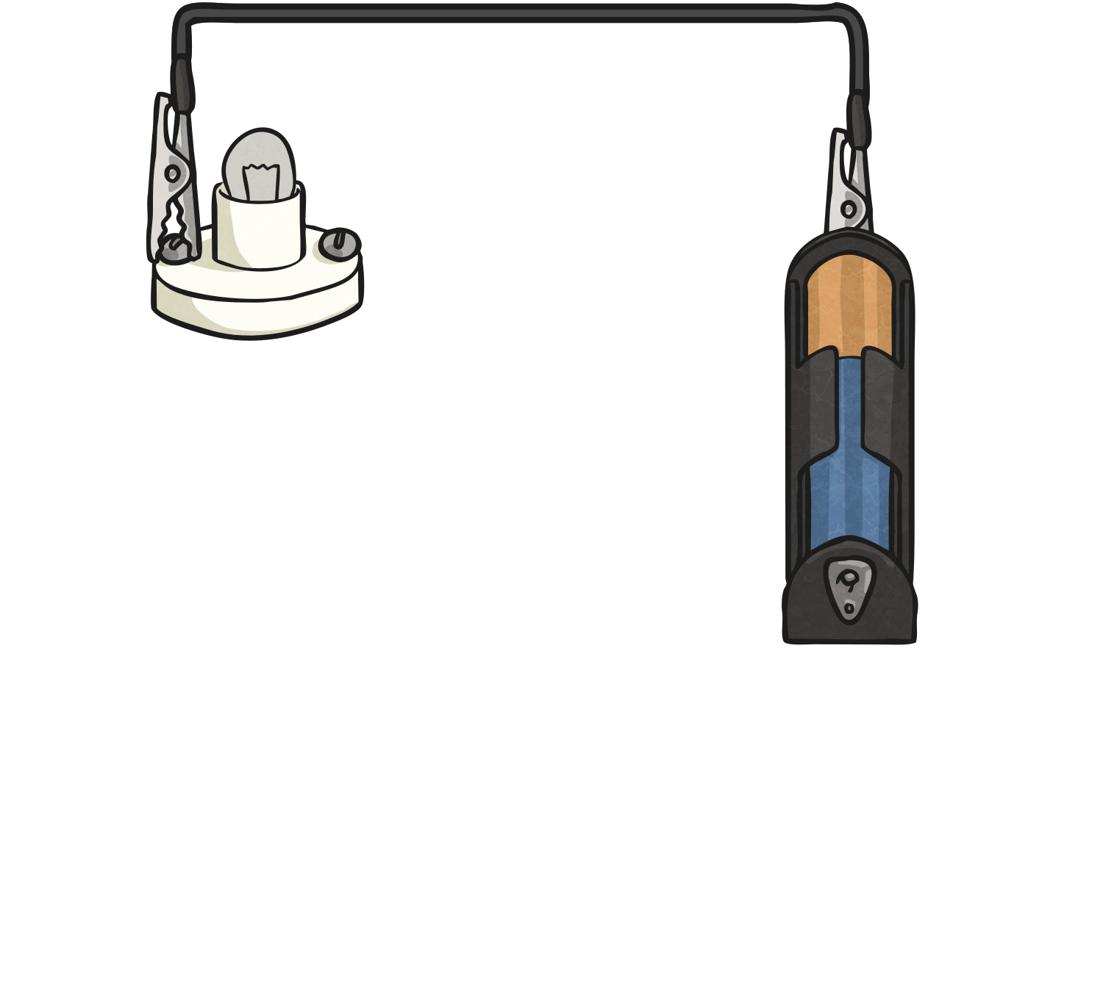
Complete or Incomplete?
This is another incomplete circuit as, again, there is no connection between the negative terminal on the battery and the bulb.

Slide 11
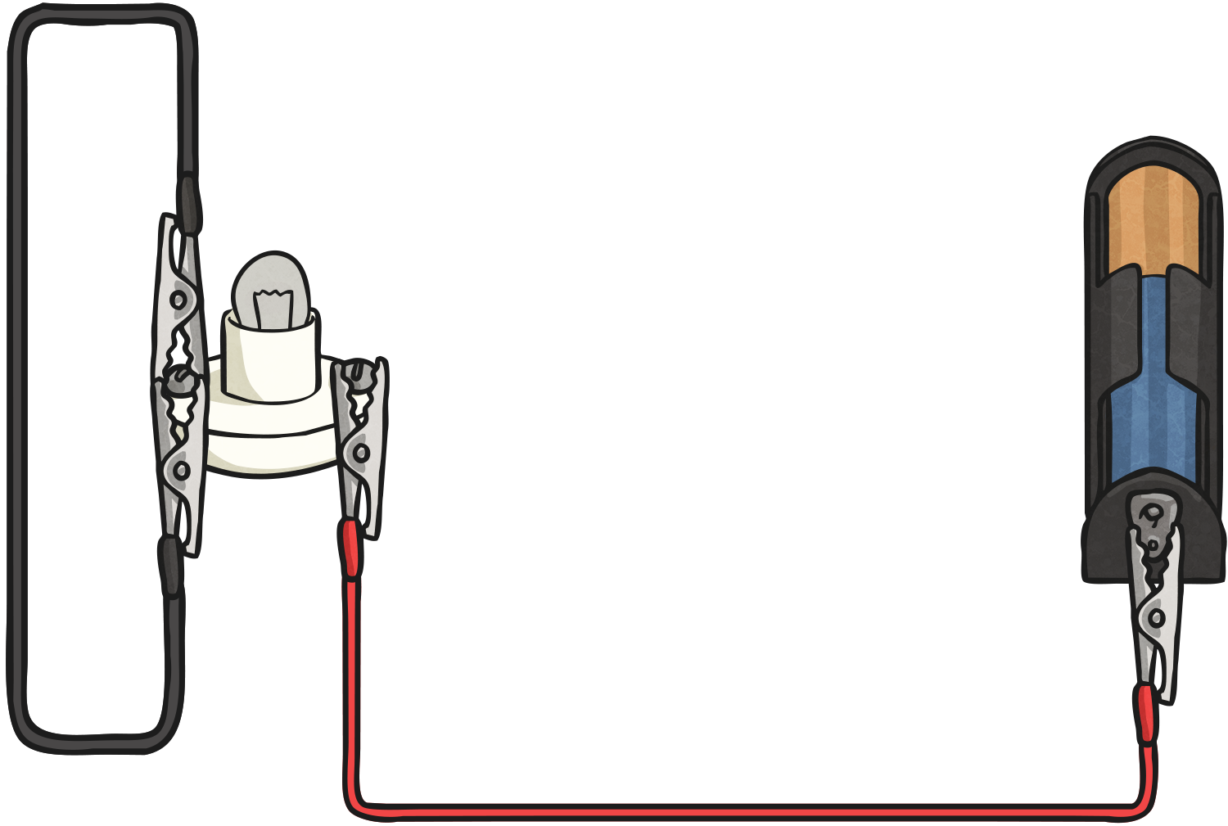
Complete or Incomplete?
Yet again, this circuit is incomplete. This time, the positive terminal has not been connected to the bulb. What would you need to change in order to complete this circuit?

