Slide 1
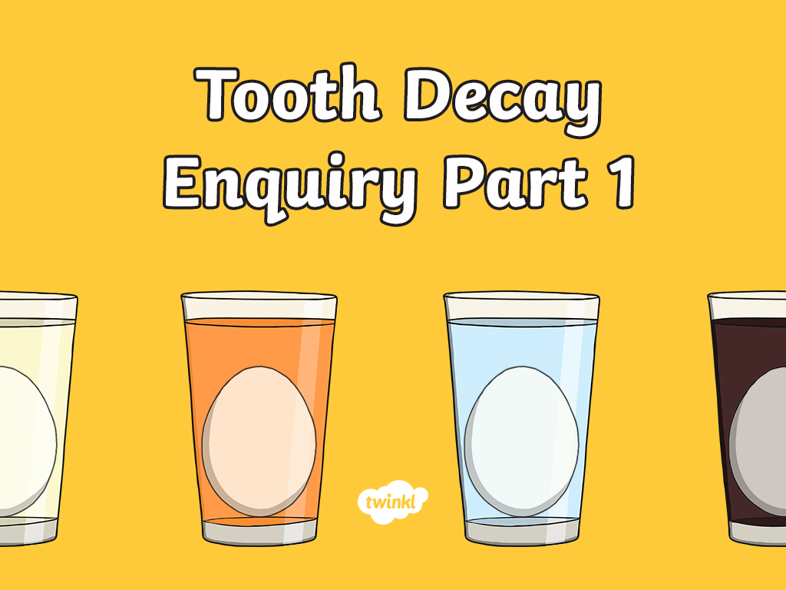

Slide 2
LO: I can ask scientific questions and come up with a test to answer them.
I can generate relevant scientific questions.
I can suggest an appropriate type of scientific enquiry to answer my question.
I can set up a simple enquiry with support.

Slide 3

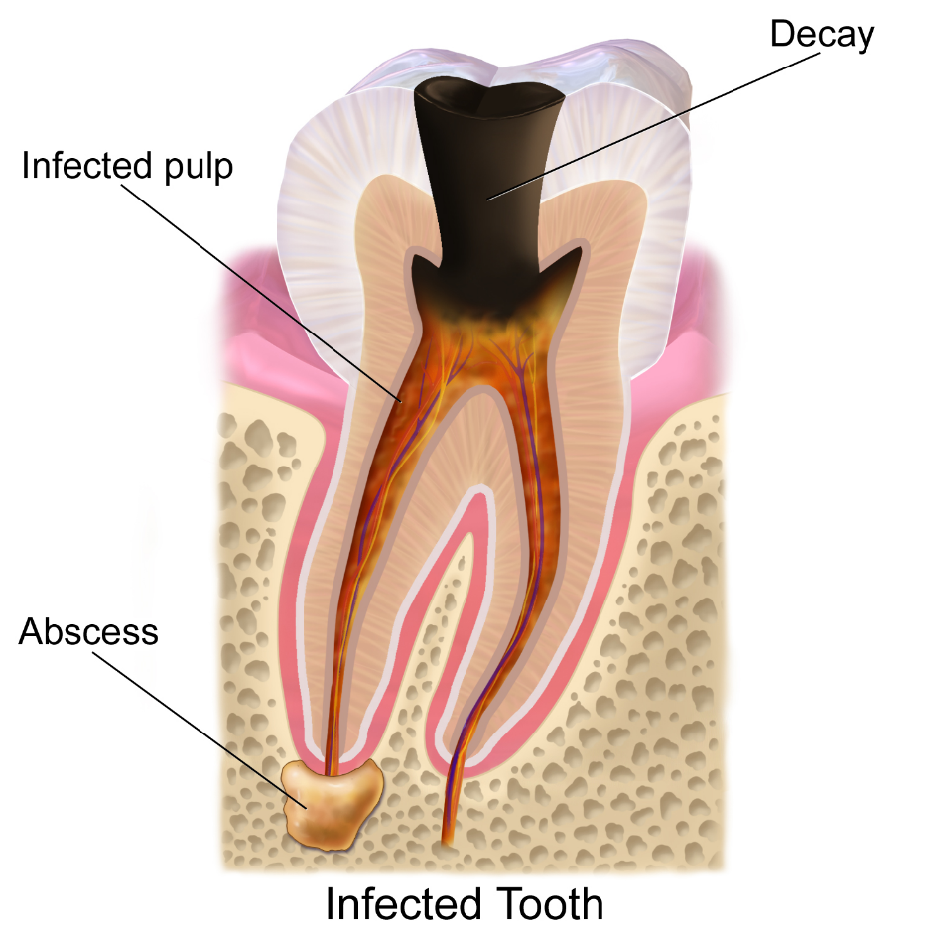
Tooth Decay
Discuss the following questions with your talk partner:
What is tooth decay?
What causes tooth decay?
How do you know?
Image courtesy of BruceBlaus (@Wikipedia.com) - granted under creative commons licence – attribution

Slide 4

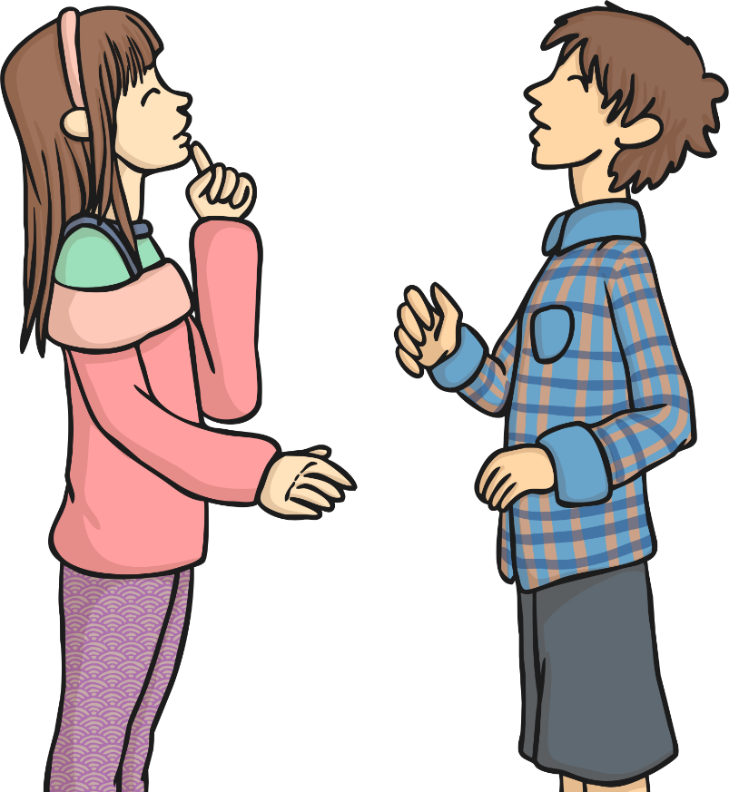
Questions!
Scientific Enquiry
Why do scientists ask questions?
Why do they carry out enquiries and tests?

Slide 5
Scientific or Not?
Categorise the questions based on whether they are scientific questions that can be tested or whether they are non-scientific questions:
Scientific Questions | Non-Scientific Questions
Does eating fruit keep you healthy?
How much sleep do rabbits need?
What time is dinner?
Does water always boil when heated?
Can you open the lid?
When should I do my homework?
Does sound travel through walls?
Do plants need soil to grow?

Slide 6
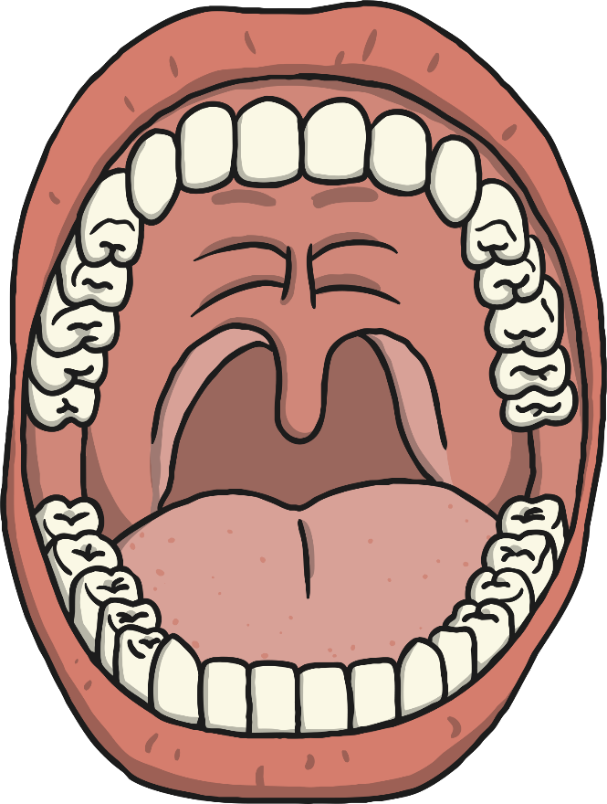
Creating Scientific Questions
Now we need to generate some scientific questions about tooth decay.
Remember we need to be able to test them so…
think about the equipment you would need
think about how the test would need to be carried out
Our Scientific Questions:
?

Slide 7
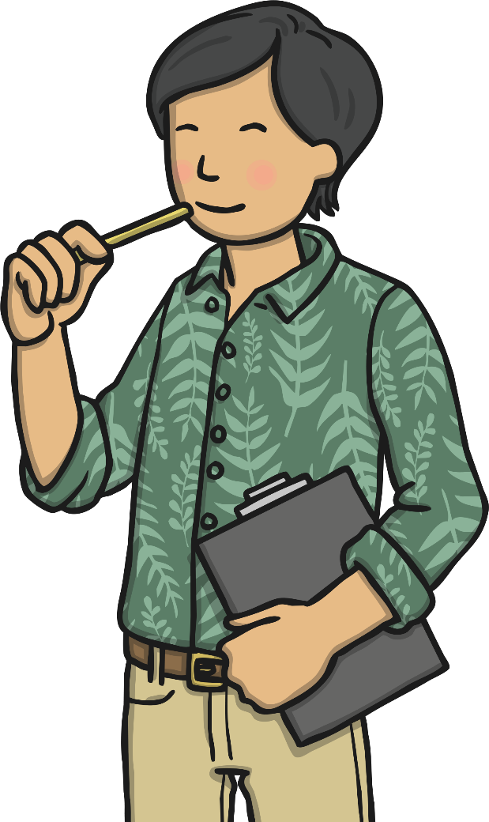
Types of Enquiries
What types of scientific enquiries are there?
Can you give examples of scientific enquiries or tests you have done?
How would you know what type of enquiry to choose?
We are going to look at some examples of questions and the kind of enquiries we could use to answer them.

Slide 8

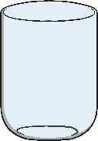
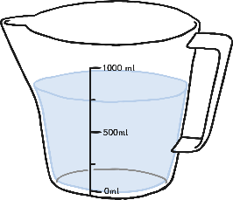
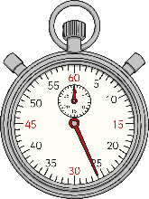
Practical Enquiries
A simple practical enquiry is when you want to just observe what happens.
So if I want to answer the question:
Question:
What effect does water have on chewing gum?
A simple practical enquiry would involve:
Placing the chewing gum in some form of liquid – for example water.
Observing what happens to the chewing gum (does it change colour, grow/shrink, change shape) either immediately or over time (what would be sensible time intervals?).
In this enquiry I would need:
Chewing gum
A container
Water
A timer/clock (way to measure time)
A table to record my observations.
Note: This is a very specific question.
Time | Observation

Slide 9
Variables
In the practical enquiry we are interested in the observation and what happens as we are not sure what the results will be.
When we conduct comparative or fair tests we want to test the particular effect of something.
You might ask - Question: Do different liquids affect the colour of chewing gum?

Slide 10

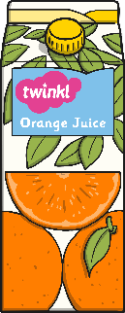

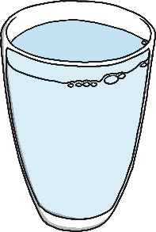
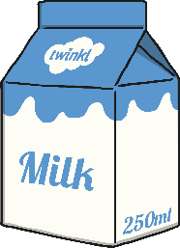
Variables
The variable you are testing is the thing you change every time you carry out the test.
In the comparative and fair tests we will look at this, it will be the liquids.
I want to change the liquids to see if different types of liquids have a particular effect on the chewing gum.

Slide 11
Variables
When you are carrying out a fair test, you need to change only one thing. All other variables should be kept the same so that they don’t affect your results.
In my tests I want to know if liquids change the colour of chewing gum but if I use different containers to put the liquid in or put the containers in different parts of the room then it could be the material of the containers that has the effect or the place in the room, not the liquid. These differences would mean I was testing lots of types of variables when I just want to test one type - liquid.
That’s why we have to keep some things the same throughout so that we know what is having the effect.

Slide 12
Variables
In my tests I would want the following things to be the same:
Containers
Where I place the containers
The amount of liquid in each container
The time between each observation
The type of chewing gum
The amount of chewing gum in each container.

Slide 13
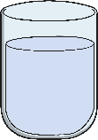
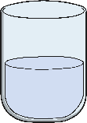
Carrying Out Fair and Comparative Tests
Question: Do different liquids affect the colour of chewing gum?
Liquids (milk, water, orange juice)
Colour
Containers
Where I place the containers
The amount of liquid in each container
The time between each observation
The type of chewing gum
The amount of chewing gum in each container.
Record observations at regular intervals of time.
Compare the results from different liquids.
Spot patterns.
Liquid | Observation after 1 day. | Observation after 2 days.

Slide 14

Testing Tooth Decay Feedback
Swap your Tooth Decay Scientific Enquiry Activity Sheets with another group.
Read through the sheets carefully as a group.
On post-its write two positives and one next step.
Remember the next step has to be about the enquiry/test not about spelling or handwriting!
Suitable next step: You should include the size of the egg as something that you keep the same.
Unsuitable next step: Spell the word decay properly.
When you get your sheets and feedback – meet your next step by making a change to your enquiry/test.

