Slide 1

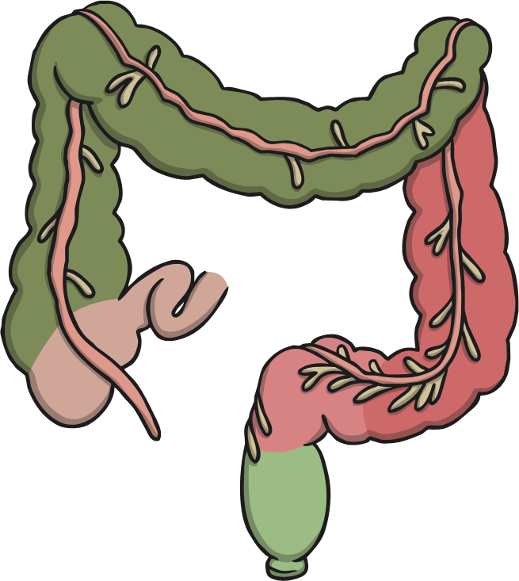
Digestive System Quiz
Click on the answer boxes.

Slide 2
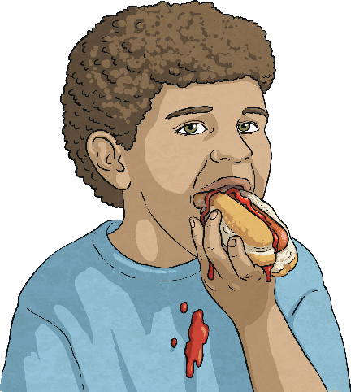

Digestive System Quiz
What part of the digestive system tears, cuts and grinds food?
?
stomach
teeth
salivary glands
pancreas

Slide 3
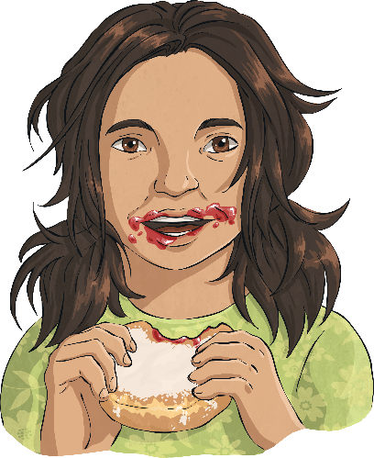
Digestive System Quiz
Which part of the body produces saliva?
?
mouth
gallbladder
salivary glands
liver

Slide 4
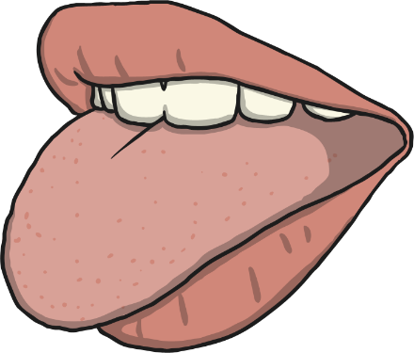
Digestive System Quiz
What is the function of the tongue?
?
mixes food with saliva
cuts food
produces saliva
breaks down food

Slide 5
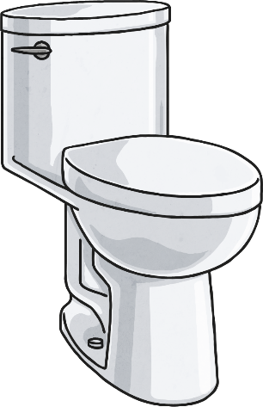
Digestive System Quiz
Which part of the digestive system forms stools?
?
rectum
oesophagus
small intestine
large intestine

Slide 6

Digestive System Quiz
Which is the only part of the digestive system which needs
to send a signal to the brain?
?
rectum
gallbladder
pancreas
anus

Slide 7
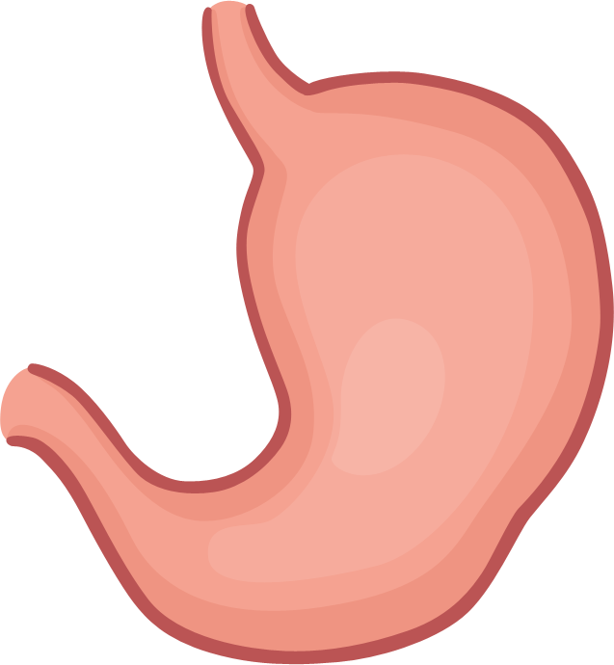
Digestive System Quiz
Which of these is the function of the stomach?
?
produces saliva
produces bile
produces acid
produces stools

Slide 8
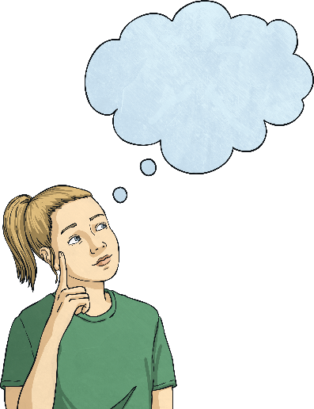
Digestive System Quiz
Where is bile stored?
?
stomach
liver
pancreas
gallbladder

Slide 9
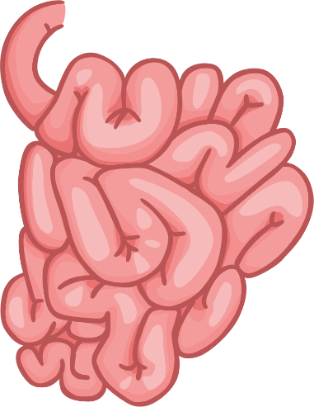
Digestive System Quiz
How many parts of the small intestine are used to digest food?
?
two
one
three
none

Slide 10
Digestive System Quiz
Which part moves the food to the stomach?
?
small intestine
oesophagus
large intestine
mouth

Slide 11
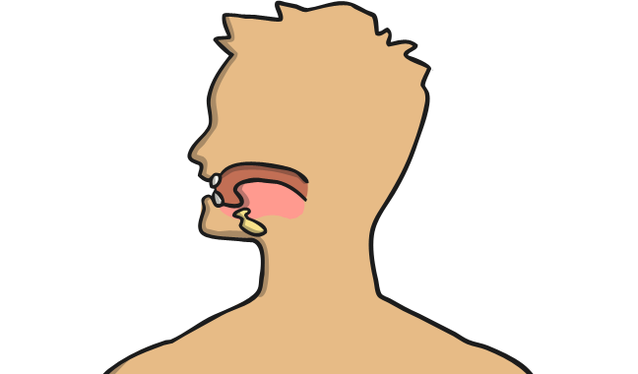
Digestive System Quiz
What do glands do?
?
break down food
keep the pancreas healthy
produce fluids
send signals to the brain

Slide 12
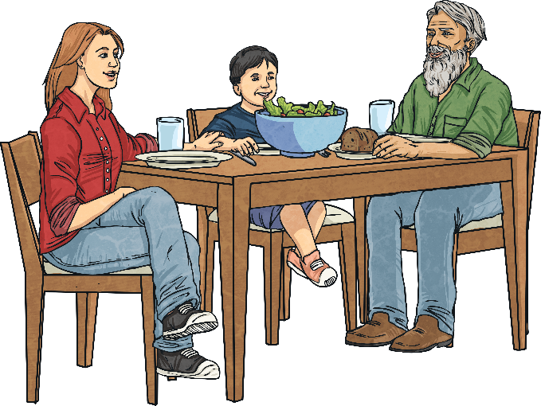
Digestive System Quiz
How many different parts of the digestive system
does food enter?
?
eight
ten
thirteen
three

Slide 13
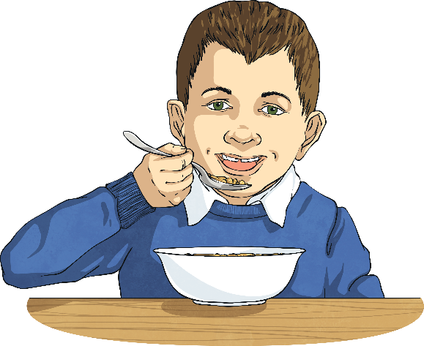
Digestive System Quiz
What are enzymes?
?
cells that break down food
molecules that break down food
glands that break down food
organs that break down food

Slide 14
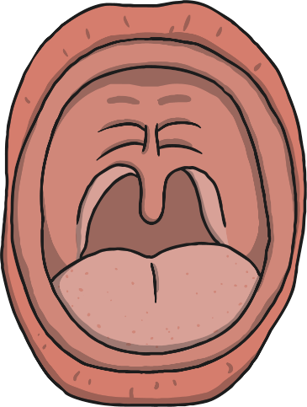
Digestive System Quiz
What is the name of the top part of the mouth?
?
hard palate
soft pilates
soft palate
hard pilates

Slide 15

Digestive System Quiz
What two substances break down food in the duodenum?
?
acid and enzymes
bile and saliva
acid and bile
enzymes and bile

Slide 16
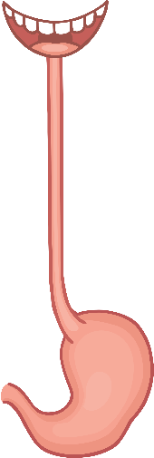
Digestive System Quiz
The name of the wave movement of the muscles in the
oesophagus is called…
?
periscope
perisic
peristalsis
periodic

