Slide 1
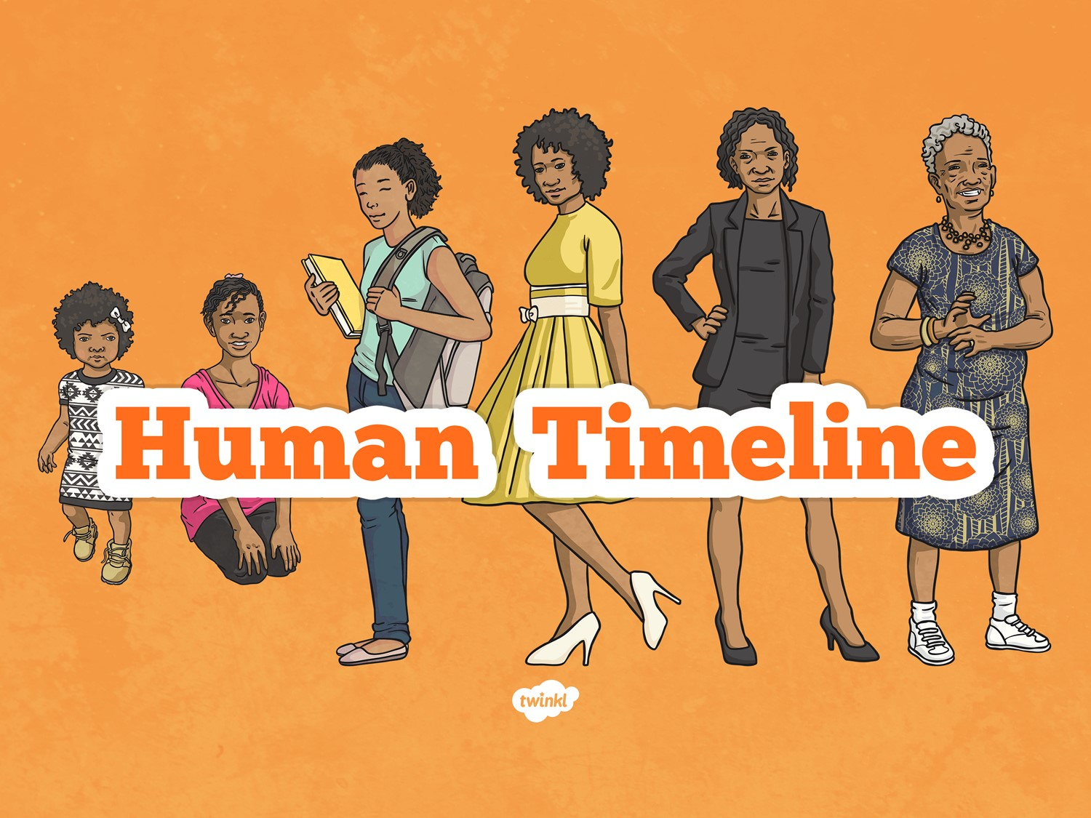

Slide 2
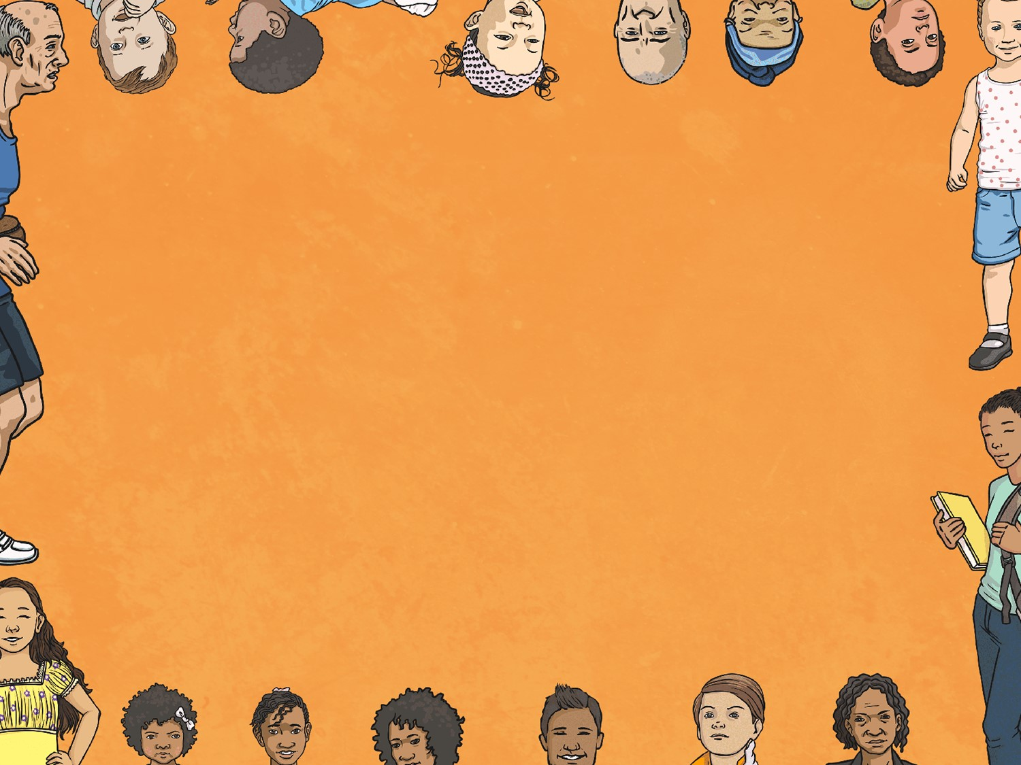
Aim
I can describe the stages of human development.
Success Criteria
I can order the stages of human development.
I can name the 6 stages of human development.
I can explain the changes that occur during the stages of human development.

Slide 3

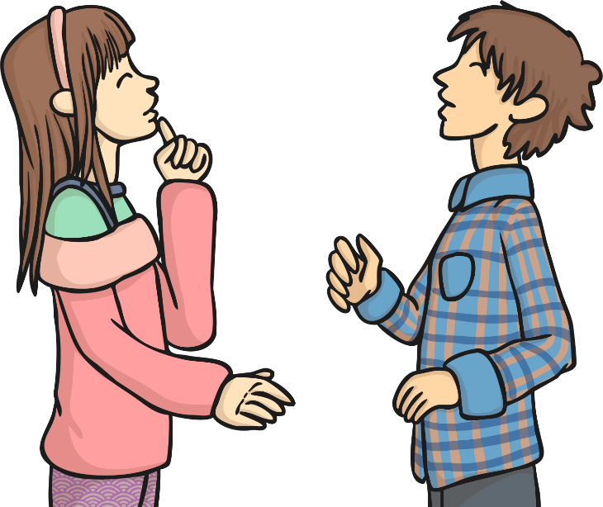
Human Life Cycle
In partners, discuss the following question:
What is the human life cycle?

Slide 4

Types of Reproduction
How does new life start?
 | Asexual Reproduction | Sexual Reproduction | Both Sexual and Asexual Reproduction
What is it? | One parent produces new life. | Two parents – one male and one female – are required to produce new life. | Either one or two parents.
How does it occur? | One cell simply starts to divide itself. All cells of the offspring are identical to the parent. This means that it is a clone of the parent. | Male sex cells (sperm/angiosperm/pollen are different versions of male sex cells) fertilise female sex cells (eggs). This fusion means that the offspring resembles but is not identical to the parents. | Some living things have the capacity to reproduce in sexually or asexually.

Slide 5
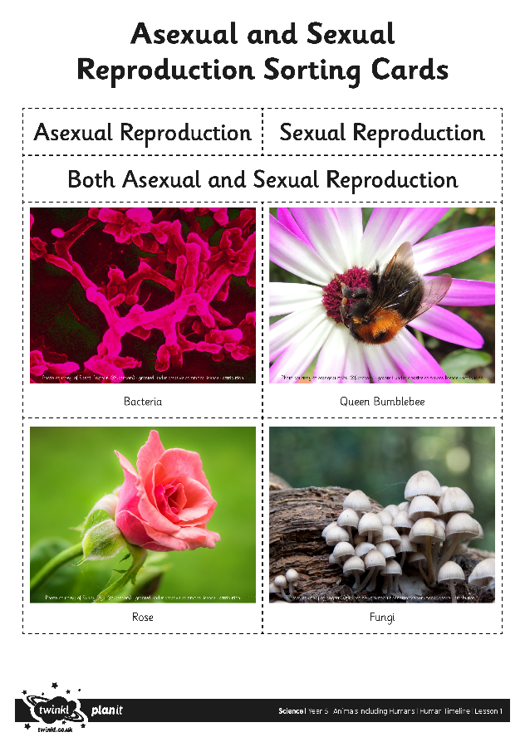
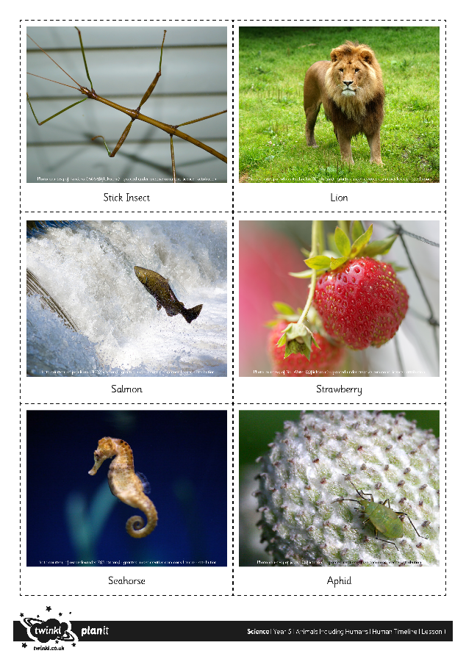
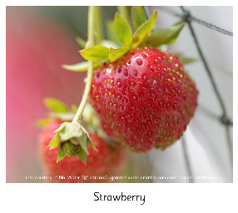
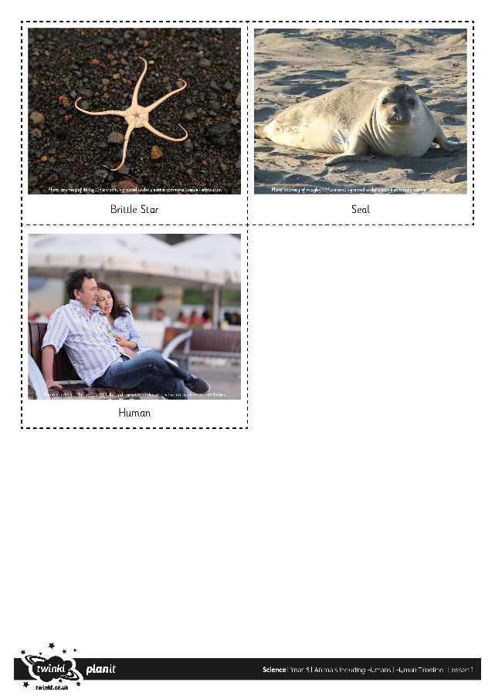

Sorting Activity Answers
Asexual Reproduction | Sexual Reproduction | Both Sexual and Asexual Reproduction

Slide 6
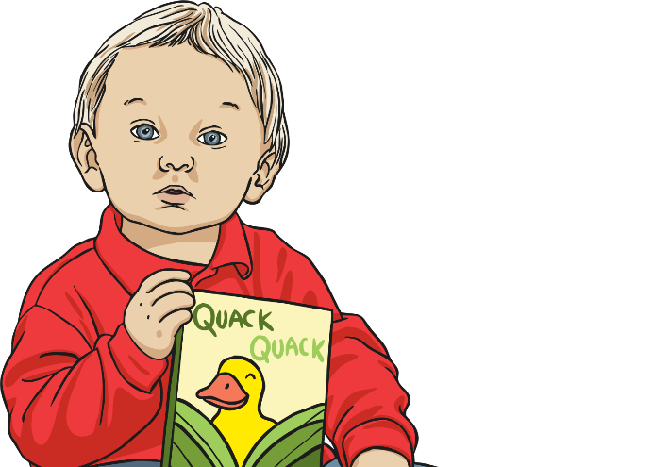
Stages of Human Growth and Development
It is possible to study human growth in lots of ways:
Physical
Emotional
Social
Psychological
In science, the focus is on the stages of human growth and development physically. The stages you will learn about are the major changes that take place.

Slide 7
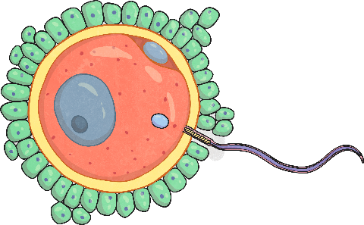
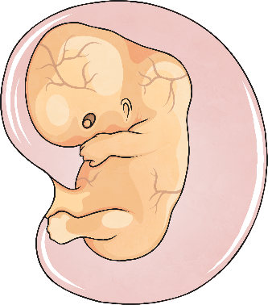
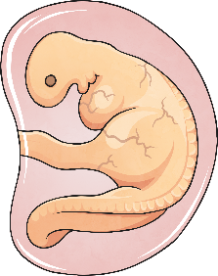
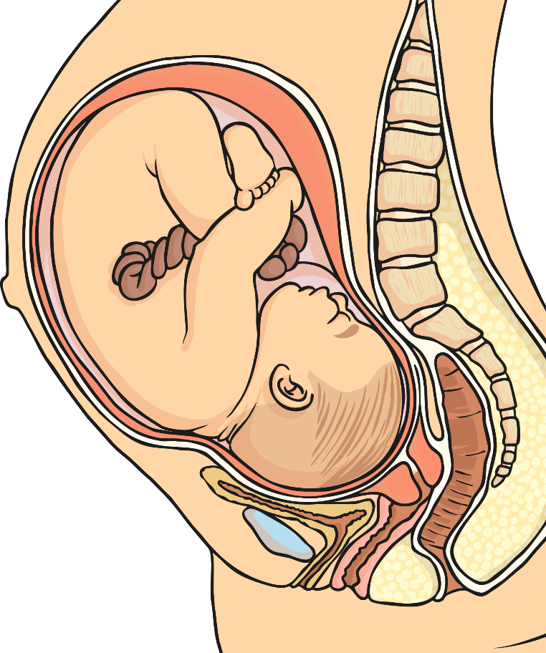
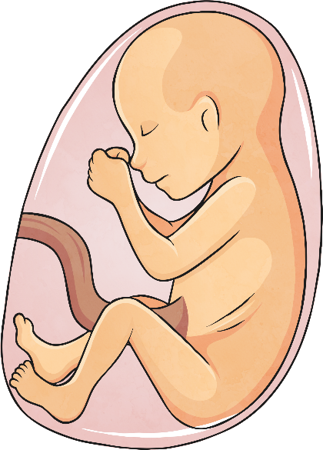
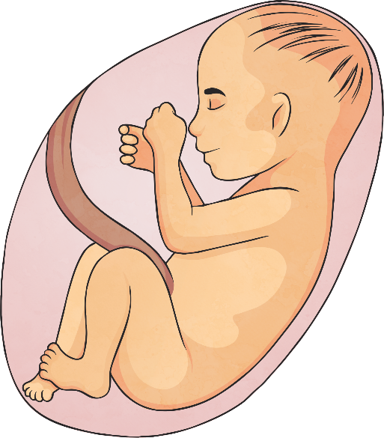
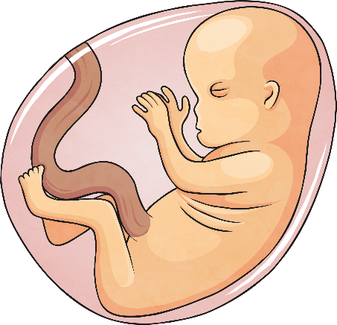
Prenatal
Prenatal means before birth. This stage of development is from the time of fertilisation (when the male and female sex cells fuse together) to the time of birth.
fertilisation
one-month-old embryo
nine-week-old embryo
three-month-old foetus
five-month-old foetus
seven-month-old foetus
39-week-old baby in womb
Notes:
NB: This is an American video – they spell fertilisation with a ‘z’ instead of an ‘s’

Slide 8
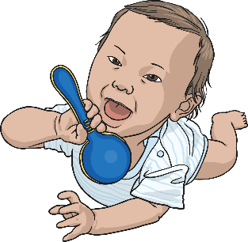
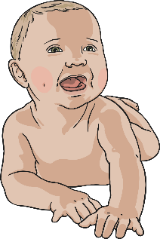
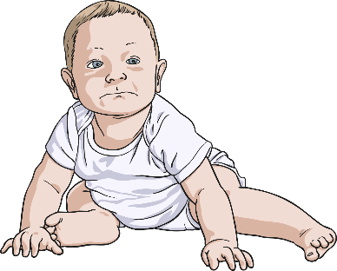
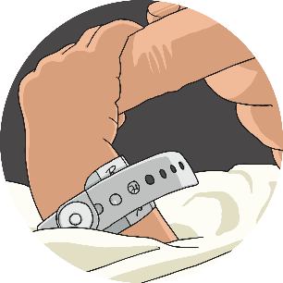
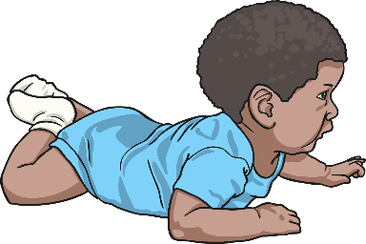
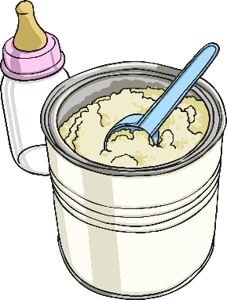
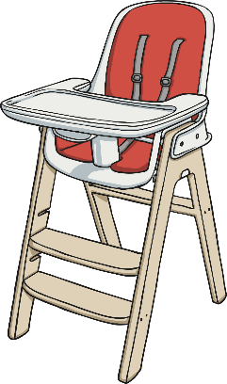
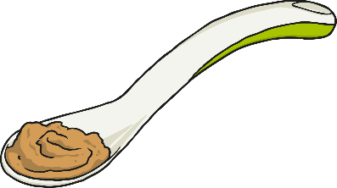
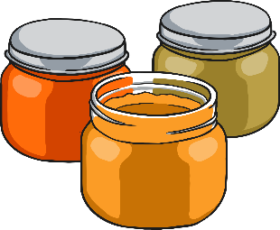
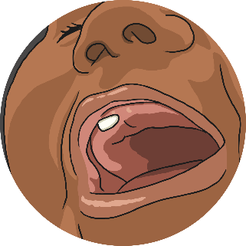
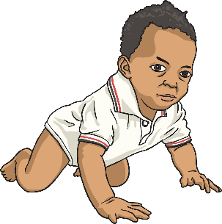
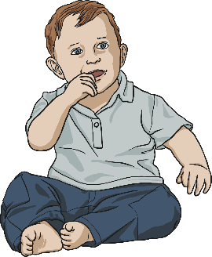
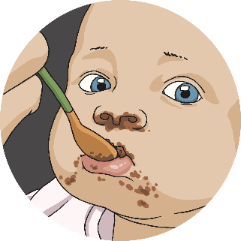
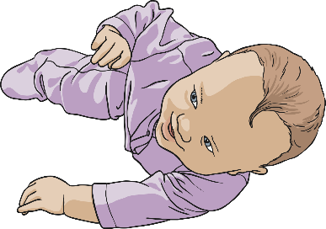
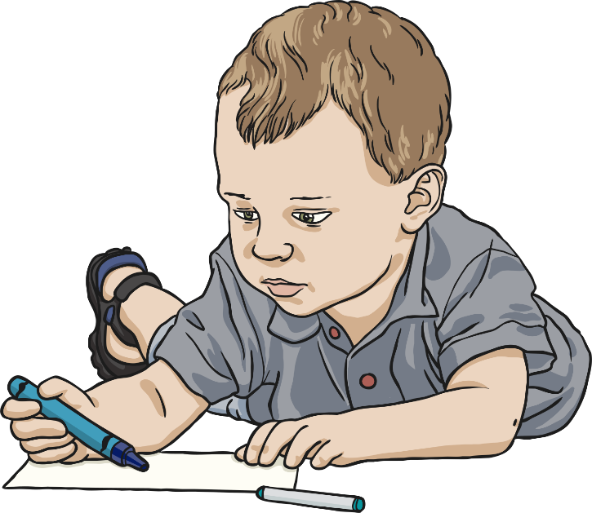
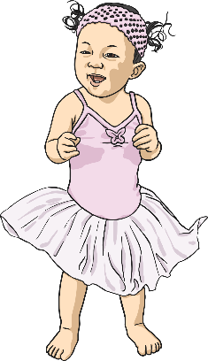

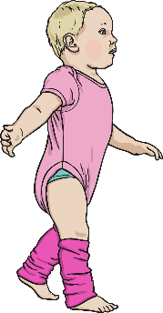
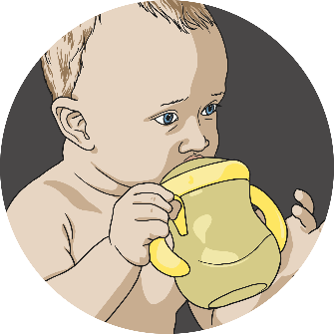

Infancy
1 month
2 months
3 months
4 months
5 months
This stage of development is from birth to 2 years old.
This includes babies and toddlers.
The rate of physical development is fast at this stage.
Infants are totally dependant on others for food and care.
6 months
7 months
8 months
9 months
10 months
Click here for a rough timeline of the period from infancy to a toddler!
11 months
1 year
toddler
Notes:
NB: This is an American video – they spell fertilisation with a ‘z’ instead of an ‘s’

Slide 9
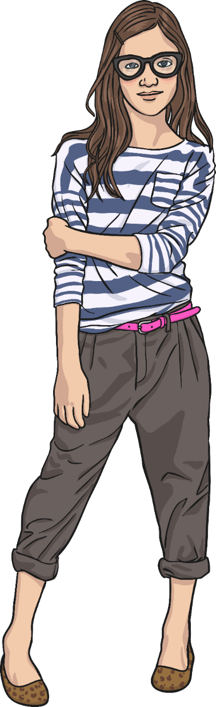
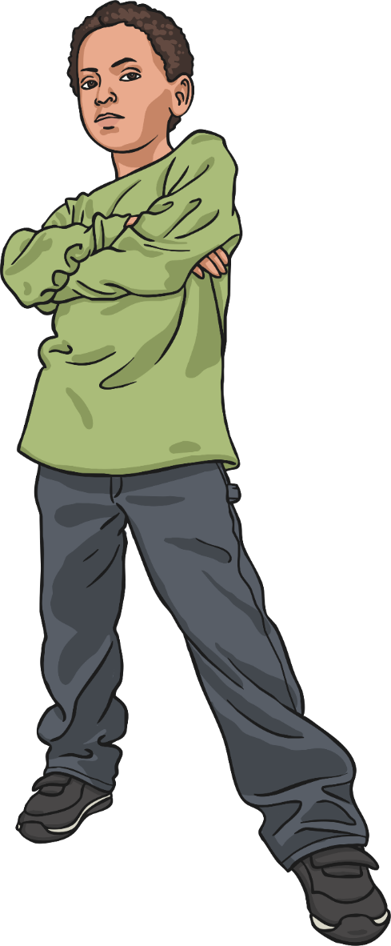
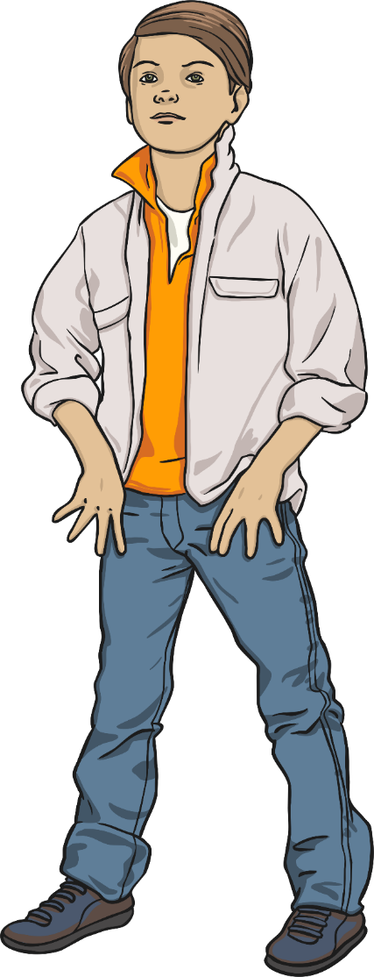
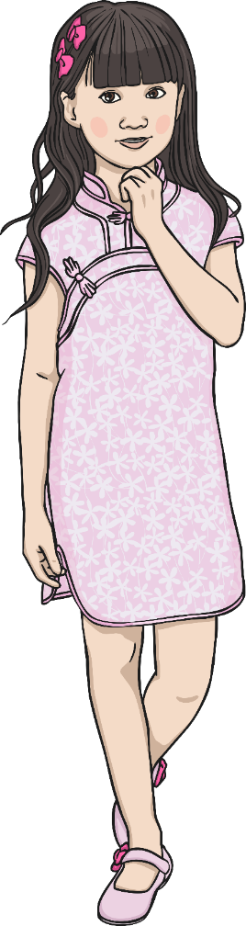
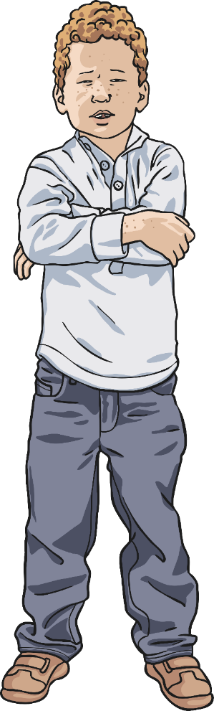
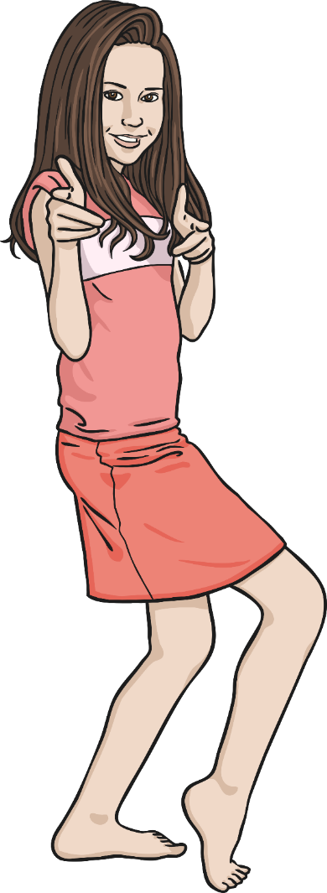
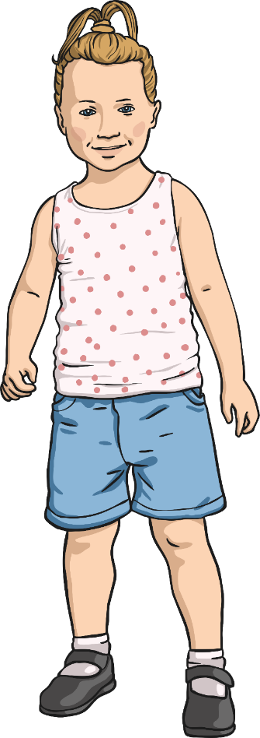
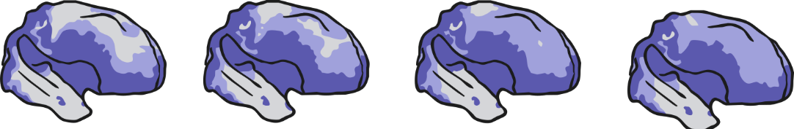

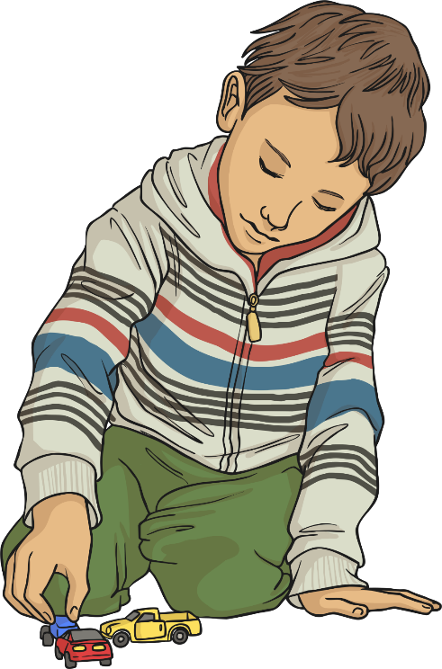
Childhood
9 years
10 years
7 years
6 years
5 years
8 years
4 years
There is considerable development of the brain.
This stage takes place between the ages of 3 and 10.
Physical growth is more steady.
Children are able to feed themselves.
They can increasingly take care of important physical needs.
3 years
Click here for a rough timeline of the period from ages 3 to 10!
Notes:
NB: This is an American video – they spell fertilisation with a ‘z’ instead of an ‘s’

Slide 10
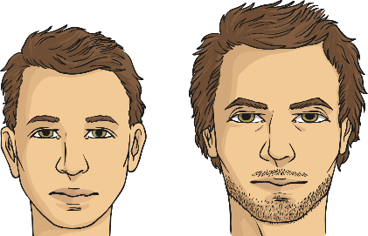

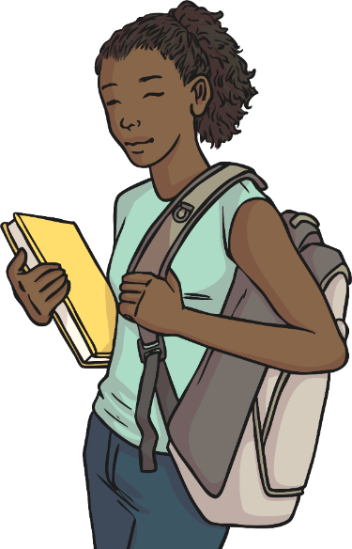
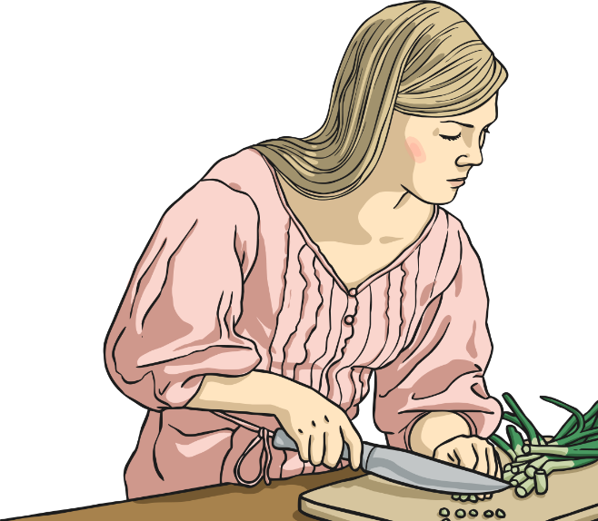
Adolescence
There is even more brain development.
The World Health Organisation defines an adolescent as being a young person aged between 10 and 19.
Puberty results in changes in the body.
Boys’ bodies start changing from around age 12 but it can be earlier or later.
Girls’ bodies start changing from around the age of 9 but it can be earlier or later.
The changes don’t all come at once.
They happen over a few years.
These changes occur to enable reproduction during adulthood.
Adolescents are increasingly independent.

Slide 11
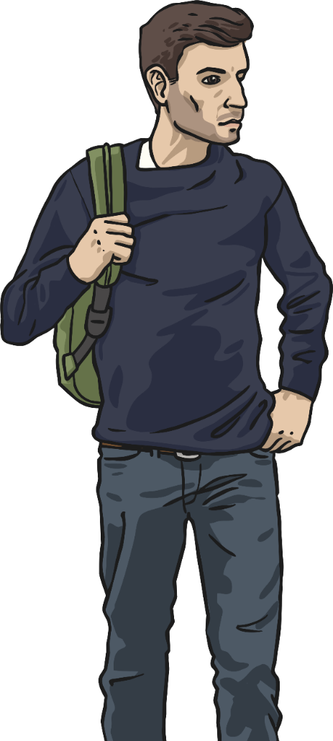
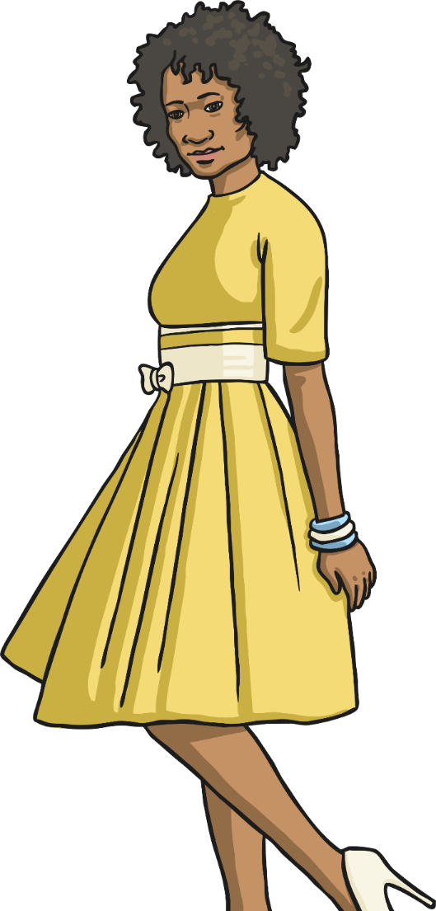
Early Adulthood
This stage of development takes place from the ages of 18/19 to 39.
The human body is at
its peak of fitness and strength.
There is still some growth but not of height.
This is the age at which most humans reproduce.
Humans are able to take care of their physical needs completely independently.
Notes:
NB: This is an American video – they spell fertilisation with a ‘z’ instead of an ‘s’

Slide 12
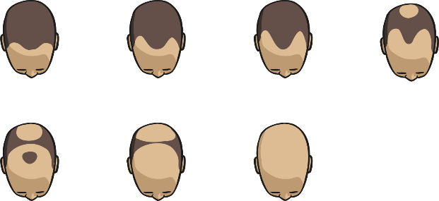
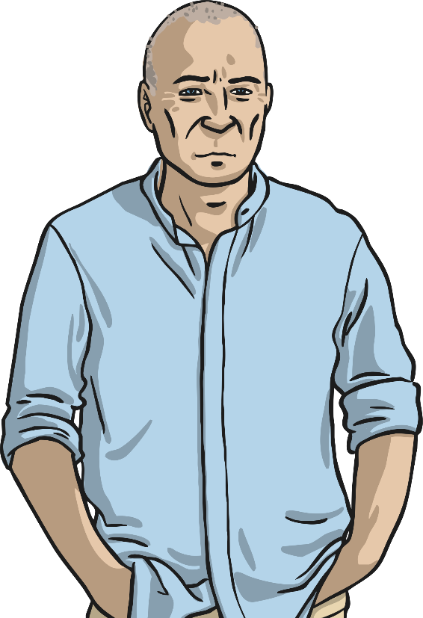
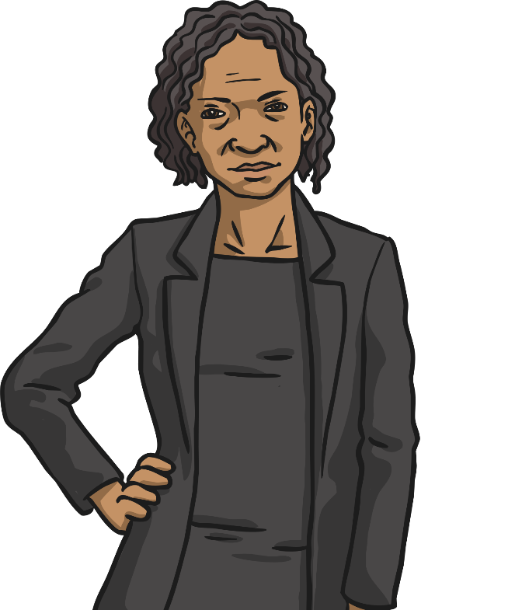
Middle Adulthood
This stage of development takes place between 40 and 59 years of age.
Both male and female ability to reproduce declines with age.
Women experience menopause in their 40s or 50s when they no longer produce eggs.
Physical changes can include loss of hair among men and greying hair for both men and women.
Notes:
NB: This is an American video – they spell fertilisation with a ‘z’ instead of an ‘s’

Slide 13


Late Adulthood / Old Age
This is the last stage of human development and takes place after the age of 60.
There is no physical growth although mental development is possible.
The body declines in fitness and health.
Some older people can become more fragile physically.
This can sometimes result in increasing dependency on others to care for them.
The end of the human life cycle is when a human dies. (The age at which this happens varies and is not simply dependent on physical factors.)
Notes:
NB: This is an American video – they spell fertilisation with a ‘z’ instead of an ‘s’

Slide 14



Human Growth and
Development
You will complete an individual task to demonstrate your knowledge and understanding of human growth and development.

Slide 15




Human Life Cycle Revisited
We are going to revisit our earlier work on the human life cycle.
Focus on the following questions:
What new vocabulary have you learnt in this lesson?
Did we identify all the stages of human growth and development?
Which new ones have you learnt about in this lesson?
Click here for first slide.

Slide 16

Aim
I can describe the stages of human development.
Success Criteria
I can order the stages of human development.
I can name the 6 stages of human development.
I can explain the changes that occur during the stages of human development.

Slide 17


