Slide 1
Writing our Investigation Conclusion
LO: To evaluate our investigation and discuss our findings.
I can reflect on my investigation.
I can discuss and explain our findings.
I can discuss and explain what was successful and unsuccessful.

Slide 2
Today we need to evaluate and write our conclusion for our science investigation.
Our investigation was looking at how we could grow the tallest beanstalk.
Who can remember what a conclusion is?
What do you think we need to include in our conclusion?

Slide 3
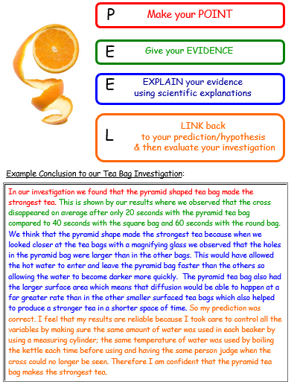
Notes:
Example of someone writing a conclusion

Slide 4
What we need to include:
What went well with your investigation?
What was unsuccessful?
Was your prediction right or wrong?
What was the end result of the investigation?
What would you change about your investigation?

Slide 5
What was the end result?
At the end of our investigation we found that…

Slide 6
Prediction:
At the beginning of the investigation I wrote a prediction. My prediction was…
My prediction was right because…
My prediction was wrong because…

Slide 7
What went well?
Some examples:
Worked well as a group.
We planned our investigation well.
We ensured it was a fair test.

Slide 8
What was unsuccessful?
Some examples:
Our group did not work well together.
We forgot to check on our plants.
We didn’t keep it as a fair test.

Slide 9
What I would change next time:
If I was to conduct another investigation, next time I would…

Slide 10
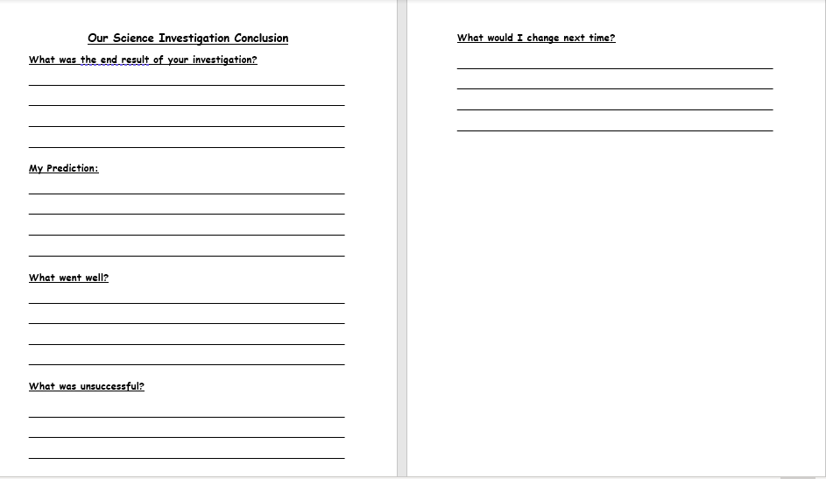
Notes:
Explain this is the Y2 sheet. Explain to Y3s that they will be writing in books using the same headings.

