Slide 2
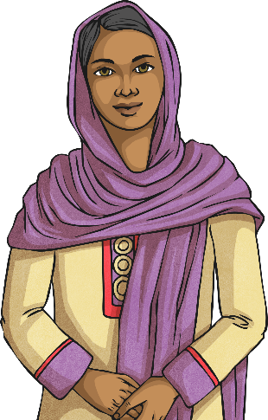
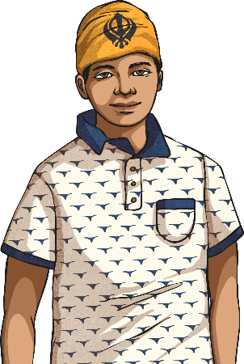
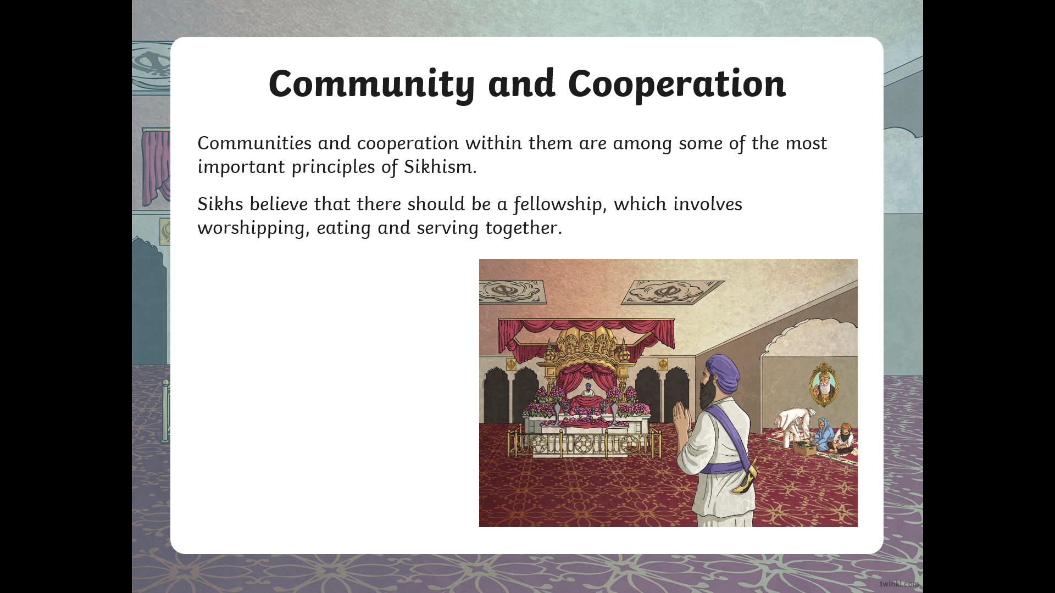
What Do Sikhs Believe?
Sikhs believe that:
There is only one God and Sikhs only worship and pray to this one God;
God cannot be described as either male nor female;
God is both sargun and nirgun;
God created the world for people to enjoy;
God created people to know the difference between right and wrong;
Images of God are forbidden, as is worshipping them;
All people are equal.
sargun – The belief that God is everywhere and within everything.
nirgun – The belief that God is above and beyond the range of human experience.

Slide 3
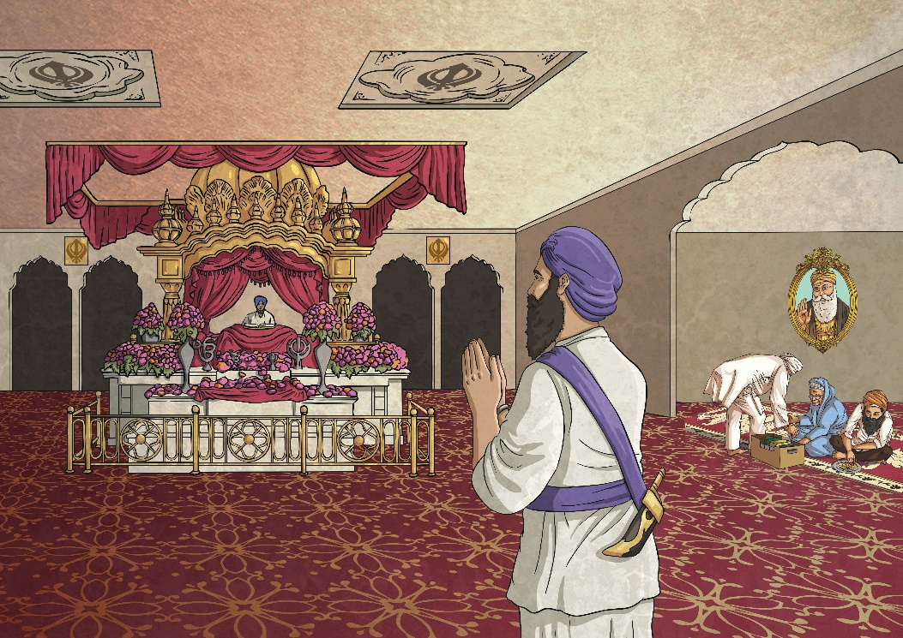
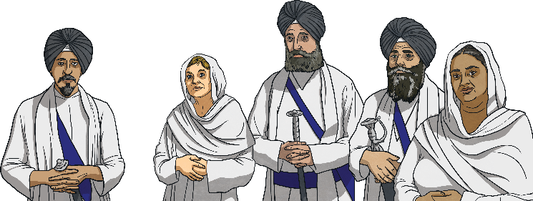
Community and Cooperation
Communities and cooperation within them are among some of the most important principles of Sikhism.
Sikhs believe that there should be a fellowship, which involves worshipping, eating and serving together.
‘Seva’ means an act of selfless service. In Sikhism, ‘seva’ refers to giving
a service for unselfish purposes on behalf of,
and for the benefit of,
a community.

Slide 4

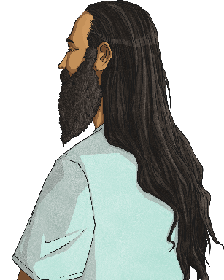



The Five Ks
Sikhs, out a sign of respect and symbolism, wear five articles of clothing. These are known as the five Ks.
Kesh: Sikhs leave
hair uncut
to show
obedience
to God.
Kanga: A wooden comb
that helps Sikhs to keep
their hair in place.
Kirpan: A tiny sword
worn by Sikhs.
Kara: A steel bangle that reminds Sikhs to behave well.
Kachera: These are shorts
worn as underwear.

Slide 5
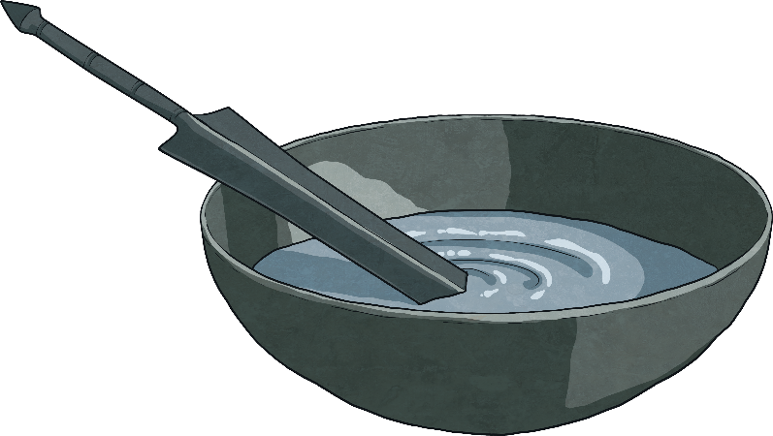
Ceremonies
Being baptised is the sign of being spiritually reborn. This is a key ceremony for Sikhs.
The baptism involves taking part in the Amrit Sanskar ceremony of initiation. Once baptised, they become part of the Khalsa - a community that Sikh people can belong to. The word Khalsa means pure. Sikh people who are part of the Khalsa show they belong by wearing the five Ks.
Usually, young Sikhs join the Khalsa between the ages of 14 and 16, when they are old enough to understand the commitment.
Amrit is a special mixture of sugar and water. The amrit is poured into the cupped hands
of the people who are going to join the
Khalsa, for them to drink. They also have
amrit sprinkled on their hair and in the eyes.

Slide 6
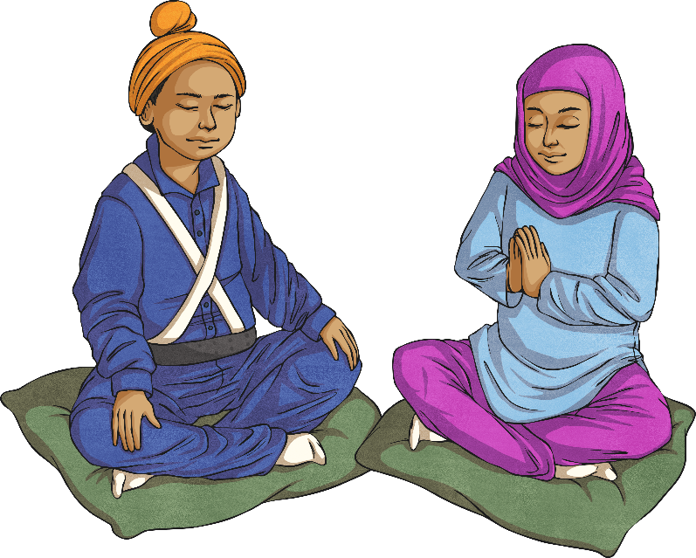
Sikh Duties
Pray, Work, Give; these are the three duties that a Sikh must carry out.
Pray: Keep God in mind at all times (Nam Japna).
Work: Earn an honest living, avoiding crime, gambling and begging (Kirt Karni).
Give: Give to those less fortunate and care for others (Vand Chhakna).

Slide 7
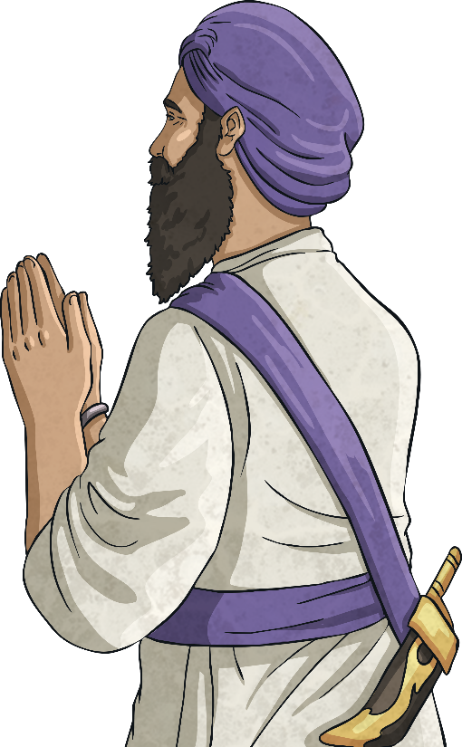
Praying
Daily prayers (Panj Bania) are an important part of individual Sikh worship.
The daily prayers of Sikhism are known as Nitnem Banis.
Nitnem includes a set of five prayers, known as Panj Bania:
Morning Prayers: Japji Sahib, Jap Sahib, Tav Prasaad Swaye
Evening Prayers: Rehras
Bedtime Prayers: Kirtan Sohila

