Slide 1
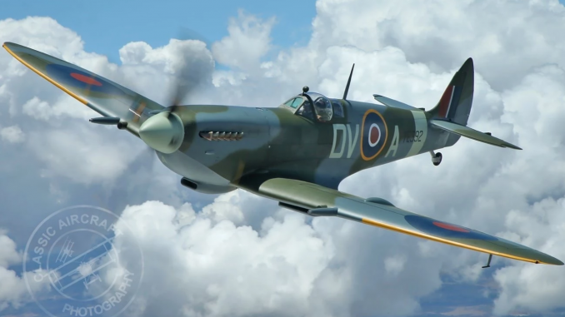
LO: To learn about the Battle of Britain.
Must: Know the key facts and ideas about the battle of britain.
Should: read sources of information about the battle.
Could: Sort and evaluate sources by how useful or reliable they are.
Even better if: I can suggest research questions for further study.

Slide 2

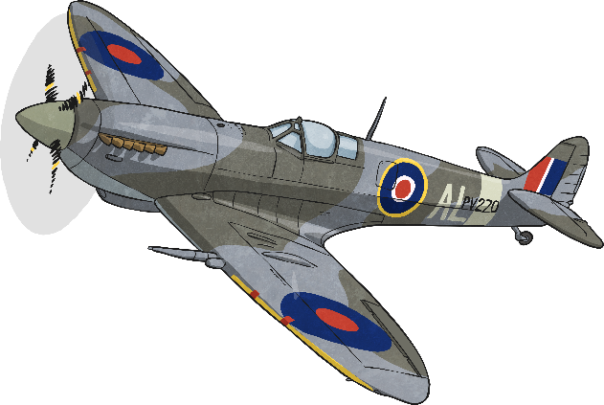
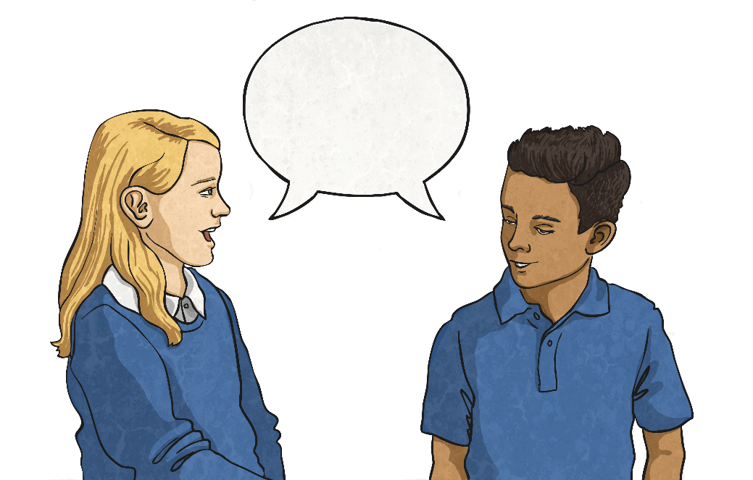
The Battle of Britain
The Battle of Britain was fought between the RAF (Royal Air Force) and the German Luftwaffe (air force).
Talk to your partner:
Do you know what the Battle of Britain was?
What do you think happened during the Battle of Britain?

Slide 3
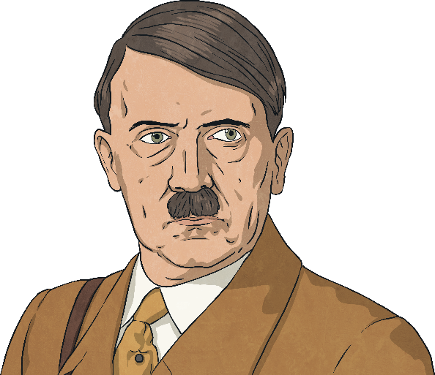
The Battle of Britain
On 10th July 1940, the leader of Germany, Adolf Hitler, planned a secret mission which was code-named Operation Sea Lion. His plan was to invade Britain and stop the Allies from being able to fight back from Britain against his plans to secure German supremacy (ultimate power and control) across the world.
‘As England, in spite of her hopeless military situation, still shows no signs of willingness to come to terms, I have decided to prepare, and if necessary to carry out, a landing operation against her. The aim of this operation is
to eliminate the English Motherland as a base from which the war against Germany can be continued, and, if necessary, to occupy the country completely.’
- Adolf Hitler, 16th July 1940
The first thing Hitler needed to do was get control of British air space and the Battle of Britain came as a result of this. The German Luftwaffe (air force) were sent to destroy the British Royal Air Force (RAF).

Slide 4
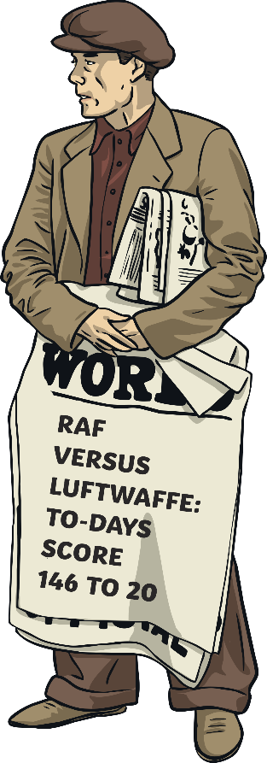
Aerial Warfare
Despite the seriousness of the situation, people in Britain could not help but be dazzled by the spectacle of British and German planes engaged in battle and carrying out daring mid-air feats in desperate bids to outsmart, and ultimately, defeat each other.
News sellers published the losses from the battles each day, almost as if they were ‘scores’ in a game and each evening people would gather around the radio to listen to news updates, like this one.

Slide 5
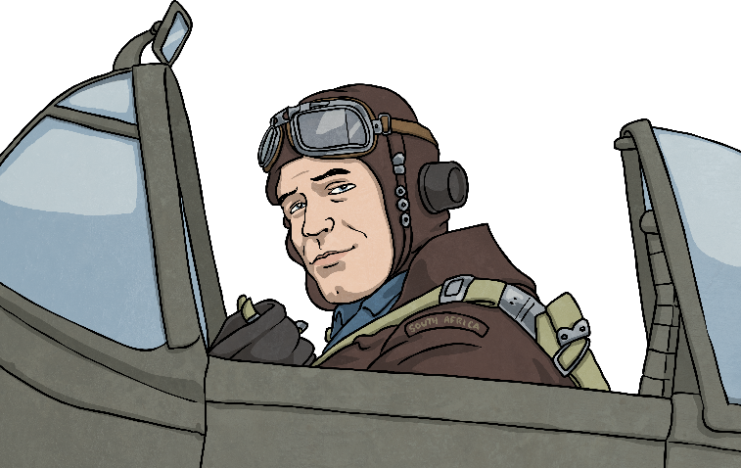
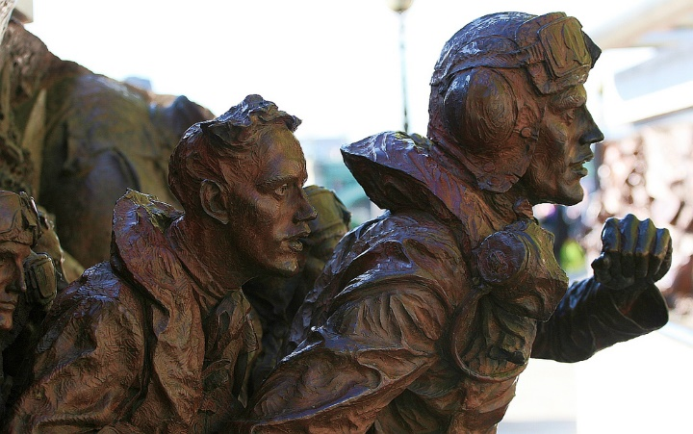
Aerial Warfare
The term dog-fight describes the intense in-air battle between small groups of aircraft fighting at close range where strategic manoeuvring was key to winning.
A pilot who destroyed 5 enemy aircrafts during a battle was known as fighter ace.
This statue was made to commemorate the pilots who fought in the Battle of Britain.
https://www.bbc.co.uk/teach/class-clips-video/history-ks2-the-battle-of-britain-and-beyond/zrk847h

Slide 6
Examine the sources in the ‘sources for pupils’ resource with your table partner.
Your job is to evaluate how useful each source is, and how reliable it is.
What is the name of a source that was recorded at the time of the event?
What is the name of a source that was created later?
As a class, come up with some interesting research questions to find out about the Battle of Britain.
Suggested topics- aircraft used in the battle, how RAF pilots lived during this time, how radar technology was used, the role of women during the battle of Britain, nationalities of pilots who fought in the battle.

Slide 7
https://www.ducksters.com/history/world_war_ii/battle_of_britain.php
https://kids.britannica.com/kids/article/Battle-of-Britain/623978
https://historyforkids.org/the-battle-of-britain/
https://www.youtube.com/watch?v=wX6swfPnpoI
https://www.rafmuseum.org.uk/research/online-exhibitions/history-of-the-battle-of-britain/

Slide 8
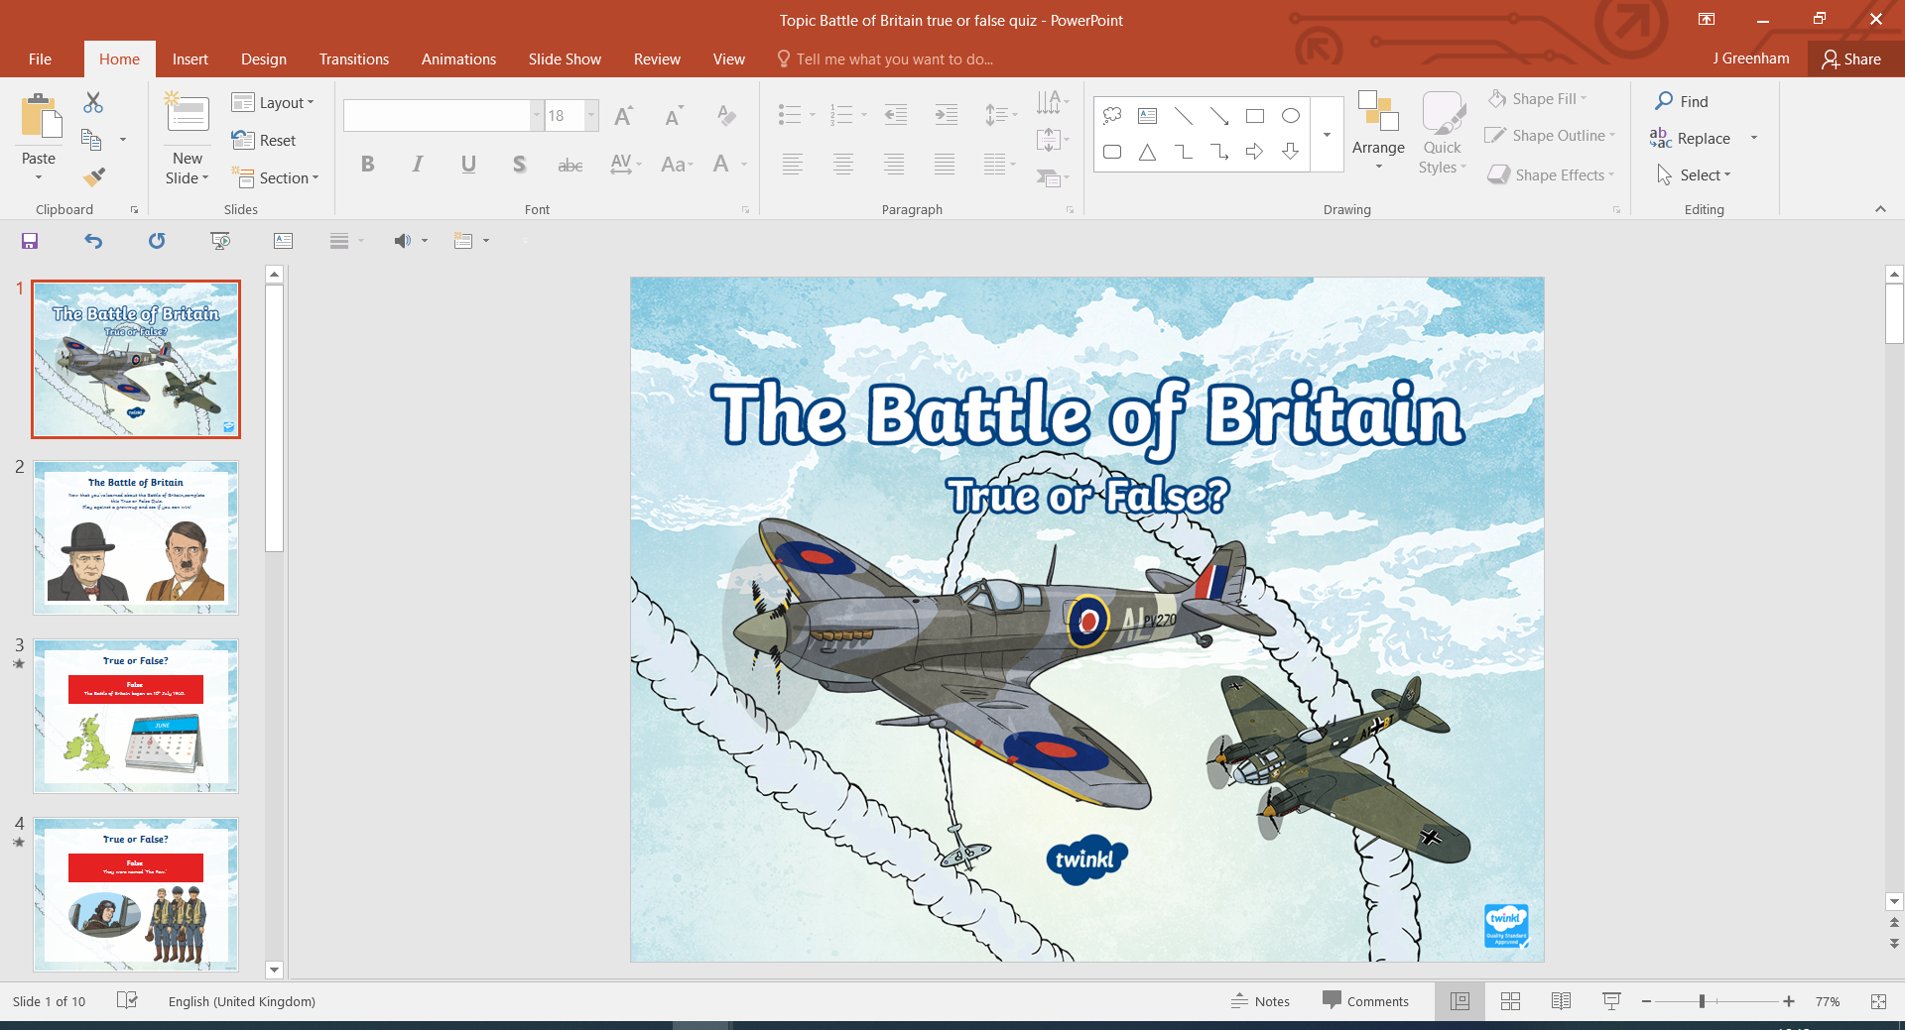
Plenary- Take part in the Battle of Britain quiz.

