Slide 1
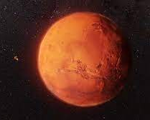
Surviving on Mars
British Science Week 2022
Notes:
Imagine isn’t moving but your brain tricks you into thinking it is.

Slide 2
What do you need to know about Mars?
What is the temperature like?
What is the terrain or landscape like?
Is there more or less gravity on Mars?
How would a Martian creature have to be different to an animal from Earth?
What might a Martian creature eat?
Notes:
Research using the internet or books.

Slide 3
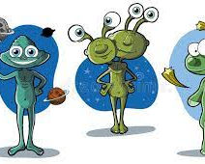
Can you design a creature that could survive on Mars? Draw it and then make it with the resources provided.
Notes:
Use playdough, buttons and pipe cleaners etc……. Ch must be able to justify the decisions they make about their Martian creature using their knowledge about Mars – eg: they have fur to keep them warm in the cold conditions or they don’t drink because there is no water on Mars etc.

