Slide 2
Digital Wellbeing

Slide 3

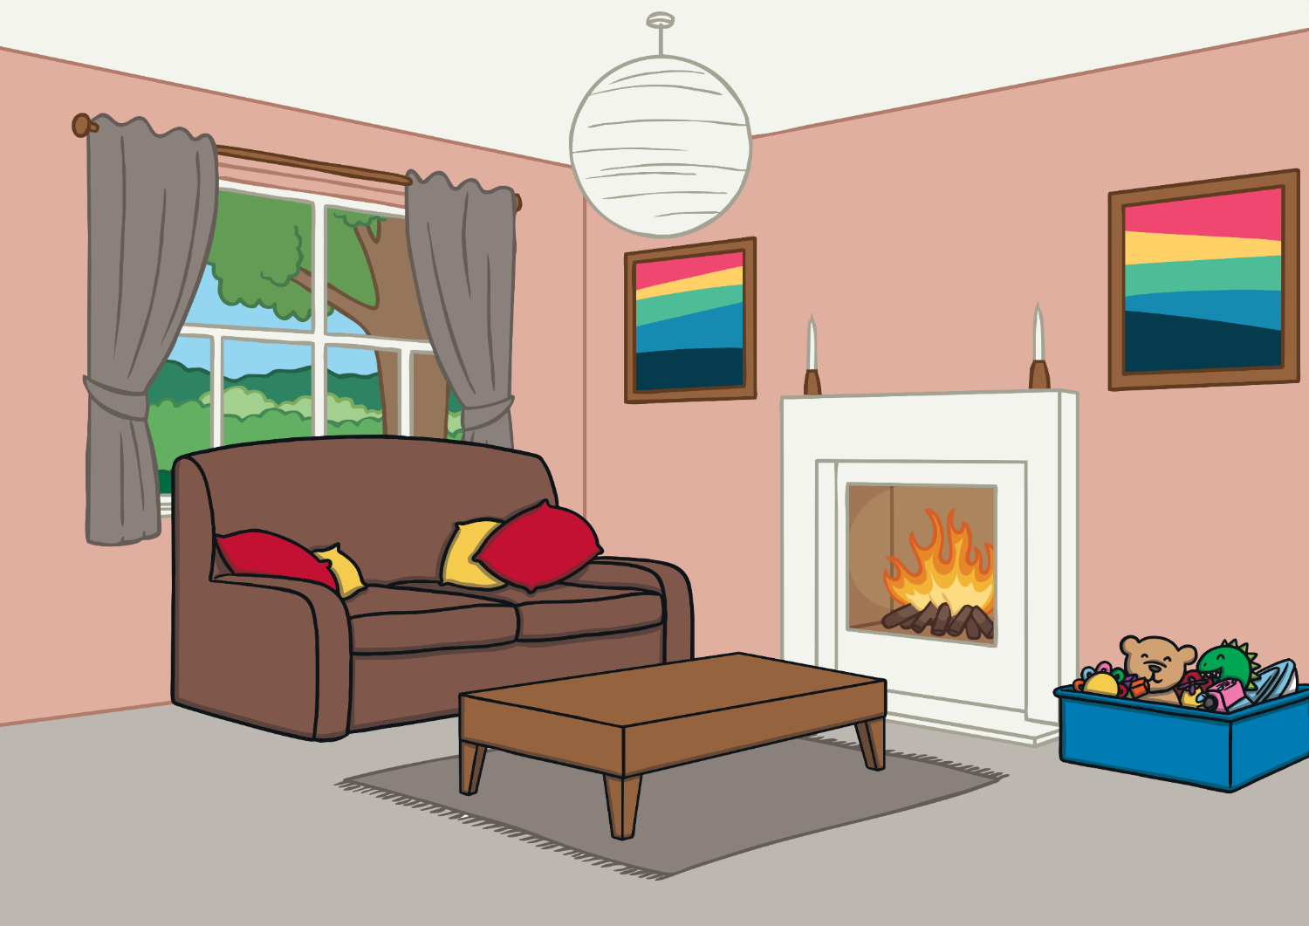

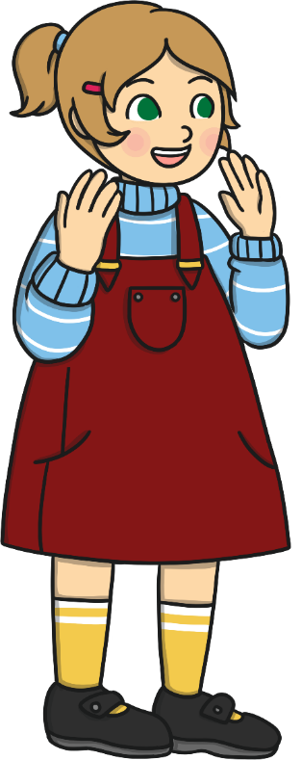
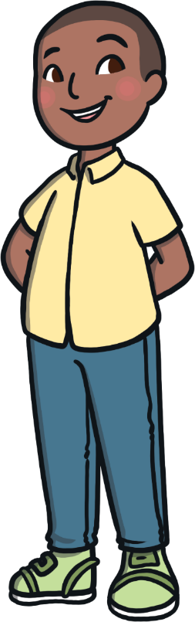
How can I make sure I do a range of activities, both offline and online, to keep my mind and body healthy?
How much screen time is healthy?

Slide 4

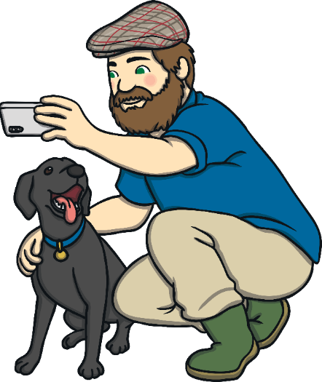

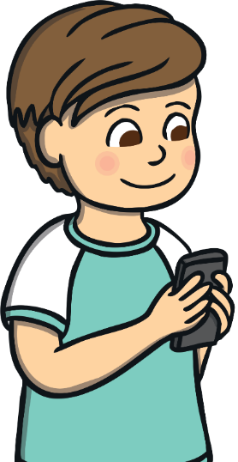
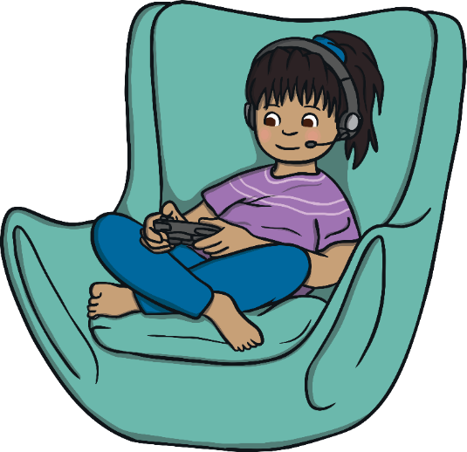
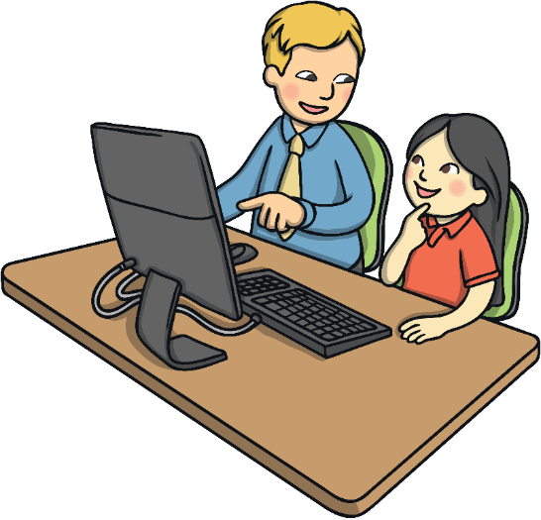
A Healthy Balance
There are lots of ways we can use the Internet.
We can use it to find information.
We can use it to send messages.
We can use it to play games.
We can use it for our learning.
We can use it to keep in touch with friends and family.
But it is important to remember how to balance our time on the Internet with other activities. This way we can make sure our mind and body stay healthy and happy.

Slide 5
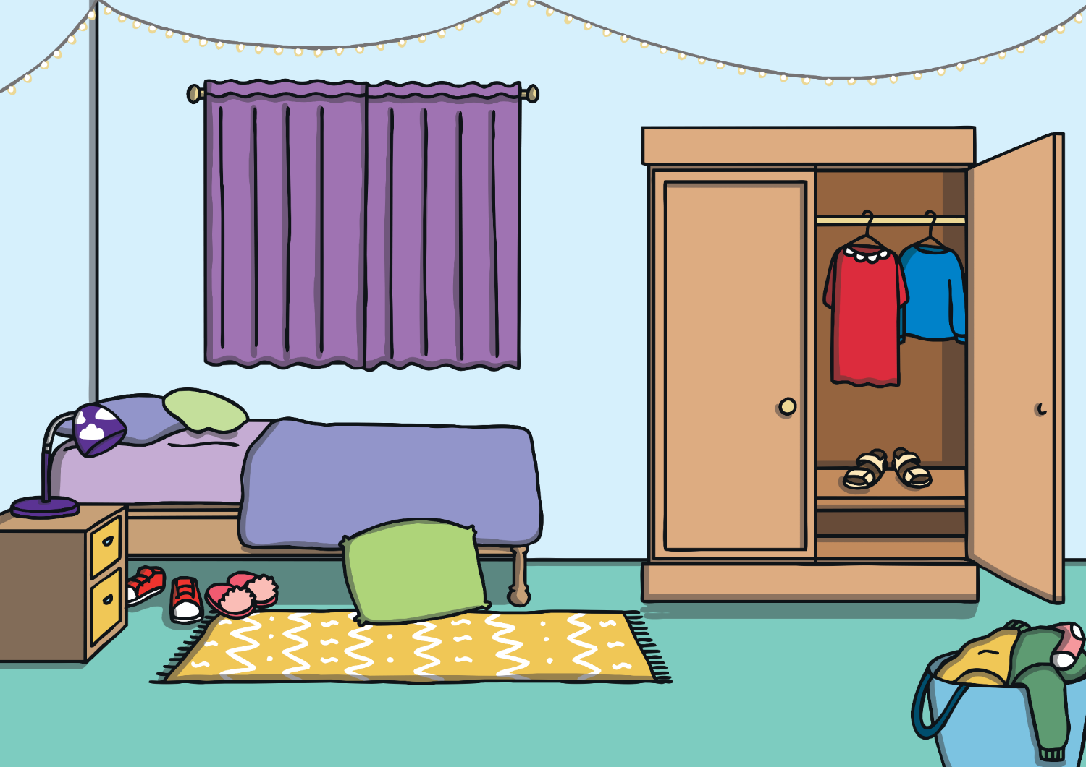
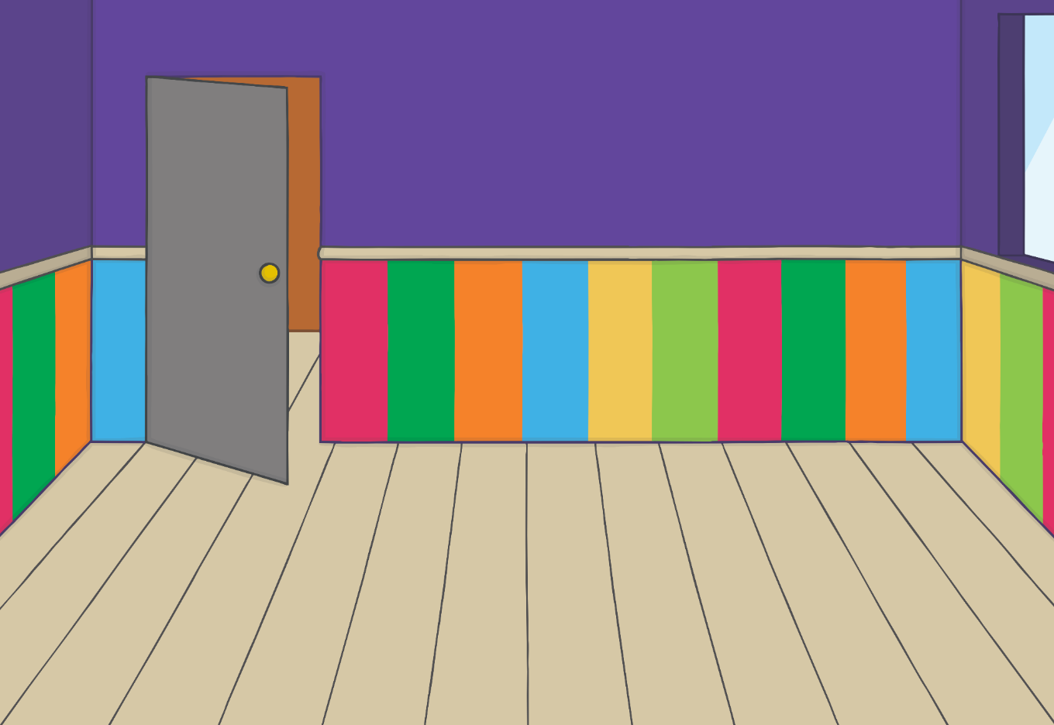
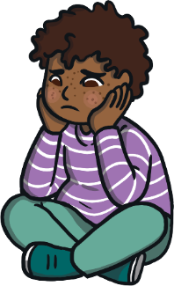
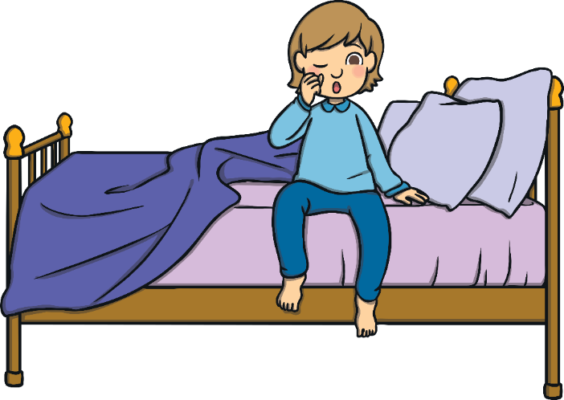
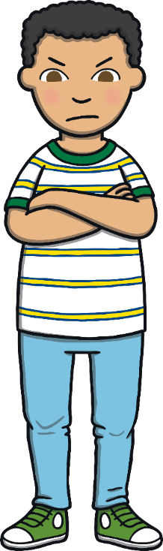
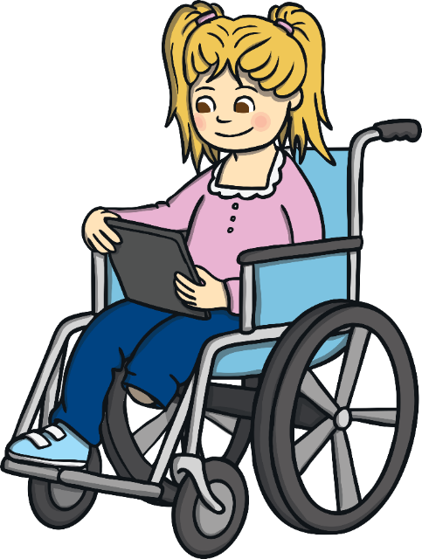
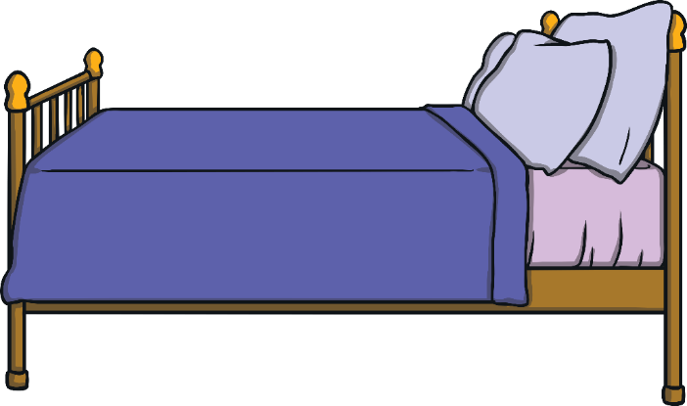
A Healthy Balance
Looking at screens too close to bedtime can make falling to sleep more difficult.
We need to remember that looking at screens for too long can affect how we think, feel and behave.
This helps to keep our mind and body healthy and happy.
If we use our screens for too long, we might find that we feel tired and a bit grumpy.
It is important that we recognise the way we feel when we have too much screen time so that we can make sure we are choosing to balance the time we spend online with doing offline activities too.
Spending too much time online can also mean we miss spending time with our friends and family which might make us feel a bit lonely or sad.

Slide 6
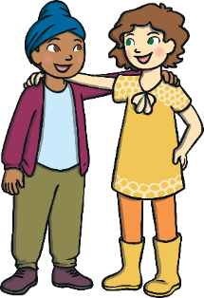

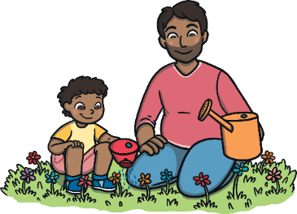


A Healthy Balance
What activities do you like to do that don't involve being online?
We can spend time with family and friends.
We can read books.
We can play with our toys.
We can design and make things.
We can enjoy nature.
We can dance.
We can sing.
We can play or listen to music.
We can spend time being quiet, calm and still.
We can do a jigsaw.
It is important that we spend our time doing a range of things. This helps to keep our mind and our body healthy.

Slide 7
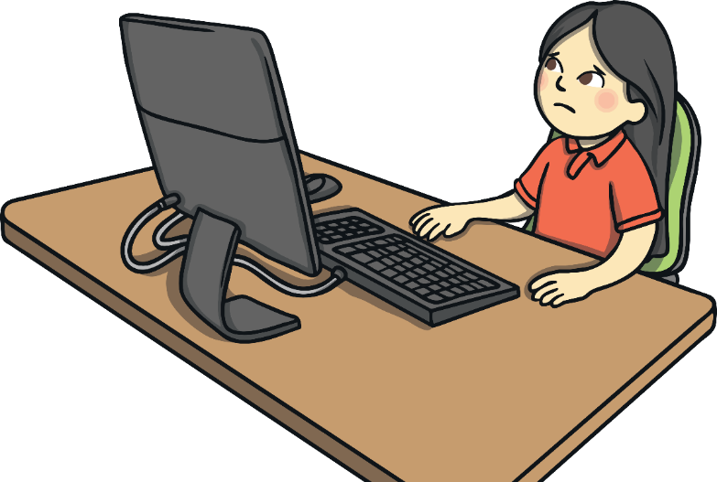
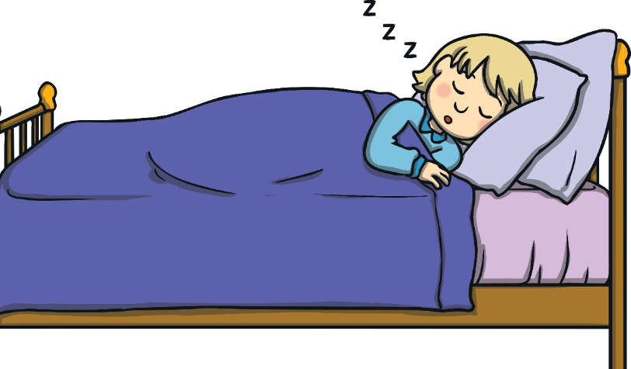
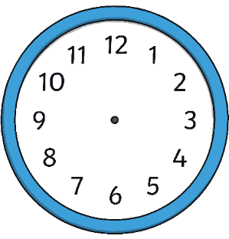
A Healthy Balance
When we have had a busy day doing a range of different things, we need a good night’s sleep.
Remember, if we use our screens too close to bedtime it can make it tricky to fall asleep.
Children between the ages of 5 and 7 years old need about eleven hours of sleep a night.
Doing calm activities at bedtime, that don’t involve screens, can help us to feel ready for bed.
What bedtime activities help you feel ready to drift off to sleep?
When we feel well rested we:
can concentrate and learn;
have fun with friends;
feel good!

Slide 8

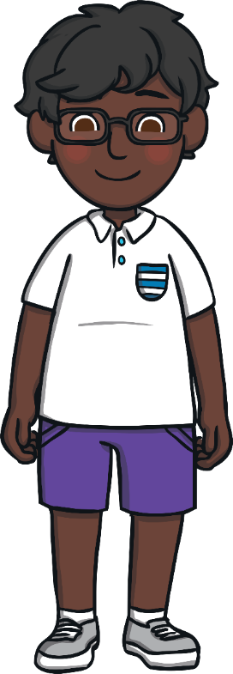
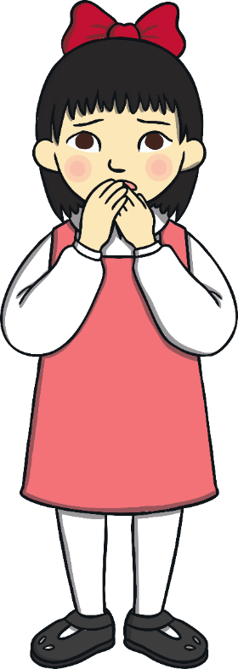
Ways to Help
What great ideas we’ve had about how to make sure we are balancing our time online, with offline activities.
It’s important to enjoy a balance of different activities as it helps our mind and body stay healthy.
I really enjoy playing my computer game online. Last week, my brother and sister went out for dinner with our grandparents but I didn’t go because I wanted to keep on playing.
It was really sunny the other day but I chose to stay inside on my computer. I was on it for a really long time and afterwards, I felt really tired and a little bit grumpy.
I really enjoy looking at my tablet at bedtime. I find it hard to fall asleep and I’m really tired in the morning.
Have a look at what some children have said about the time they spend online. Are their choices healthy for their body and mind? What would you say to help them get a better balance?

Slide 9
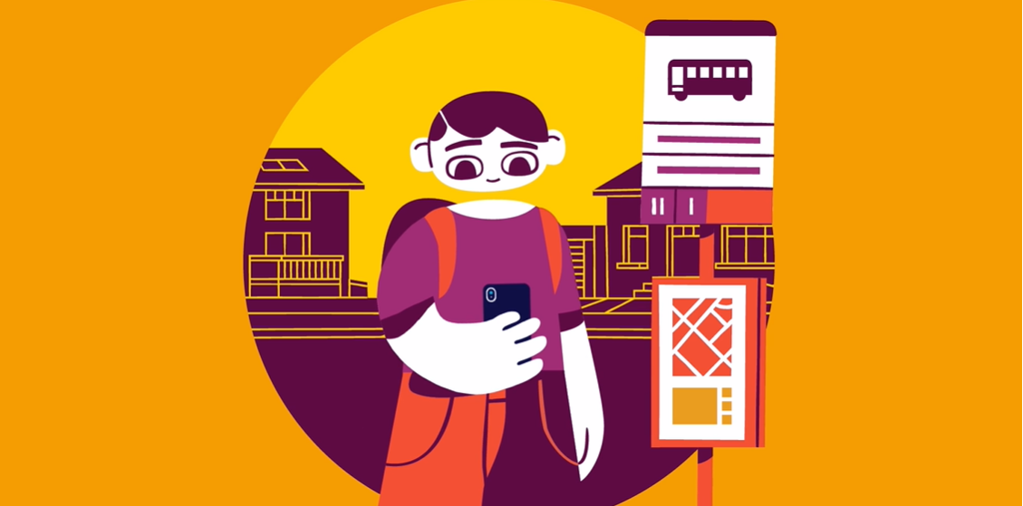
Notes:
BBC Own It animations for digital wellbeing | The Kid Should See This

Slide 10

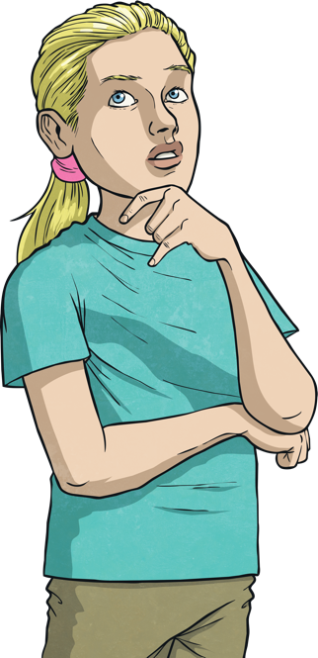
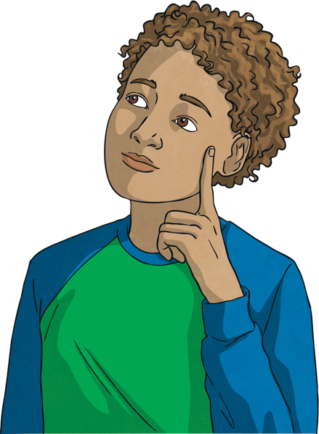
How can we look after our mental health and emotional wellbeing when
spending time online?
How can the Internet be used positively?
How can it be used negatively?

Slide 11




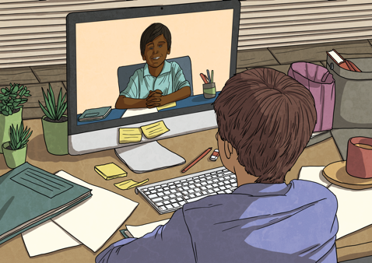
What Do We Use the Internet For?
With a partner and in the time you are given, think of as many different ways as you can that we use the Internet in our daily lives.
Stop
The Internet is a growing part of our daily lives, that’s why it is important we learn how to use it in a way that helps us all and doesn’t harm anyone.
Your time is up! What different uses did you think of?

Slide 12

Digital Wellbeing
Technology, and how we use it, can affect how each of us feel, think and behave. It can also affect the health of our body and mind. This is digital wellbeing.
It is important to understand how using digital technology, such as computers, tablets, phones and gaming devices, makes us feel so that we
can develop positive digital wellbeing.
Another part of digital wellbeing is knowing how to look after ourselves and how to look after others online.
How do you think we can develop positive digital wellbeing?

Slide 13
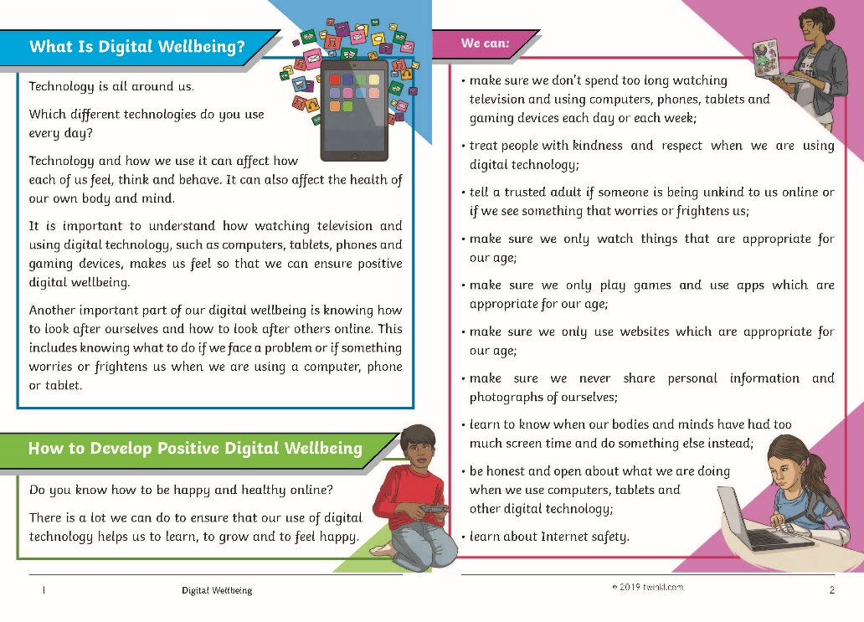
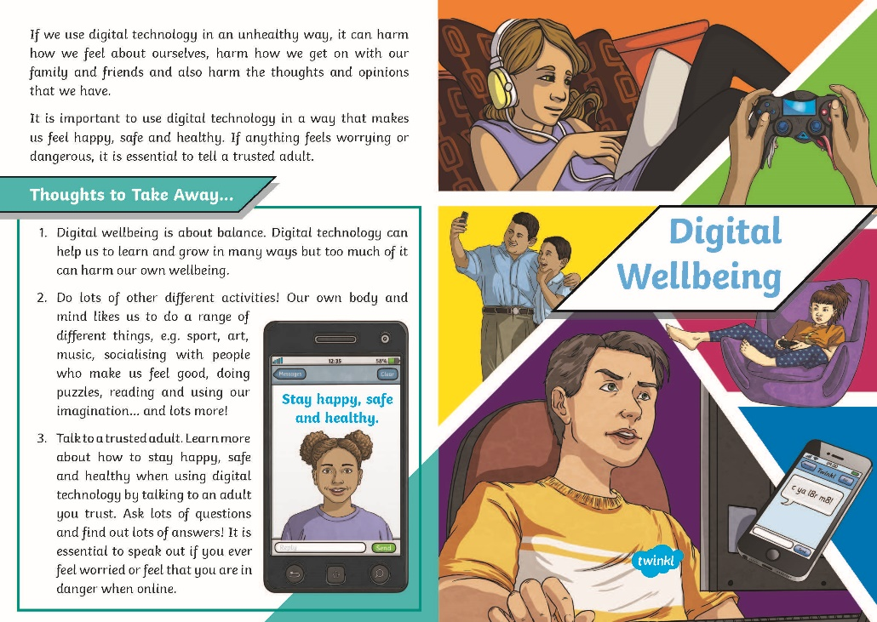
Digital Wellbeing
With a partner, read the Digital Wellbeing Information Sheet.
After you have finished, talk together about your answers to these questions:
What is digital wellbeing?
What might harm our digital wellbeing?
How can we develop positive digital wellbeing?
What are your top tips for looking after our mental health and wellbeing
when using the Internet and digital technology?
Consolidating
Reflecting

Slide 14
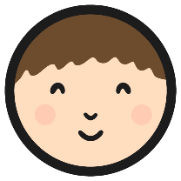
Looking After My Digital Wellbeing
What steps are you going to take to develop positive digital wellbeing and
have a healthy digital life?
Sit quietly and think about your answer to this question. Then, if you feel happy to, share your thoughts with the class.
Remember, if anything about being online is worrying or frightening you, it is important to talk to an adult you trust - tell them what is happening and ask for help.
Let’s do all we can to have a healthy digital life, look after our digital
wellbeing and the digital wellbeing of others too!

Slide 15
A Healthy Digital Life
It is important we use the Internet and other digital technology positively and in a way that does not harm our health and wellbeing.
In groups you are going to write your own story or poem based on digital wellbeing, and how can we help people to understand about living a balanced digital life?
Once you have planned your story or poem, you are going to type it up on the computer and digitally illustrate it.
Word Bank
online, negative, privacy, Internet,
activities, honest, balance, trusted adult,
Internet safety, time management,
kindness, happy, digital wellbeing, respect,
mental health, age-appropriate, positive,
screen time

