Slide 1
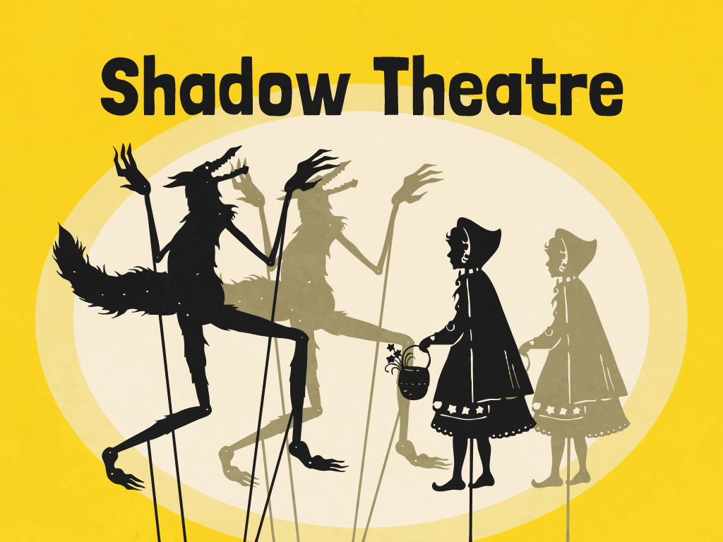


Slide 2
Aim
I can explain why shadows have the same shape as the object that casts them.
Success Criteria
I can explain how a shadow is formed.
I can explain why shadows are the same shape as the object that casts them.
I can use my knowledge of Isaac Newton's ideas about light to create a shadow puppet play.

Slide 3

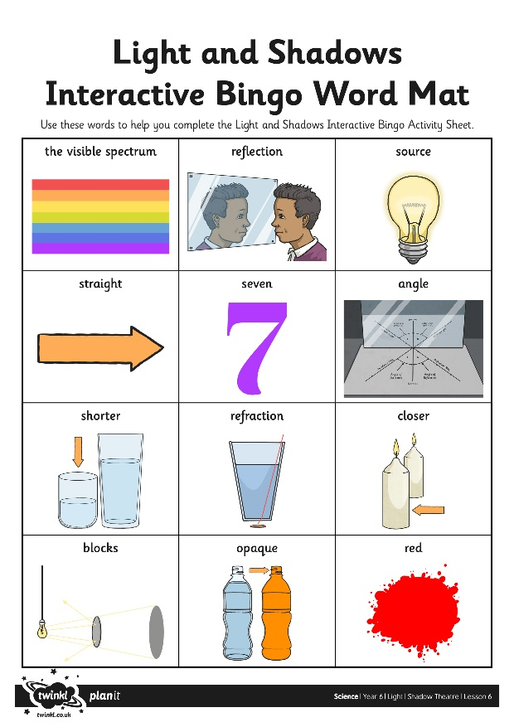
Interactive Bingo
You will have an Interactive Bingo Activity Sheet with 12 questions about light and shadows on it.
The aim is to move around the classroom, finding a different person to answer each question.
Once you have answers to all 12 questions on your sheet, you should shout ‘Bingo!’ The first person to do so is the winner!
Make sure each person you ask writes their answer and signs their name or initials on your sheet.
Remember, you will also be asked to answer questions for others at the same time!

Slide 4
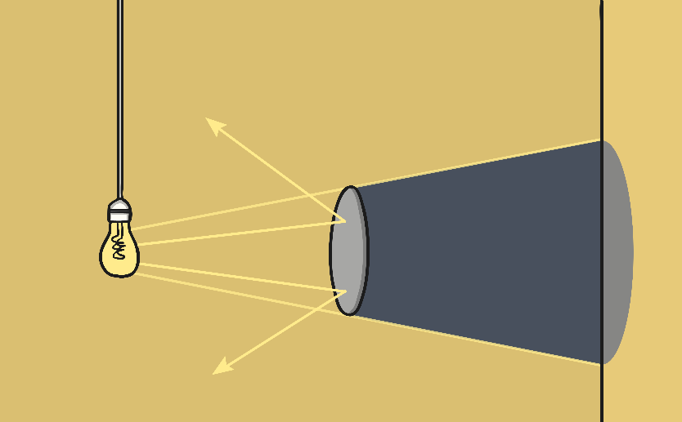
Shadows
Shadows are formed when an opaque object blocks a ray of light.
Is a shadow always the same shape as the object that casts it?
A shadow can change size depending on the distance the object casting it is from the light source. Shadows can also be elongated or shortened depending on the angle of the light source.
However, a shadow is always the same shape as the object that casts it. This is because when an object is in the path of light travelling from a light source, it will block the light rays that hit it, while the rest of the light can continue travelling. Therefore, the shadow it casts is exactly the same shape.

Slide 5

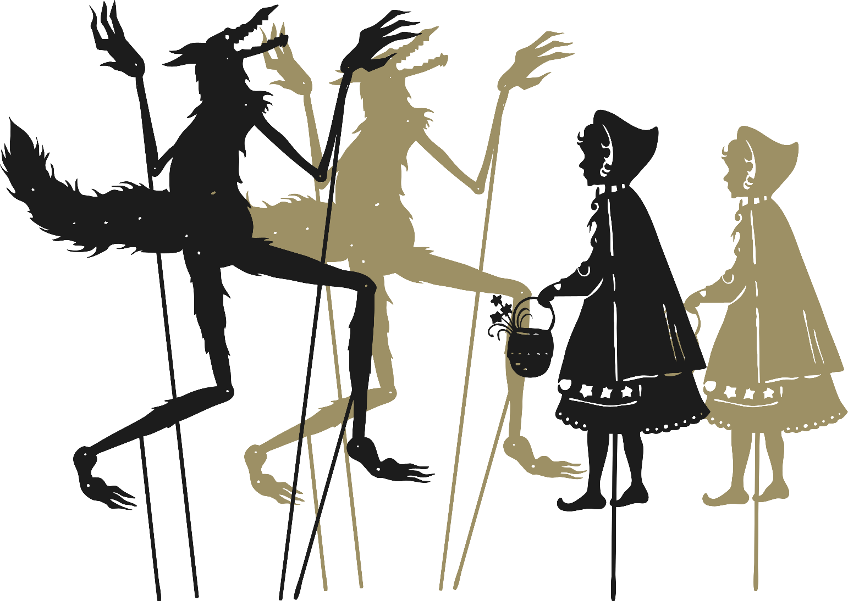
Shadow Theatre
For this challenge, you will need to work in a group to produce a shadow puppet show.
You will perform a short scene involving the scientists Newton and Hooke using the Experiments and Enemies Script.
Isaac Newton made many important discoveries about light. However, some of his contemporaries, notably Robert Hooke, did not agree with his ideas. They were enemies and rivals.
You should make shadow puppets of the two scientists to perform a dramatisation of the dispute between them. You may also choose to create shadow puppet props of key objects - you could make a prism, or use coloured tissue paper to make a shadow of the visible spectrum.
Think about how you can use your shadow puppets creatively - moving them closer to the light source to make them look bigger, or tilting them to change the angle.

Slide 6
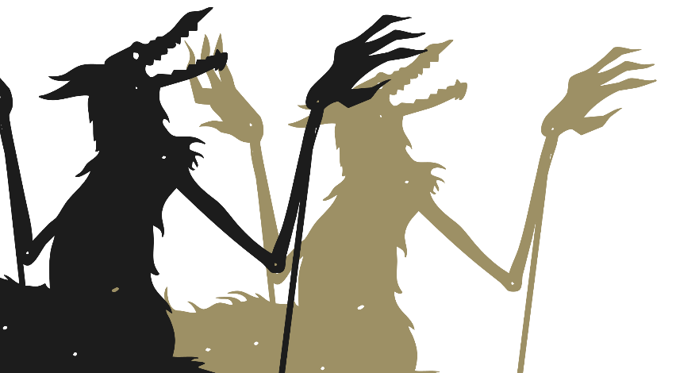

Shadow Theatre
Use cardboard and straws or craft sticks to make your shadow puppets.
Remember, your puppets will not need to have features or detail as your audience will only see their shadows in the performance.
You will have chance to perform your puppet show at the end of the lesson or at a later time.

Slide 7

Aim
I can explain why shadows have the same shape as the object that casts them.
Success Criteria
I can explain how a shadow is formed.
I can explain why shadows are the same shape as the object that casts them.
I can use my knowledge of Isaac Newton's ideas about light to create a shadow puppet play.

