Slide 1
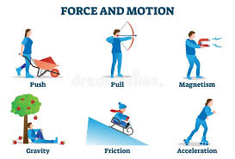
L.O: To learn how gears and pulleys affect the amount of force needed. 18.01.22
P | Success Criteria | T
 | I can recognise gears and pulleys in everyday life.
 | I can explore gears and pulleys.
 | I can explain how gears and pulleys give mechanical advantage.
Talk to your partner-
What was the scientific name of an object that allows you to apply more force?
Can you think of any other objects that could help you use forces in a different way?

Slide 2
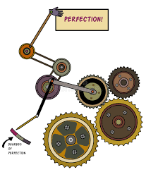
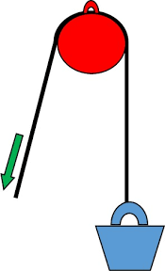
In this lesson we will be splitting into three teams, and taking part in different activities to learn about pulleys and gears.
Can you think of any ways we use gears or pulleys in everyday life?

Slide 3
Will gears allow children to pull a piano uphill?
Task A- Watch the videos carefully to get more information about gears and pulleys. Then complete ‘Lever, gear or pulley?’ activity sheet.
Will pulleys be able to let kids beat Britain's strongest man?
https://www.bbc.co.uk/teach/class-clips-video/science-physics-ks2-ks3-will-pulleys-let-9-year-olds-beat-Britain%E2%80%99s-strongest-man/zvm4d6f
https://www.bbc.co.uk/teach/class-clips-video/science-physics-ks2-ks3-will-gears-let-children-pull-a-piano-uphill-with-their-bikes/zmcpy9q

Slide 4
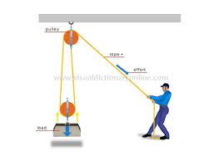
Task B – Pulley system.
Use a pulley system to help lift a heavy weight, such as a bag of sand.
How much difference will the pulley make?
Try out different configurations and see which one works the best for your team.
When you have decided, draw a labelled diagram of your system and explain how you set it up.

Slide 5
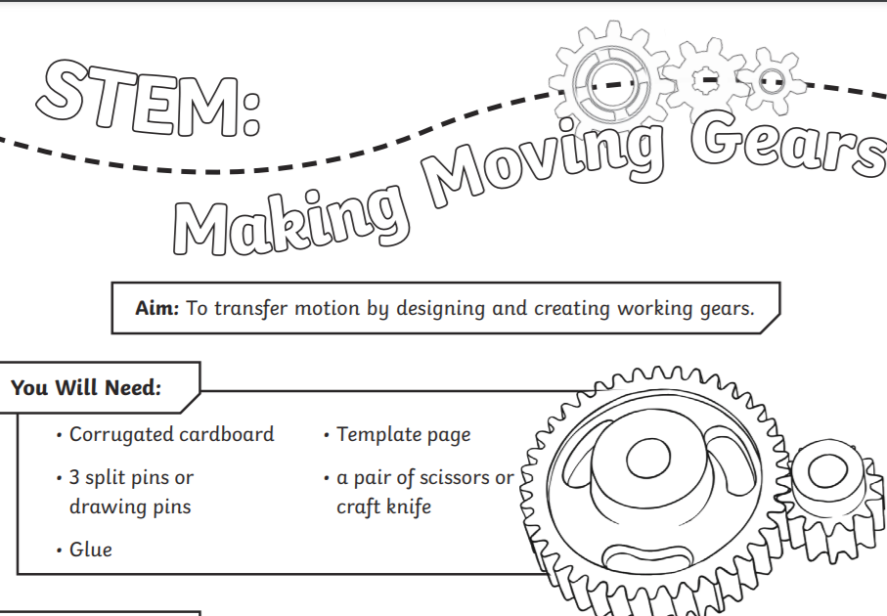

Task C- Gears
Use the gears to explore how gears interact.
How do gears affect the force applied?
How does the size of a gear affect the way it interacts with other gears?
Can you get two joined gears to turn in the same direction?

Slide 6
Plenary
Which mechanism would be most suited to these jobs?
A
Hoisting a flag up a flagpole

Slide 7
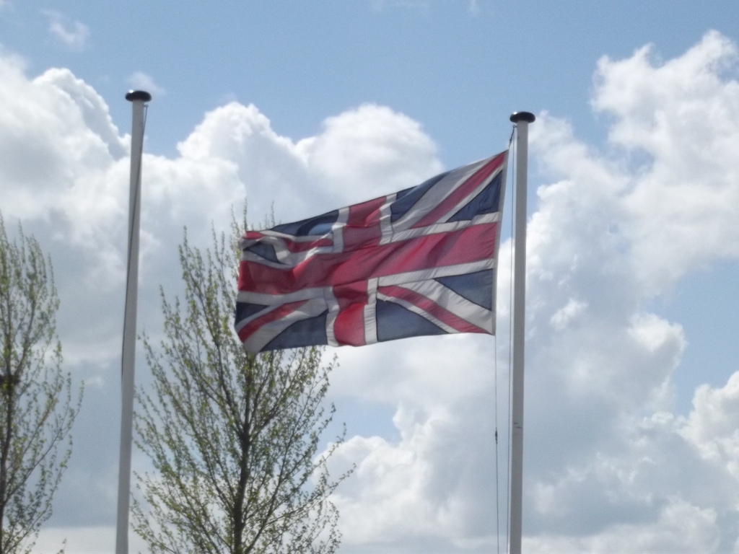
A pulley.
Photo courtesy of ell brown (@flickr.com) - granted under creative commons licence - attribution

Slide 8
Plenary
Which mechanism would be most suited to these jobs?
B
Making one wheel turn faster than another.

Slide 9
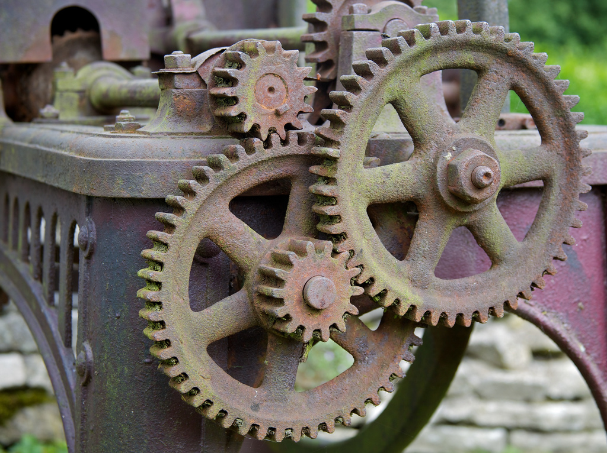
A gear.
Photo courtesy of BinaryApe (@flickr.com) - granted under creative commons licence - attribution

Slide 10
Plenary
Which mechanism would be most suited to these jobs?
C
Making a heavy sack easier to lift.

Slide 11
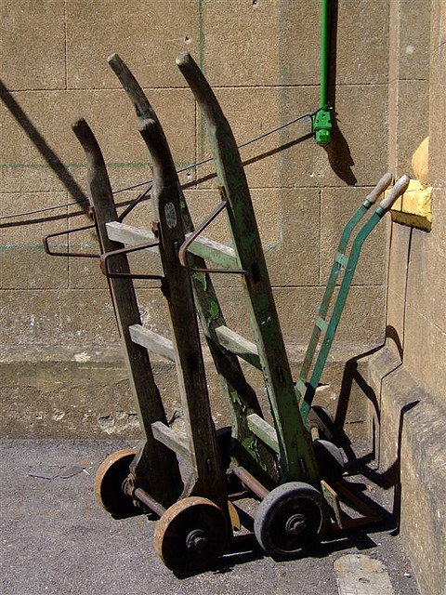
A lever.
Photo courtesy of Elsie esq. (@flickr.com) - granted under creative commons licence - attribution

