Slide 2
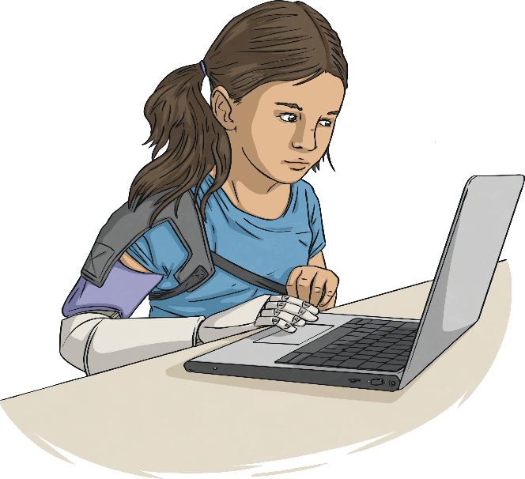
Aims
To know the purpose of the annual Safer Internet Day
To understand the theme, ‘All Fun and Games? Exploring Respect and Relationships Online’
To know what respectful online behaviour looks like and what to do if I see unkind words or bullying online

Slide 3


Word Check!
Let’s check your understanding of these key words:
Internet
DM/PM/chat
respect
online
gaming
relationship
block
bullying

Slide 4
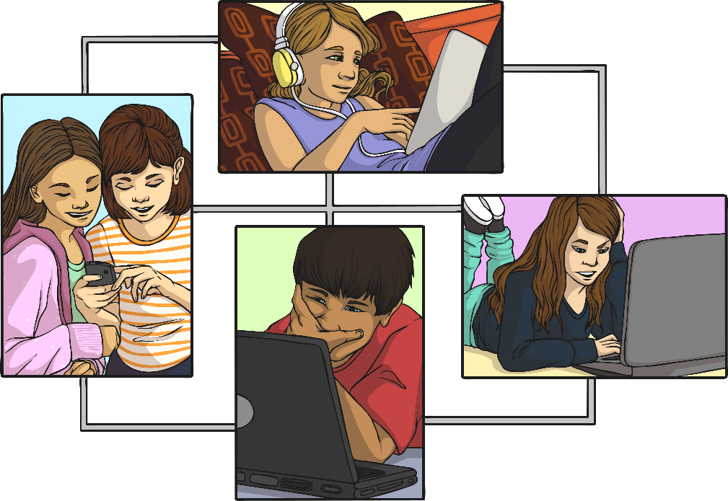
What Is Safer Internet Day?
Safer Internet Day is celebrated in over one hundred countries across the world on Tuesday 8th February 2022.
It is a day for everyone to talk about how to look after each other and stay safe in an online space.
The theme this year is, ‘All fun and games? Exploring respect and relationships online’.

Slide 5
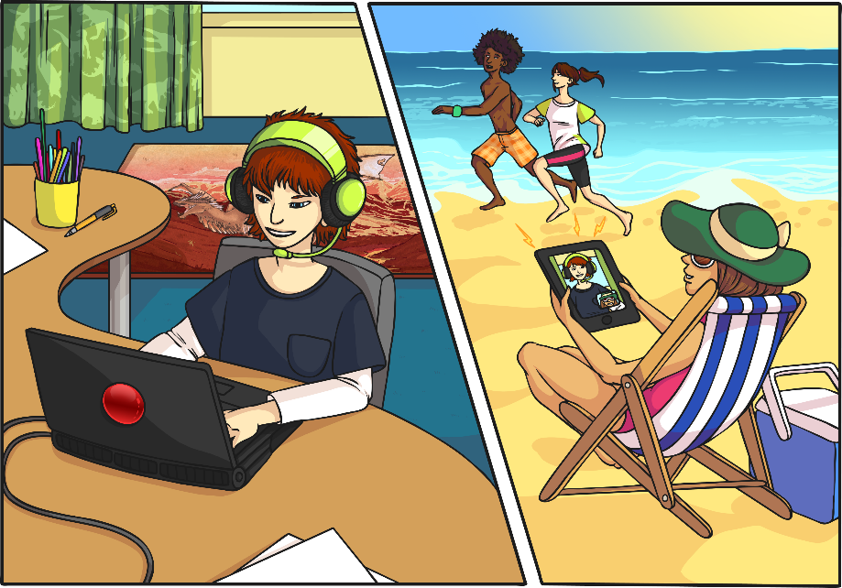
What Do You Use the Internet For?
The Internet is an amazing place!
In our real lives, it provides us with entertainment, allows us to communicate and helps us learn new things.

Slide 6
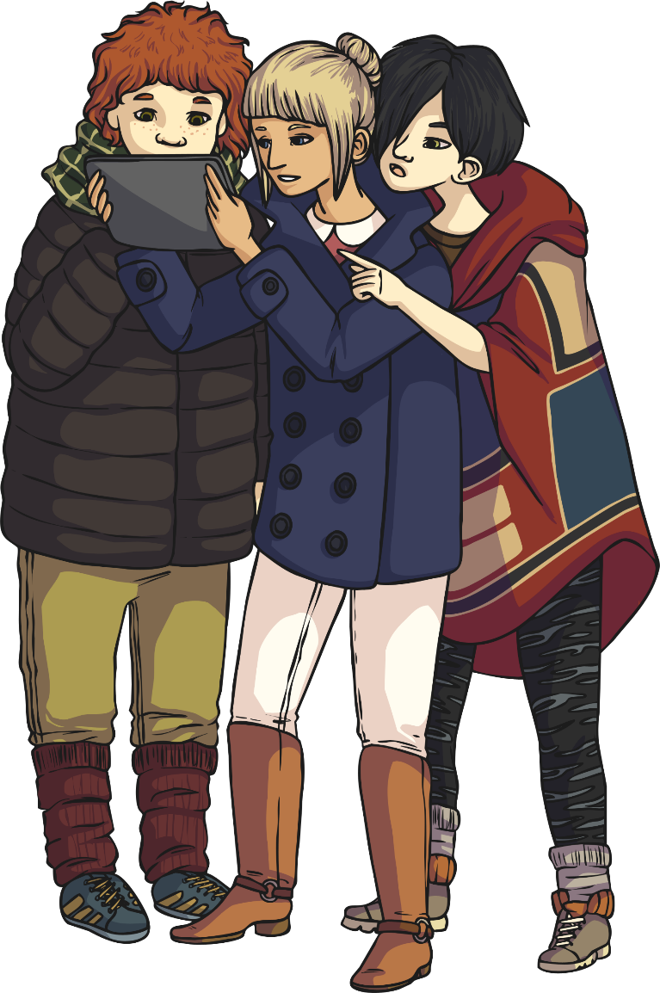
Who Can Use the Internet?
Many people across the world use the Internet every day for work, school or for fun.
In January 2021, about 4.66 billion (4,660,000,000) people were using the Internet.
That is about 59.5% or nearly 6 out of every 10 people in the whole world.
Interestingly, about 95% of people in northern Europe use the Internet.

Slide 7
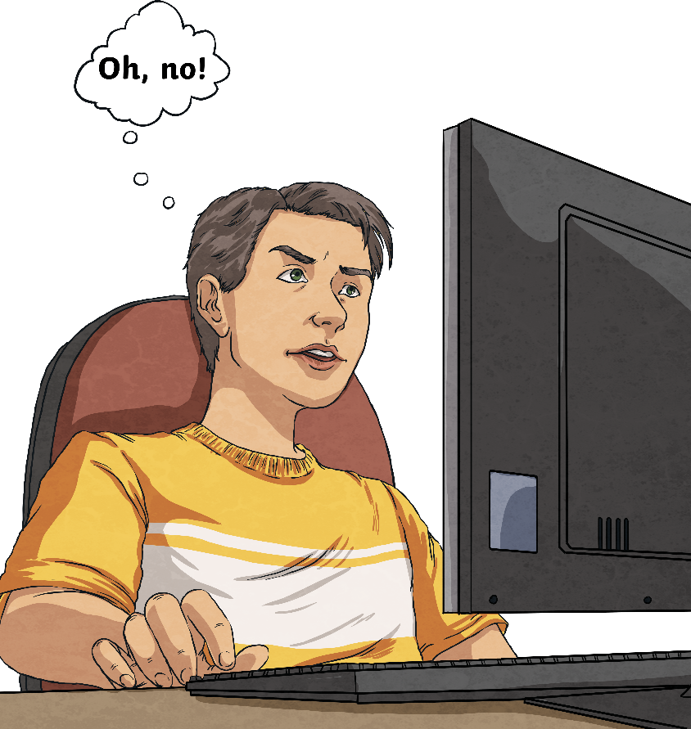
How Would You Feel If the Internet Was Turned Off?

Slide 8



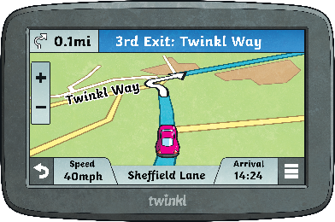
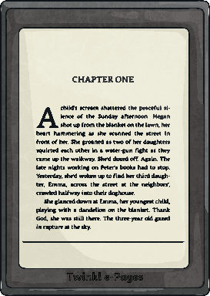



How Do We Access the Internet?
We can use lots of different devices to access the Internet. How many can you think of?
Did you think of all these?

Slide 9
All Fun and Games? Exploring Respect and Relationships Online
This is the theme for Safer Internet Day 2022. It’s a great time to talk about how we use the Internet respectfully and responsibly.
Lots of young people play games online and take part in ‘live’ experiences, such as video streaming.
Lots of young people use chat boxes to message other players in a game or to type messages in a live stream.
Is the Internet always ‘fun and games’ for you?

Slide 10

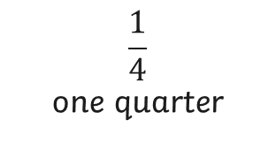
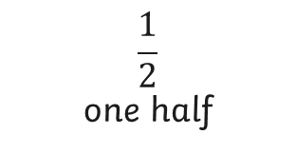
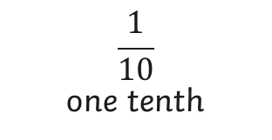
Fact Check!
What fraction of young people have chatted in an online game with people they don’t know in real life over the past year?
About…
$$\frac{1}{10}$$
one tenth
$$\frac{1}{2}$$
one half
$$\frac{1}{4}$$
one quarter
More than half of young people have chatted with strangers online!
What do you think about this?

Slide 11
Should Respectful Behaviour Be the Same Online as in Real Life?
YES!
Using the Internet makes it hard to see other people’s reactions and to know how they feel but we should always be kind, respectful and responsible!

Slide 12
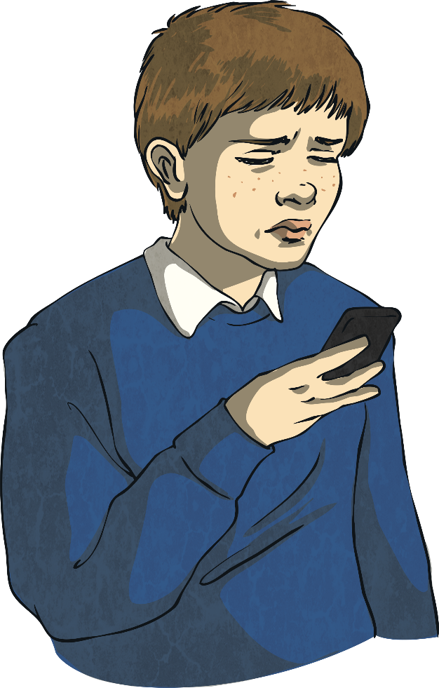
How Can We Make a Safer Online Space?
Unfortunately, sometimes we might watch or read something that makes us feel sad, worried or confused. We might see unkind words or feel bullied online.
This is wrong!
There are lots of ways of reporting this through the app or game
that we are using. These include finding the buttons that allow us to:
Report
Help
Block the user
Save the evidence or message
Remember to talk to an adult you trust to let them know, too!

Slide 13


What Would You Do If…
You read a message in chat or on a live stream that makes you feel sad or bad?
Your friend is upset by what someone said to them in a game?
Your team beats another team? What would you say to the other team?

Slide 14
Thinking Time
This Safer Internet Day, we can all play a part in making the Internet a safer place to be.
When we are watching, creating content or gaming online, we can be a good friend, cheer someone on, celebrate being different or just be ourselves! If we see something that makes us feel bad or sad, we can report it and block the user.
Now, think about the games you play.
How would you like people to talk to you?
How will you talk to others?

Slide 15
Aims
To know the purpose of the annual Safer Internet Day
To understand the theme, ‘All Fun and Games? Exploring Respect and Relationships Online’
To know what respectful online behaviour looks like and what to do if I see unkind words or bullying online

