Slide 1
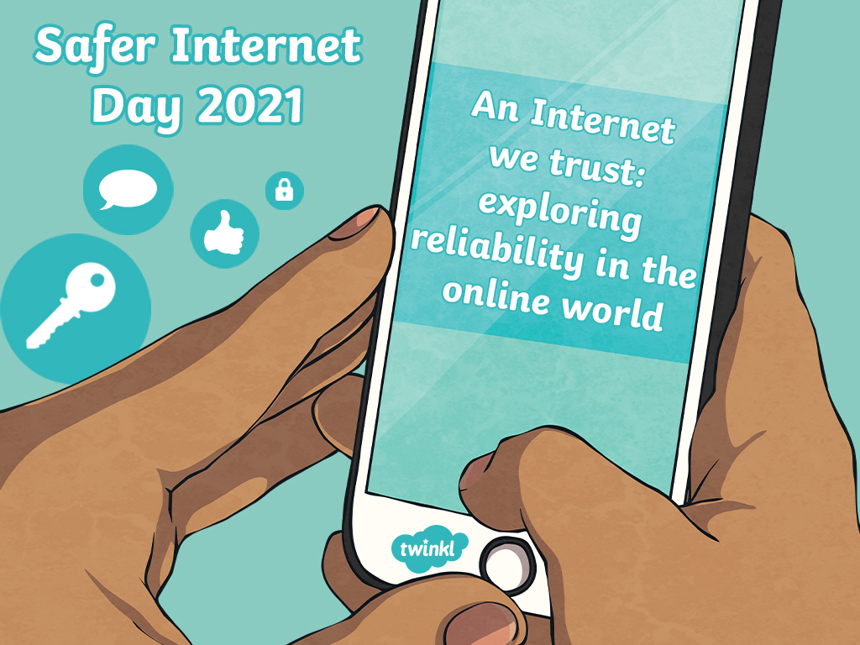

Slide 2
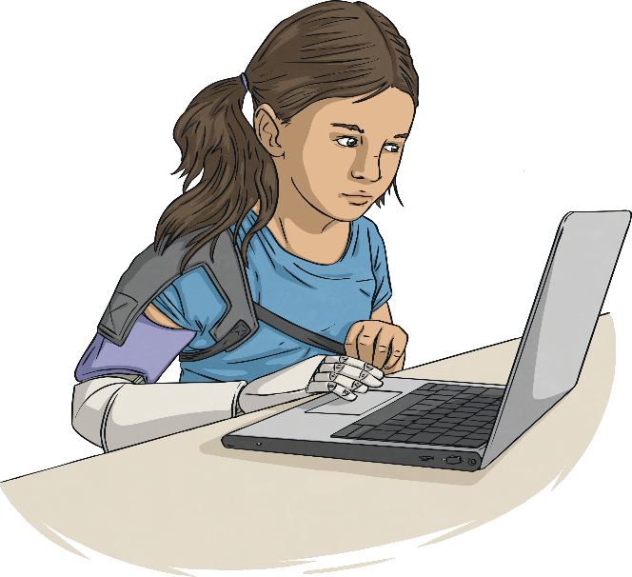
Aims
To know the purpose of the annual Safer Internet Day
To understand the theme, ‘An Internet we trust: exploring reliability in the online world’
To understand my online identity and how to keep safe online

Slide 3


Word Check!
Let’s check your understanding of these key words:
Internet
email
source
online
avatar
app
messaging
advert

Slide 4
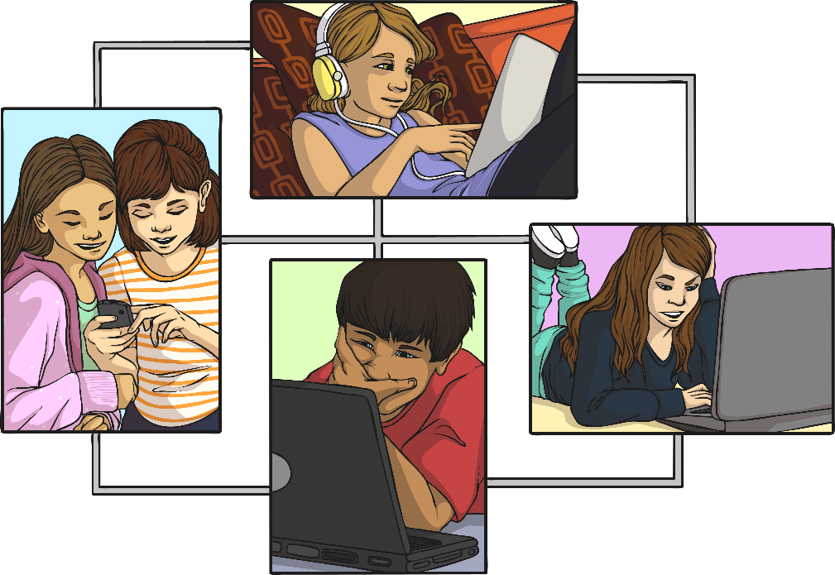
What Is Safer Internet Day?
Safer Internet Day is celebrated in over one hundred countries across the world on Tuesday 9th February 2021.
The theme this year is ‘An Internet we trust: exploring reliability in the online world’.

Slide 5
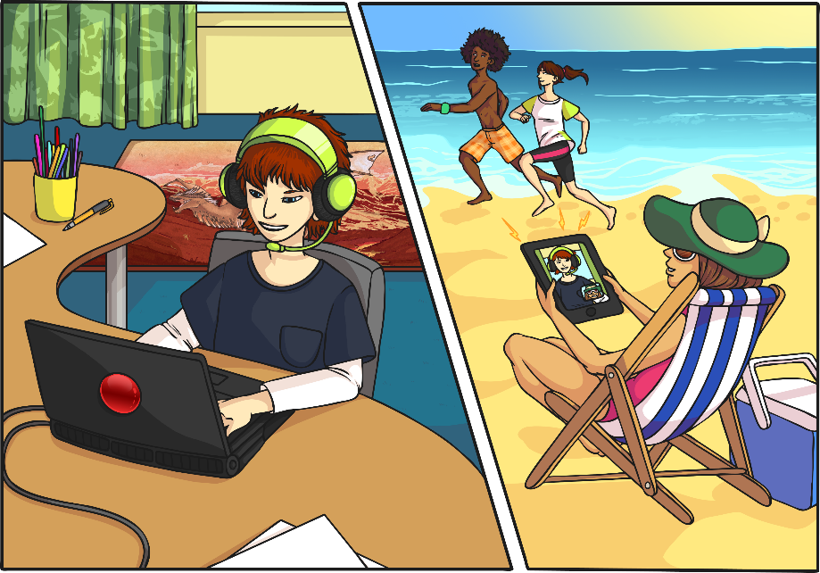
What Do You Use the Internet For?
The Internet is an amazing place!
In our real lives, it provides us with entertainment, allows us to communicate and helps us learn new things.

Slide 6
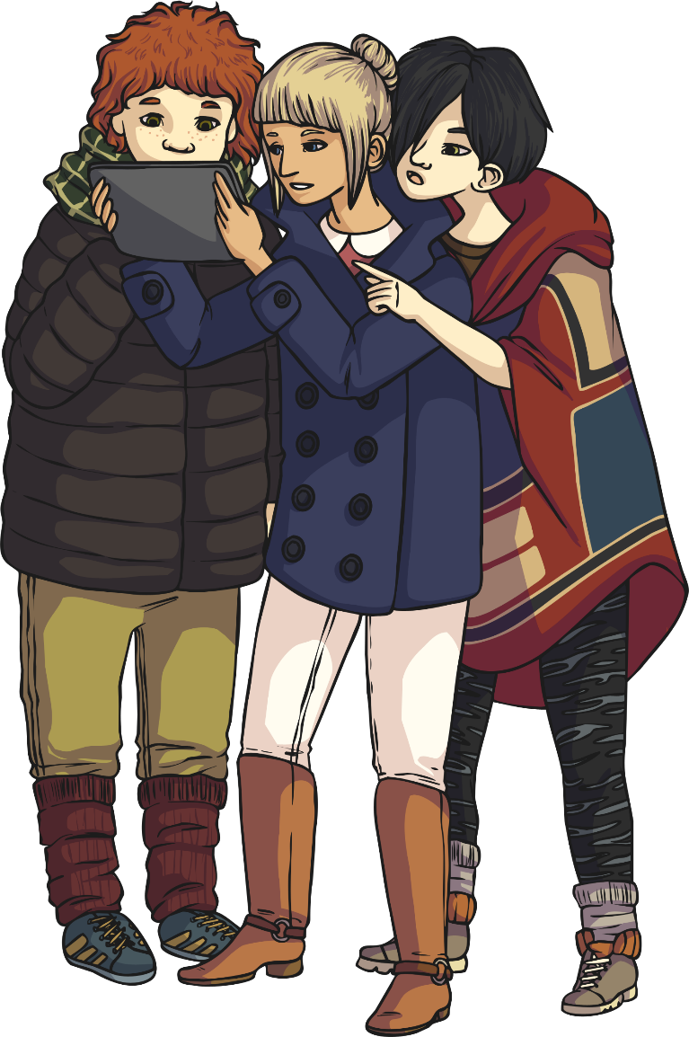
Who Can Use the Internet?
Many people across the world use the Internet every day.
By the end of 2019, four and a half billion (4,500,000,000) people were using the Internet. That is nearly 6 out of every 10 people in the whole world.

Slide 7



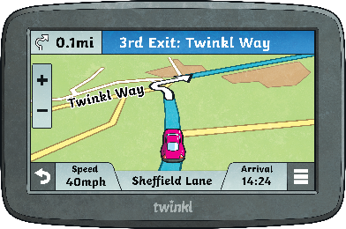
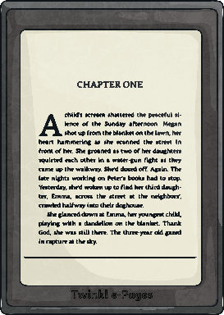
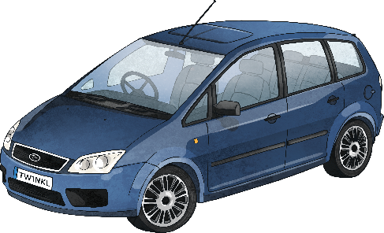


How Do We Access the Internet?
We can use lots of different devices to access the Internet. How many can you think of?
Did you think of all these?

Slide 8
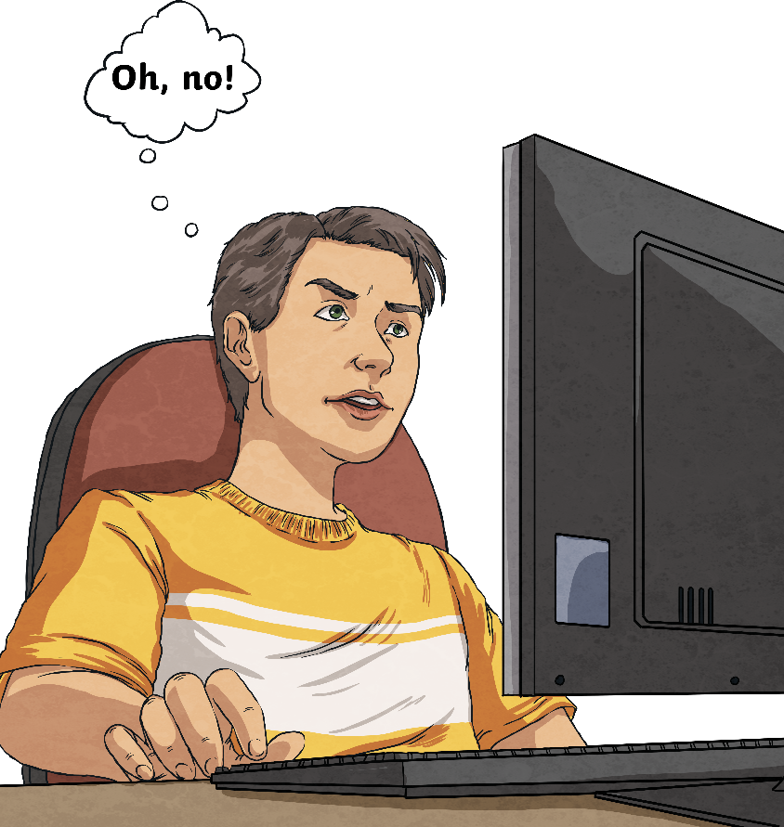
How Would You Feel if the Internet Was Turned Off?

Slide 9
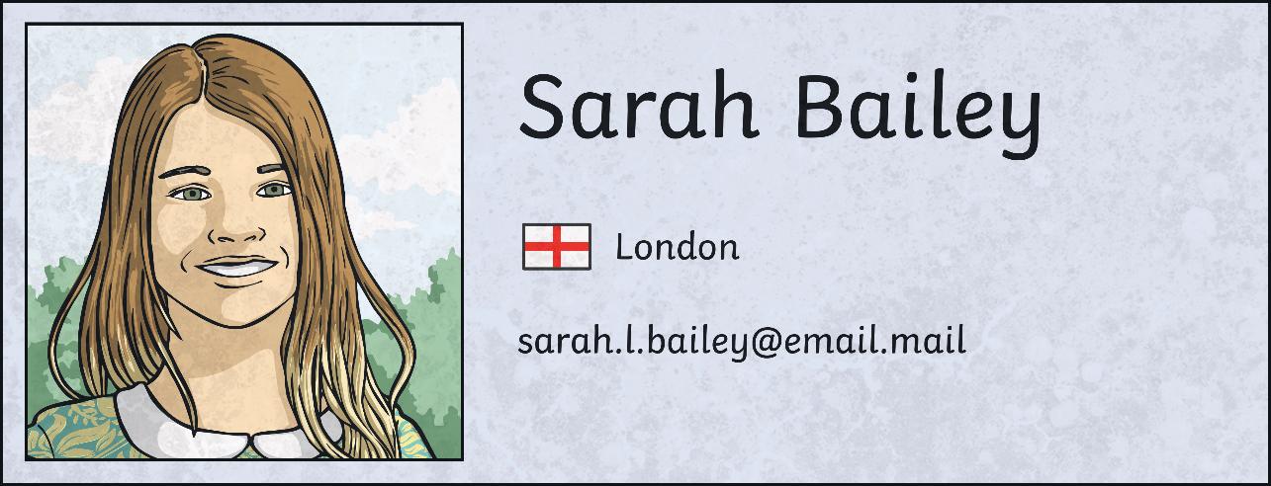
What Is Your Online Identity?
When we go online, we have an online identity.
This is information about ourselves, our likes, what we share and how we talk to others.
On some apps, we can make an avatar or a profile that other people online can see.

Slide 10
This Is Me
What do you like to do online?
Who likes to do the same/different?
Is it OK for people to like different things online?
What could we do to make the Internet better?

Slide 11

An Internet We Trust
The theme this year asks us to think about how we can know what to trust online.
We need to learn how we separate fact from fiction.
How do we know if we can trust something online?

Slide 12
News or Fake News?
There are ways we can investigate if the information we read is fact or fiction.
The online world can influence, persuade and manipulate our decisions and opinions. It’s important we find out what is fact and what is fiction. Sometimes fake news can even be harmful.
What can I do?
Ask myself who wrote this?
Investigate why is was written.
Support my friends if fake news upsets them.
Only share things I have checked are true.

Slide 13
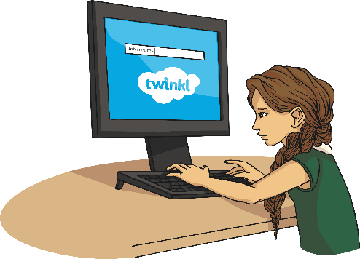
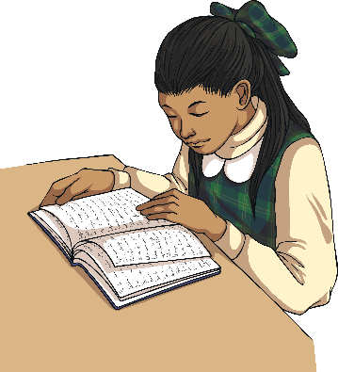
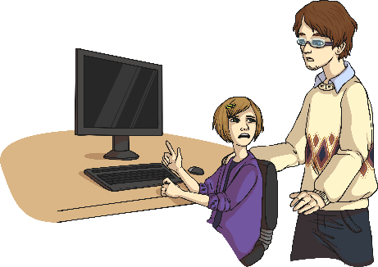
An Internet We Trust
There are ways we can investigate if the information we read is fact or fiction.
question what you see
check other sources online
check sources offline
ask for help

Slide 14
What Would You Do If…
You see an advert pop up saying you have won a prize?
You saw a link for a video to an amazing new football trick?
Someone you play games with online asks to meet in person?

Slide 15
An Internet We Trust
Remember
question
check
ask

