Slide 2
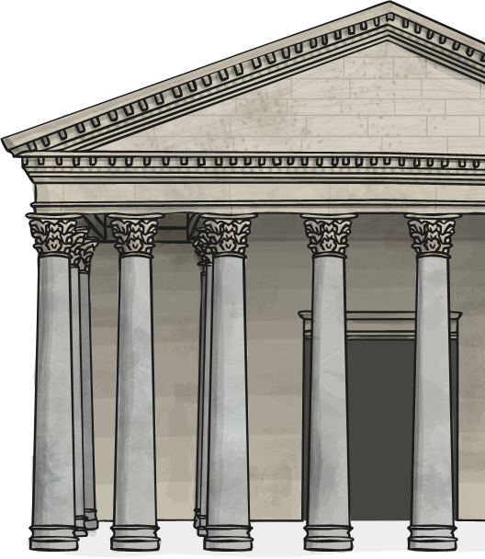
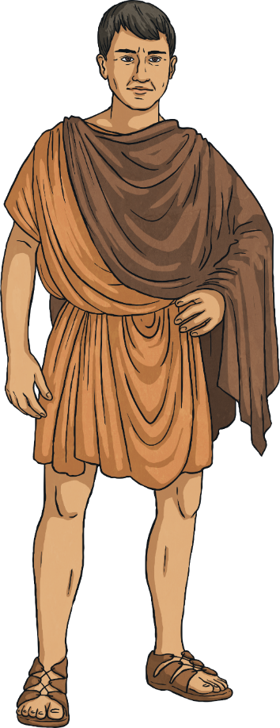
Roman Society
In Roman society, people
were not seen as equals.
You were either a citizen,
a non-citizen, or a slave.

Slide 3
Roman Society
Roman citizens were divided into two main classes:
Patricians - The patricians were at the top of Roman society. They were the ruling classes and were always Roman citizens. Patricians were very wealthy and made up a very small percentage of the Roman society. These people could trace their ancestry back to the founding of Rome.
Patricians
citizens
Plebeians
Patricians and Plebeians did not mix with each other.
Plebeians - Plebeians were the working class. They generally lived in very crowded, basic apartments. Most plebeians were soldiers, farmers, bakers, builders or craftsmen. They were also usually Roman citizens.
There was a third social class in Roman Society, below the plebeians, who were not considered Roman Citizens. The Slaves.
slaves

Slide 4
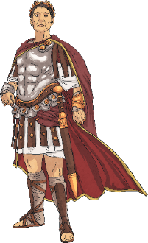
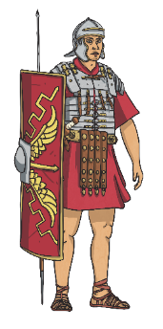
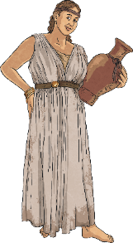
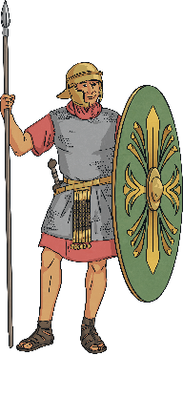
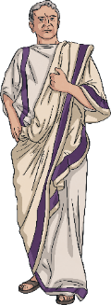
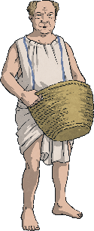
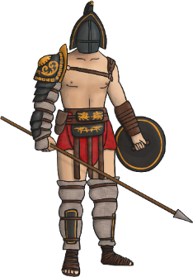
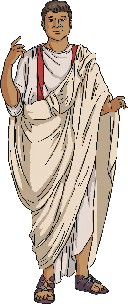
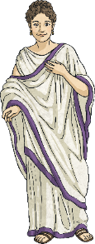
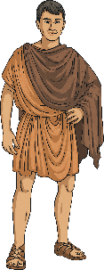
Roman Society Structure
Activity
Click on each image to find out more.
Patricians
Plebeians
Slaves

Slide 5
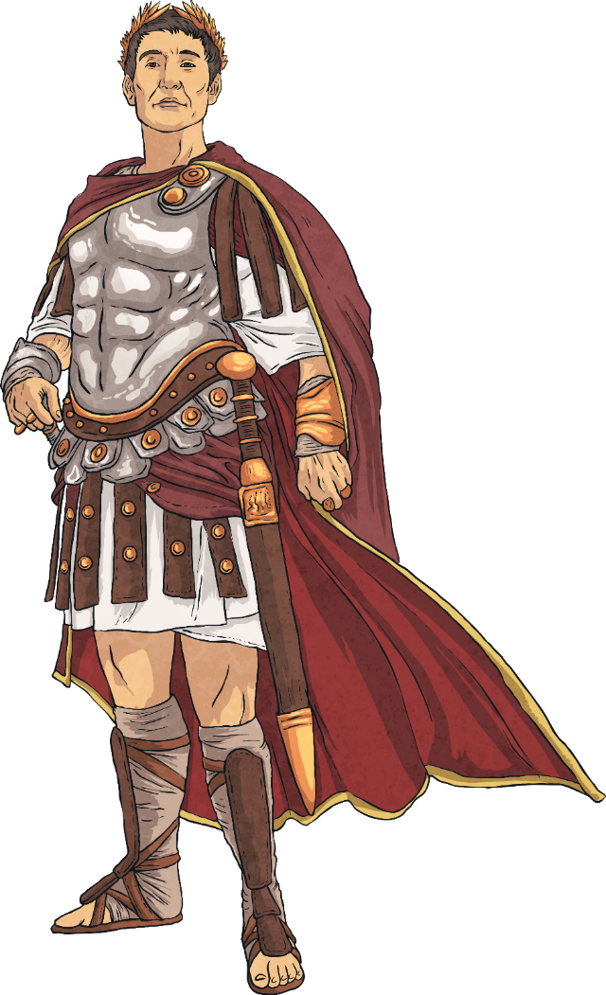
Emperor
The emperor was the ruler of the Roman Empire and was in charge of the senators and the army. They were supreme leader and were occasionally thought of as a god.
The emperor was the leader of the senate as well as the church.
He could decide to inflict punishments upon people and could stop any acts proposed by magistrates.
Emperors were very rich and lived a life of luxury.

Slide 6

Senators
The senate was made up of a group of men (senators) who advised the emperor. Senators
were always wealthy, upper class citizens from powerful families.
Being a senator was a very prestigious and highly respected position.
Once you became a senator, you held the position for the rest of your life.
Although senators didn't get paid, it was still considered a lifelong goal of many Romans to become a member of the senate. Only senators could wear a purple striped toga and special shoes.

Slide 7
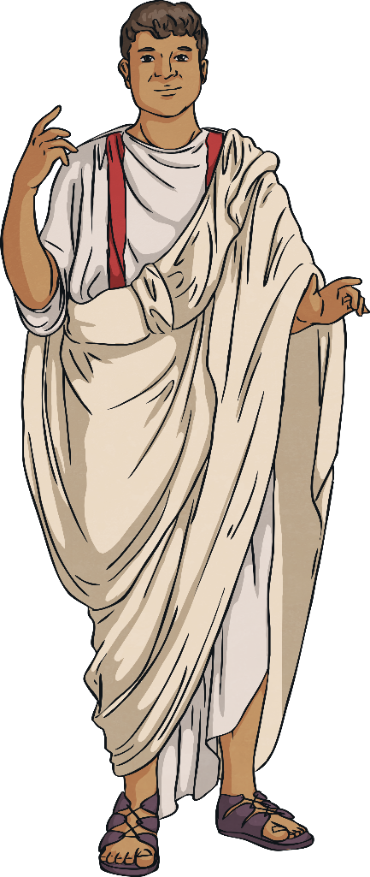
Equestrians
Equestrians were the wealthy members of society who chose to focus on business, rather than politics.
The equestrian class were businessmen and many became very wealthy.
They may have had jobs such as:
Some would have been in charge of roads being built or other government projects.
tax collectors
bankers
exporters

Slide 8
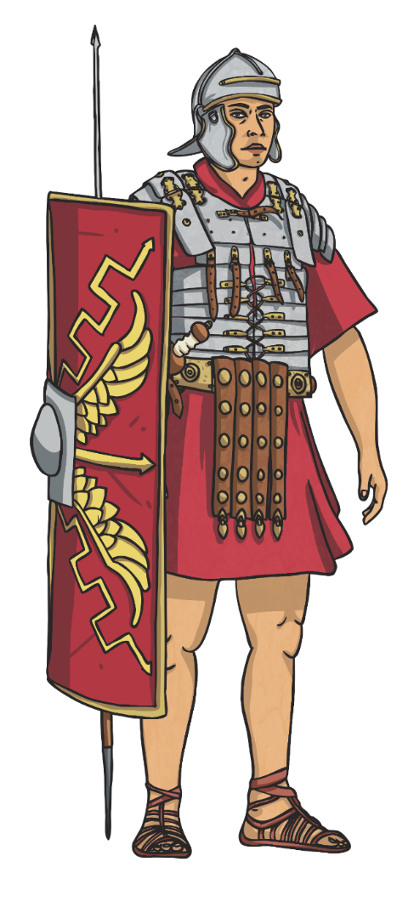
Soldiers (Legionaries)
Male Roman citizens who wanted to become soldiers had to be over the age of 20 to join a legion. Soldiers had to serve the army for 25 years and were not allowed to marry during this time.
They were paid for their service although it was hard work - they would walk up to 24 miles a day wearing armour and carrying heavy equipment. Their shields were large, rectangular and made of metal.
As well as learning to fight, they were trained to build bridges, set up camp, swim and learn formations.
These were clever ways to move as a group that provided protection, such as the testudo formation.
After legionaries had completed their service, they would be rewarded with land.

Slide 9

Plebeians
The plebeians were the working class. They were people of little wealth who did not own land and worked hard for their families and to pay taxes.
These jobs were varied and included:
Farmers
Bakers
Merchants
Craftsmen
Lawyers
Teachers
Entertainers
Children would learn the same trade as their parents. They lived in crowded apartments called Insulae, which were shared between several families.

Slide 10
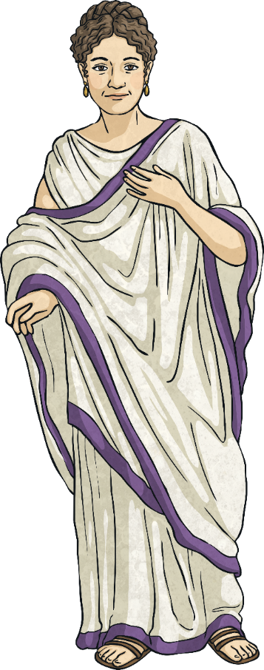
Women
Women and girls were not seen as being equal to men and boys. In fact, they were treated only a little better than slaves.
In Roman society, the amount of freedom you had as a woman was decided by your wealth and who your father or husband was. They had to obey them at all times.
Free women were classed as Roman citizens but didn’t have the rights of a full citizen. For example, they weren’t allowed to vote or become involved in politics.
Women were given a very basic education and were expected to take a traditional role in the household doing jobs, such as preparing and cooking the meals, making clothes and raising any children.

Slide 11
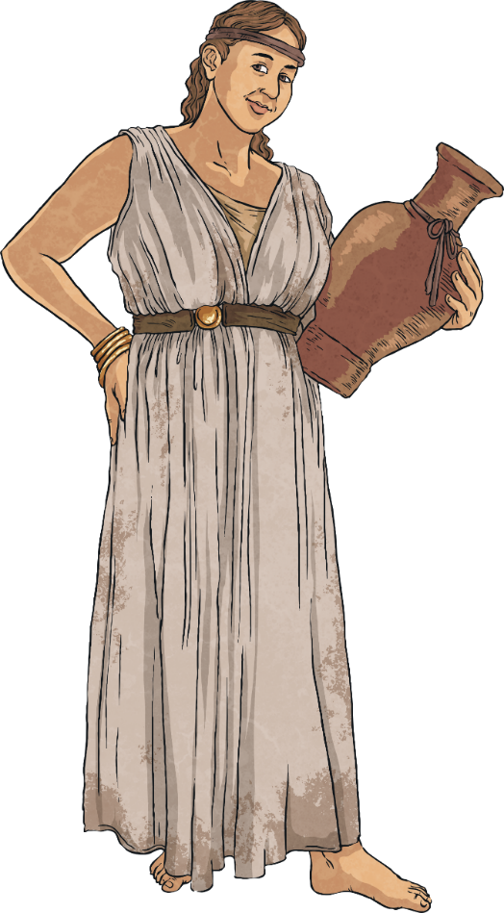
Freed Slaves
Slaves could buy their freedom or be freed by their master after many years of service, making them ‘freedmen'.
Manumission was the act of a slave master freeing his or her slaves. If done by a magistrate, it would allow the slave to become a citizen of Rome (but they would still not be allowed to enter politics).
If the master freed the slave themselves, the slave would have fewer rights and any property or money they earned would go back to their master when they died.
Freed slaves still had a duty to their former master and would continue to do paid work for them. In some cases, former slaves were treated like family and would marry into the family they served.

Slide 12

Soldiers (Auxiliary)
Non-Roman citizens who joined the Roman army were known as the auxilia.
‘Auxilia’ is Latin for ‘help’ and it was the auxiliary soldiers’ job to protect the legionaries. This could mean fighting in front of, or to the side of the legionaries. They often had special skills such as archery or horse riding.
They carried shields, although these were made from leather and wood and were oval shaped.
They were paid less than the legionaries and didn’t wear armour but wore a light, chainmail shirt. However, they were granted Roman citizenship at the end of their service (at least 25 years).

Slide 13
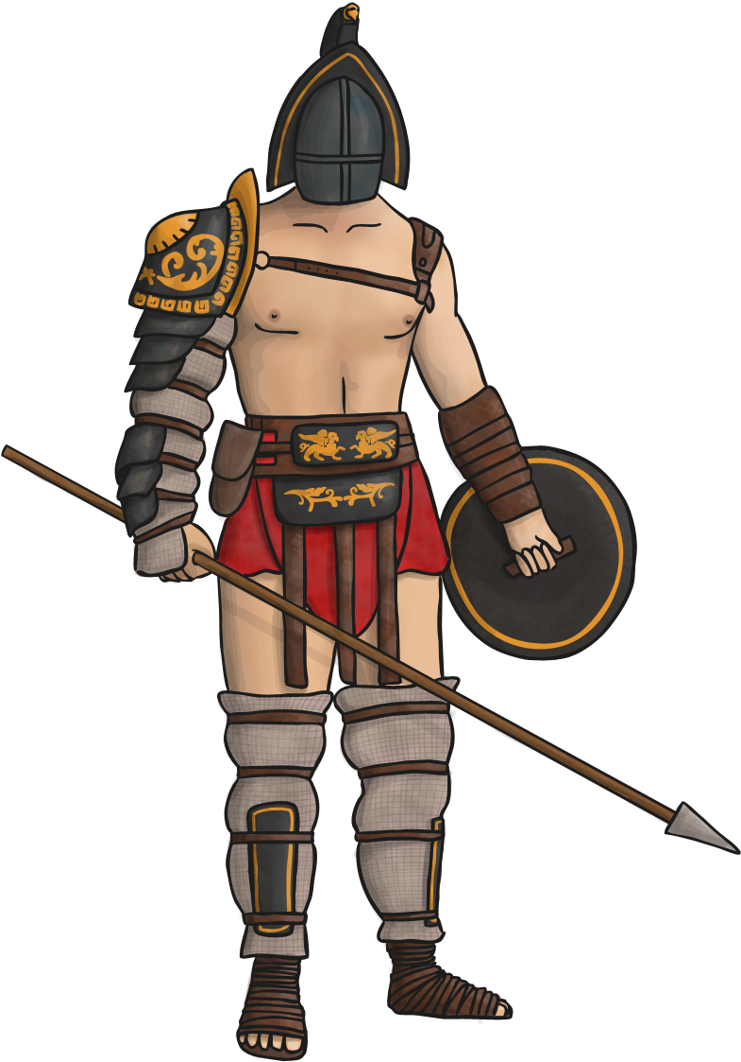
Gladiators
Most gladiators were slaves who were taught to fight. However, some were prisoners of war and others were volunteers who were paid.
However, they could win their freedom by fighting successfully in arenas.
Gladiator battles varied greatly but usually ended when someone either admitted defeat or was killed.
They were a popular form of entertainment in Roman times and many large arenas, such as amphitheatres, were built to host gladiator games.

Slide 14

Slaves
Life wasn’t easy for slaves. They were seen as the property of their master and had no rights. Some masters treated their slaves very harshly.
Some worked in the homes of the wealthy and had jobs such as cleaning, washing, dressing their master and preparing the meals.
Some slaves worked on farms and those who were educated tutored the children of their masters.
Mining was the toughest job a slave could be given as it was very dangerous.
A slave that had served within a household for a long time may have been treated as an important part of the family.

Slide 15
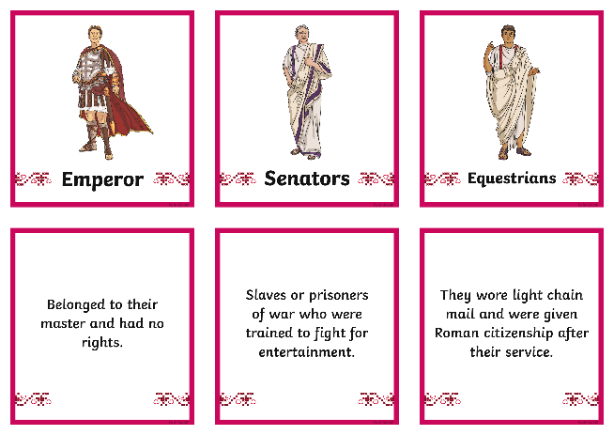
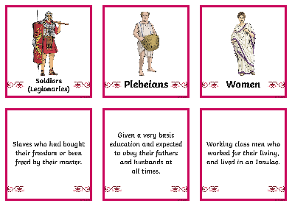
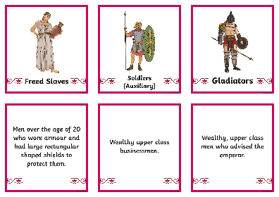
Activity
Use the Roman Society Matching Cards to see if you can match up the description to the roles in Roman Society.
Can you sort them into Patricians, Plebeians and Slaves?
Can you order them from most powerful to least powerful?

