Slide 1
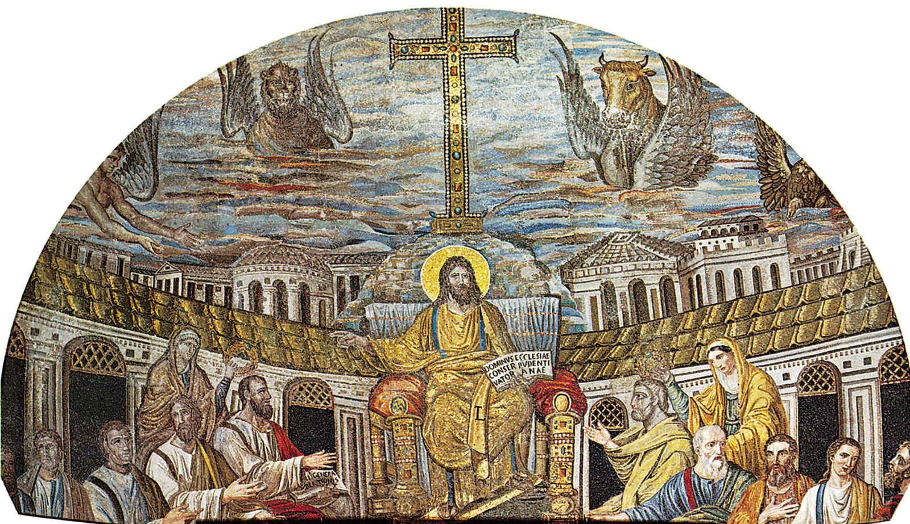
Christianity
Lesson 4

Slide 2
LO: To understand the miracles of Jesus and why these were important.
I understand what a miracle is.
I can sequence and retell the miracle of healing a blind man.
I can explain why Jesus’ miracles were important.
Notes:
A miracle is an unusual or wonderful event that is believed to be caused by the power of God

Slide 3
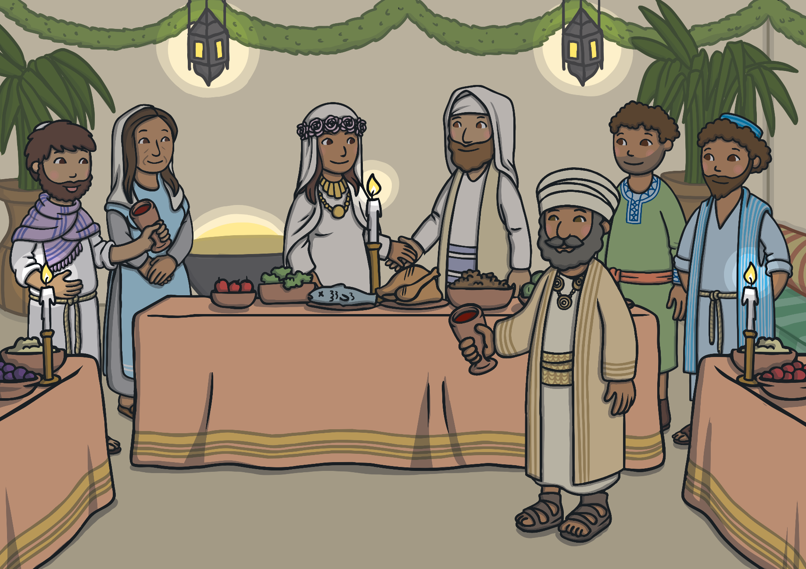
Throughout his time on Earth, Jesus performed many amazing miracles and helped many people. Part of the reason why he did so many amazing things is because he wanted us to be sure he really was the Son of God. He started out at a wedding in the town of Cana.

Slide 4
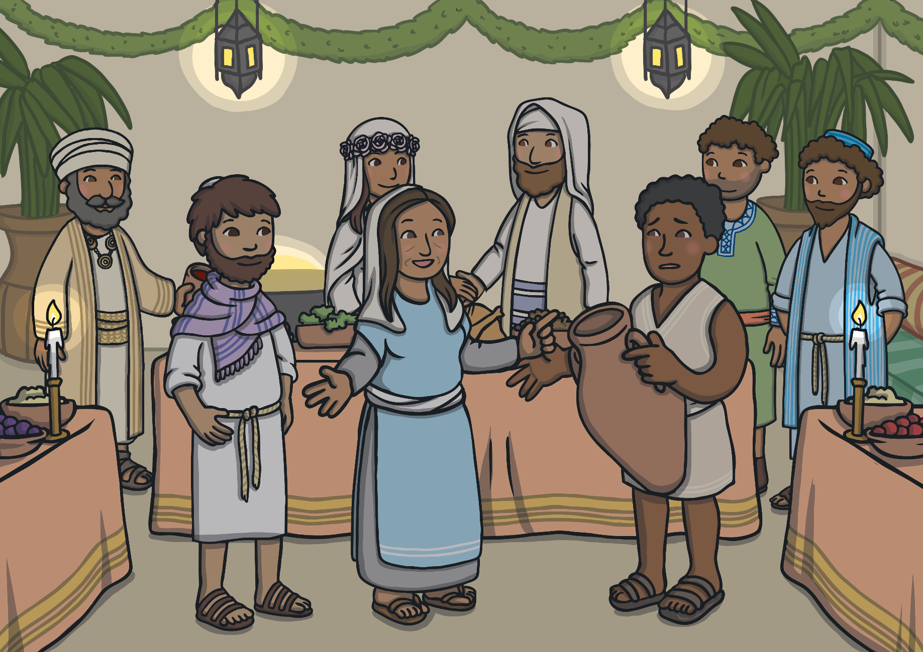
Everyone had been having such a great time that nobody noticed the wine had run out. Mary, Jesus’ mother, knew that her boy could sort this problem out! “Do whatever he tells you,” She told the servants.

Slide 5
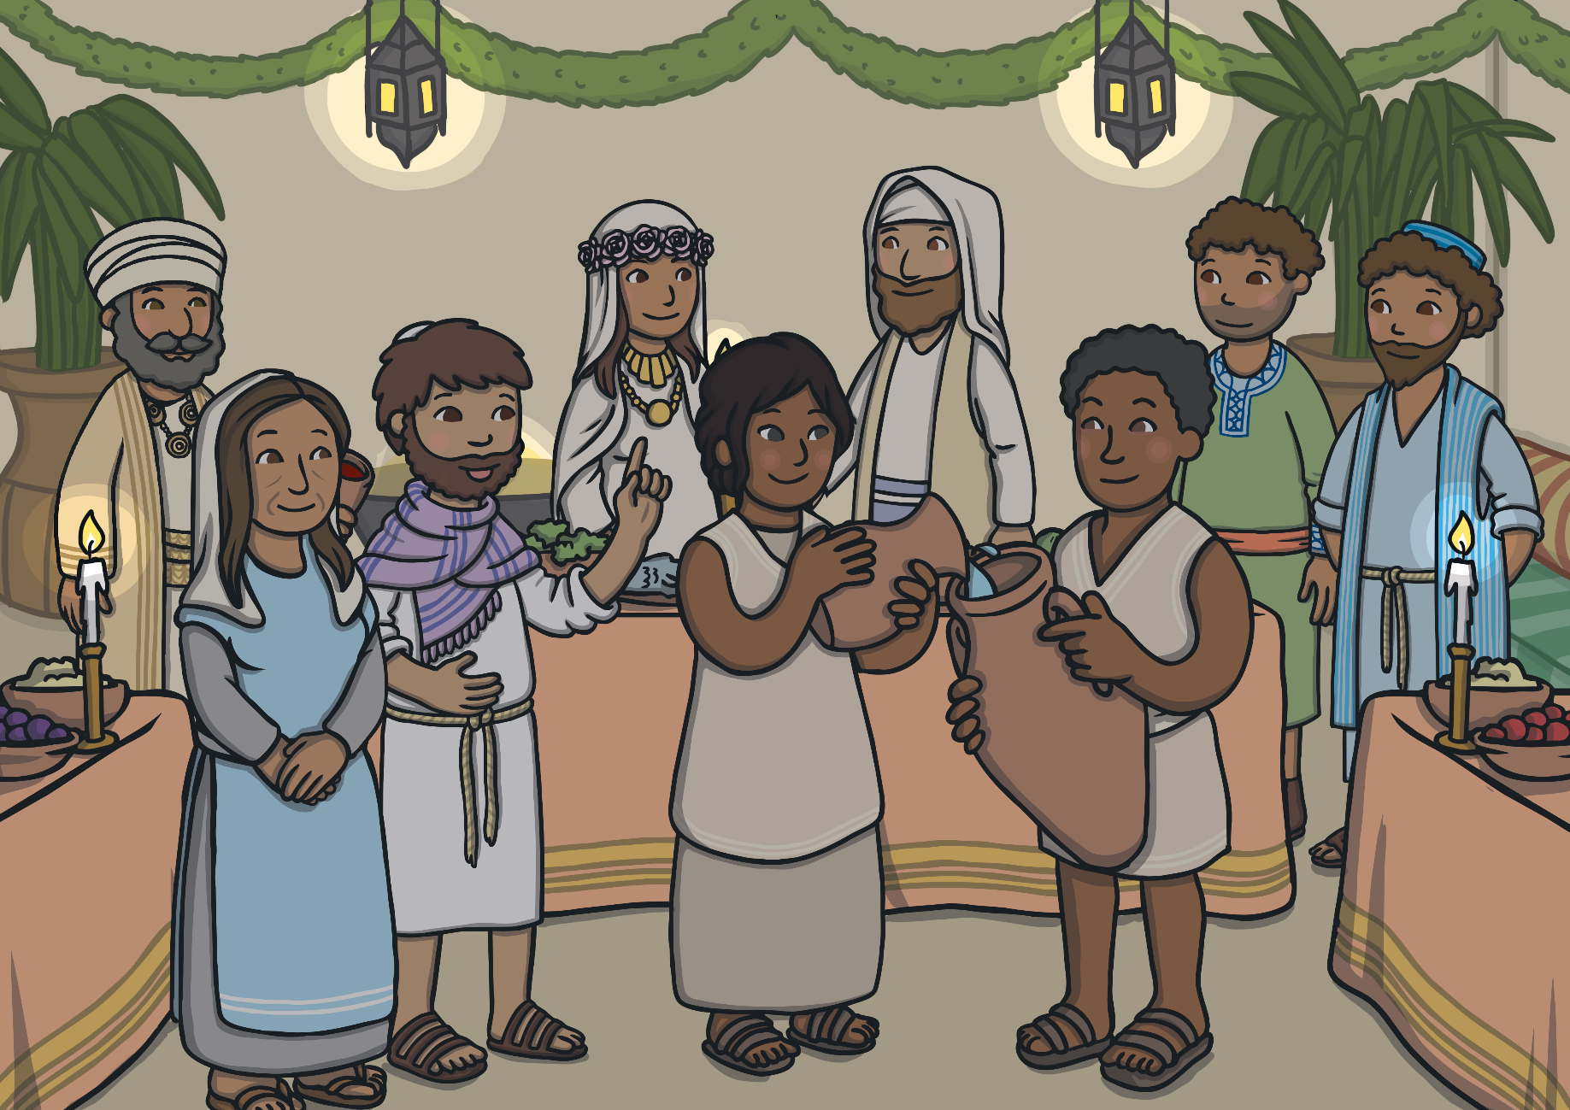
Jesus told them to fill some empty jars with water. They were sceptical that putting water into jars would do anything at all. But they obeyed Jesus anyway and filled the jars. “Now go and pour some out for the guest,” Jesus said.
Notes:
Read PPT about some of Jesus’ other miracles.

Slide 6
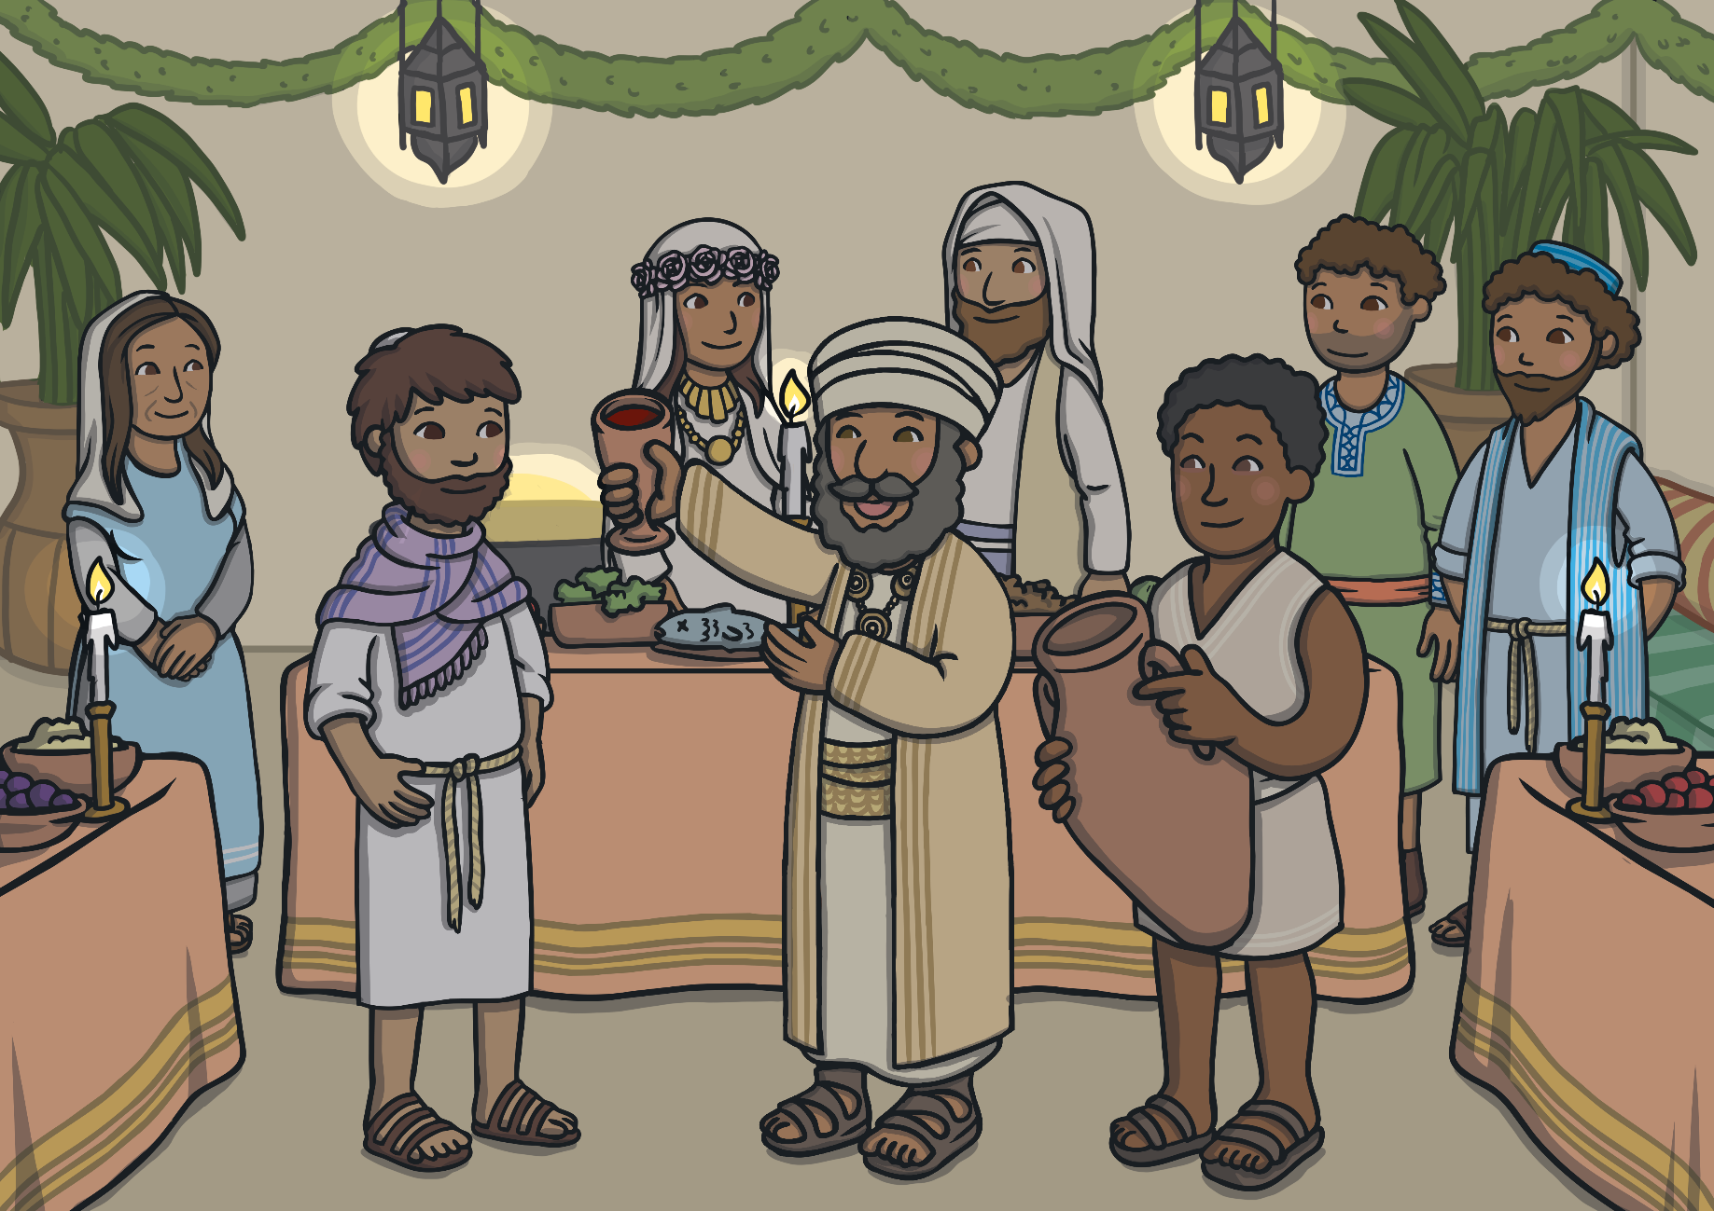
To everybody’s amazement, the jars now contained the best wine they’d tasted all evening! “Everybody we know begins with their finest wines first and after the guests have had their fill, they bring in the cheap stuff. But you’ve saved the best till now!” said the guest.

Slide 7
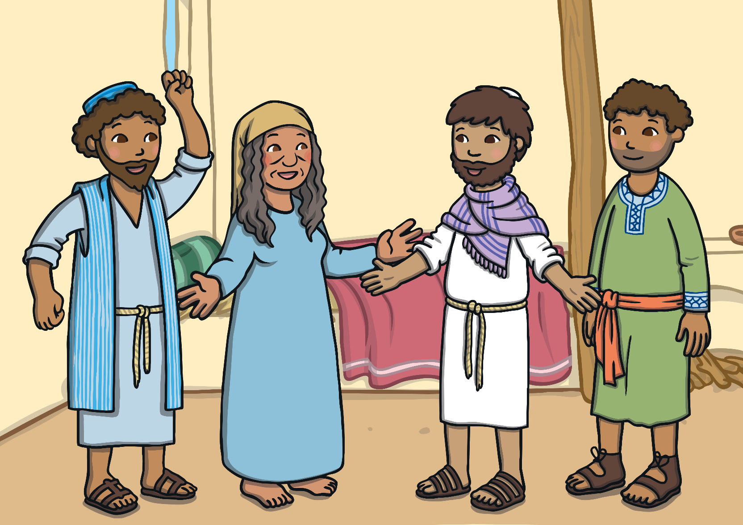
After this first miracle, Jesus visited Peter and Andrew at their family home in Capernaum. Peter’s mother-in-law was very ill with a fever. Jesus ordered the sickness to leave her and she became so well she even offered to serve them right away!

Slide 8
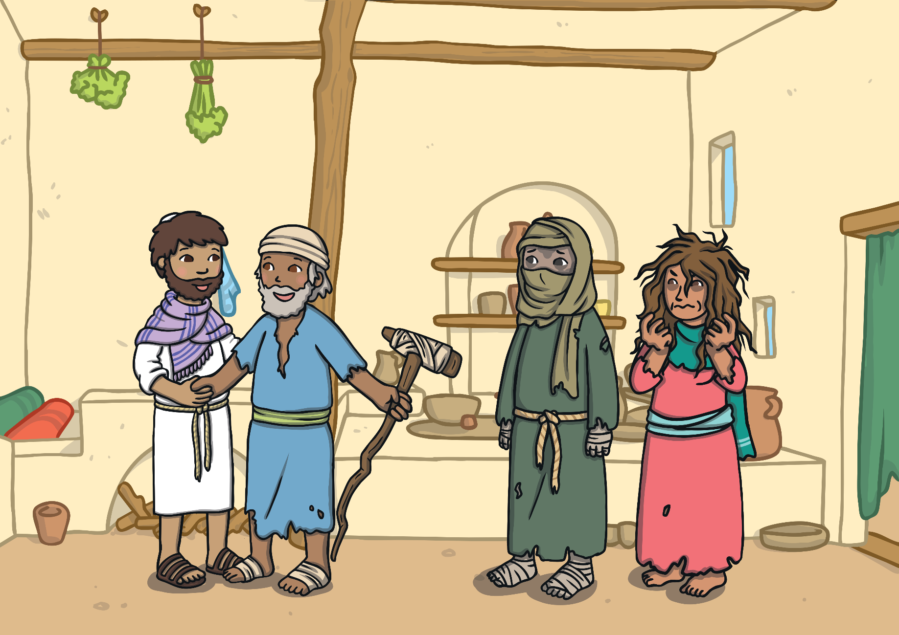
People heard about this miracle and everyone from all around came asking Jesus to heal them from their ailments. People who had walked their whole life on crutches were made well and could walk.

Slide 9
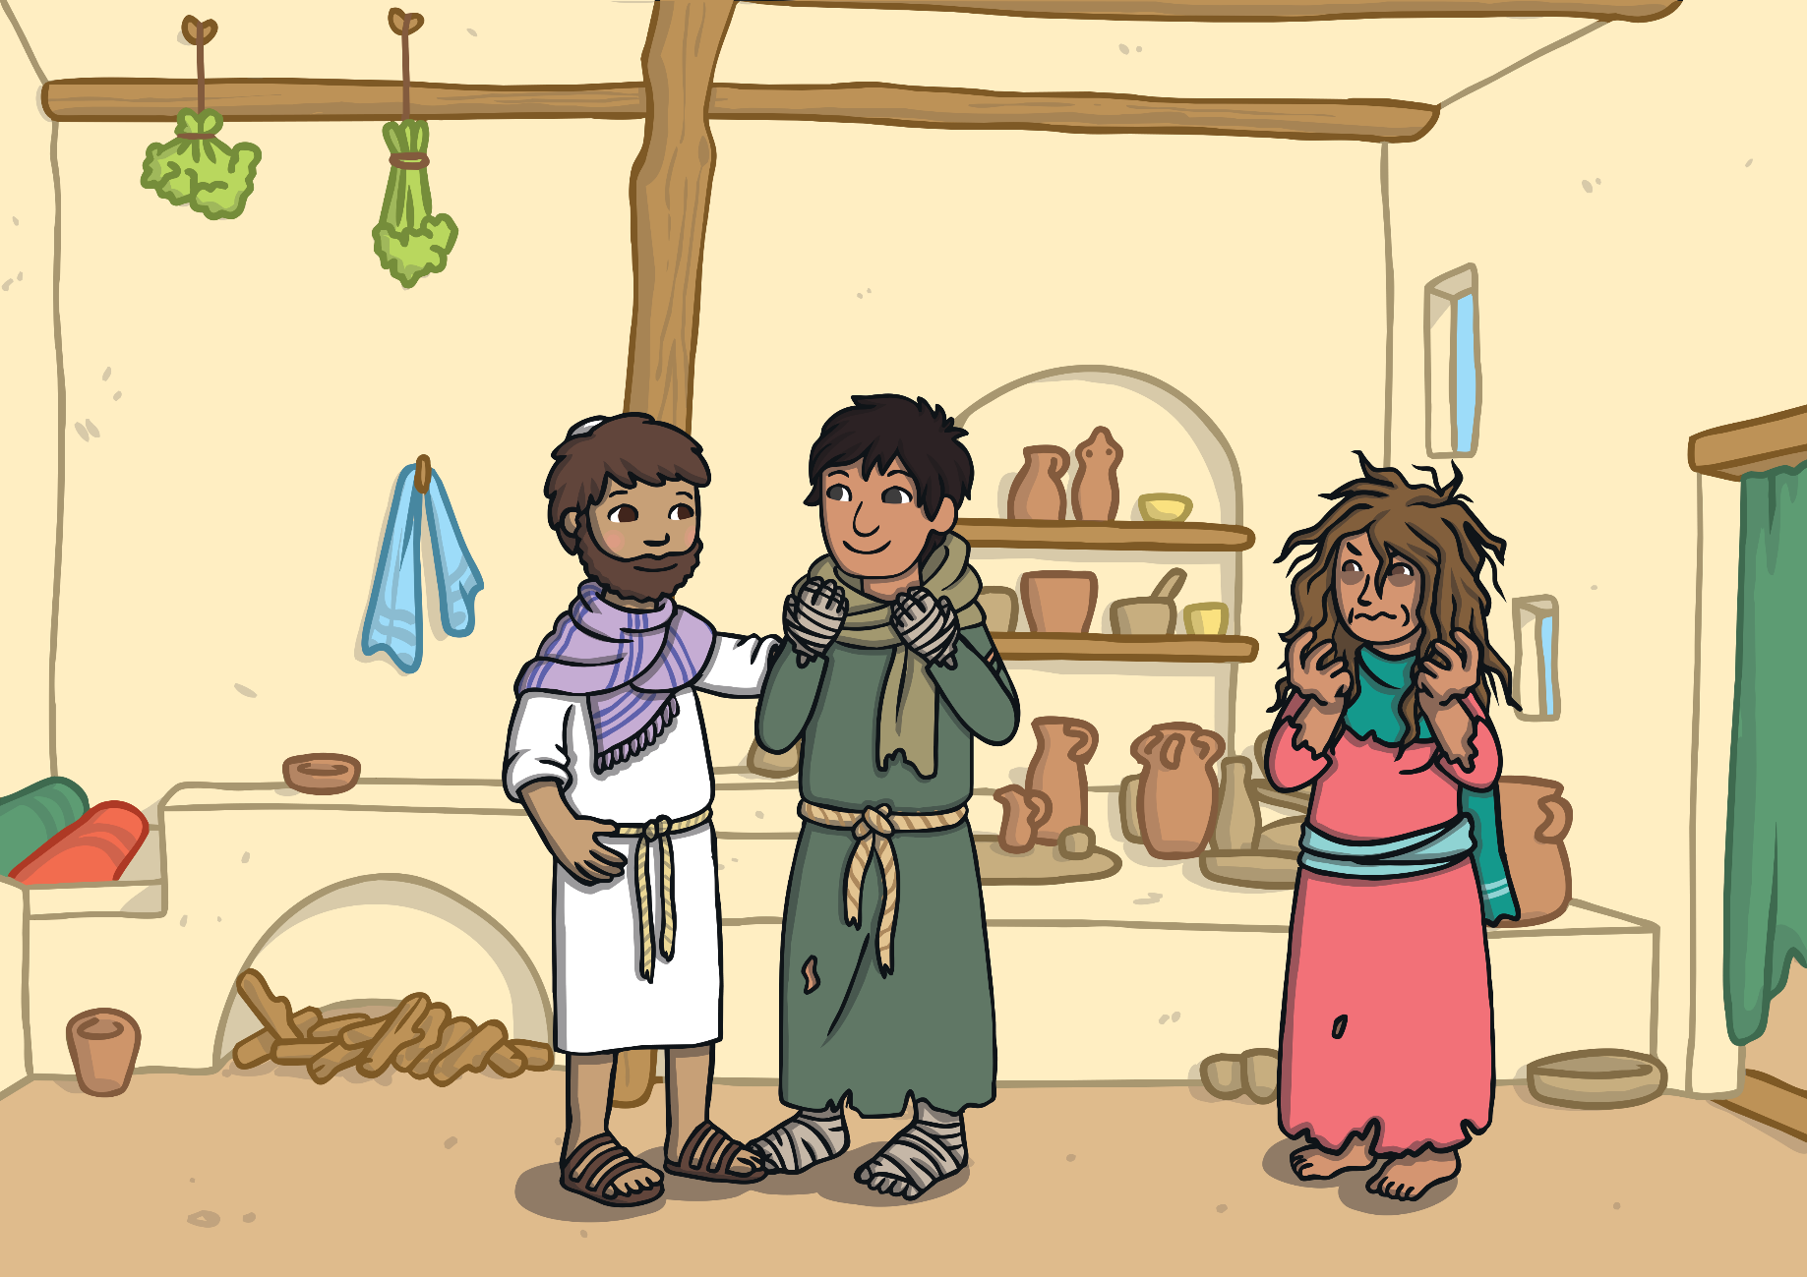
People with horrible disfiguring afflictions like leprosy came to see Jesus. No one else would touch them for fear of catching their disease, but after healing other with a word, Jesus healed these people with a touch because he wanted them to feel loved.

Slide 10
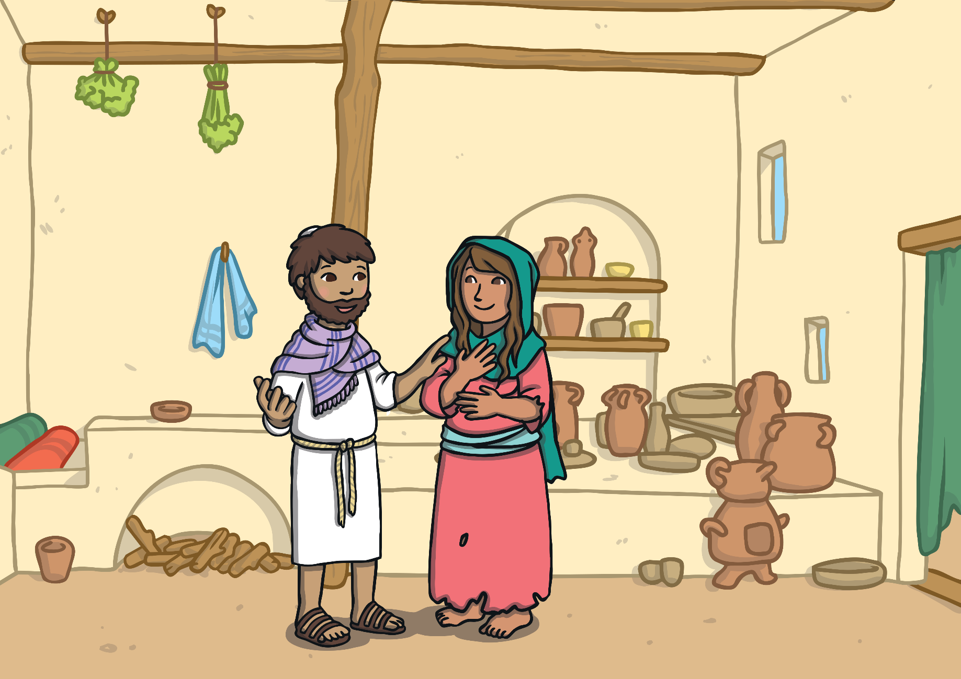
He also had people who were possessed by demons, who were making them do evil things, come to see him. Jesus commanded the demons to leave these people and they fled from Him, leaving the people free again.

Slide 11
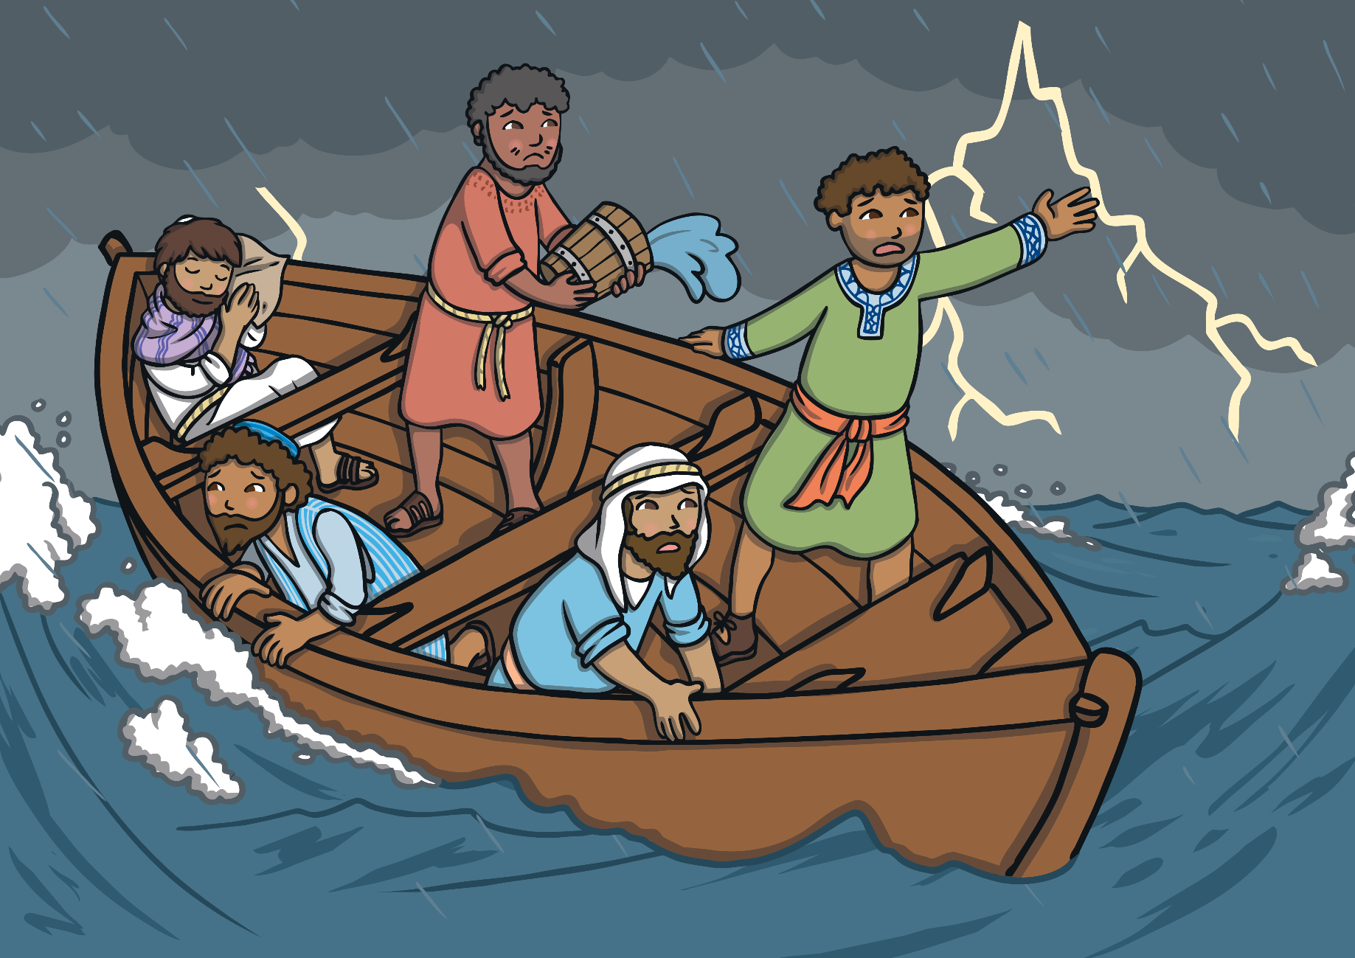
On another occasion, Jesus and his disciples were crossing the Sea of Galilee when a huge storm threatened to sink the boat. Jesus just slept, while around him the disciples were terrified of drowning. “Teacher, is it nothing to you that we’re going down?” they cried out.

Slide 12
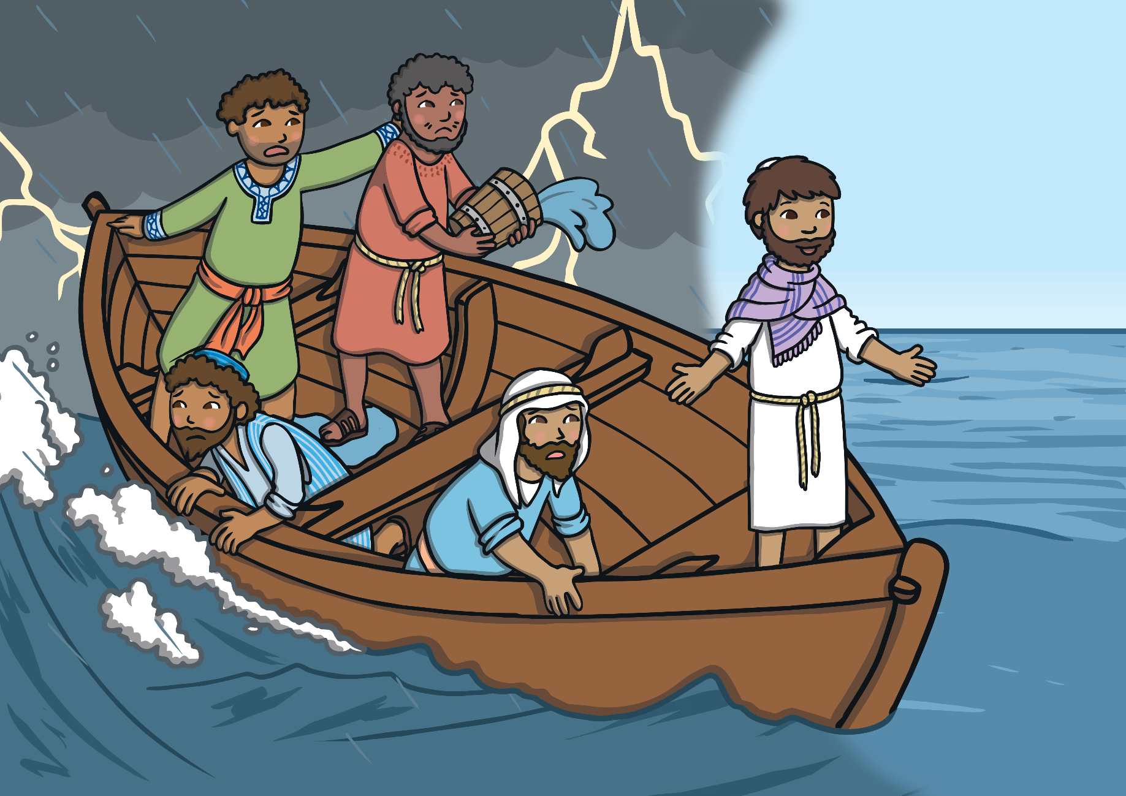
Jesus woke up and told the wind and the wave to settle down. The wind ran out of breath and the sea was soon as smooth as glass. Amazed, they asked “Who is this, anyway?” “Wind and sea at his beck and call!”

Slide 13
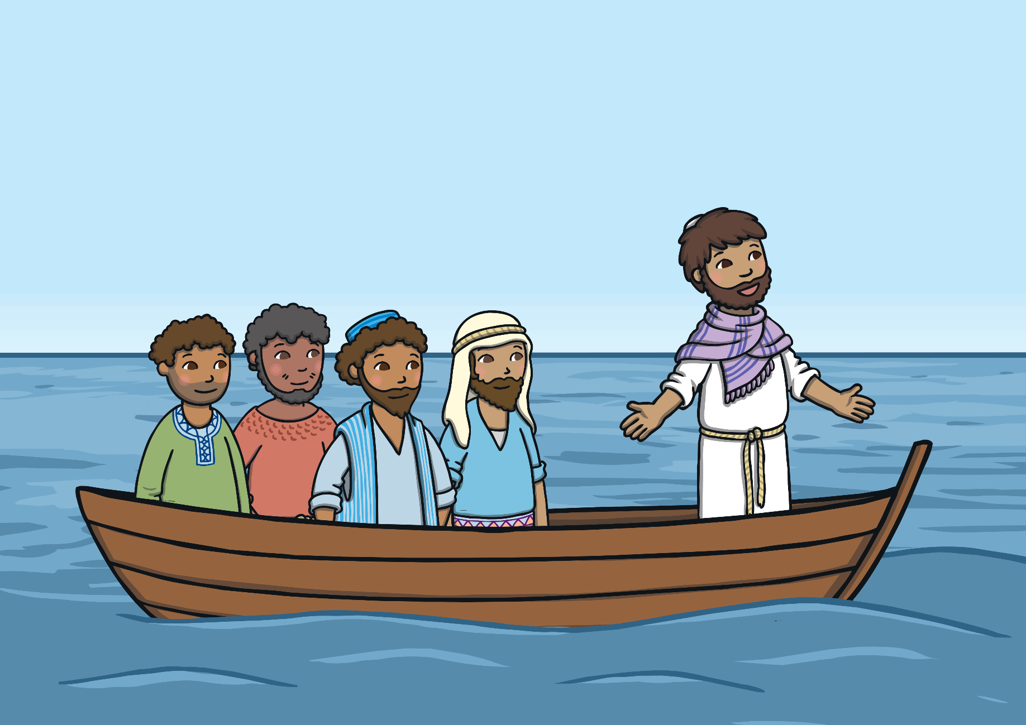
Jesus performed all these miracles and those who followed him soon realised that Jesus was truly the Son of God. However, they hadn’t seen anything yet, there was an even greater miracle still to come!

Slide 14
Notes:
John 9:1-12
This is the miracle that we are going to be focusing on.

Slide 15
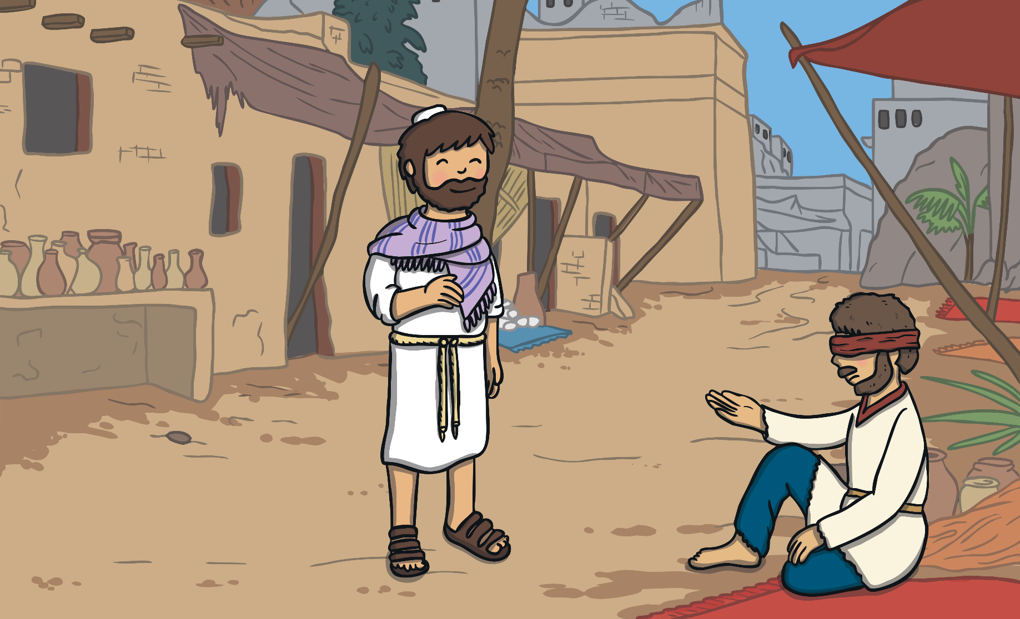
One day, as Jesus walked along with his disciples, they saw a man who was begging at the roadside. The man had been born blind.

Slide 16
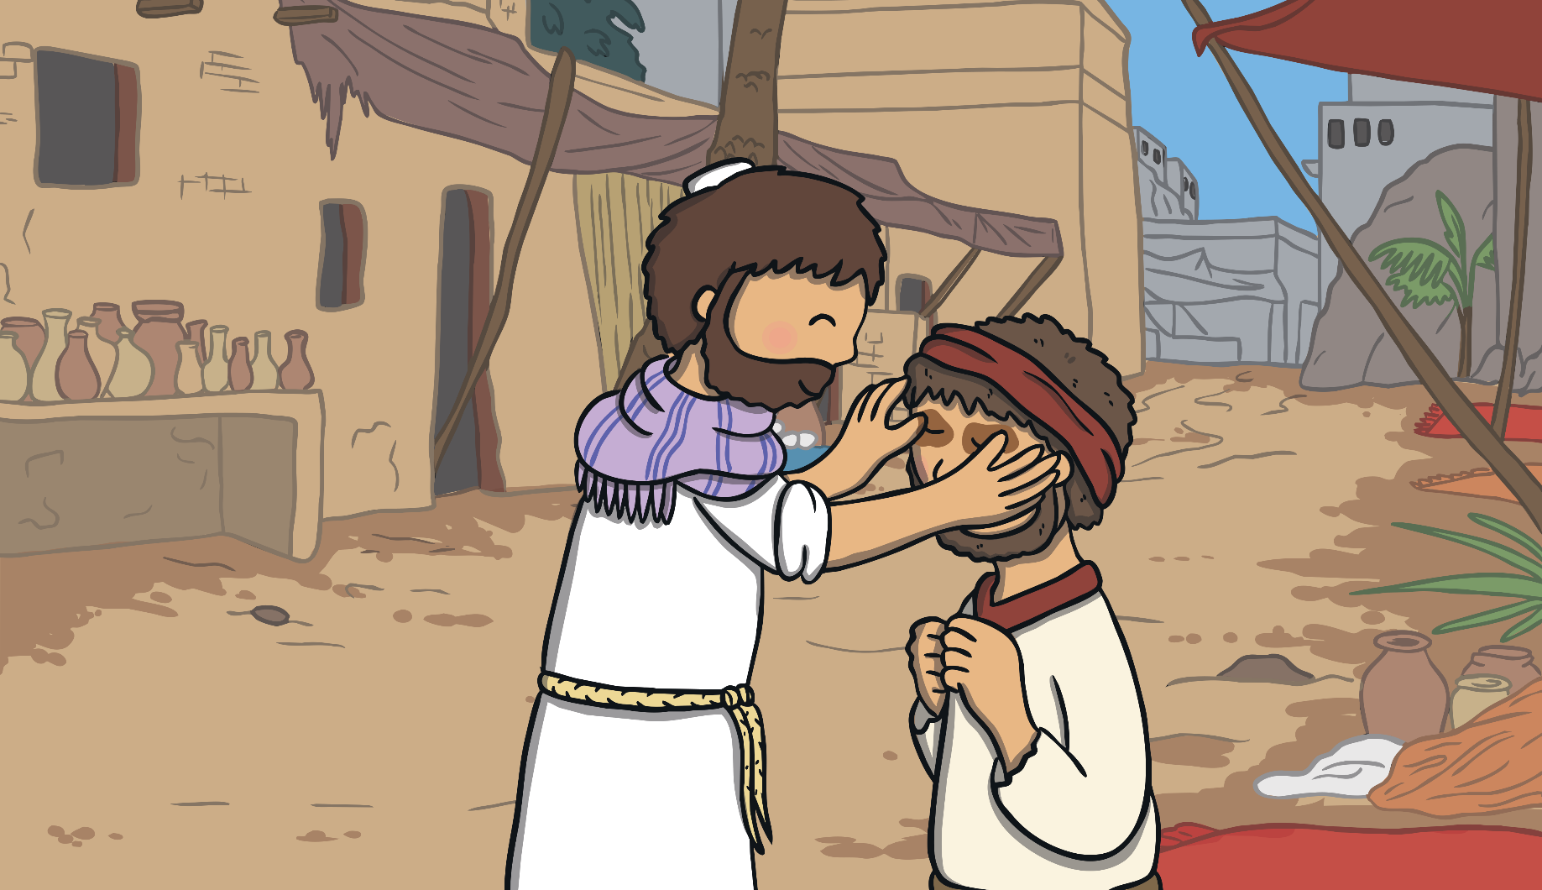
Jesus walked over to the man and said, “While I am in the world, I am the light of the world.” Then he spat on the dusty ground, mixed it into some mud and gently rubbed the mud on the man’s eyes.

Slide 17
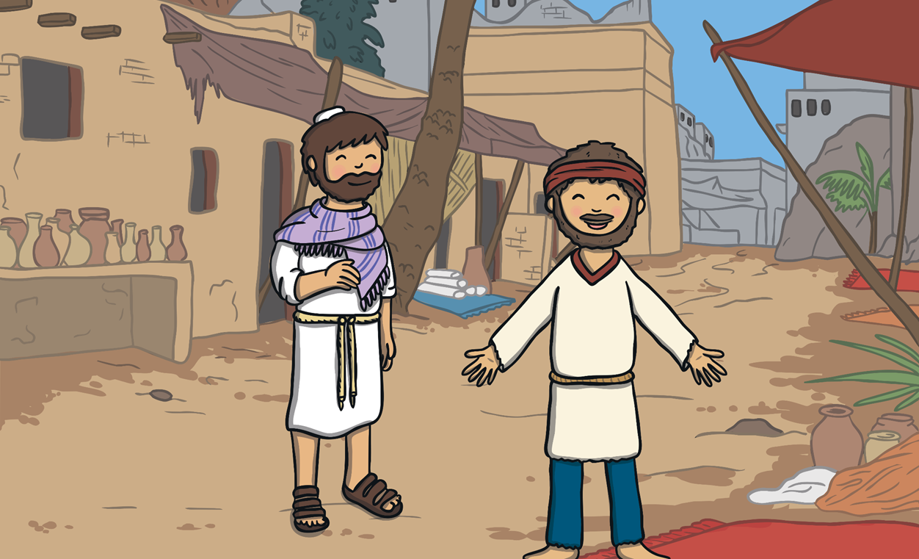
Then, Jesus said to the man, “Now, go and wash your face in the pool of Siloam.” The man returned, overjoyed that he could now see!

Slide 18
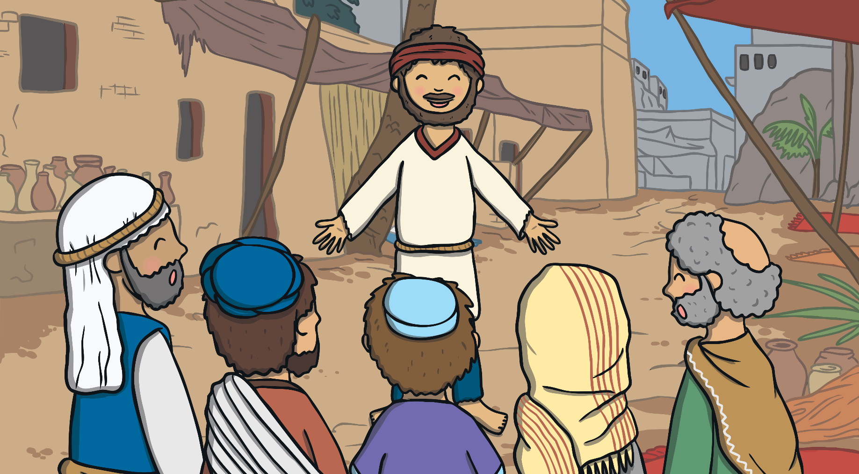
The man’s neighbours had seen him begging and said, “Are you the same man who was begging?”
Others said, “No! That’s not him. He was blind!” But the man said,
“It is me! I was blind but now I can see!”

Slide 19

The man explained, “The man called Jesus came along. He made some mud and rubbed it on my eyes. Then, he told me to wash in the pool of Siloam. When I did, I could see!”

Slide 20
Let’s order the events together.
Notes:
Print out 1 star sheet large and order as a class.

Slide 21
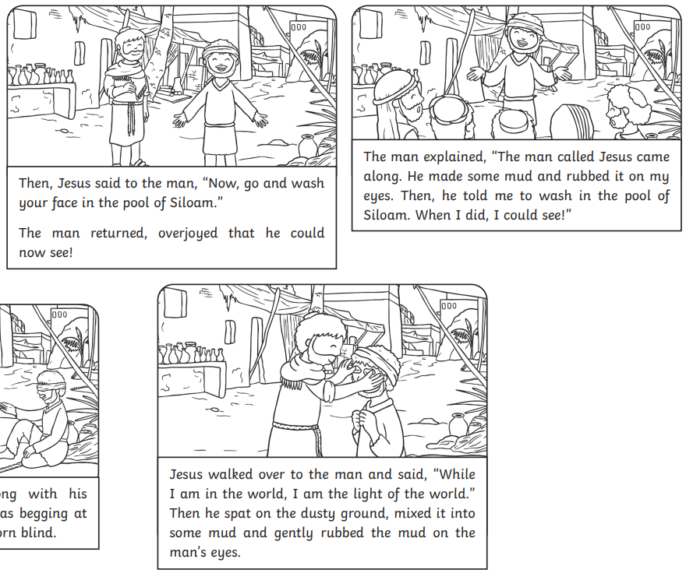
Your task
Using the differentiated sheet, can you order the events of Jesus healing a blind man. HA – can you retell the story under each picture.
Once you have finished, use the lined paper to explain why the miracles of Jesus were important in your own words.
Notes:
Provide word mat.

