Slide 1
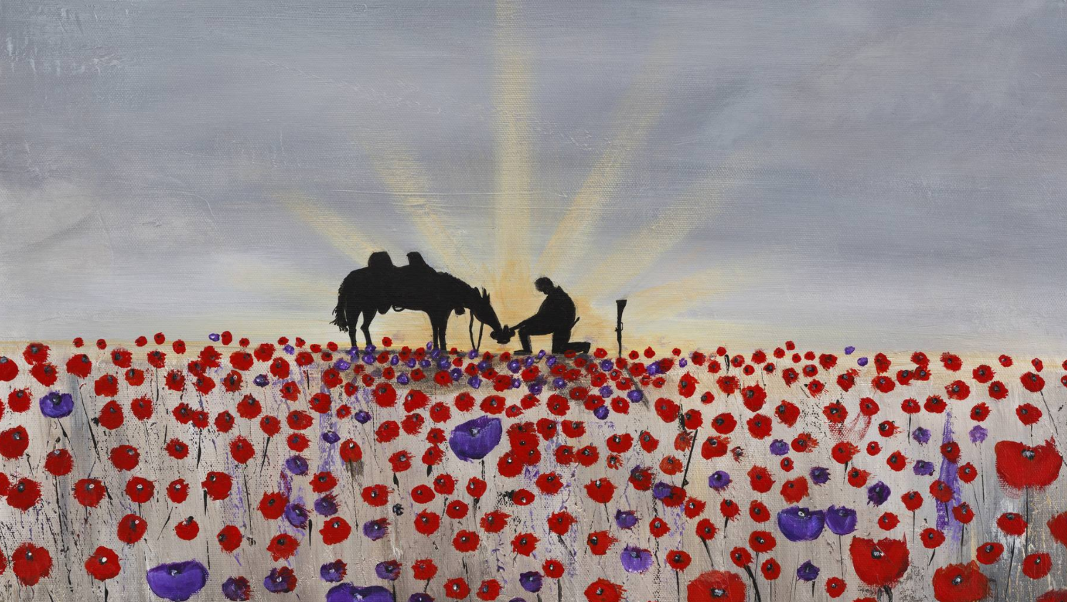
What can you see? Do you like this artwork?

Slide 2
L.O: To mix primary colours with accuracy.
Must: Identify primary colours.
Should: Mix primary colours accurately to create secondary colours.
Could: Identify what could be done differently.

Slide 3

The Purple Poppy
A two–minute silence is always held at 11 a.m. to remember the millions who have died in wars.
Remembrance Day is held on the 11th of November
- the 11th day of the 11th month of the year.

Slide 4
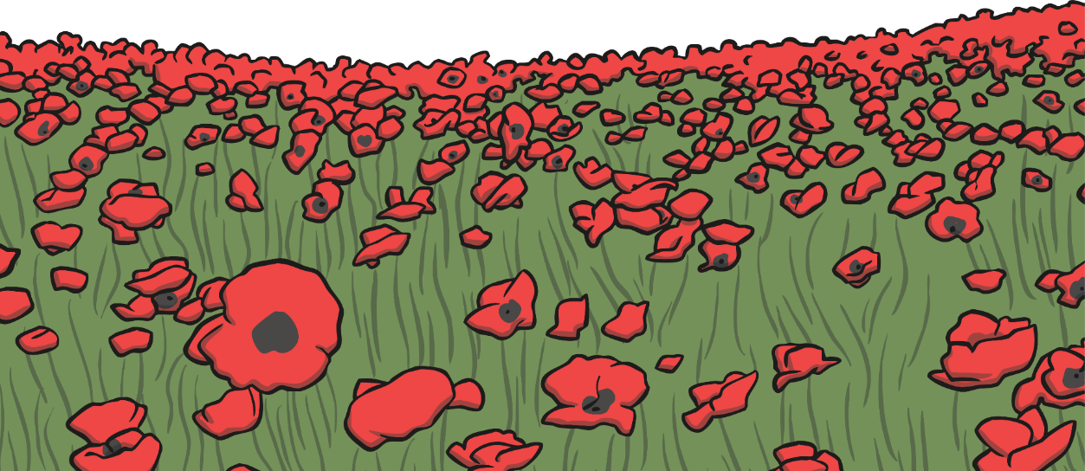
The Purple Poppy
Poppies are worn on Remembrance Day.
This is because they are the flowers that grew on the battlefields after the First World War ended.

Slide 5
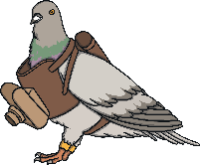
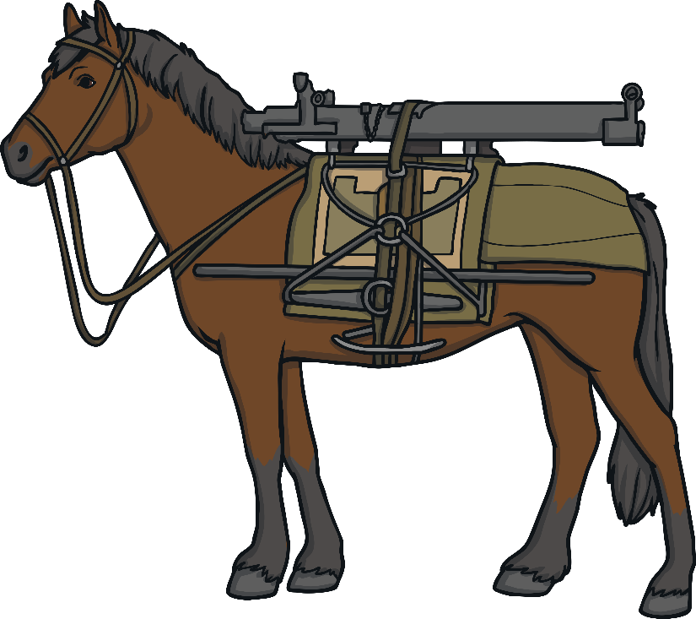
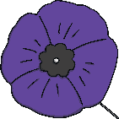
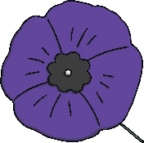
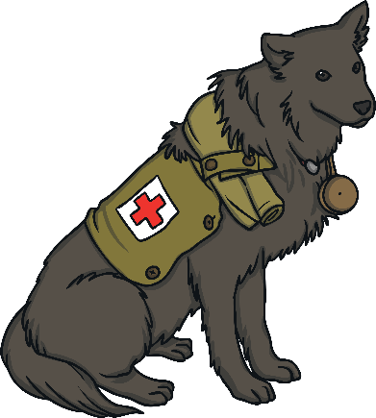
The Purple Poppy
Purple poppies are also worn to remember animals who have died in wars.
Many animals, such as horses, dogs and pigeons, were used in the First World War to help soldiers fight, move heavy items and deliver messages.

Slide 6
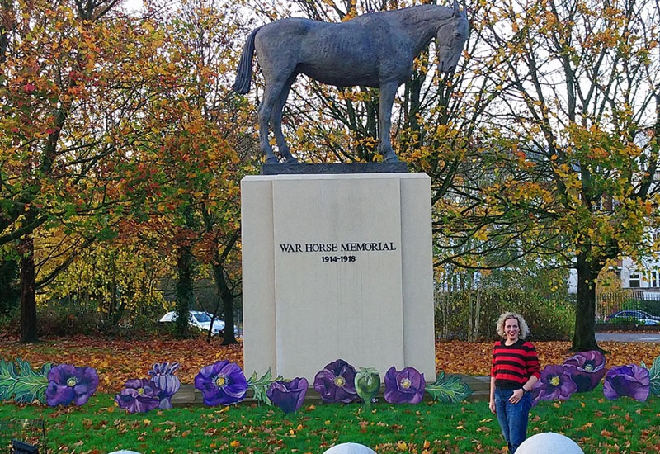
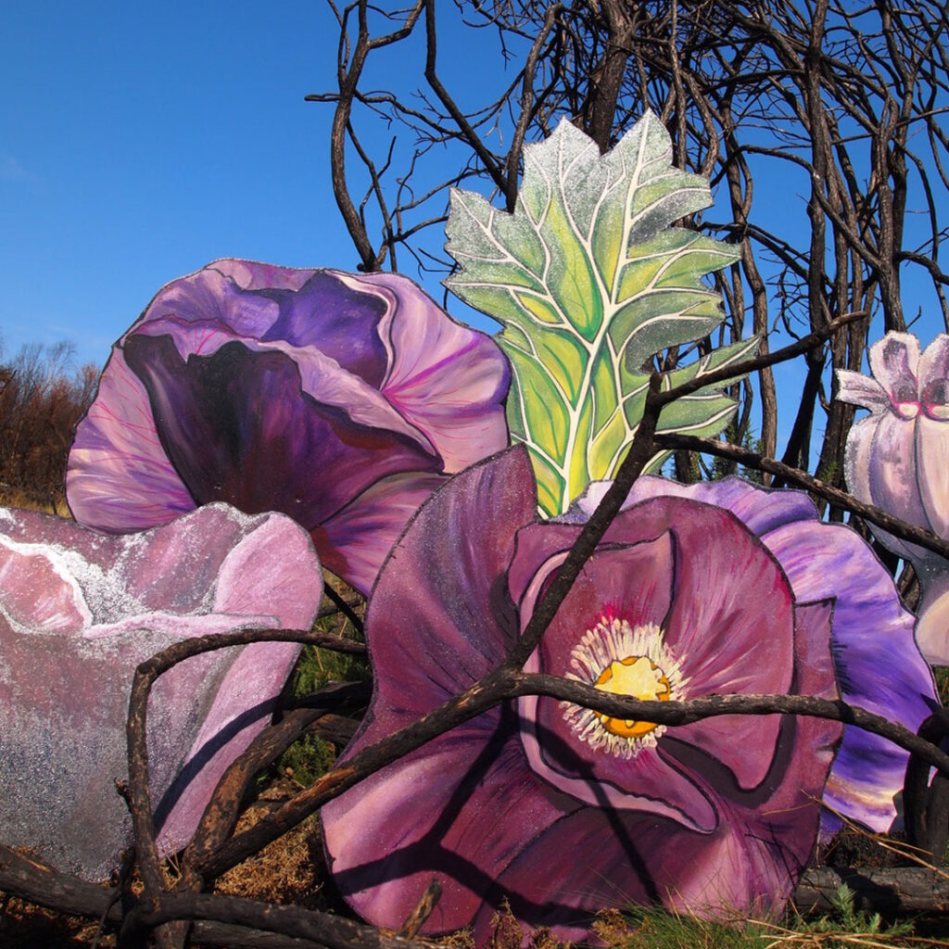
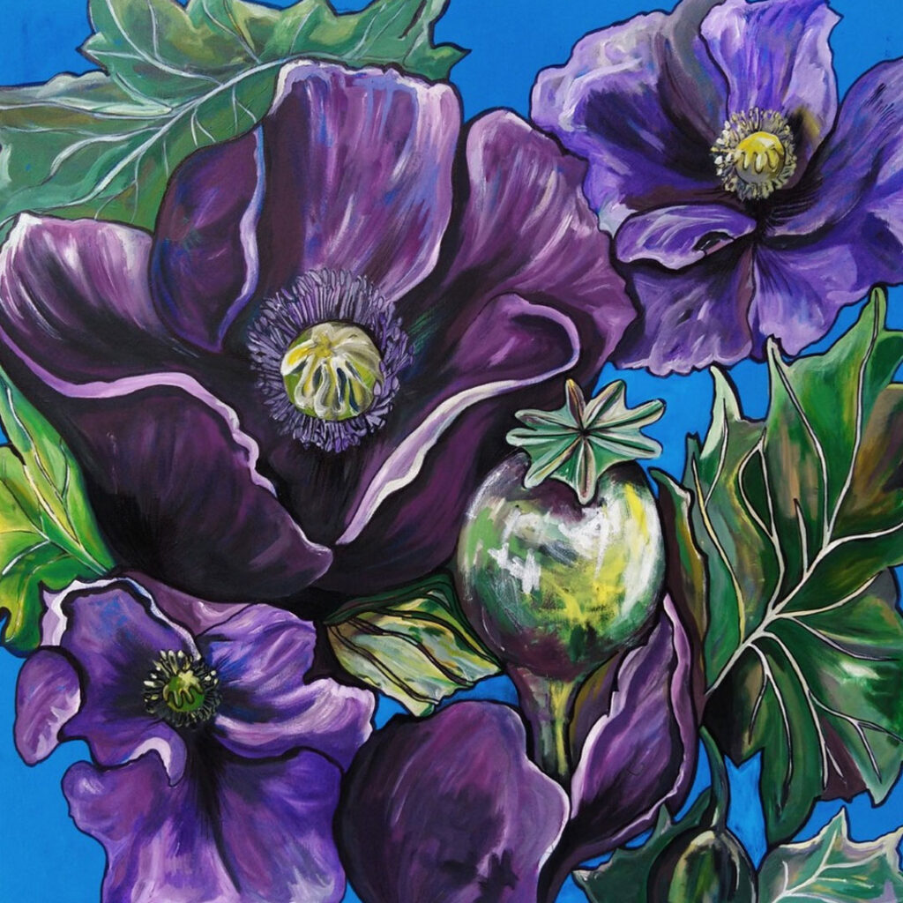
Jenna Fox made a meadow of giant wooden purple poppies positioned at the feet of the giant bronze war horse memorial.

Slide 7
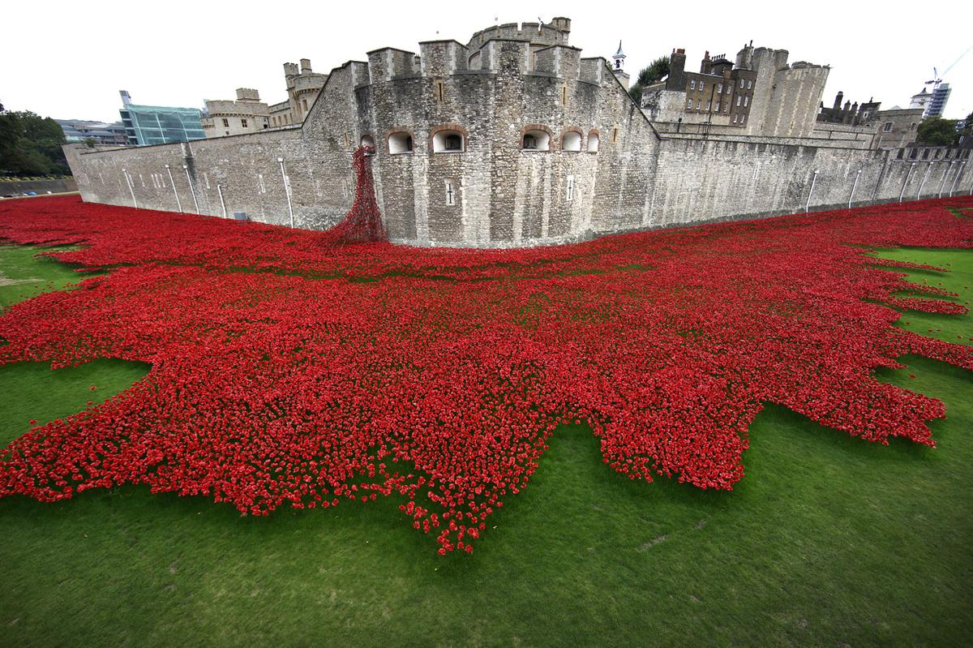
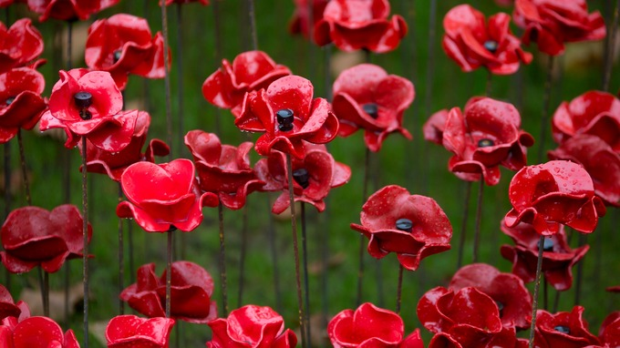
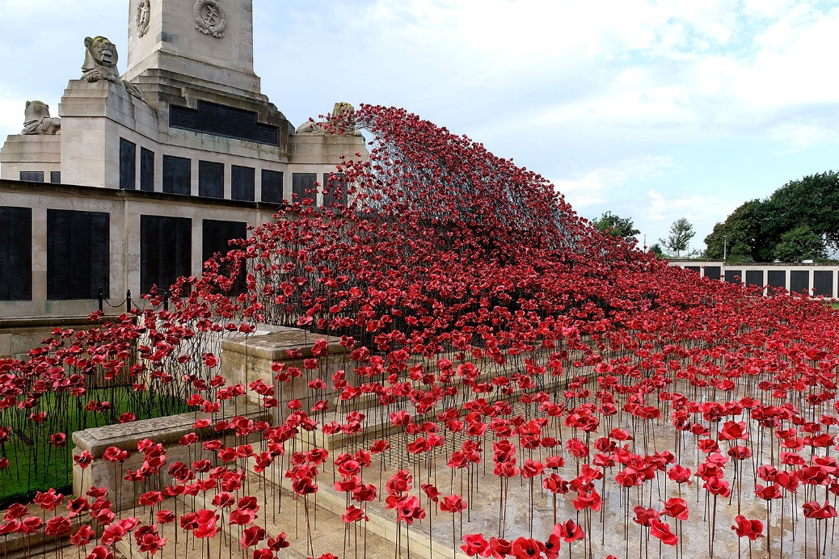
Paul Cummins, blood swept lands and seas of red.
What do you think the poppies are made from?
Notes:
To commemorate the 100th anniversary of the start of the First World War, Paul conceived and created a truly memorable installation, Blood Swept Lands and Seas of Red at the Tower of London between 17 July and 11 November 2014. The installation was made up of 888,246 handmade red ceramic poppies, one for each British and Colonial life lost at the Front in the First World War. Each day thousands of poppies were ‘planted’ in the Tower’s moat by volunteers from across the world. Each poppy from the installation was sold, with proceeds donated to charity.

Slide 8
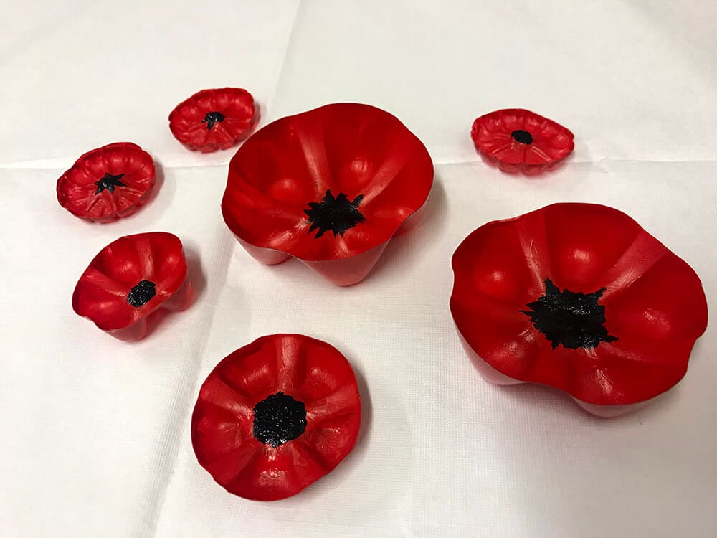
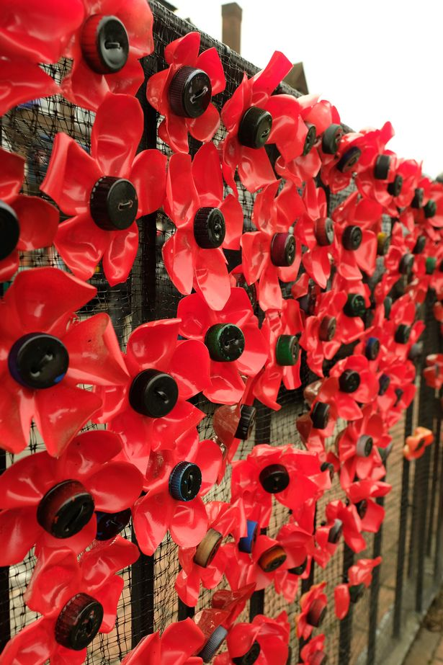
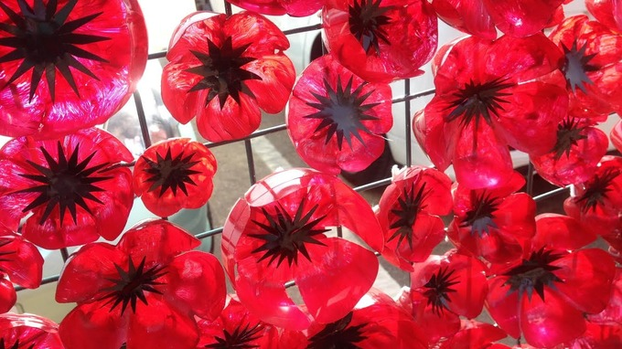
Today using plastic bottles we will be making our own purple poppies. Have a look at the different shapes created using the bottles.

Slide 9
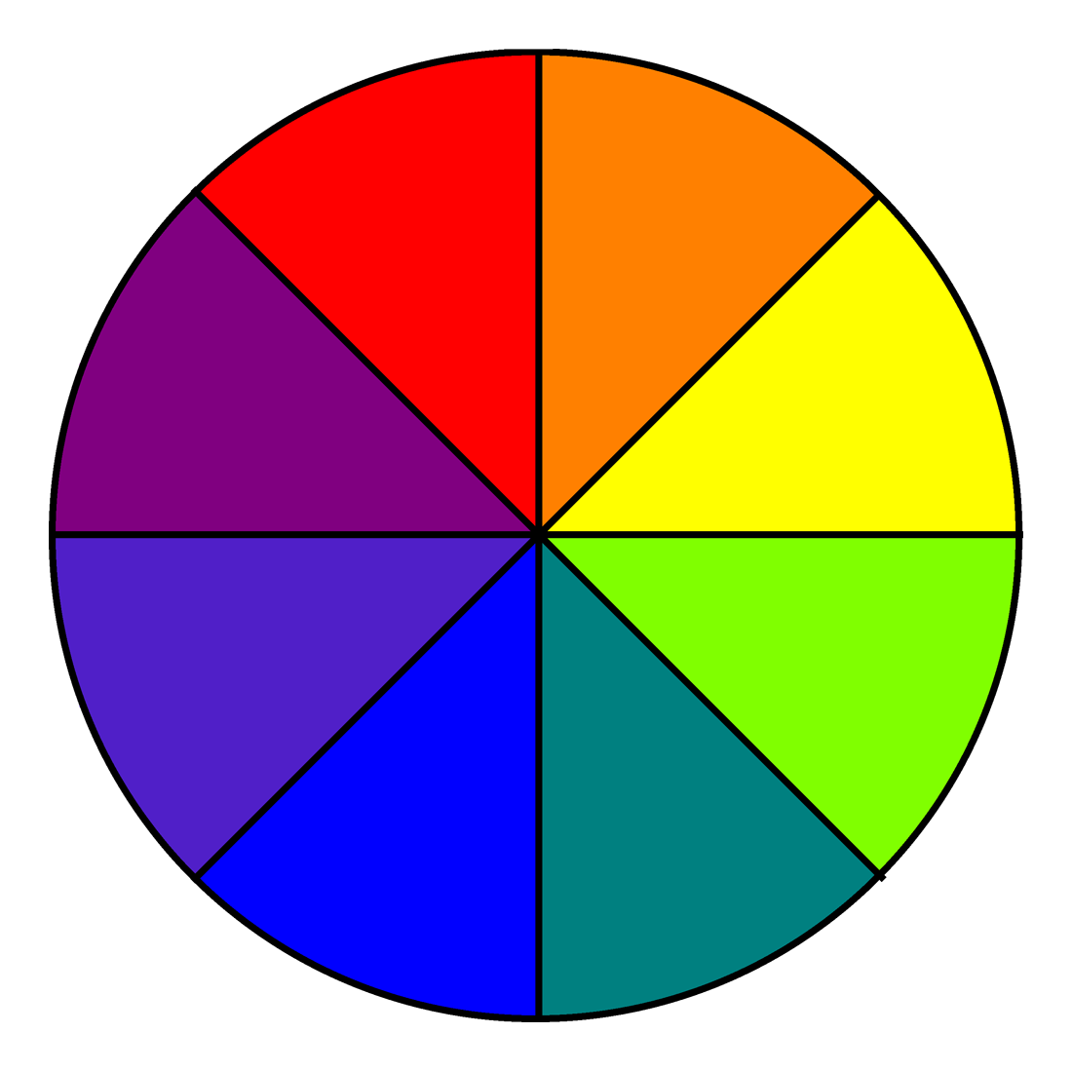
How can we make purple?
Using our knowledge of primary and secondary colours how can we make purple?

Slide 10
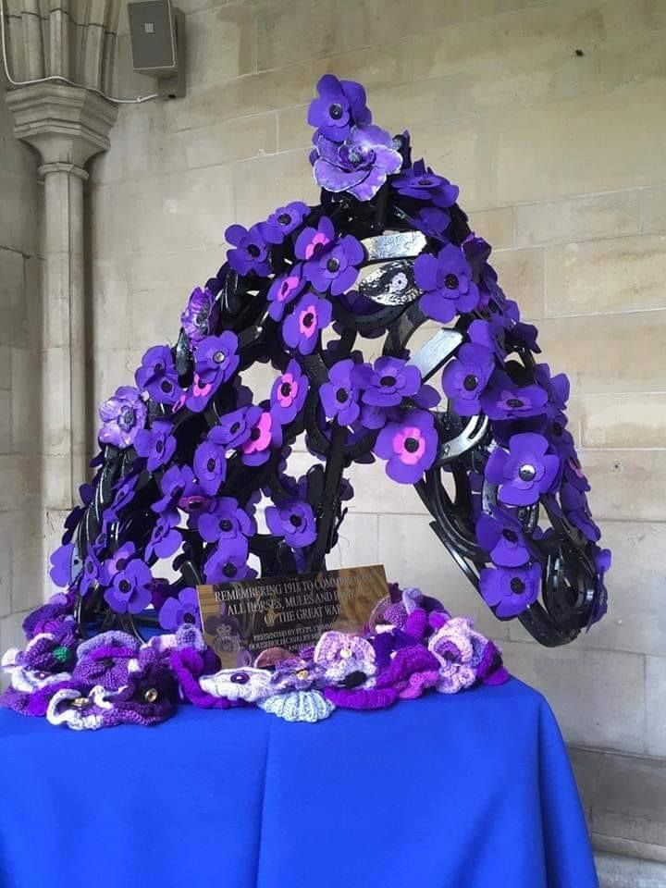
Task:
In your art book sketch the shape of the poppy you wish to do. Then using the palettes mix the primary colours to create purple. Make swatches in your art book and write a comment whether it is the colour you wanted, and if it isn’t, what do you need to do to fix it?
Then when you are happy with your purple paint your poppy.

