Slide 1
PSHE
LO: To recognise the negative effects of stereotyping and prejudice

Slide 2
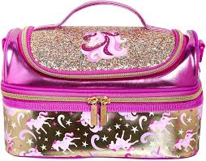
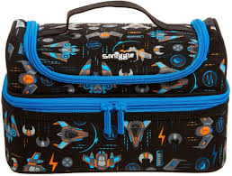
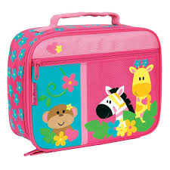
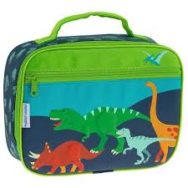
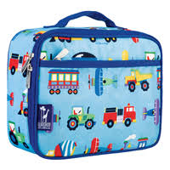
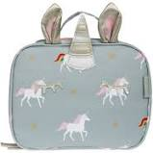
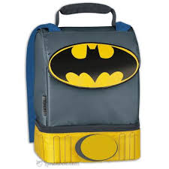
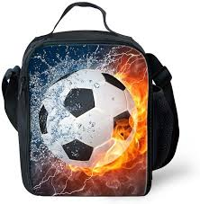
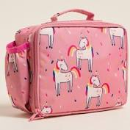
Who have these lunchboxes been designed for?

Slide 3
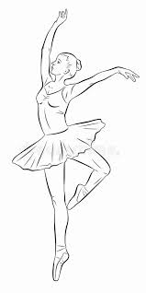



Drawing task
Divide a piece of paper into quarters
Draw one of the following in each quarter:
  A ballet dancer
  A scientist
  A builder
  A nurse
Now reflect on your drawings; do they look like these?

Slide 4

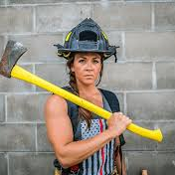
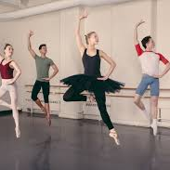
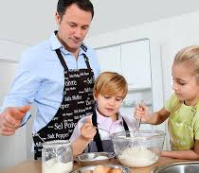
Challenging the stereotypes
Can you think of some examples where people challenge the stereotypes?

Slide 5
What are your opinions about these statements?
All people with red hair are bad tempered
All black people are fast runners
People who wear glasses are the most clever
Old people are boring
All teenagers are rude time wasters
Mums make the best dinners
Girls can’t play football

Slide 6

Thinking time…
How do you think stereotyping shapes people’s first perceptions of others?
How do you think stereotyping might affect people’s behaviour?
How do you think stereotyping might affect peoples choices about their own lives?
What judgements and assumptions might people make about you as a result of stereotyping?
How does that make you feel?

Slide 7
What can I do about it?
How could you help to combat the unfair treatment of groups who are regarded as different?

