Slide 1


Anti-Bullying
Week 2021

Slide 2
L.O: To understand what is bullying and how we can be kind to everyone.
Must: Understand what it means to be kind.
Should: Understand the definition of bullying.
Could: Explain how to help someone who is being bullied.

Slide 3
?
What is bullying?
Bullying is the repetitive, intentional hurting of one person or group by another person or group, where the relationship involves an imbalance of power. It can happen face to face or online.
Video: https://youtu.be/U8iX-rstY9I
Anti-Bullying Week 2021 – One Kind Word
3

Slide 4
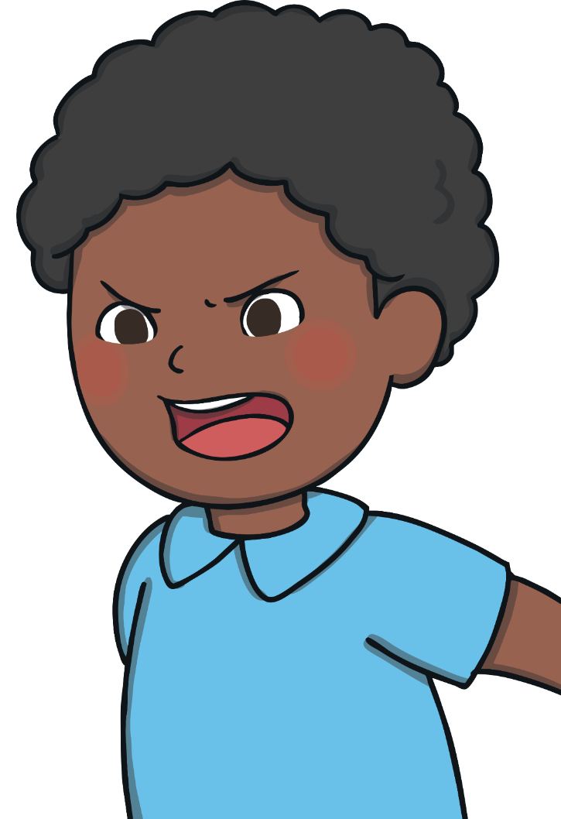
What Is Bullying?
Remember, bullying is hurting someone on purpose over and over again. It is not when an unkind thing happens only once.
Bullying can be shouting at or teasing another person.
Bullying can be saying unkind things to somebody or
whispering unkind things about somebody else.
Bullying can be saying unkind things about
someone’s body.
Bullying can be saying unkind things about how
somebody looks, what they are wearing or what
they are doing.
Bullying can be saying somebody can’t join in.

Slide 5
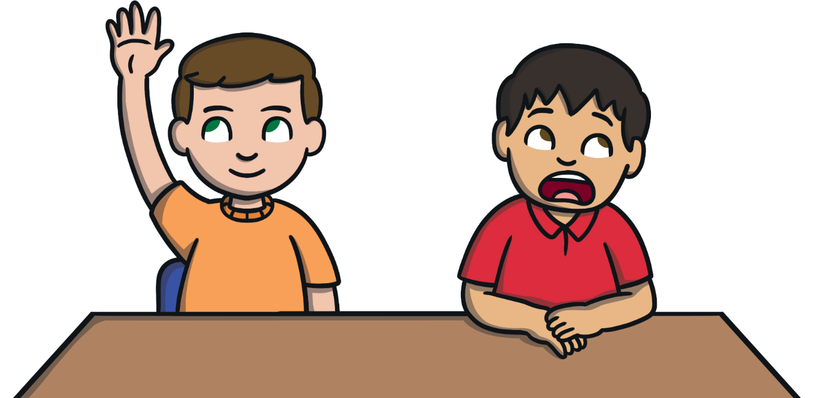
We Are All Different
We are different for lots of different reasons.
eye colour
skin colour
hair colour
family
what we find tricky to do
body shape
likes and dislikes
Can you think of any more?

Slide 6

Anti-Bullying Week 2021
In 2021, Anti-Bullying Week begins on Monday 15th until Friday 19th November. The week will begin with Odd Socks Day.
The theme this year is One Kind Word
Kindness is more important today than it
has ever been before. The isolation of the
last year has made us more aware of how
little acts of kindness can brighten the
lives of the people around us.
Remember:
Small actions make a huge impact.
Ask someone if they’re OK.
Say you’re sorry.
Say hello!

Slide 7
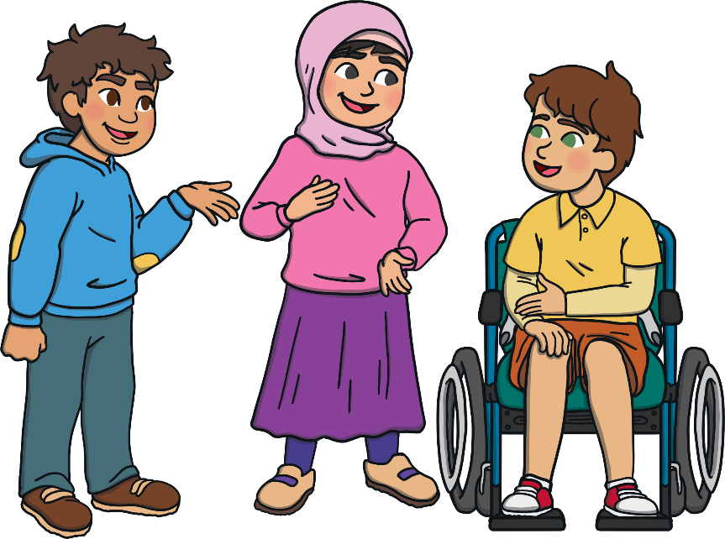
One Kind Word
One kind word can give a moment of hope. Something so small can change someone’s thoughts from bad to good. It can change their day and help to end bullying.
One kind word leads to another kind word. Kindness spreads and we can create a chain of kindness.
What kind word could you pass on today?

Slide 8
?
How does being bullied make someone feel?
Think / Pair / Share
Anti-Bullying Week 2021 – One Kind Word
8

Slide 9
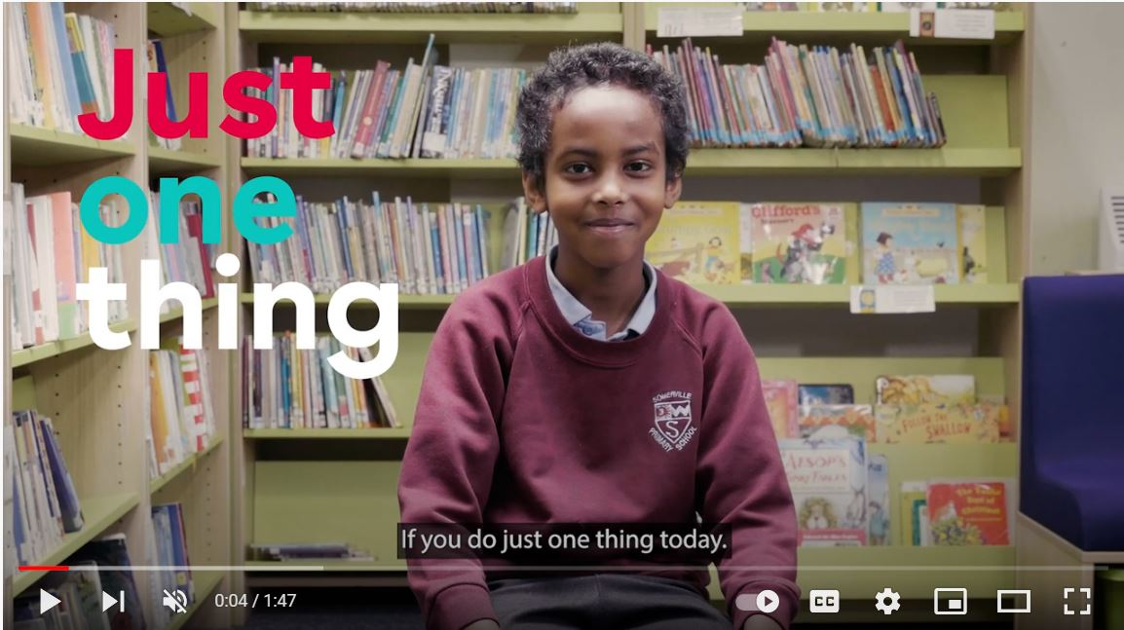


“
“
https://youtu.be/oJQg2JyQ3mM
Anti-Bullying Week 2021 – One Kind Word
9

Slide 10
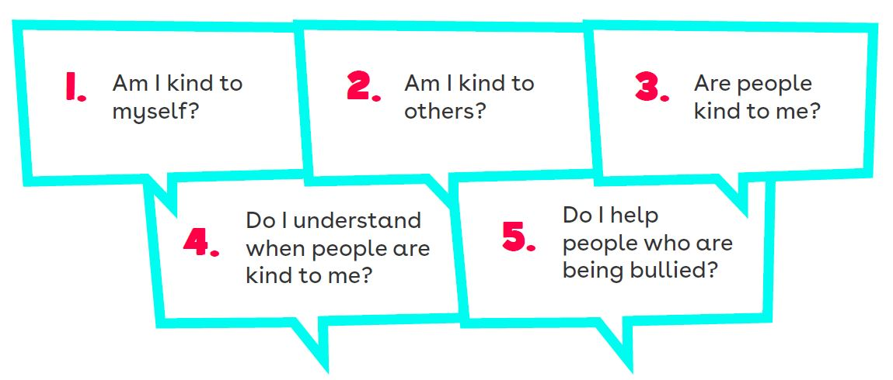
5 Key Kindness Questions
Anti-Bullying Week 2021 – One Kind Word
10

Slide 11
Situation
1
You see Tomas sending Molly unkind messages on Roblox
What could you do to spread kindness and stop bullying?
Anti-Bullying Week 2021 – One Kind Word
11

Slide 12
Situation
3
Henry is getting pushed by other children when they’re standing in line
What could you do to spread kindness and stop bullying?
Anti-Bullying Week 2021 – One Kind Word
12

Slide 13
Situation
4
At choir your friend tells you they don’t like Mya because they don’t like her singing voice
What could you do to spread kindness and stop bullying?
Anti-Bullying Week 2021 – One Kind Word
13

Slide 14
Task:
Create a informative poster or leaflet explaining how we can be kind.
What ways can we show kindness? How does it make people feel when they are shown kindness?

