Slide 1
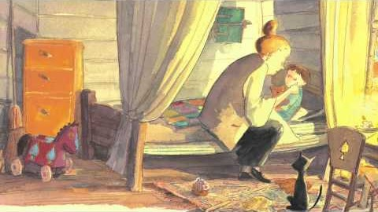
What do we do to keep things safe and private? Listen to this story ‘Password Please?’ and then discuss with your class the lessons you have learnt from the story.
Talking about the right to privacy might make you think about ‘personal space’. Discuss with your teacher and class what personal space means and how we respect each other’s personal space. This ‘social story’ in symbol format may help the discussion. Create a set of top tips or design a poster to remind everyone about personal space.
Watch this telling of the book 'Some Secrets Should Never be Kept' by Jayneen Sanders and use as class discussion. *Teachers - this story contains sensitive subjects so please watch it first before sharing with the class.
A few weeks ago, some new rules came into force to help with online privacy and safety. See the Newsround article about internet safety and then talk about the Children’s Code with your class and your teacher.

Slide 2

Think about why privacy is important to you. Have a go at showing your reasons in a way that works for you. It could be a list, a piece of creative writing or a picture.
Watch this video about privacy online. Use this as a starting point for class discussion.
Look at the PANTS lessons from the NSPCC. What can you remember about this? Discuss how these link to your right to privacy?
You have the right to privacy. Think about a 2-year-old, a 10-year-old and a 16-year-old. What are the similarities and differences in the types of privacy that should be respected at these ages?

