Slide 2
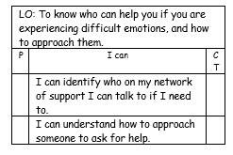

Slide 3
The Big Questions

Slide 4

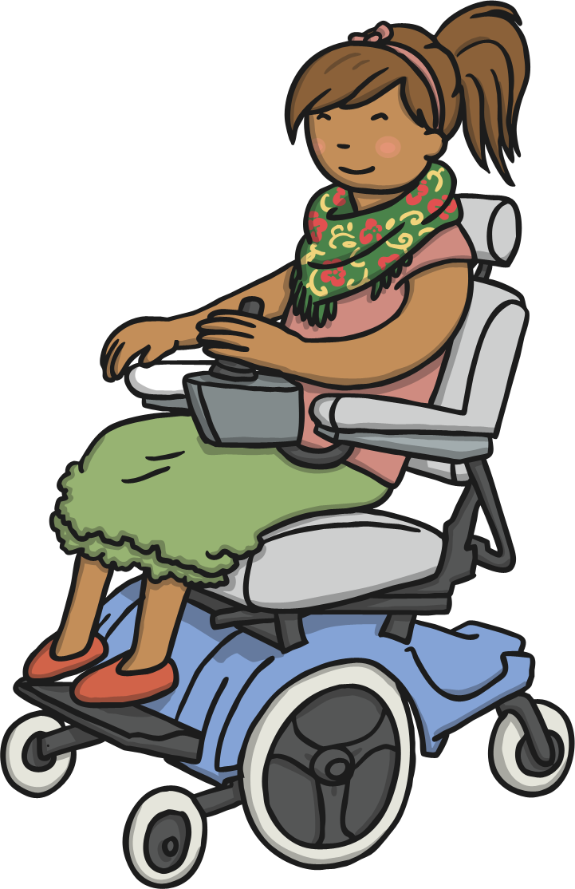
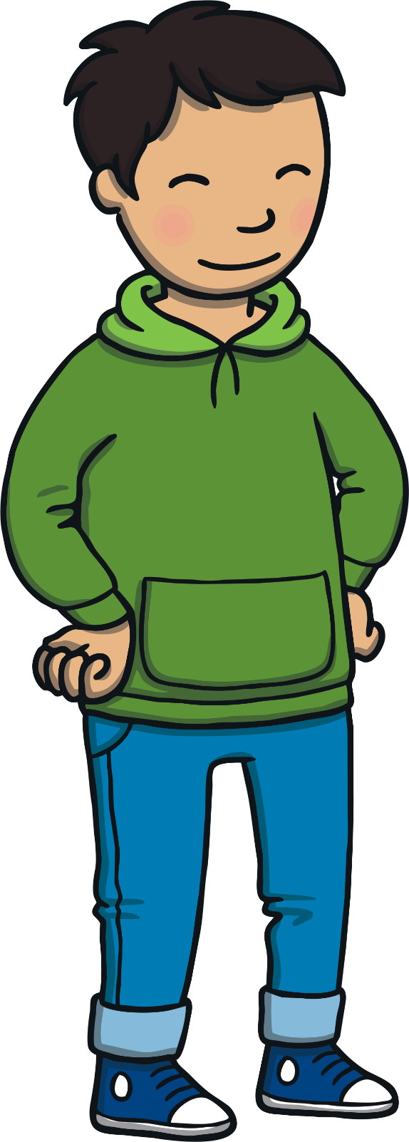
Which people help keep us safe?
How can we help those people to look after us?

Slide 5
Reconnecting

Slide 6

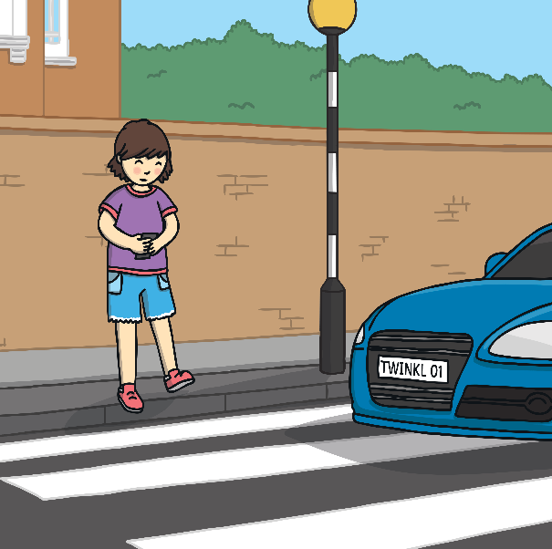
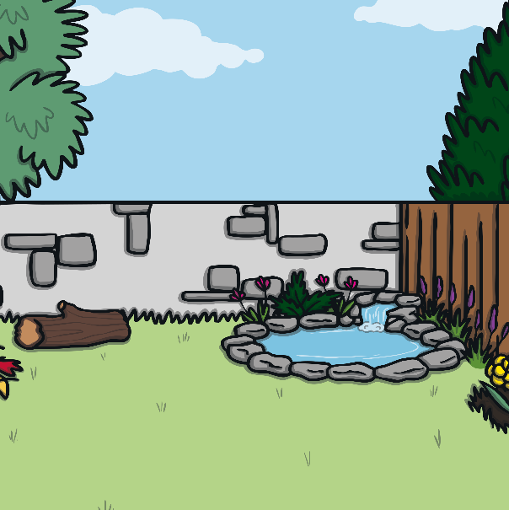
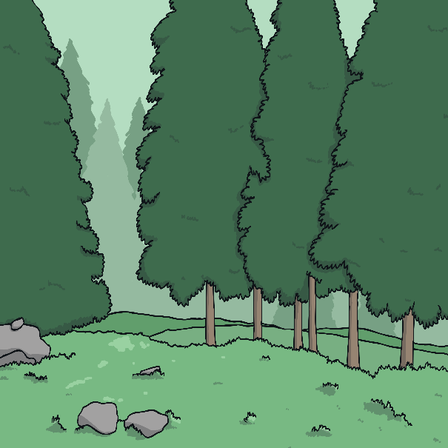
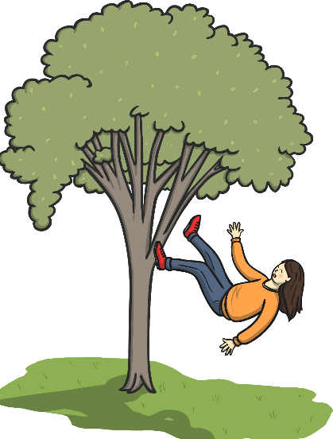
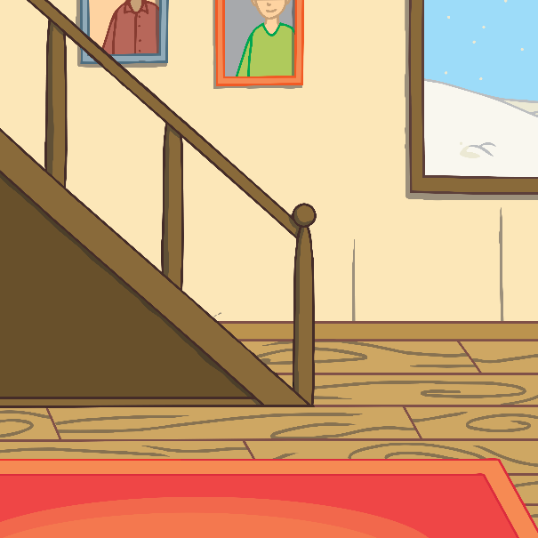
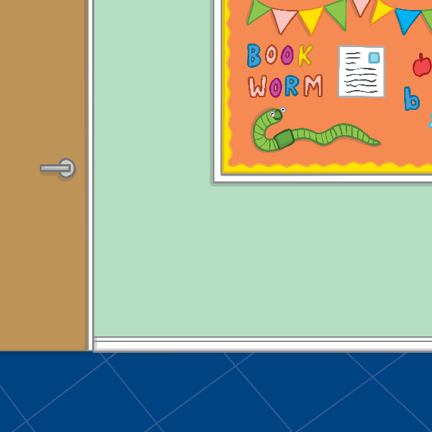
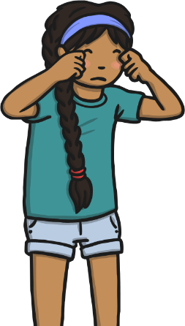
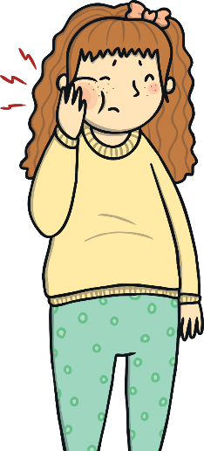
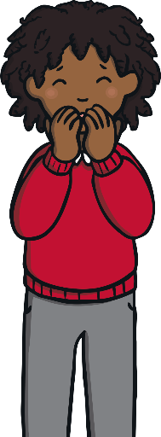
Who Can Help?
Hopefully, you can think of lots of people who can help you.
lost
toothache
worried
danger
a bad fall
Look at these children and discuss, in your groups, who can help them.

Slide 7
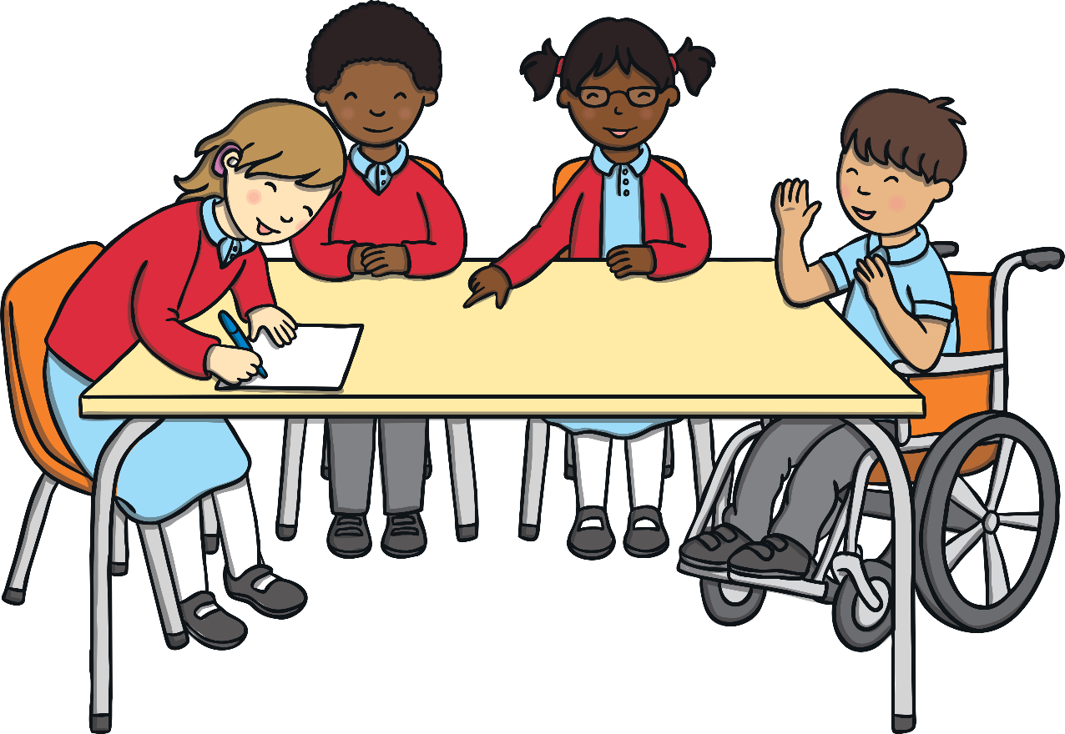
Who Can Help?
There are people who help us stay safe at home, people who help us at school and people who help us stay safe when we are out.
Different people can help us at different times and in different situations.
There are also people who help in emergencies.

Slide 8
Exploring

Slide 9

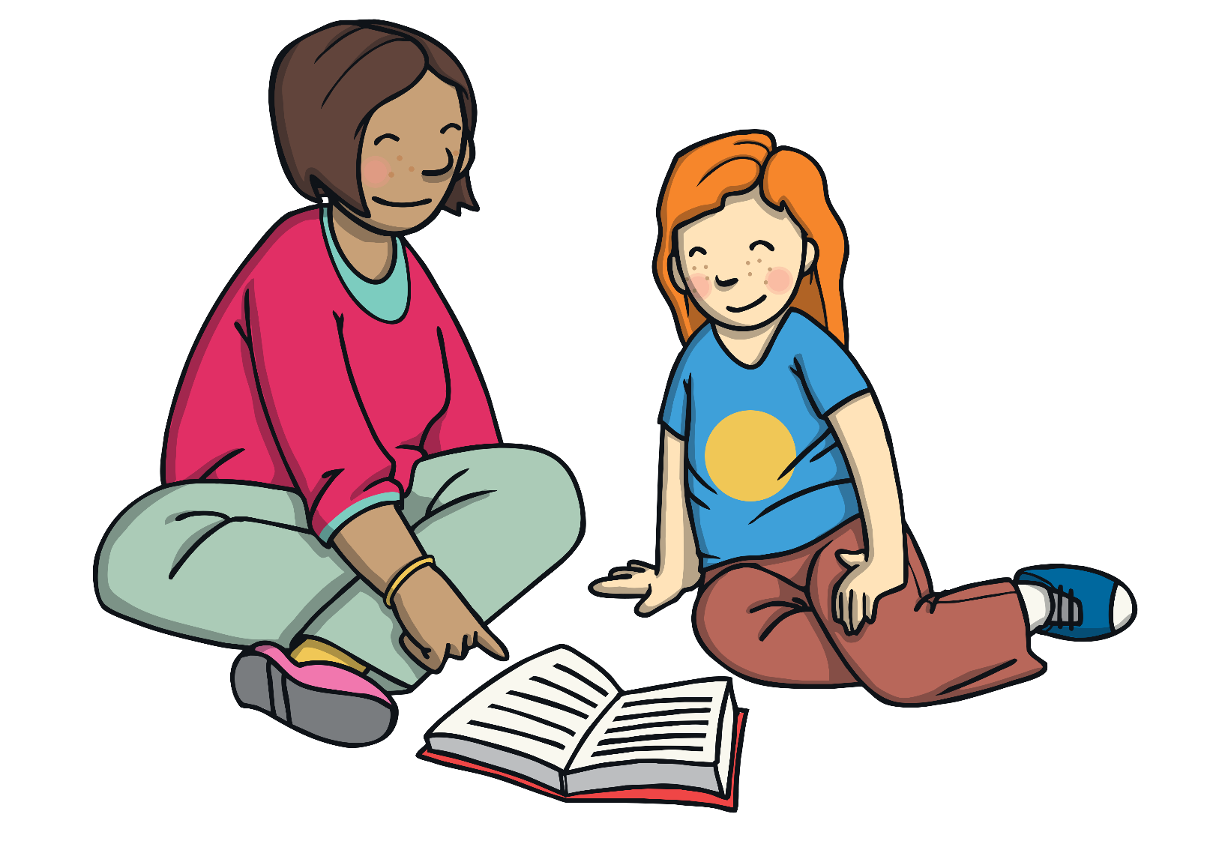
Who Helps Me?
We all have special people who can help us. When we are young, we might need more help with all sorts of things, including staying safe.
Who helps you at home?
Who helps you at school?
Maybe you go to a club – who helps you there?

Slide 10
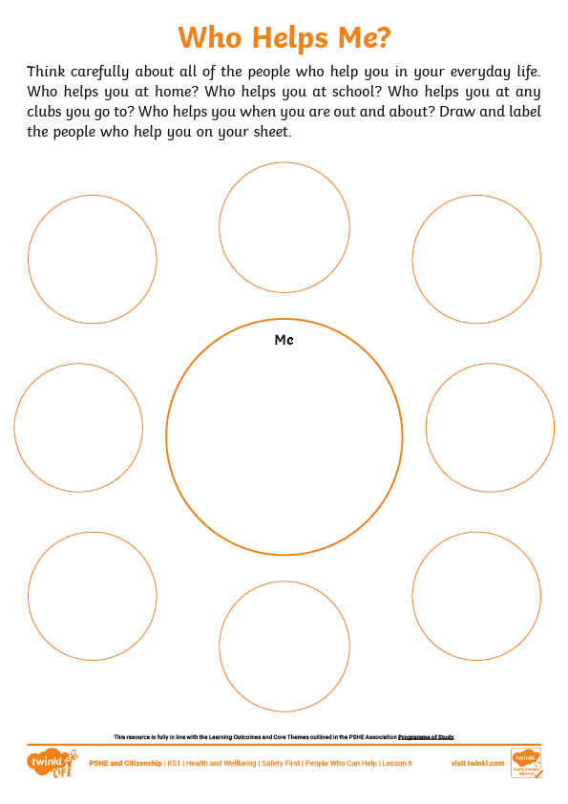
Who Helps Me?
Think about all of the people who help you in your everyday life.
You are going to draw and label them on your Who Helps Me? Activity Sheet.
Include anyone who is special to you, who is there for you and who helps you to stay safe.
You might have some people on your sheet that are the same as others in the class but you will probably have some people that are not on anyone else’s sheet.
Let’s share some of the special people you have put on your sheet.

Slide 11

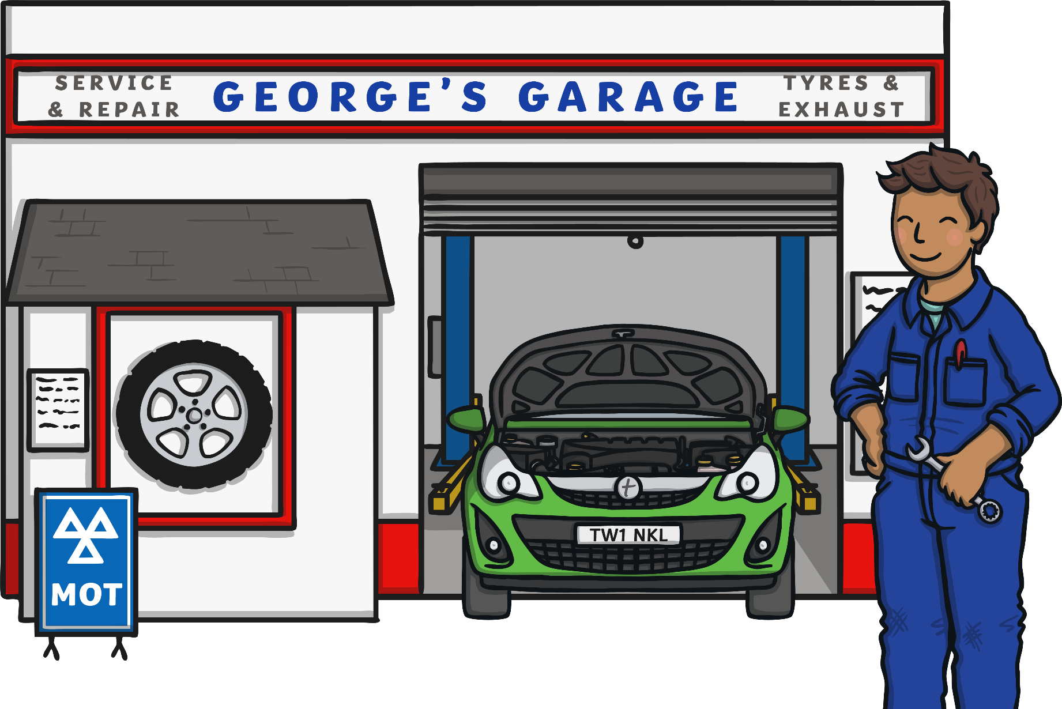
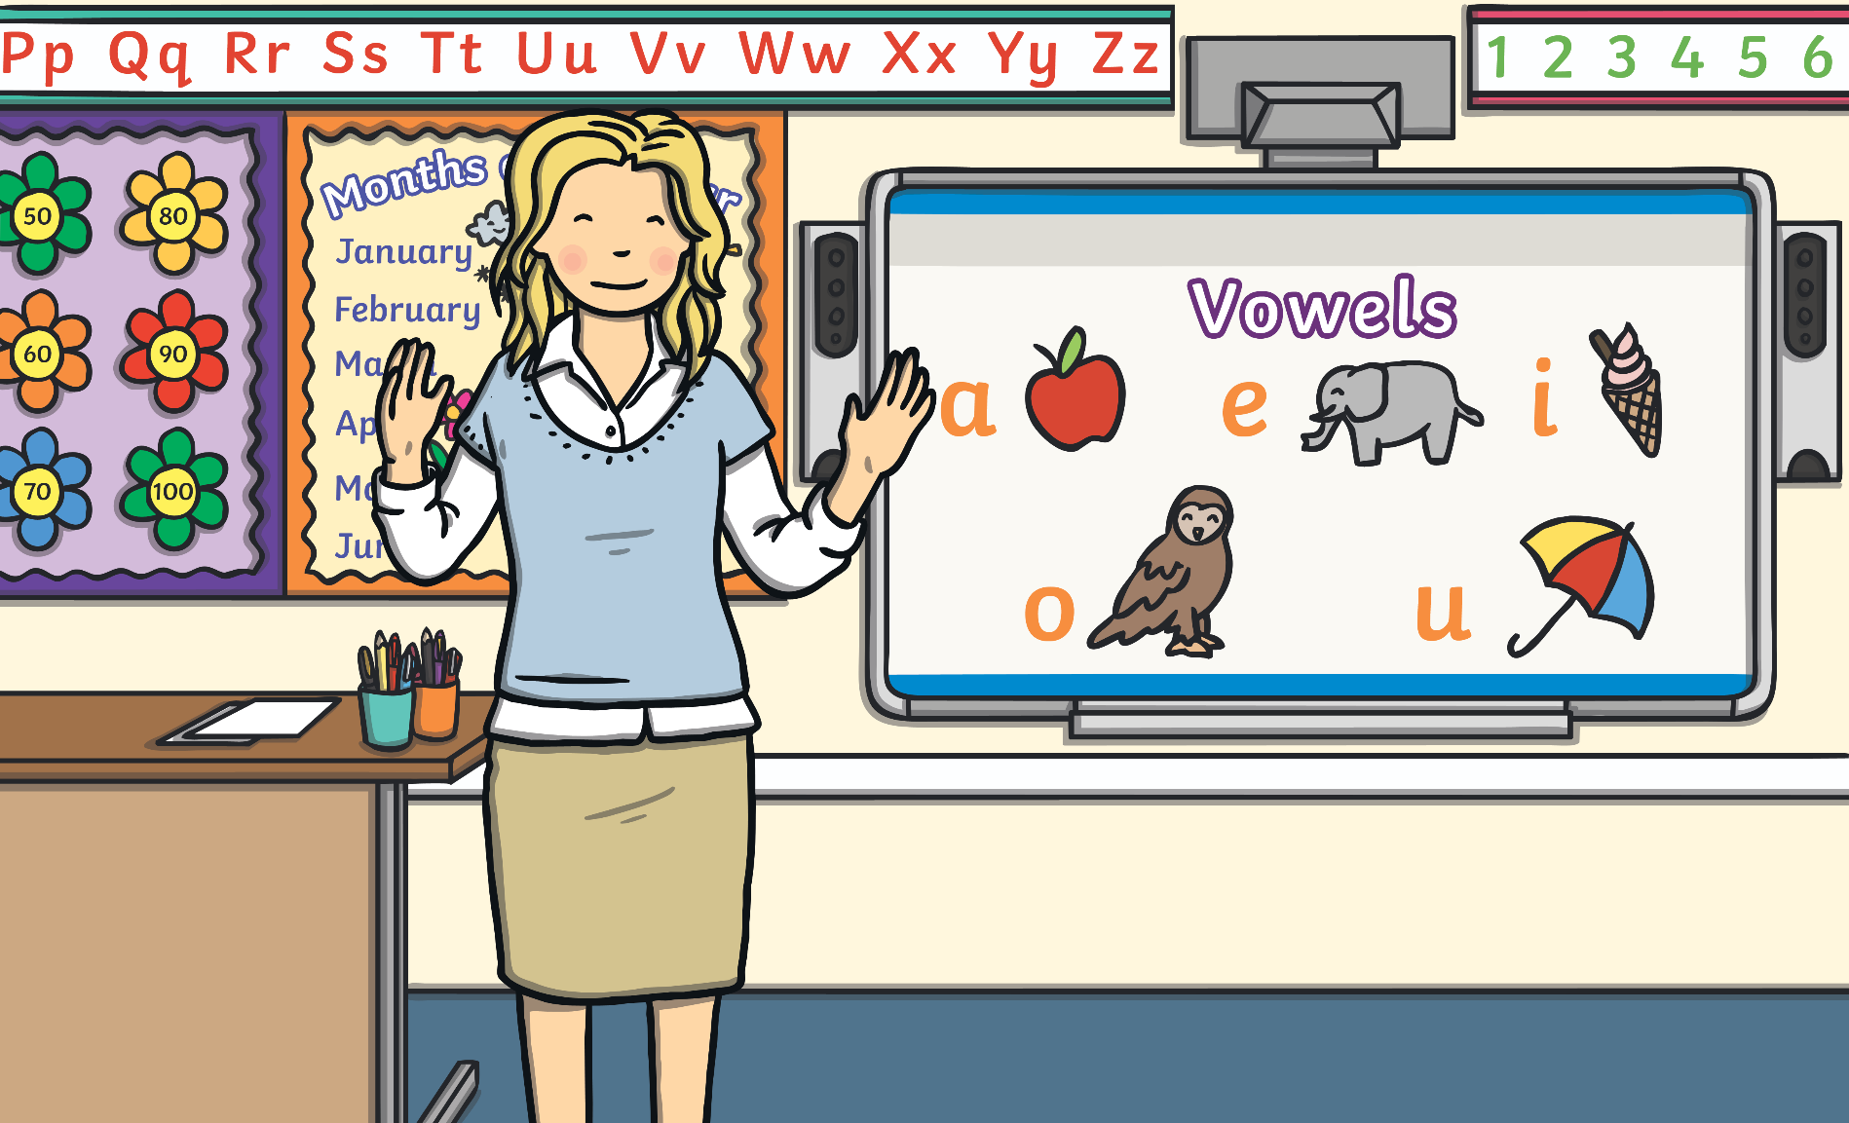
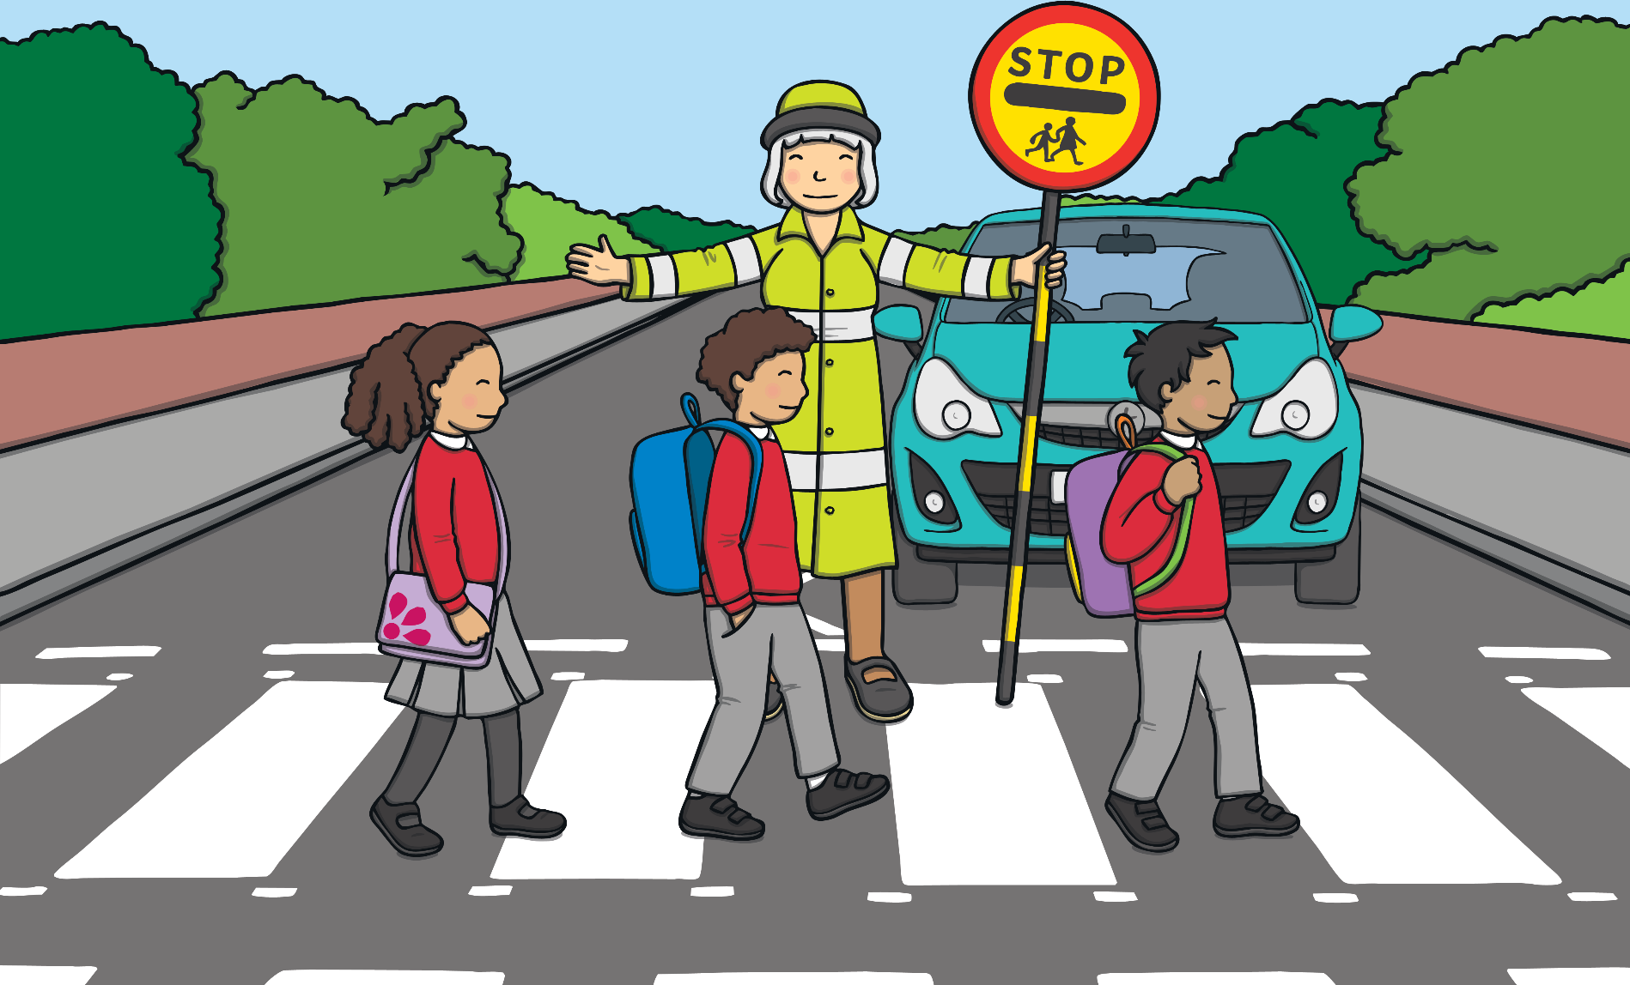
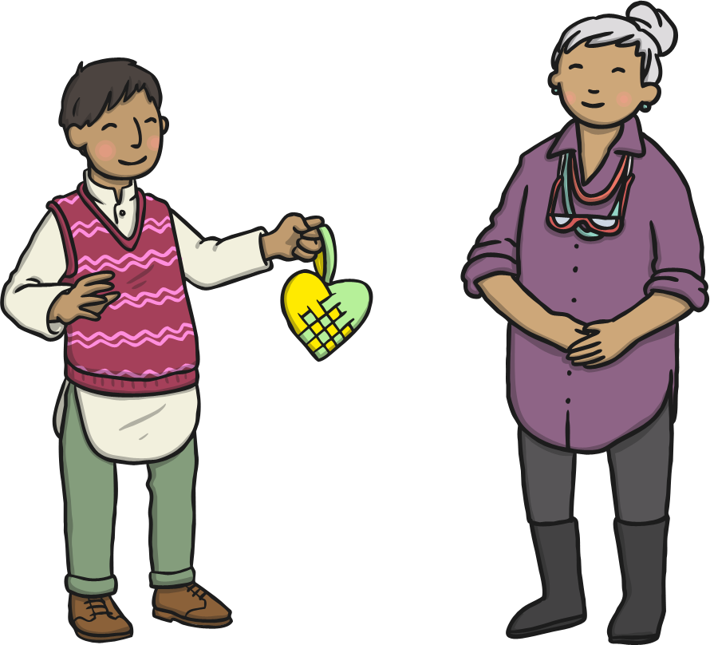
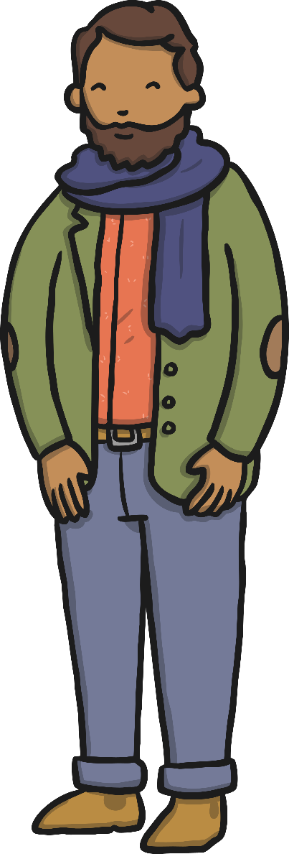
Helping Those Who Help Us
We all need help sometimes. Even grown-ups need help from others.
There are things we can do to keep ourselves safe and things we can do to help those who look after us.
We often need help from other people but we also need to help those people who help us.
Can you think of anything we can do to help those who help us to stay safe?

Slide 12
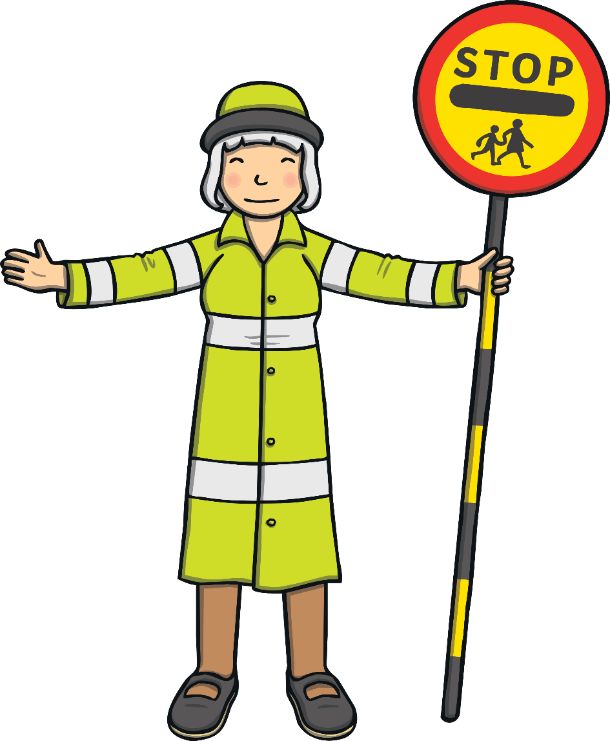
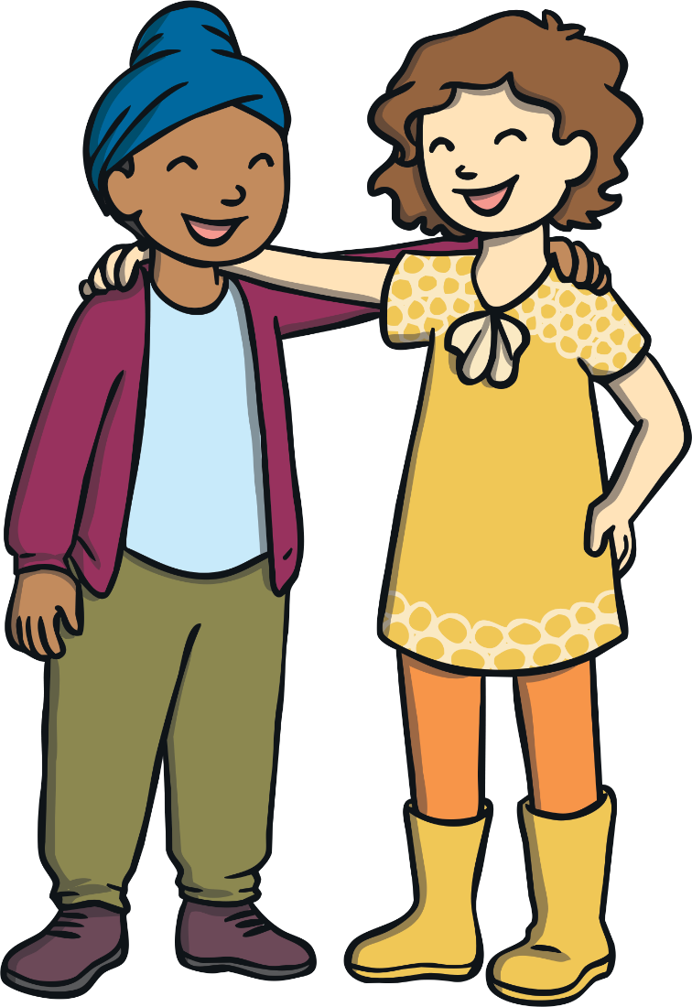
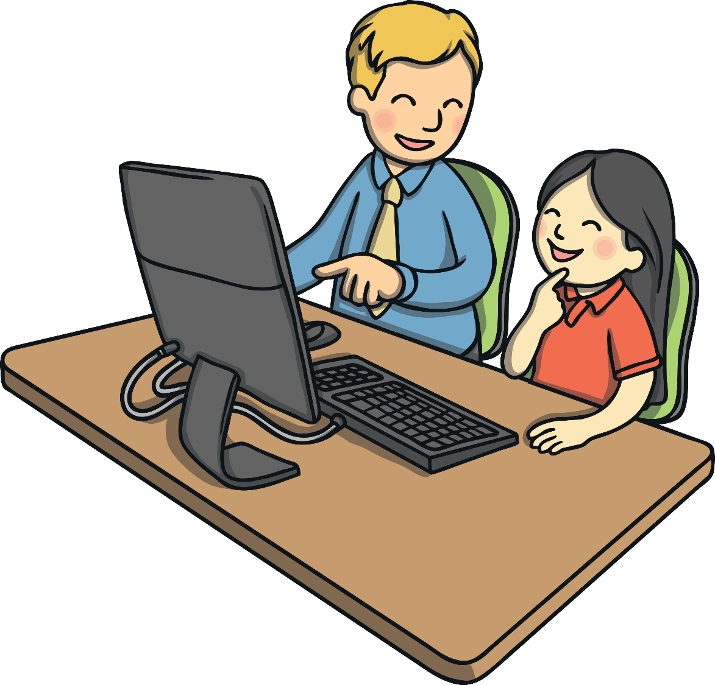
Helping Those Who Help Us
We can do what grown-ups ask us to do.
We can look at and read safety signs.
We can listen to advice from adults.
We can follow safety rules wherever we are.

Slide 13
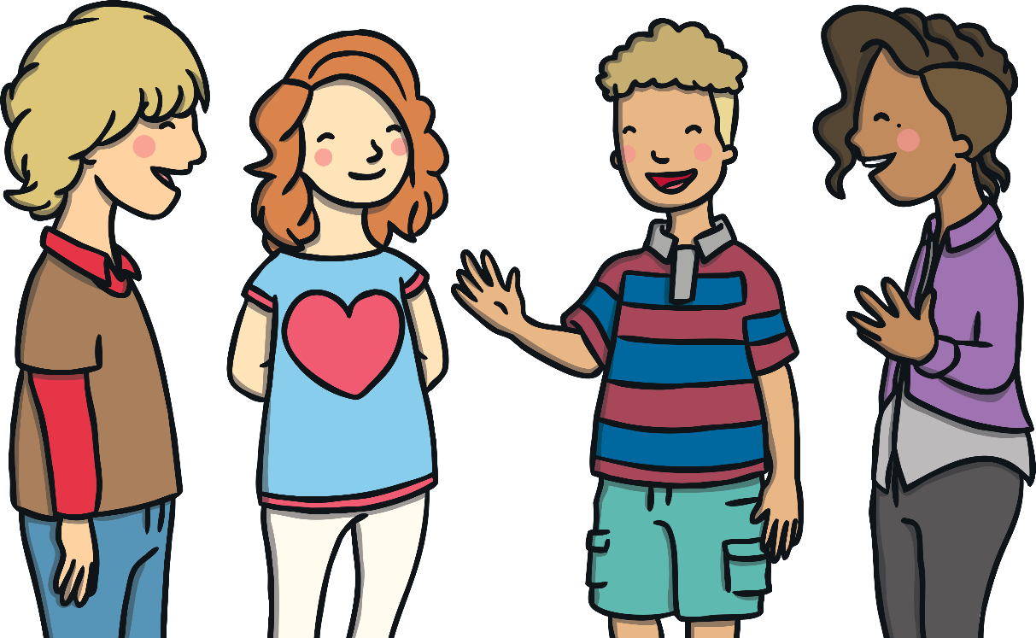
Helping Those Who Help Us
There is something else very important that we can do to help those who help us — talk!
Tell someone if you think you are in danger.
Speak up if you are in trouble.
Ask for help when you need it.
Why do you think this is so important to do?
Those who help us cannot help if they don’t know we need help.

Slide 14
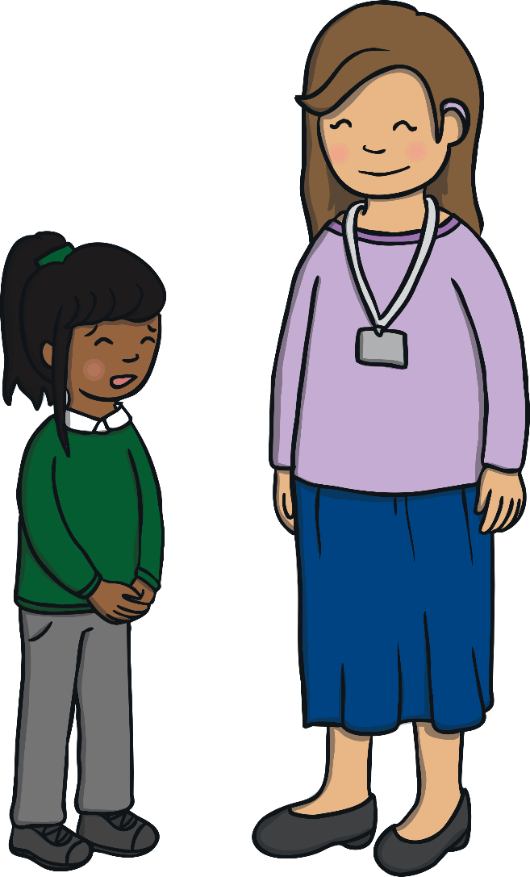
Helping Those Who Help Us
Those special people you drew on your activity sheet earlier are usually the best people to speak to if you feel you are in any sort of danger.
If you ask one person for help and nothing happens,
ask someone else you trust to help.
Reflecting
If there is an emergency and no adult around, call 999.
If you need advice but have no one to speak to, call Childline on 0800 1111.
Consolidating

Slide 15
Consolidating

Slide 16
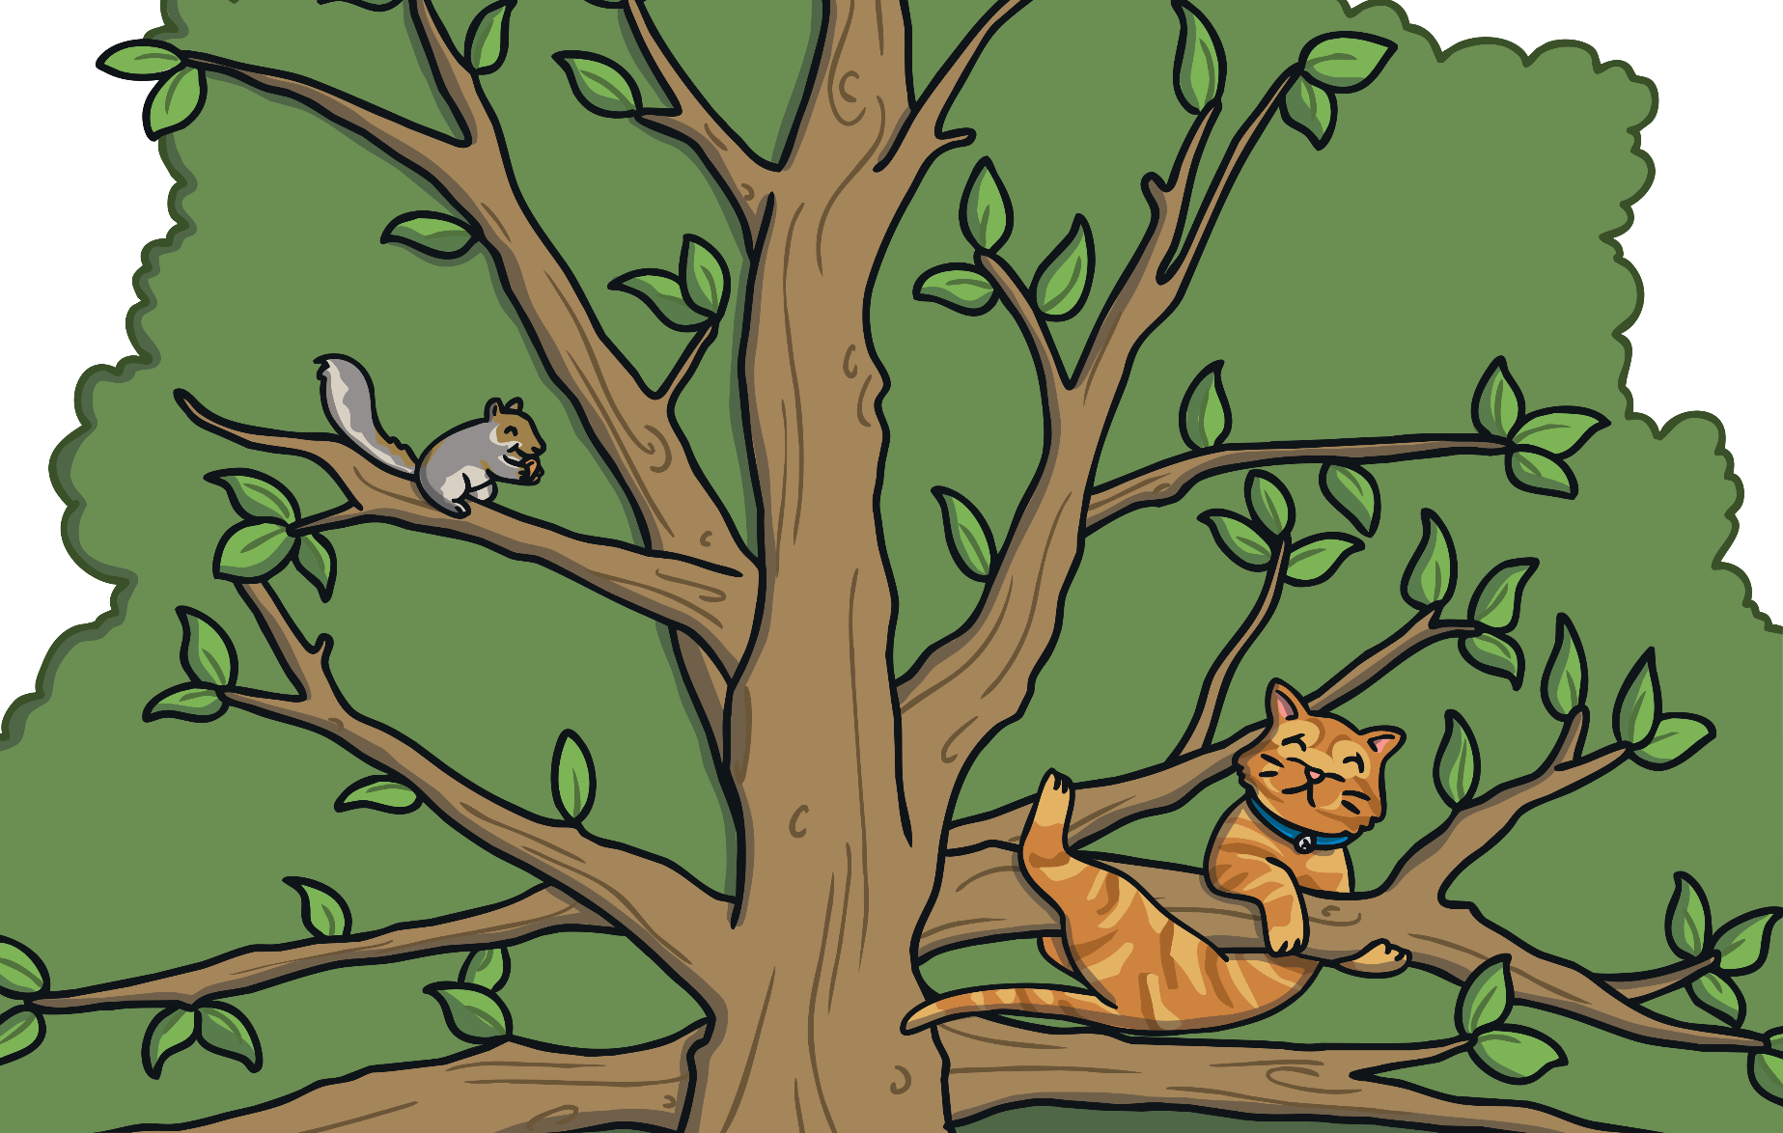
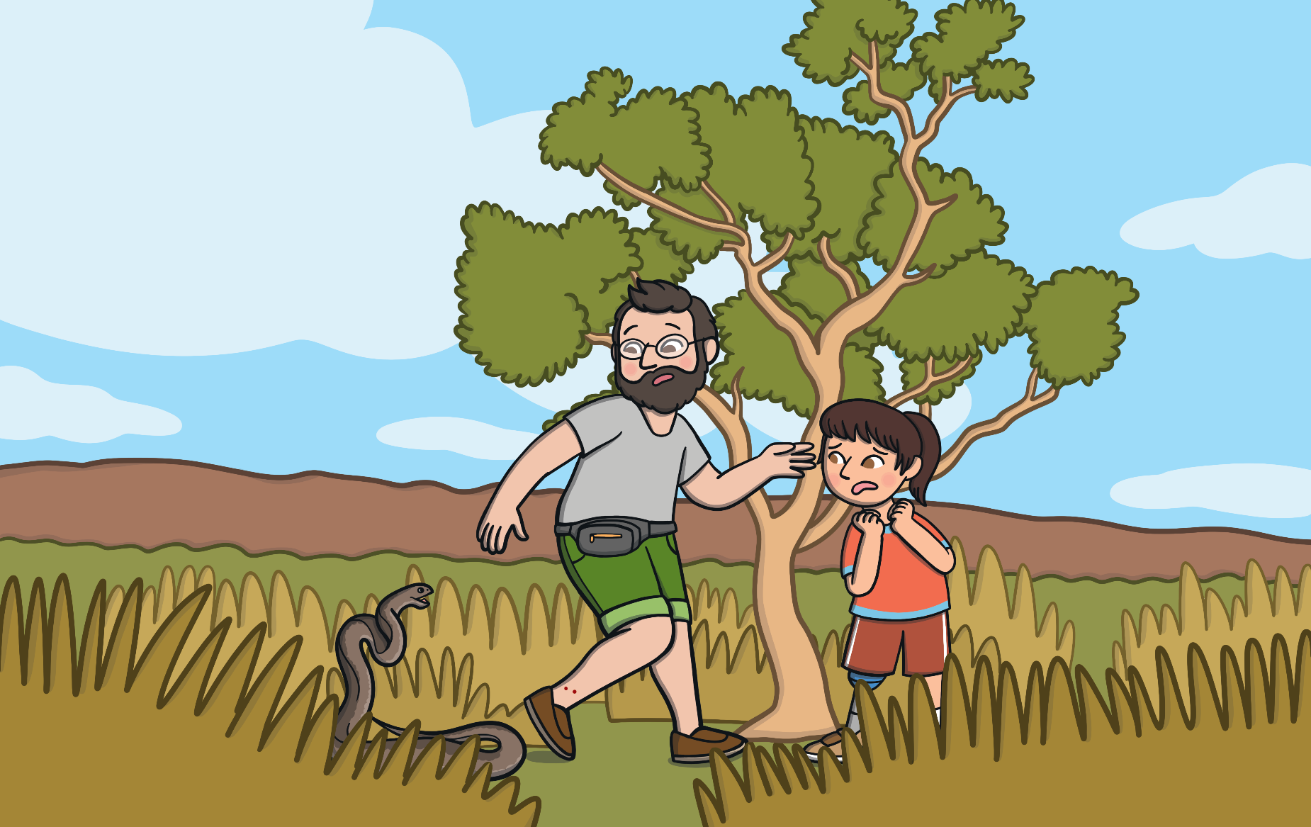
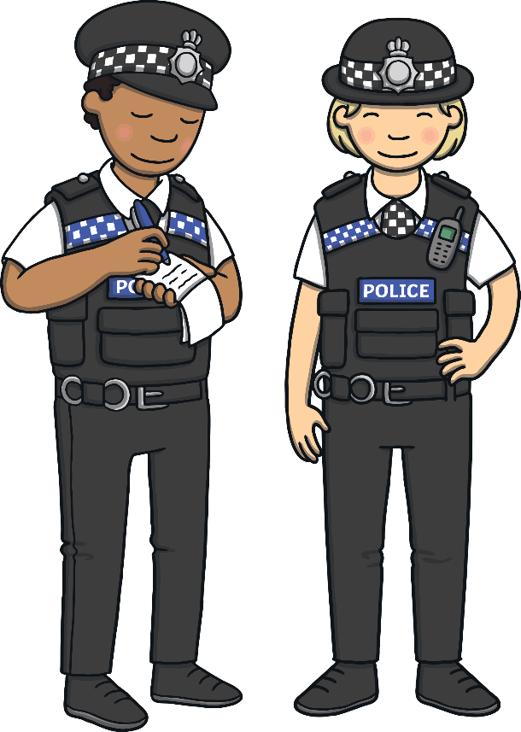
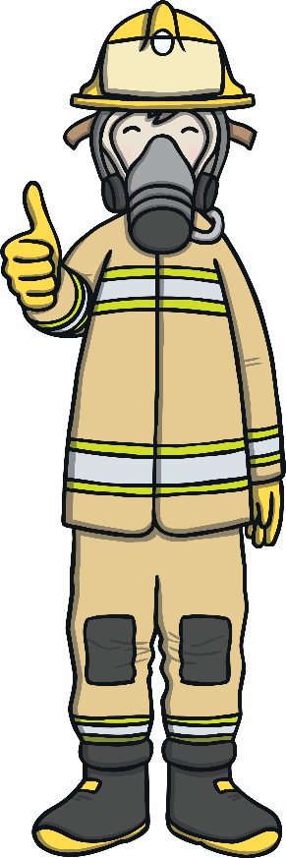
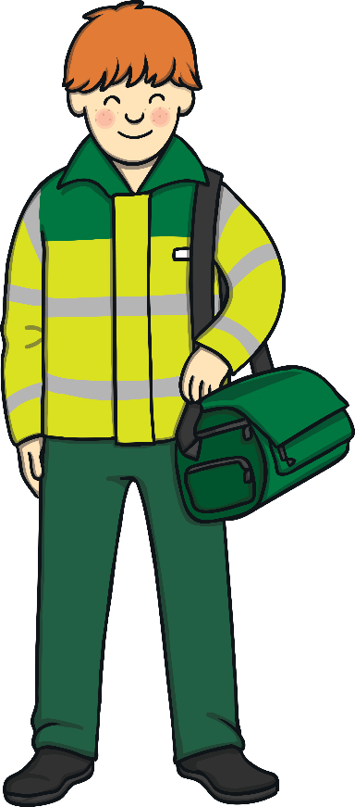
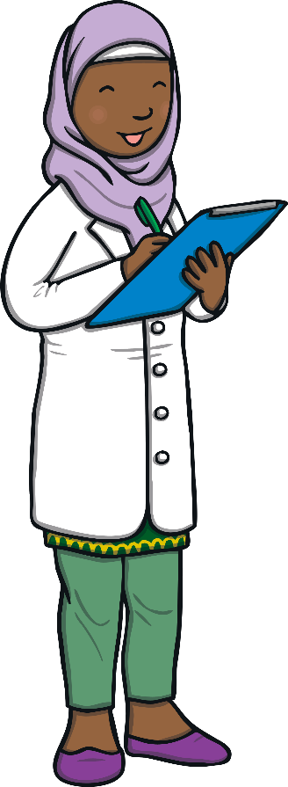

In an Emergency
We have been thinking about lots of different people who can help us when we need help. Many of these people are specially trained to know what to do in an emergency.
In your groups, you are going to create a short role play about an emergency. Some of you can be the people who need help and others can be the people who help.
It could be a medical emergency when someone is hurt or ill. It could be a fire or natural disaster, such as an earthquake, landslide or storm. It could be a crime or someone in danger due to water or because they are lost or stranded.
On the next slide are some ideas for your role plays.
An emergency is a situation that is likely to be serious or dangerous and often happens without any warning.

Slide 17
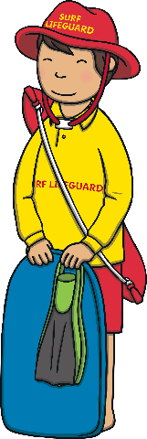

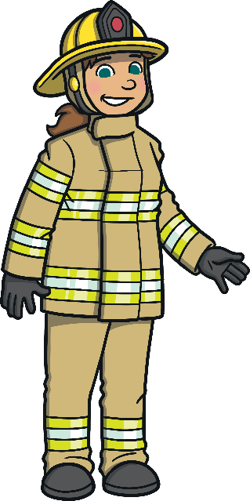
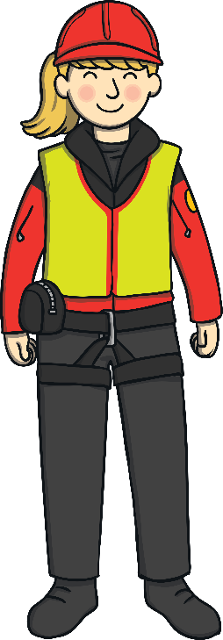
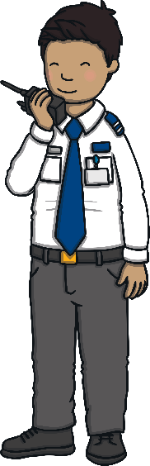
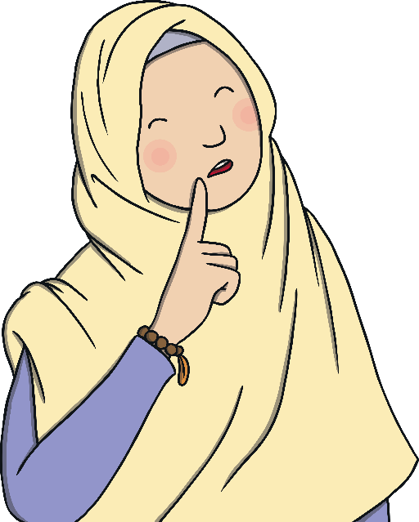

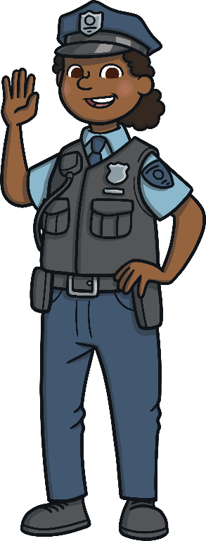
In an Emergency
Some children are at the swimming pool and one goes too far in the deep end. They are in trouble so the lifeguard jumps in to help.
A child has been knocked over by a car.
The ambulance has arrived.
There is a small fire in the school kitchen. Firefighters are here to help.
A family are walking in the mountains when one of the children slips on a rock and falls down onto a ledge. Mountain rescue are called to help.
Some children are lost in a shopping centre. The security guard helps.
A child keeps getting messages from a stranger online asking them to meet up. The child’s parent has reported it to the police.

Slide 18
Reflecting

Slide 19

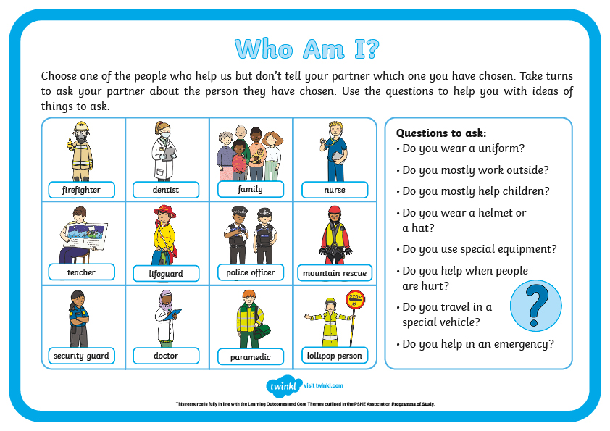
Who Am I?
Let’s think about all of the different people who can help us and how they can help in different ways.
Choose one of the people to pretend to be then take turns to ask each other questions. Try to guess who your partner is before they guess who you are!
We are going to play a game in pairs. It might be similar to a game you have played before.
There are questions on your sheets to help you.
You and your partner will each have a sheet with lots of different people who help us on it.

Slide 20
The Big Questions

Slide 21
Which people help keep us safe?
How can we help those people to look after us?
What have you learnt today that will help you to stay safe?

