Slide 1
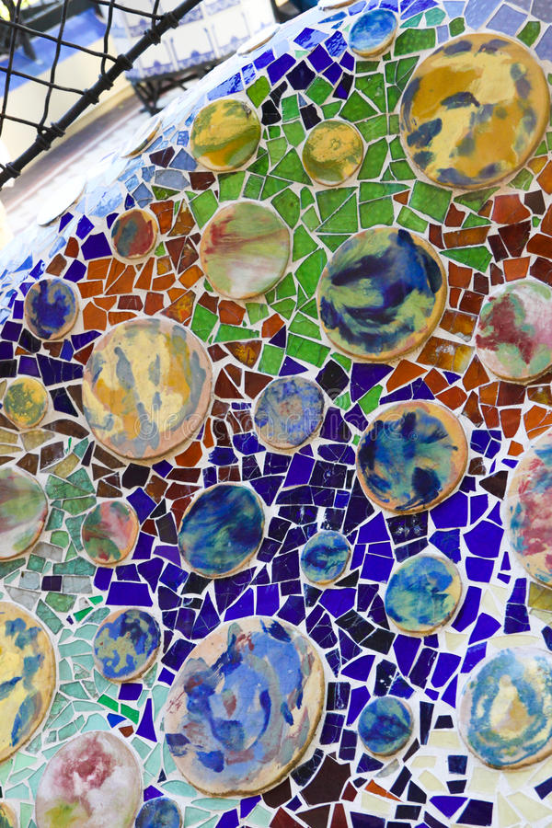
Pattern
Antoni Gaudi

Slide 2
LO: To use pattern to create a piece of artwork in the style of Antoni Gaudi.
I understand what pattern is.
I can mix colours to create different shades.
I can copy and replicate patterns used by Gaudi.

Slide 3
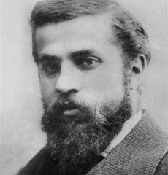
What do we know about Antoni Gaudi?
He was born in 1852 and died in 1926.
His name is Spanish, and he was from Catalonia
Gaudí's work was influenced by his passions in life: architecture, nature, and religion.
He considered every detail of his creations and joined into his architecture such crafts as ceramics, stained glass, wrought ironwork forging and carpentry.

Slide 4
Notes:
In small groups, see if the chn can name any of the colours in the sculpture. Don’t prompt them at all to think about shades.

Slide 5
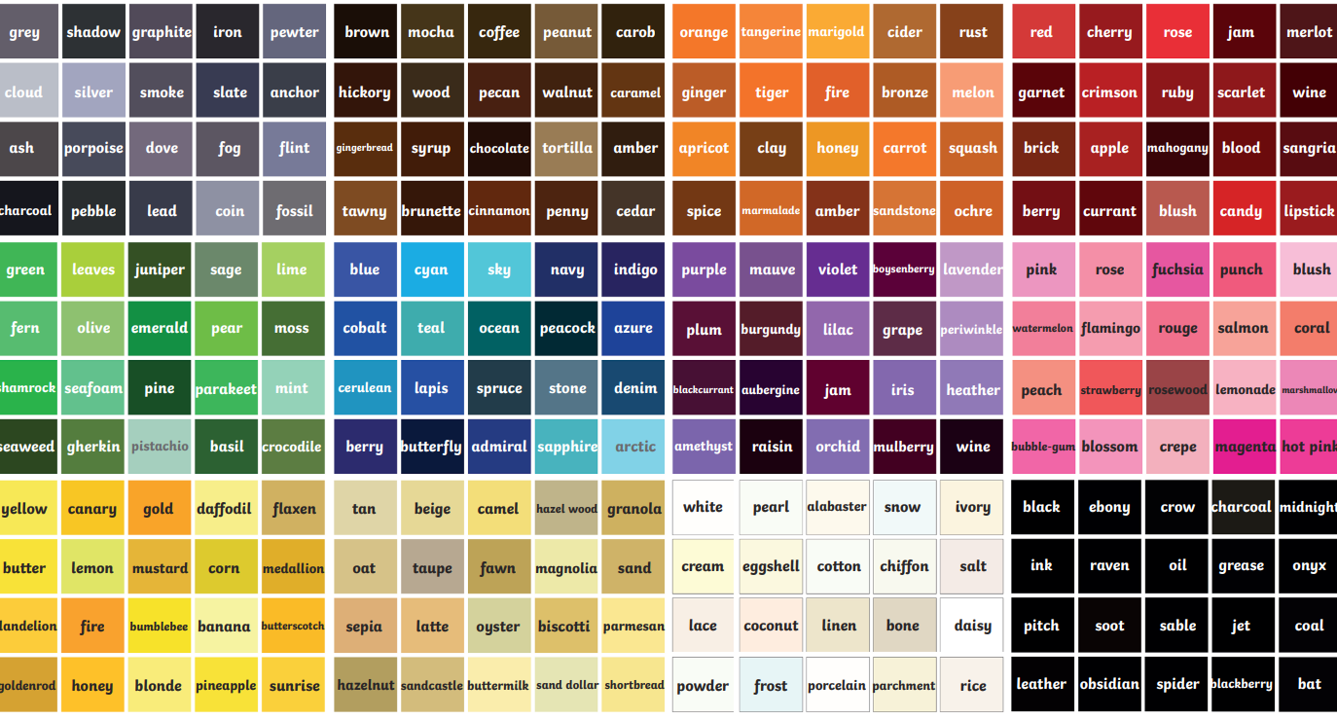
Notes:
Show chn the colour chart and explain that there are different tones and shades in each colour. We can create these colours by mixing different shades of colours together. Do any chn have a favourite shade that they can see on the board? Are there any shades that they recognize? Any new ones? Some chn to share their favourite colours.

Slide 6
Task One
In your art book, pick three primary (yellow, blue or red) or secondary (green, orange or purple) colours. For each colour, can you mix different colouring pencils together to make new shades of your colour.
Once you have finished, can you use the colour chart to see if you can match a shade that you have created and write the name underneath.

Slide 7
Red Blue
Purple

Slide 8
Task Two
Using a viewfinder, we are going to focus on a small part of the sculpture. Can you copy out the pattern into your sketch books and colour in the patterns using your new knowledge of shades.

