Slide 2
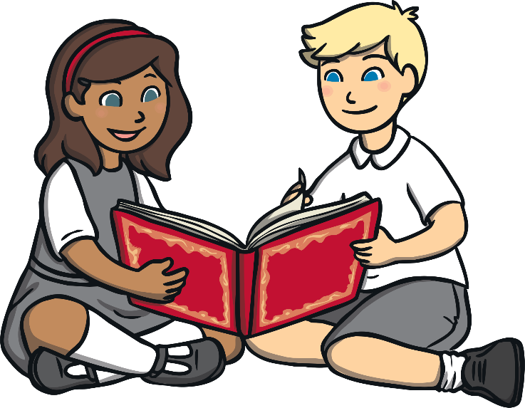
National Storytelling Week
30th January - 6th February 2022
What is National Storytelling Week?
National Storytelling Week is a week for celebrating storytelling and encouraging people to tell their own stories.
National Storytelling Week takes place in lots of places, such as storytelling clubs, theatres, museums, schools and hospitals.

Slide 3
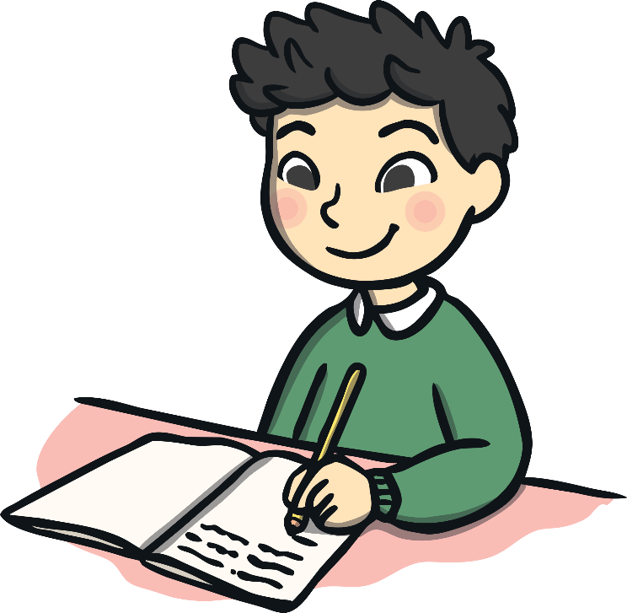
What Are Stories?
What do you think stories are?
Are stories always written down?
Who do you think tells stories?

Slide 4

What Are Your Favourite Stories?

Slide 5
Why Do We Tell Stories?
We tell stories about what we have been doing at school, stories about funny or scary things that have happened to us or even stories about what we have seen on TV.
People have used stories for thousands of years to communicate. We all tell stories every day.
Many stories we know have been told for hundreds of years. Fairy tales and myths were told by people long before they were written down.
Everyone is a storyteller!

Slide 6

Why Are Stories and
Storytelling Important?
Storytelling helps people to feel close to each other and to become friends. Storytelling helps people to understand the things that happen in the world.
Stories can teach us lessons (a moral), they can be warnings, and they can be funny, scary or explain things to us. They can be fairy tales and myths. Storytelling is also fun!

Slide 7
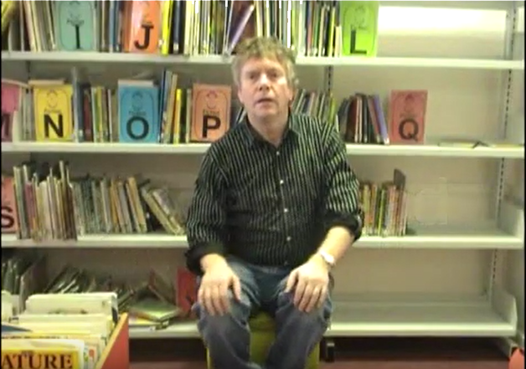
Story Time
You are now going to watch a story teller.
What do you like about how the story has been told?
What makes a good storyteller?

Slide 8
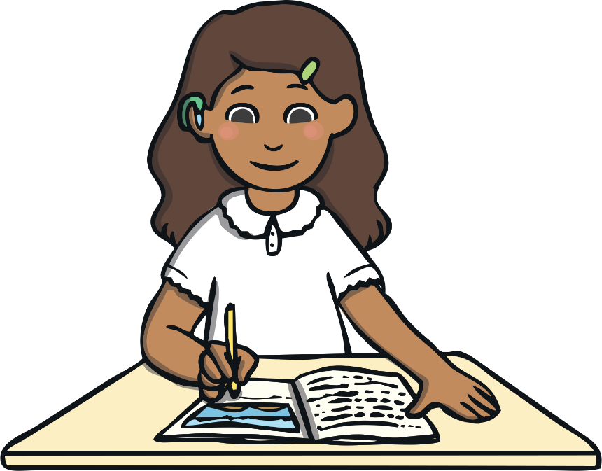
Happy Storytelling!
Remember, everyone is a storyteller!

