Slide 1
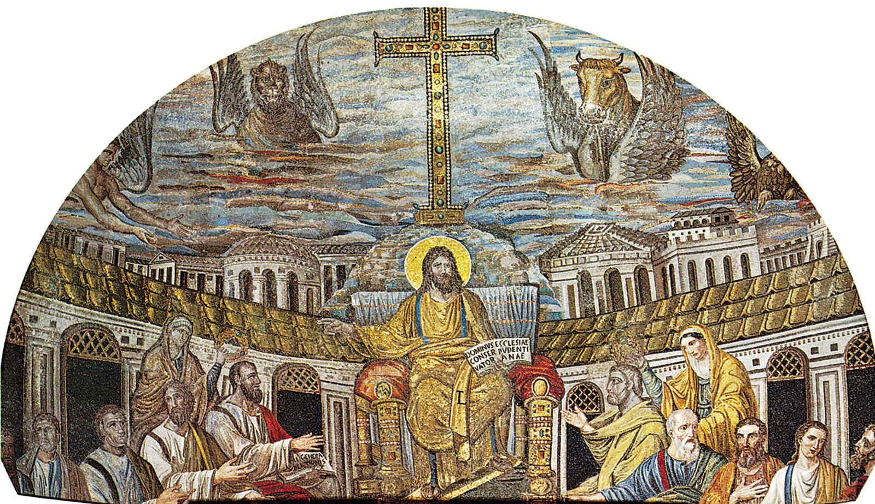
Christianity
Introduction

Slide 2
In this lesson we are going to think about what we already know about Jesus.
With the person next to you, talk about what you already know about Jesus.
Maybe think about:
What religion did he belong to?
When was he born?
What festivals do we celebrate because of Jesus?
Who were his parents?
How did he die?

Slide 3
Now let’s think about what we might want to know.
With the person next to you, talk about what you might want to know about Jesus. Let’s write down some of our questions.

Slide 4
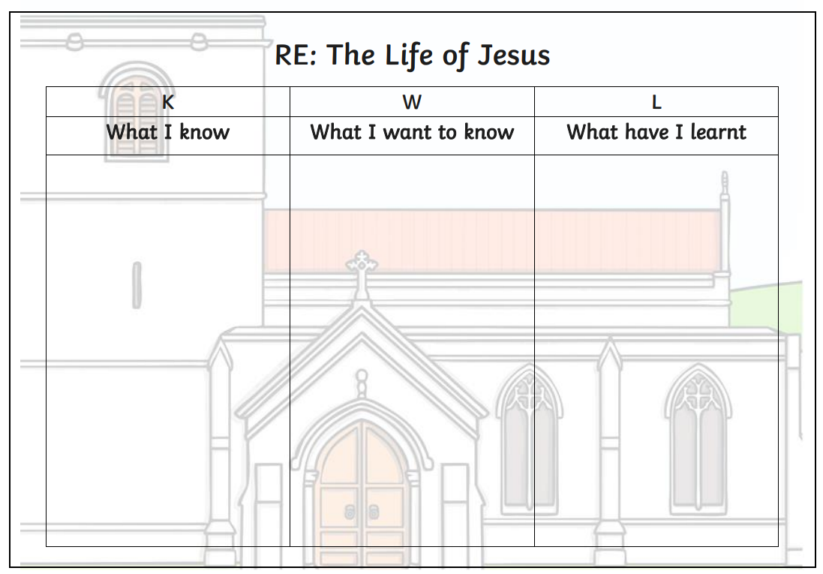
We are going to be filling in our KWL grids. We are filling in the ‘K’ section – What do you already know about Jesus. Then we are writing questions in the ‘W’ section – What I want to learn.

Slide 5
What keywords might we need?
We can add to our list when we are writing:
Jesus
Christianity
God
Church

