Slide 1
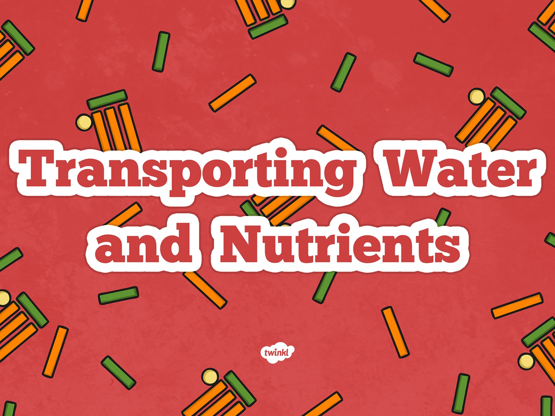

Slide 2
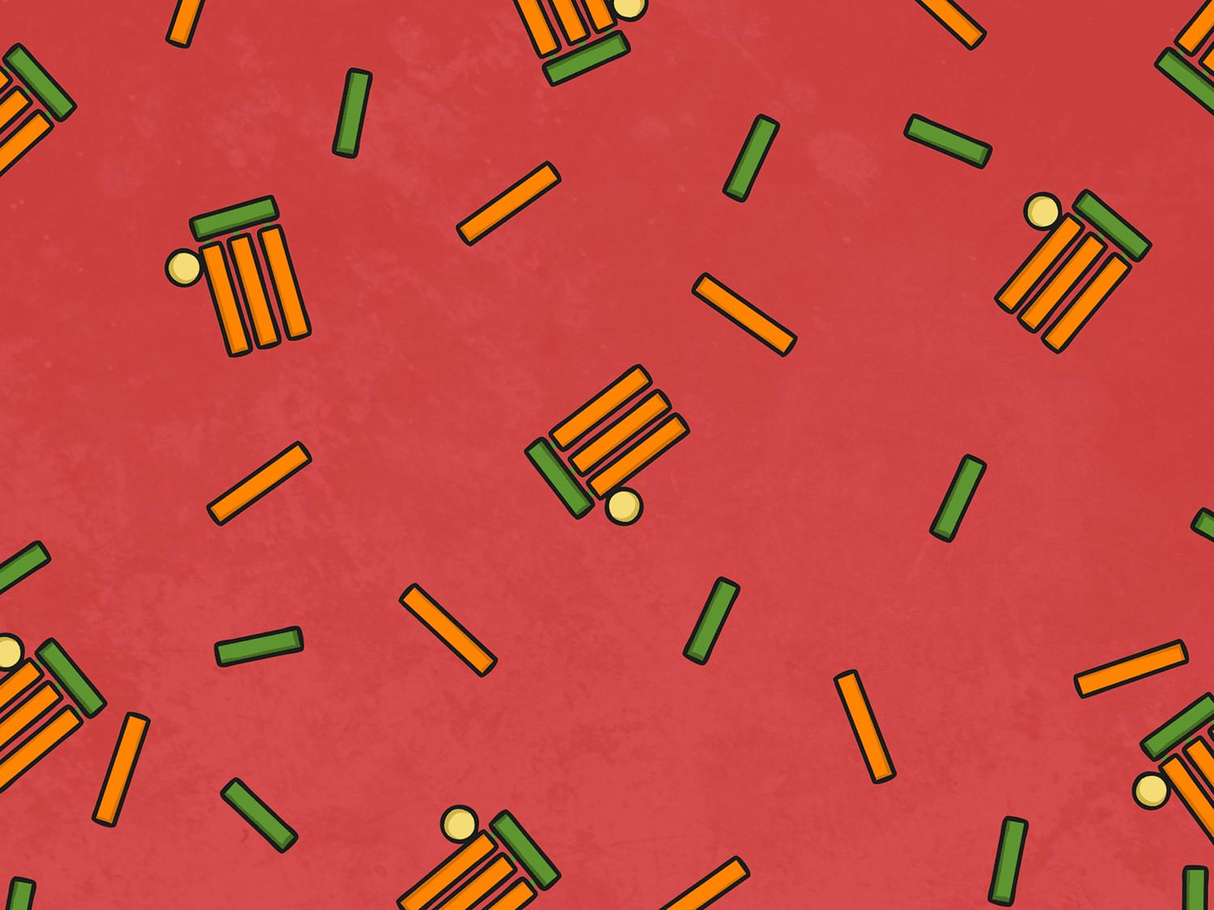
Aim
I can explain how water and nutrients are transported within the body.
Success Criteria
I can state how the digestive system breaks down nutrients.
I can explain the role of circulatory system in transporting nutrients and water in the body.

Slide 3

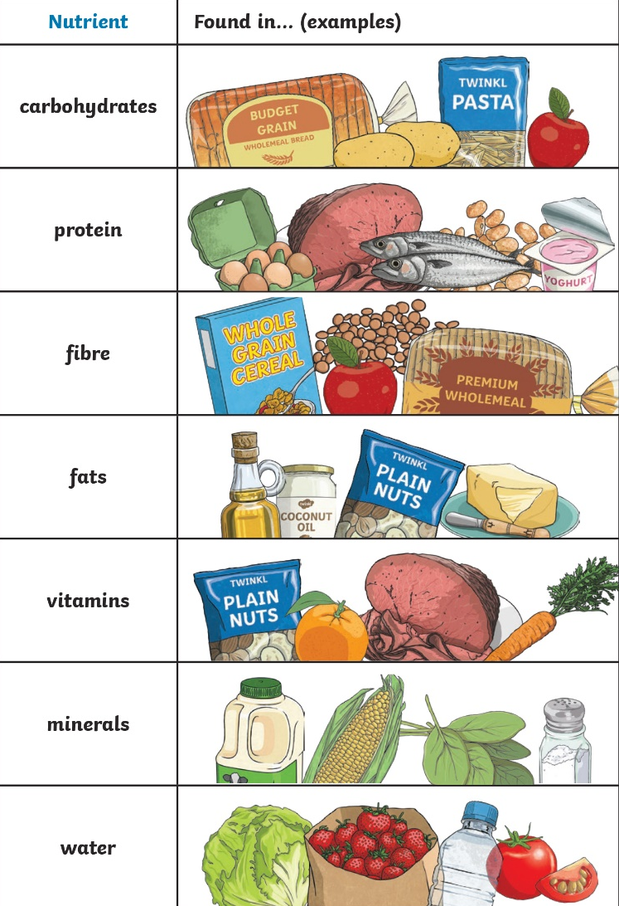
Why Do We Need Nutrients?
Match the type of nutrient with the job that it does.
Help the body to grow and repair itself.
Gives the body energy so we can be active.
Help the body to stay healthy. For example Vitamin C helps wounds to heal.
Gives the body energy, stores energy and helps insulate against the cold.
Keep the body healthy.
For example: calcium keeps our teeth strong and iron is needed to help circulate oxygen around the body.
Helps keep food moving through the colon and intestines.
Needed for bodily fluids and normal cell function.

Slide 4
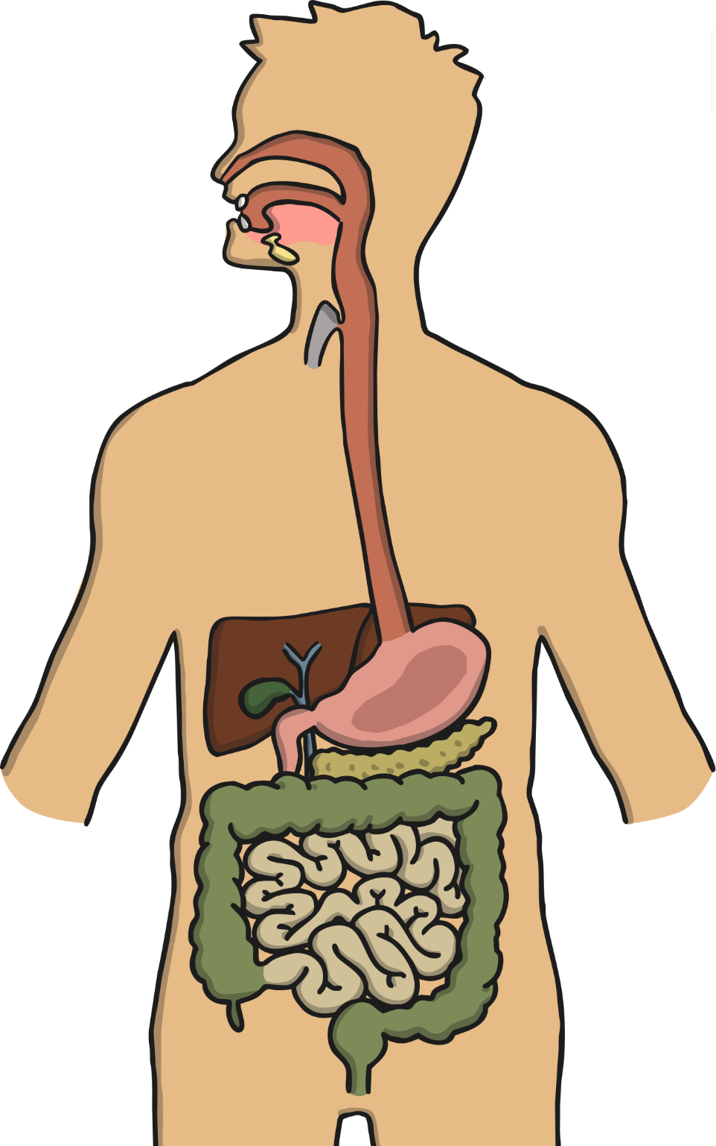


How Do We Get Nutrients?
Mouth: Food enters the system
Salivary glands: Produce saliva which contain an enzyme called amylase. This breaks down starch in carbohydrates.
Tongue: Mixes food with saliva.
Teeth: Tear, cut and grind food.
Oesophagus: Tubes that leads food to the stomach.
Stomach: Produces enzymes and acids to break food down. Churns food into small pieces. The mixture of stomach acids, enzymes and food is called ‘chyme’
Pancreas: Produces enzymes to break down fats, carbohydrates and proteins which are released into the duodenum.
Liver: Produces bile that breaks down fats.
Gall Bladder: Stores bile and releases it to the Duodenum when needed.
Duodenum: First part of the small intestine. Food is broken down by bile and enzymes.
Small Intestine: Nutrients are absorbed into the bloodstream here. Remaining food is passed to the large intestine.
Large Intestine: Absorbs water from remaining food. This food forms into stools.
Rectum: Stores stools and signals to the brain that there are stools that need releasing.
Anus: Stools are released out of the body.
Humans get nutrients from food and drink. This is broken down by the digestive system.
Can you remember the functions of the digestive system?
4
1
3
2
5
Click me for answers!
8
9
6
10
7
12
11
13
14

Slide 5
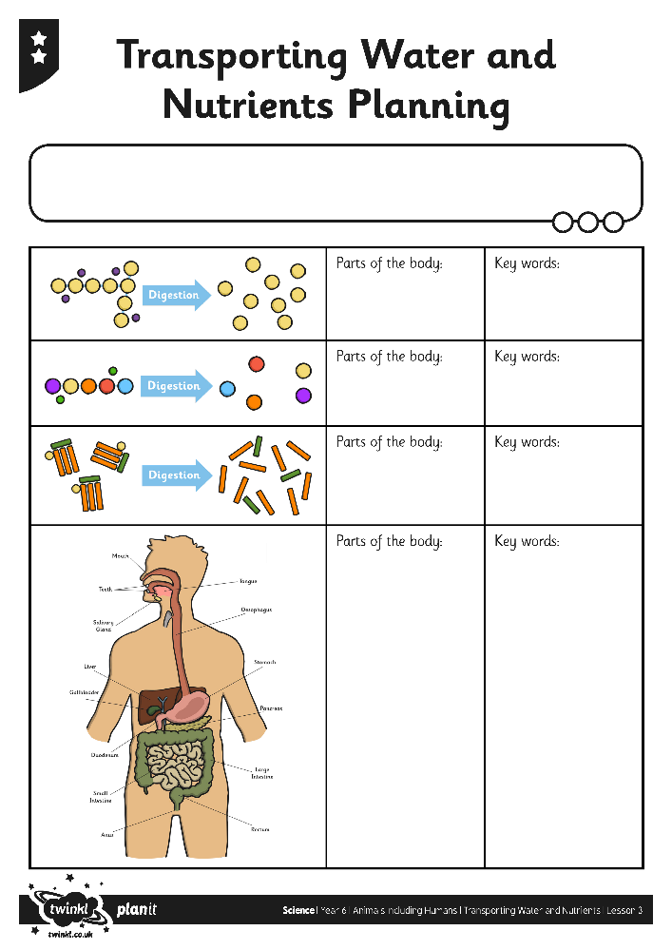
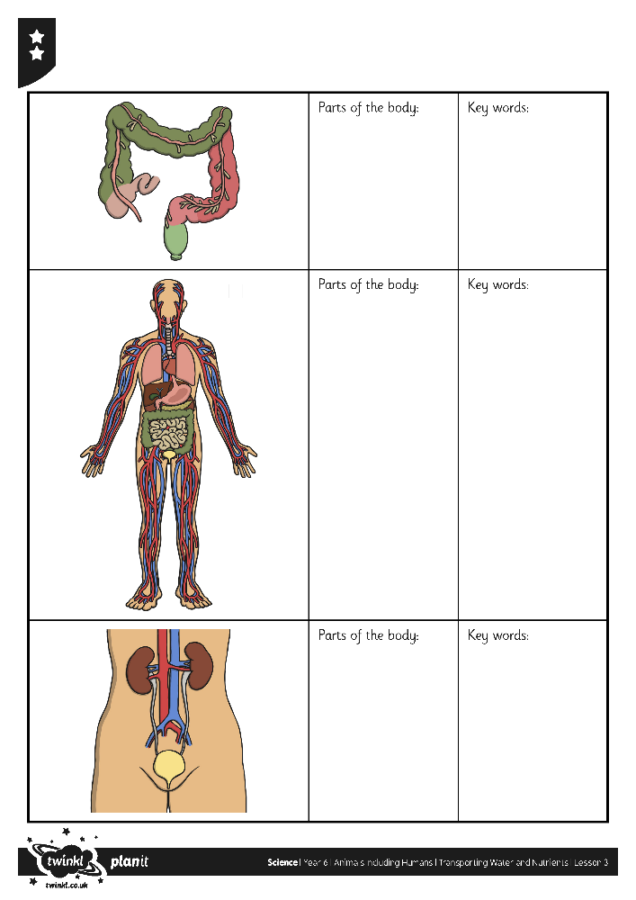
How Does It Work?

Slide 6
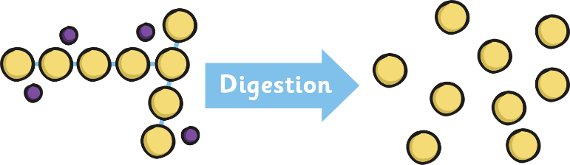
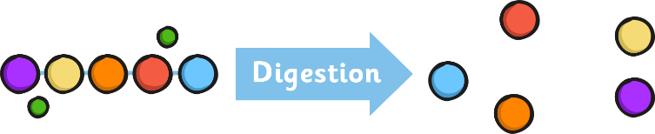
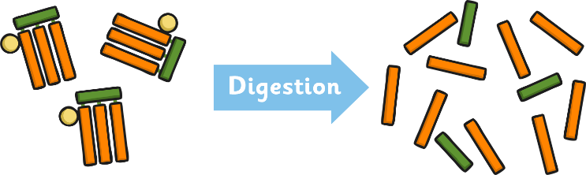
How Does It Work?
How Are Nutrients Broken Down?
Stomach acids break food down into a substance called chyme. This passes through to the duodenum where bile and enzymes break up larger molecules into their smaller parts.
Starch molecule
Sugar molecules
Carbohydrase enzymes break down starch (in carbohydrates) into sugars.
carbohydrate
Protein molecules
Amino acid molecules
Protease enzymes break down proteins into amino acids. (Not to be confused with stomach acid!) These are essential to help the body to grow and repair body tissue.
protease
Fat molecules
Fatty acid and glycerol molecules
In the duodenum, bile from the liver breaks down fat. Then the lipase enzymes break the fat down further into fatty acids and glycerol.

Slide 7
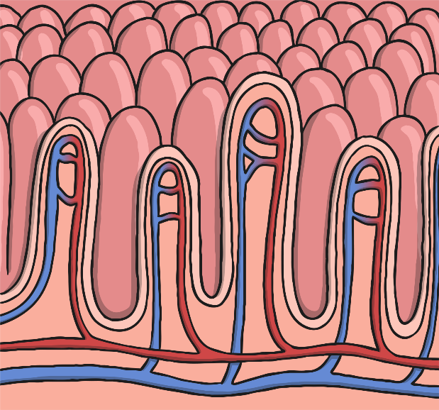
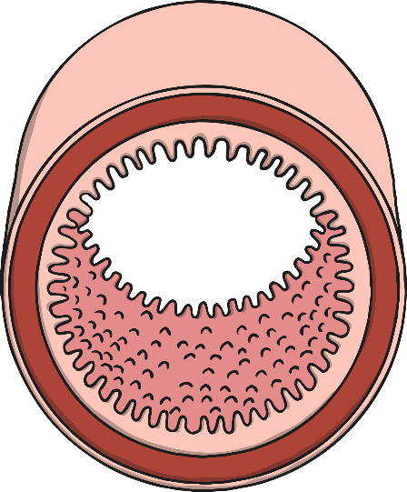
How Does It Work?
A Closer Look
After the nutrients have been broken down into smaller separate molecules in the duodenum, they can then pass through to the rest of the small intestine, where they are absorbed into the blood stream.
Inside the Small Intestine
serosa
villus
The small intestine is a muscular tube with several layers. It is lined with tiny hair like villi which are attached to arteries and veins.
The chyme (which now contains smaller broken down nutrient molecules) is moved back and forth in the small intestine. The nutrients pass through the villi and are absorbed into the blood vessels.
Bacteria in the large intestine break down waste food for any more nutrients which are absorbed. This process also leads to gas which is eventually passed through the anus.
muscle layers
submucosa
artery
vein
mucosa
villi

Slide 8

How Does It Work?
What about Water?
Water enters the body in the mouth. Unlike other nutrients it is not broken down by enzymes or bile.
A small amount of water is absorbed through the stomach but the majority passes through to the small intestine.
Water is absorbed in the small intestine in the exact same way as other nutrients are absorbed – through the villi into bloodstream via the blood vessels.
The large intestine (also called the colon) is similar to the small intestine in structure except that it does not contain villi. By the time waste material reaches the large intestine, 90% of water has already been absorbed.
The waste food enters into the cecum which is the first part of the large intestine. It moves through the large intestine through a series of mass movements. These are long, slow moving waves of muscles contracting and relaxing. The rest of the water in the waste food is absorbed in all the different parts of the colon. The resulting stool and any gases are moved to the sigmoid colon. It is this part of the large intestine that enables gases to be released without releasing stools at the same time. The stools then enter the rectum before expulsion through the anus.

Slide 9
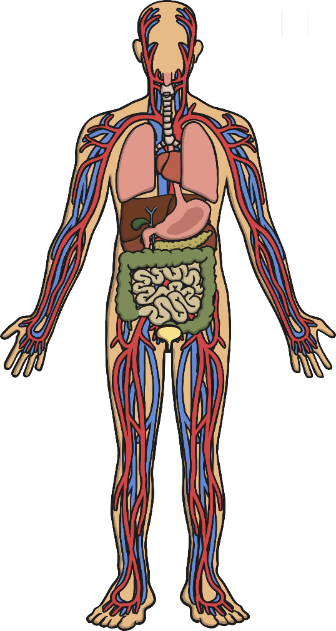
How Does It Work?
How Does It All Fit?
Nutrients and water are absorbed in the system in the stomach, small and large intestines.
They enter the blood stream via the capillaries where they are passed through to the arteries.
The blood is circulated throughout the body (including being oxygenated in the lungs and the heart).
Nutrients are absorbed by the cells that need them and water is absorbed by all cells.

Slide 10
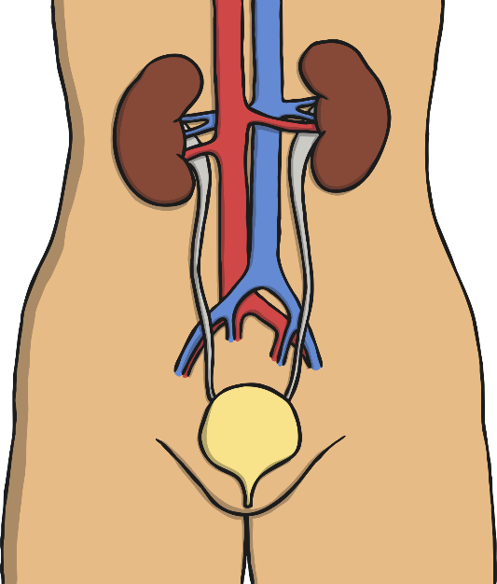
How Does It Work?
How Is Waste Expelled from the Body?
There are kidneys are responsible for getting rid of waste from blood in two ways.
Veins collect waste from cells. Most of the waste is released into the liver. The liver then uses it to create bile. This goes into the duodenum to break down food into chyme. The waste that is not turned into bile is made water soluble (dissolves in water) and goes to your kidneys.
The kidneys perform a function called filtration. The renal vein delivers blood to the kidneys which it filters for waste. This is called ultrafiltrate and is turned into urine which is passed through to the bladder.
The bladder serves the same function as the rectum, in that it sends signals to the brain. It sends signals to indicate that urine needs to be expelled.
Urine is then released through the urethra.
kidney
ureter
bladder
urethra

Slide 11
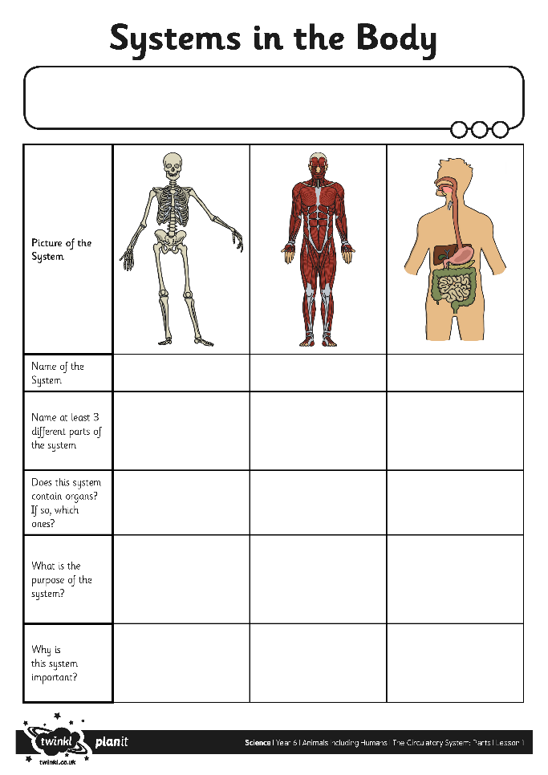
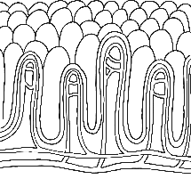
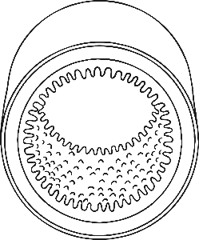
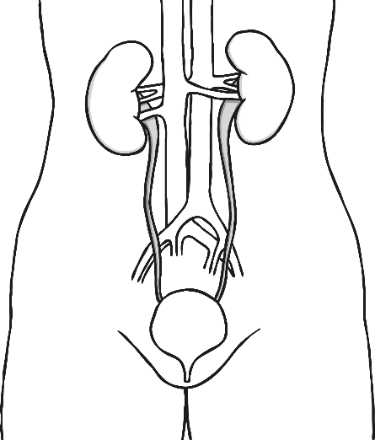

Explanation Diagram
Create diagrams explaining how nutrients and water are transported around the body.
Use the notes that you have written down to support you.
You may ask an adult if you are unsure about any of the information or ask to see the appropriate information again.
Make sure that your diagrams are clear and can be understood by others by making your handwriting neat and easy to read, and checking that your sentences make sense.

Slide 12

Aim
I can explain how water and nutrients are transported within the body.
Success Criteria
I can state how the digestive system breaks down nutrients.
I can explain the role of circulatory system in transporting nutrients and water in the body.

