Slide 1


Science
Electricity
Year One
Science | Year 6 | Electricity | Electricity Investigation (Part 1) | Lesson 4

Slide 2


Slide 3

Aim
I can plan an investigation.
I can understand variations in how components function
Success Criteria
I can select an appropriate scientific enquiry.
I can plan an investigation in detail.
I can decide which variables to control.
I can explain variations in functions.

Slide 4

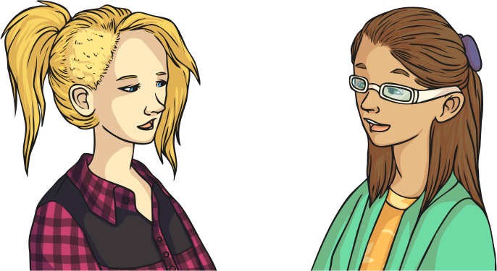
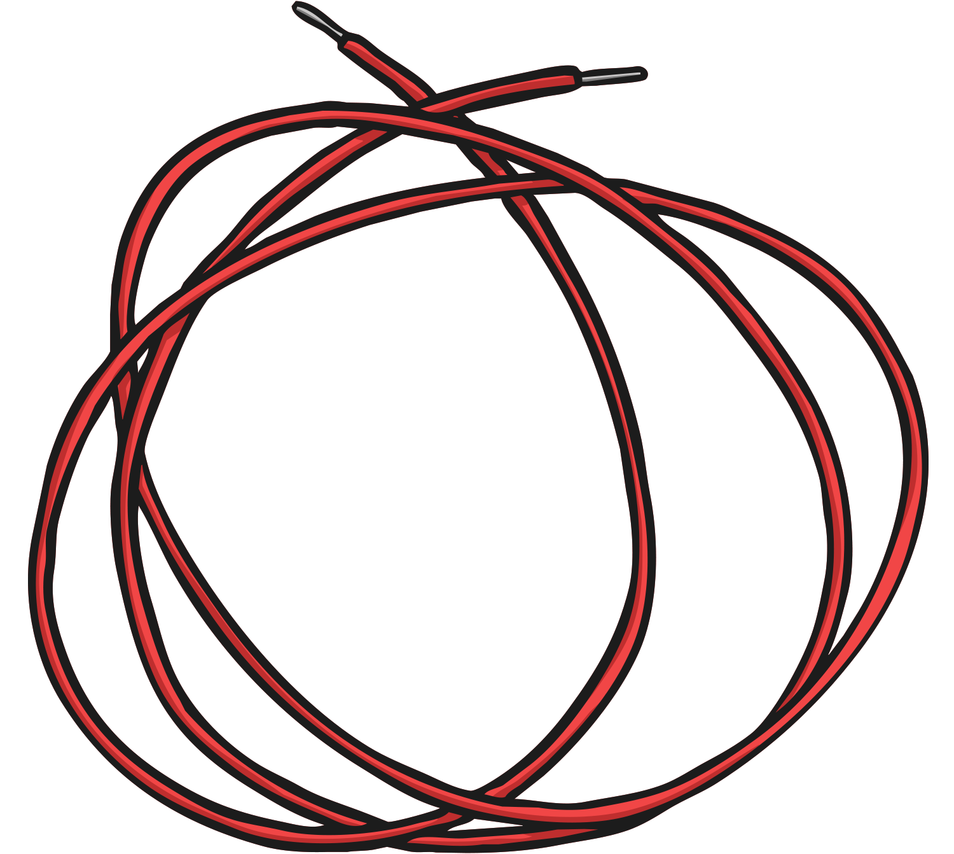
Wire Length
Does wire length affect how components in a circuit work?
Discuss this question with your talk partner and predict:
what difference it might make;
to which component/part of the circuit.

Slide 5

Planning Your Investigation
You will need to think of a question to answer and to predict what you think will happen. In order to carry out the investigation you will need to choose which type of investigation is the most appropriate to answer your question.
You could carry out:
a practical enquiry (a simple practical enquiry is one where you just observe what happens);
a fair and comparative test.
In a fair and comparative test you have to:
record observations/measurements;
compare results;
spot patterns.

Slide 6
Planning Your Investigation
Making Your Test Fair
In order to make sure that you carry out a fair test, which means that your results are accurate and can be trusted, then you need to be clear about:
what you will change and compare each time (make sure you only change one variable – the thing you are testing);
what you will measure;
what variables you will keep the same (control).
Keeping all other variables the same except for the variable you are testing is important because it makes sure that your results are caused by the changes to the variable you are testing and not other things.

Slide 7

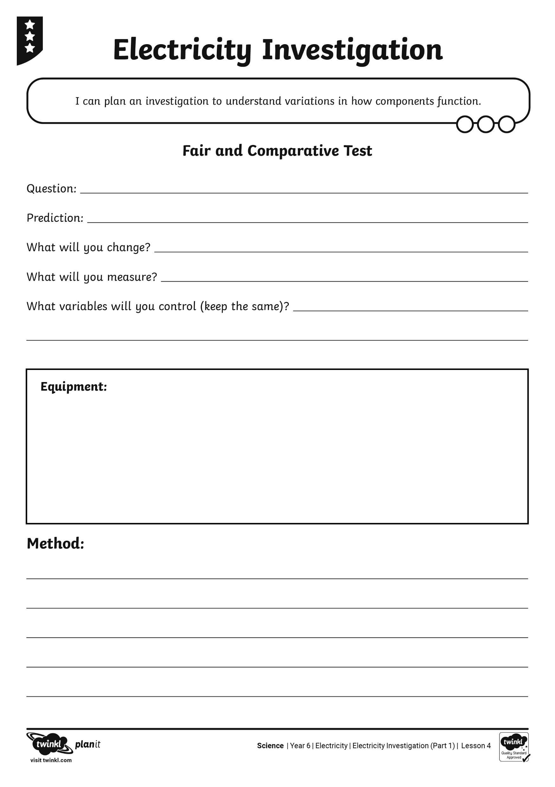
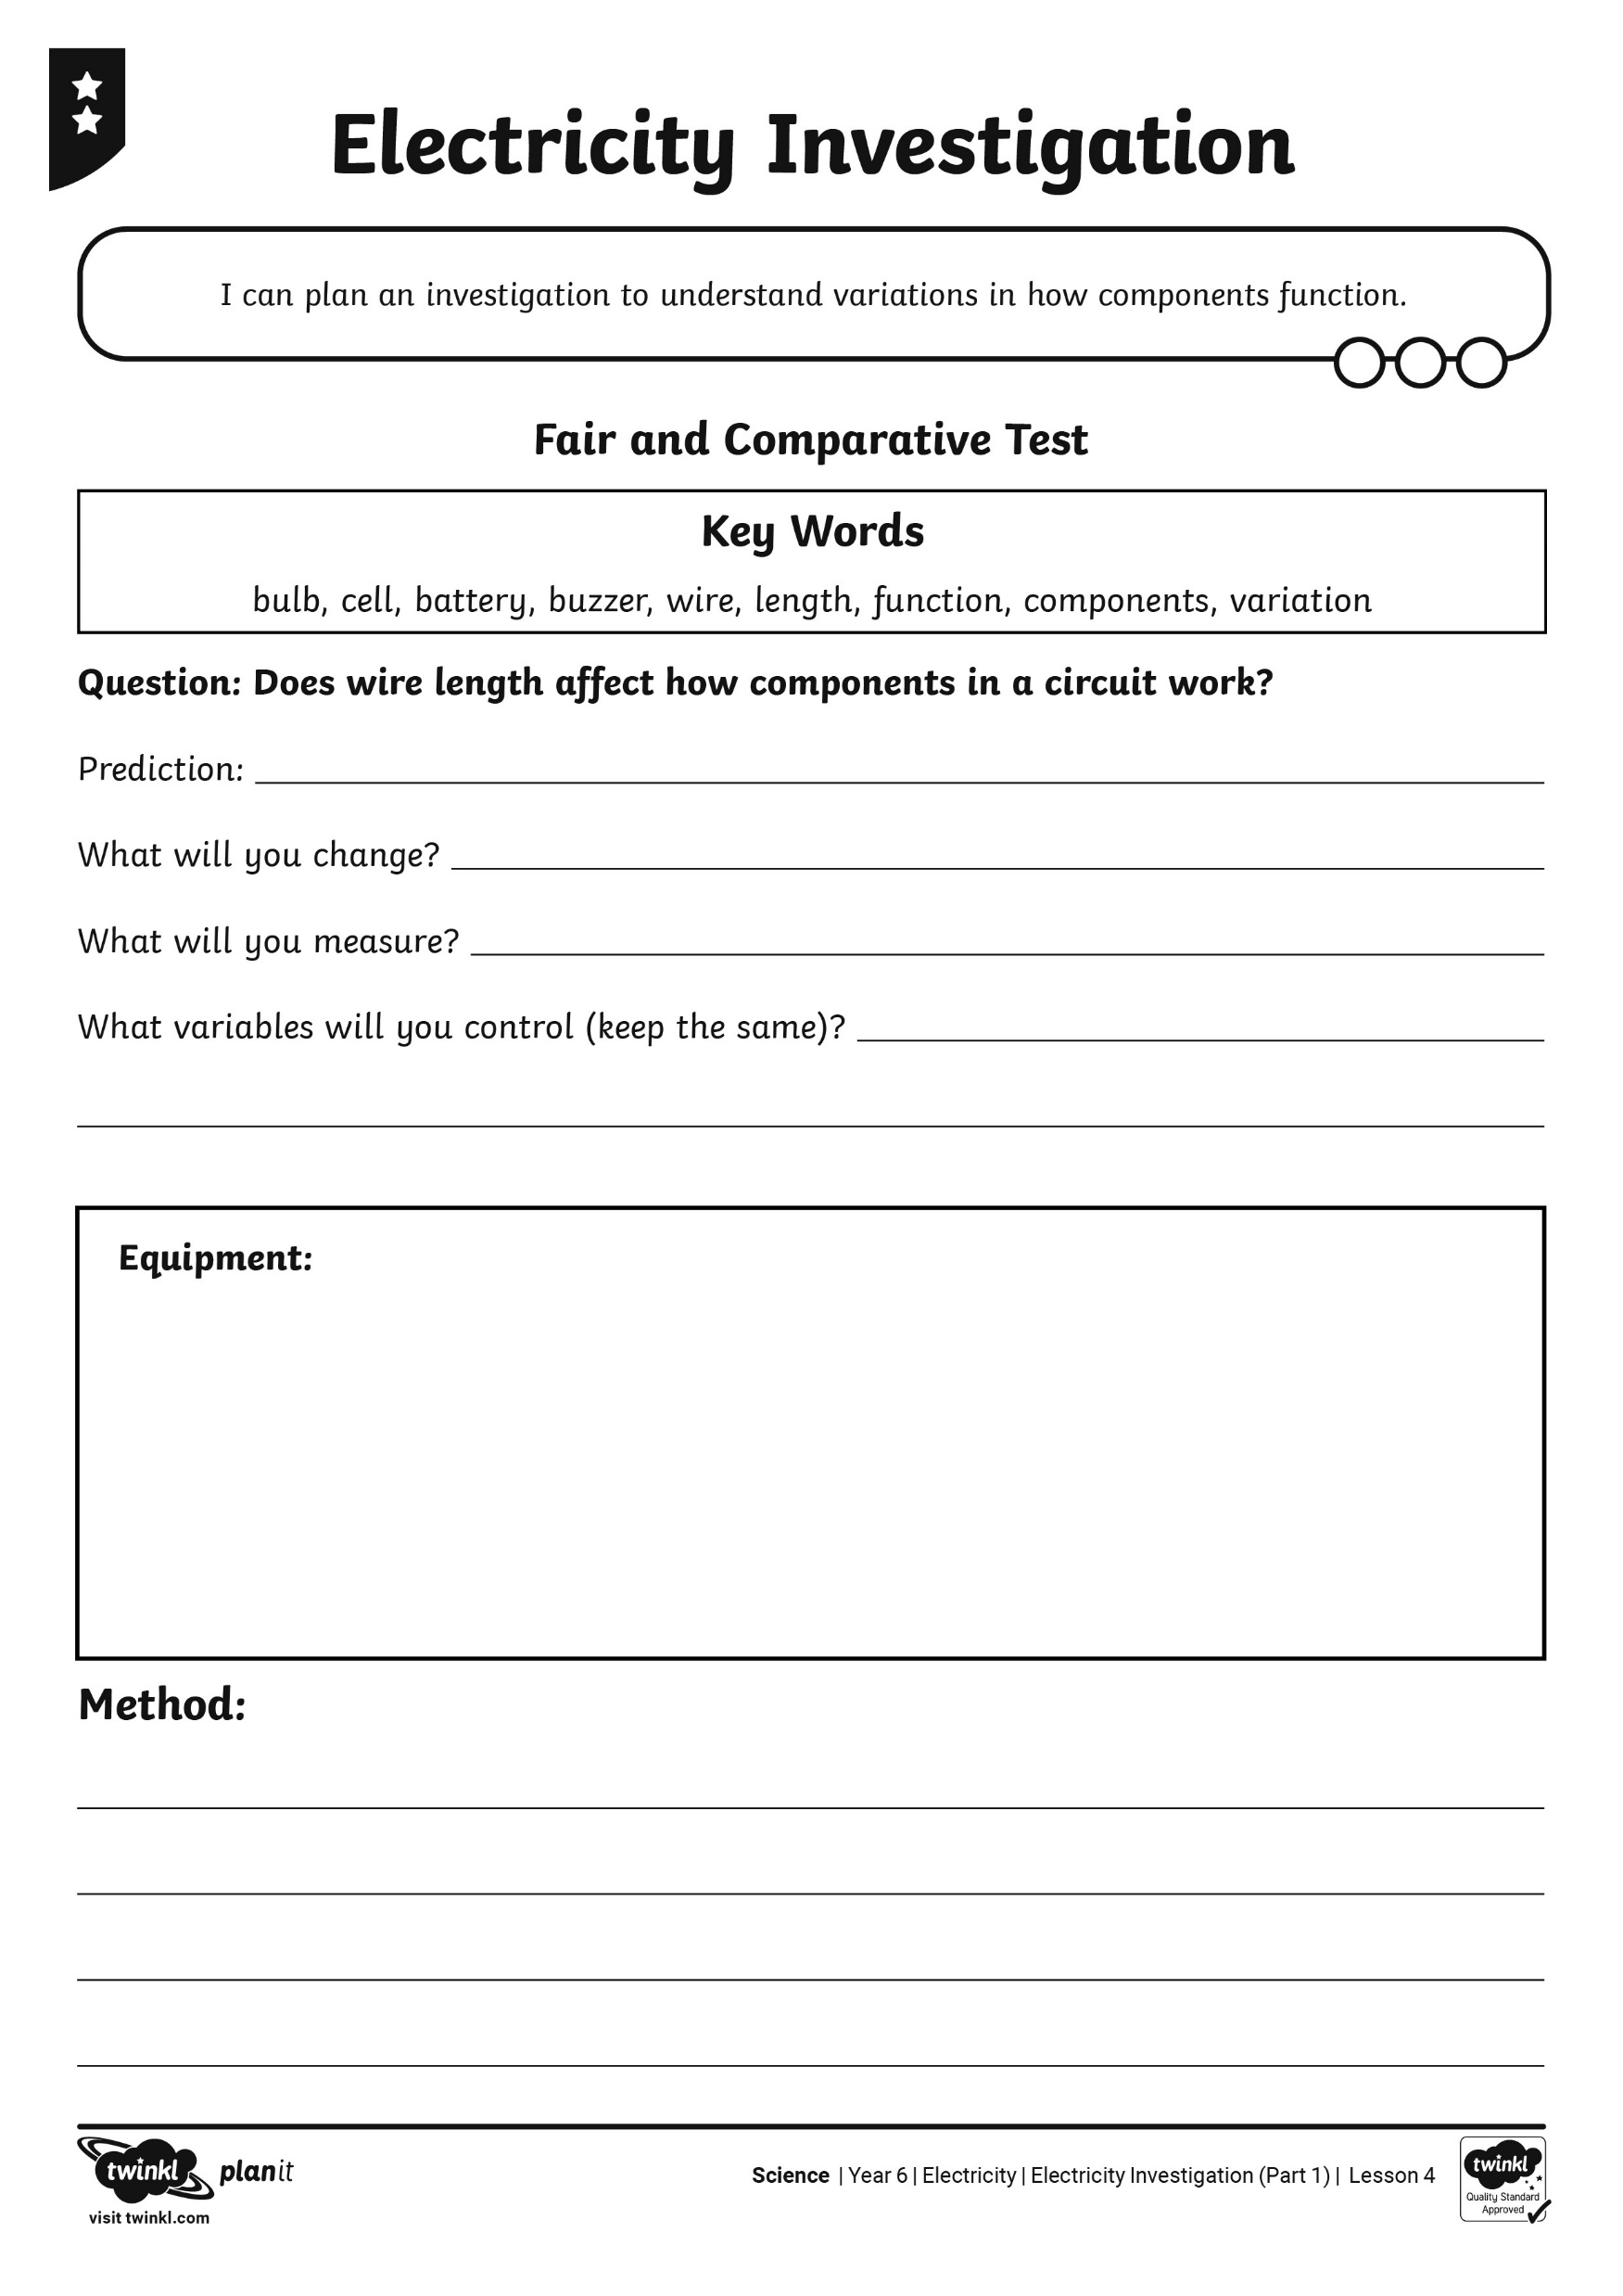
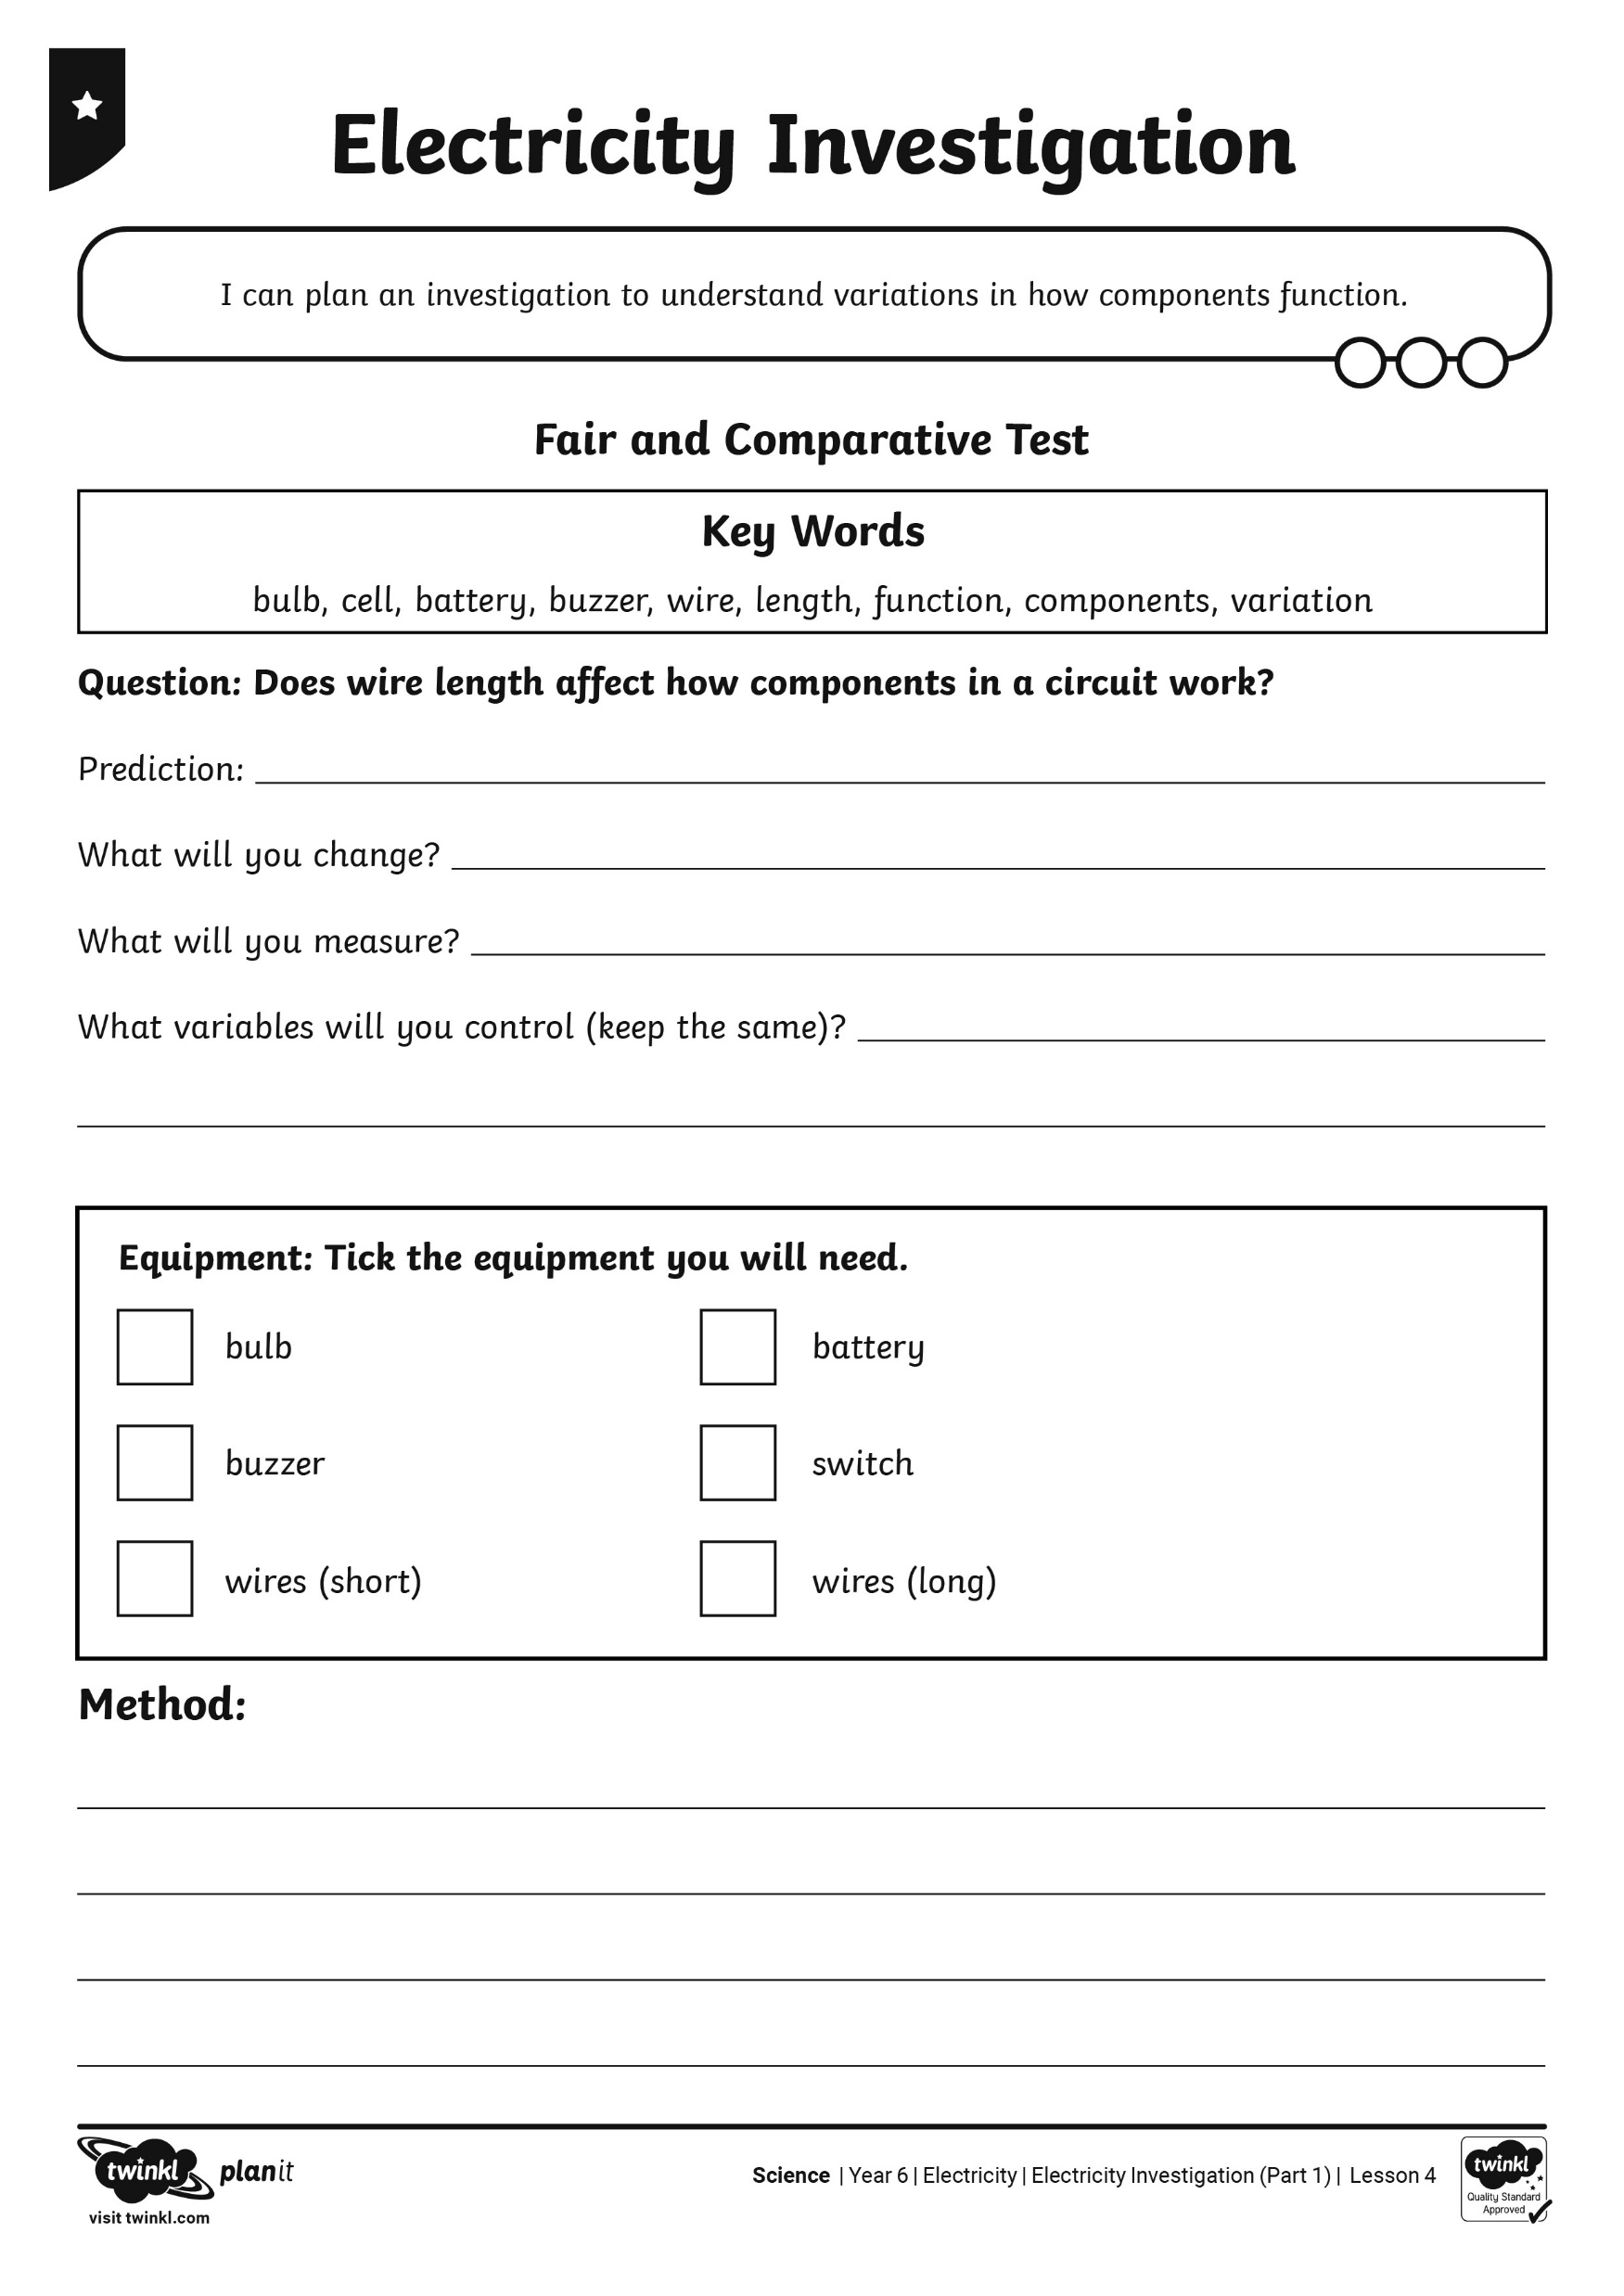
Investigation

Slide 8
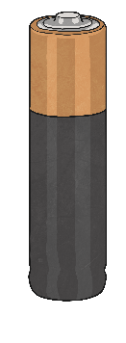

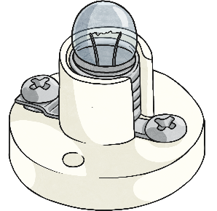
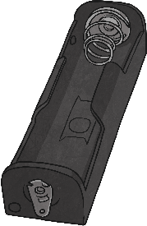
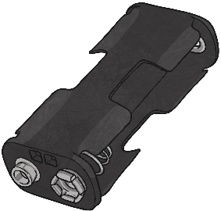
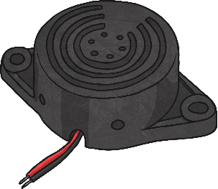
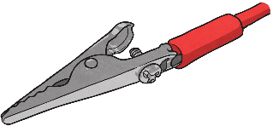




Investigation

Slide 9
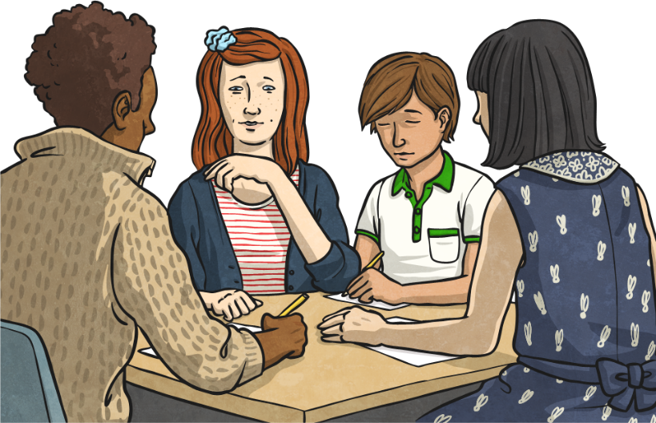
Peer Assessment
Swap your Electricity Investigation Activity Sheet with your partner.
Read through the sheet carefully.
Discuss any parts of the investigation that you think need changing.
Be clear about what needs changing and how it should be changed.

Slide 10

Aim
I can plan an investigation.
I can understand variations in how components function
Success Criteria
I can select an appropriate scientific enquiry.
I can plan an investigation in detail.
I can decide which variables to control.
I can explain variations in functions.

