Slide 1
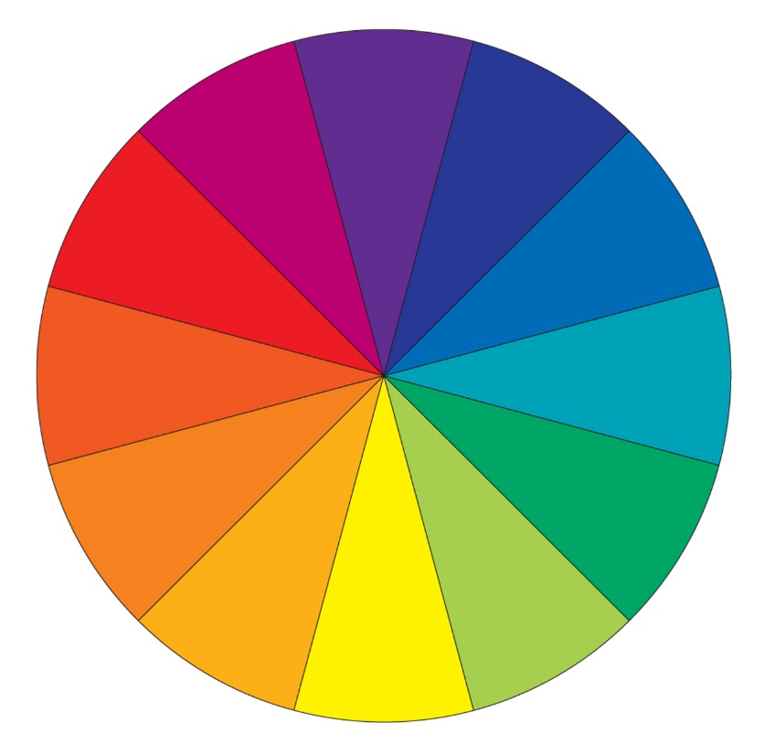
Starter:
Which colours are on the colour wheel?

Slide 2
LO: To convey feelings in a portrait.
Must: Identify colours to feelings.
Should: Justify colour choice.
Could: Blend to show emotion.

Slide 3
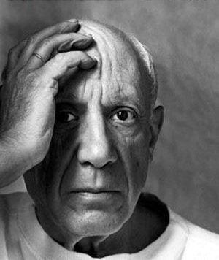
Pablo Picasso
Picasso was a Spanish artist and is one of the most famous artists in the world.
https://www.bbc.co.uk/bitesize/clips/zdfgkqt
Photo courtesy of freeparking (@flickr.com) - granted under creative commons licence – attribution
Notes:
Stop video at 1.14

Slide 4




Picasso’s Blue Period
Picasso had a phase in his painting where he made lots of blue paintings.
This was called his Blue Period.
Let’s have a look at some of the paintings that he made.
Think about the colours that Picasso used.
How do the colours make you feel?
How do you think the people in the paintings are feeling?

Slide 5
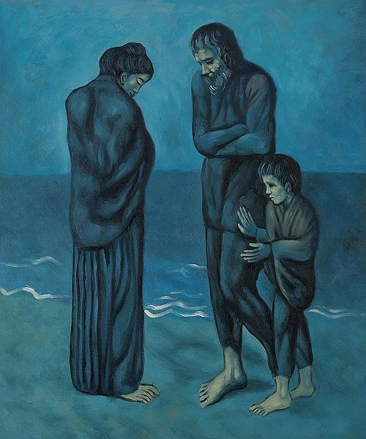
The Tragedy (1903)
by Pablo Picasso

Slide 6
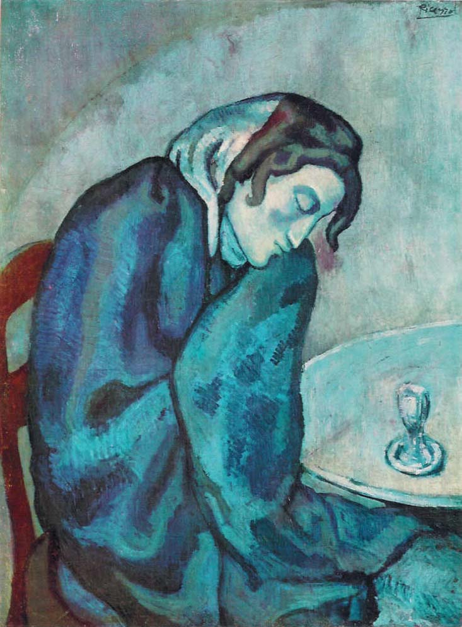
Sleeping Drinker (1901)
by Pablo Picasso

Slide 7
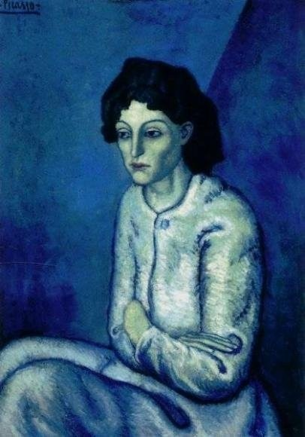
Woman with Folded Arms (1902)
by Pablo Picasso
Photo courtesy of markldiaz (@flickr.com) - granted under creative commons licence – attribution

Slide 8


Other Paintings by Picasso
The next portraits we are going to look at are also painted by Picasso.
Think about the colours that Picasso used.
How do these paintings make you feel?

Slide 9
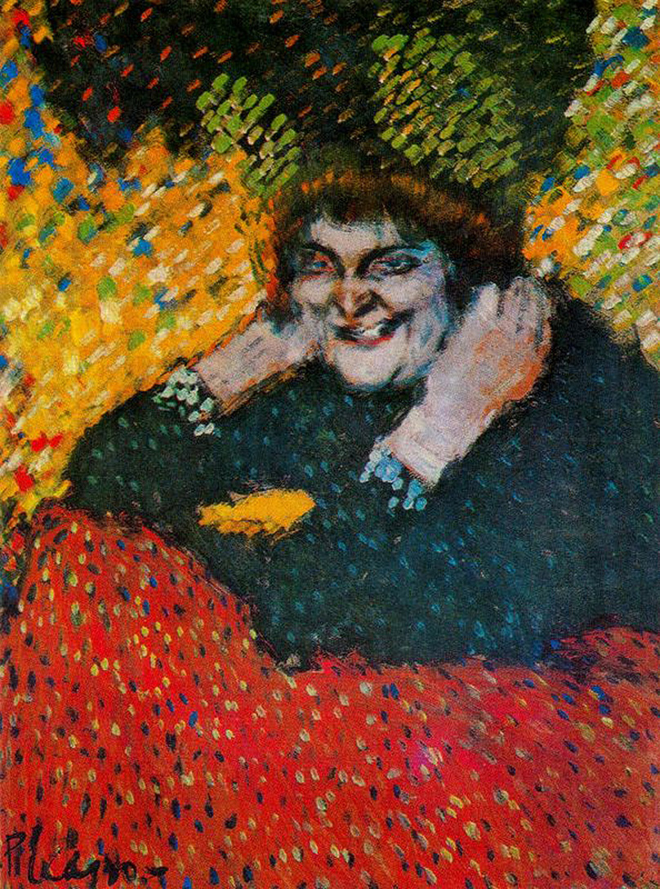
Old Woman with Gloves (1901)
by Pablo Picasso

Slide 10
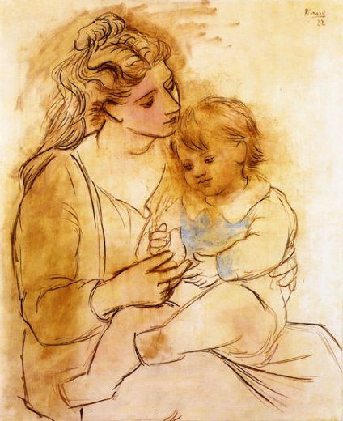
Mother and Child (1929)
by Pablo Picasso

Slide 11
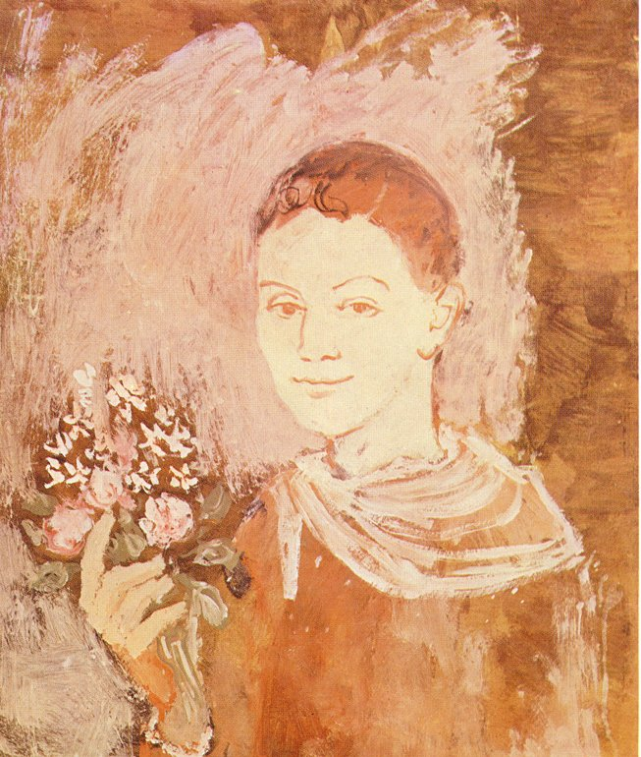
Boy with Bouquet of Flowers in his Hand (1905)
by Pablo Picasso

Slide 12
Picasso’s Blue Period
What differences do you notice between these two portraits?
Photo courtesy of markldiaz (@flickr.com) - granted under creative commons licence – attribution

Slide 13














Using Colours to Show Emotions
What colours do you think we should use to make a happy portrait?
What colours do you think we should use to make a sad portrait?

Slide 14
Activity:
Looking at the cropped photos you need to decide what emotion you think they are feeling, and what colour you would use to convey this feeling.
Then have a go at sketching the cropped photo and try and include your chosen colour in some way.

Slide 15
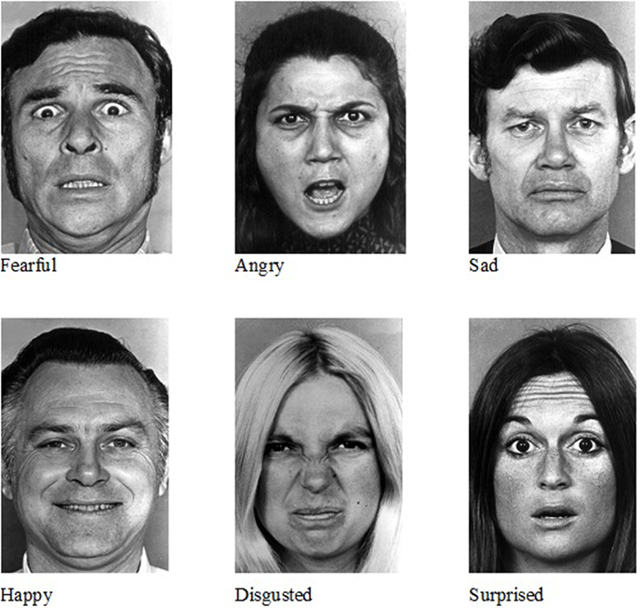
Notes:
Example- discuss what emotion- anger, what colour? Then discuss how to sketch this and how could you incorporate the chosen colour into their sketch

Slide 16
Notes:
Same as slide before

