Slide 1
Sketching Skills

Slide 2
LO: To be able to develop sketching skills of human bodies.
Must: Use observation skills.
Should: Think about proportion.
Could: Add detail.

Slide 3
What do you think this diagram represents?
9H 8H 7H 6H 5H 4H 3H 2H H F B HB 2B 3B 4B 5B 6B 7B 8B 9B
Hardest
Medium
Softest
Notes:
Tell chd you are going to discuss different areas of sketching, then we will be sketching a body part.

Slide 4
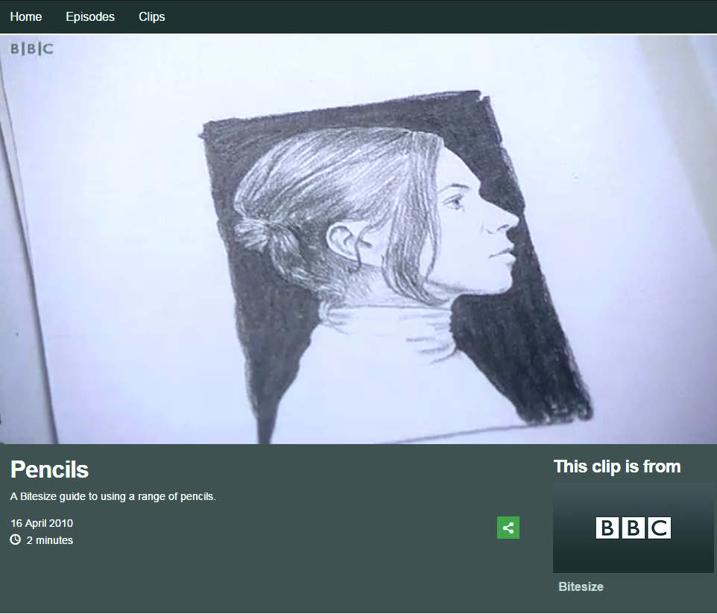
Different pencils give different tones.
Tone is the degree of lightness or darkness.
Click on the image to watch the clip:

Slide 5
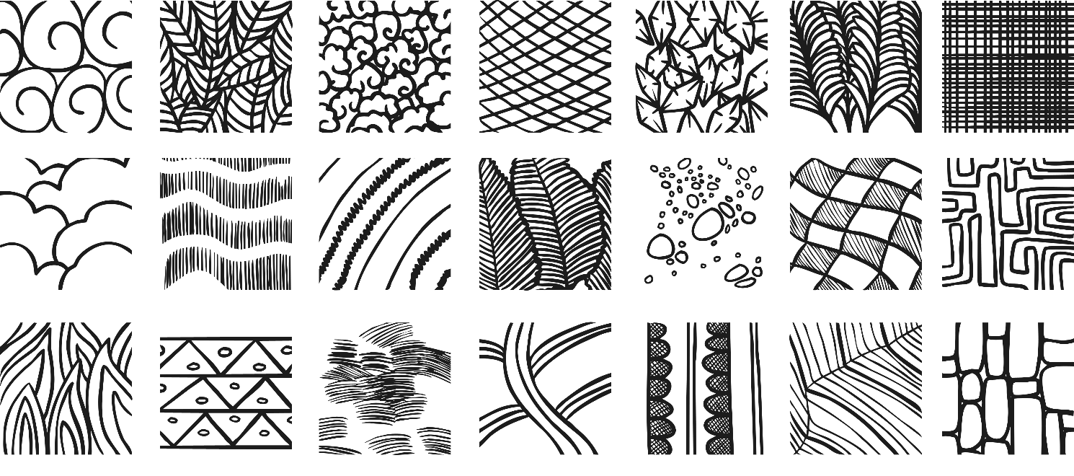
Drawing texture with pencil
Texture is the feeling, appearance or consistency of an object or material.
It can be natural or man-made, functional or decorative. Artists try to replicate the texture of the subject to make their work look as realistic as possible.

Slide 6
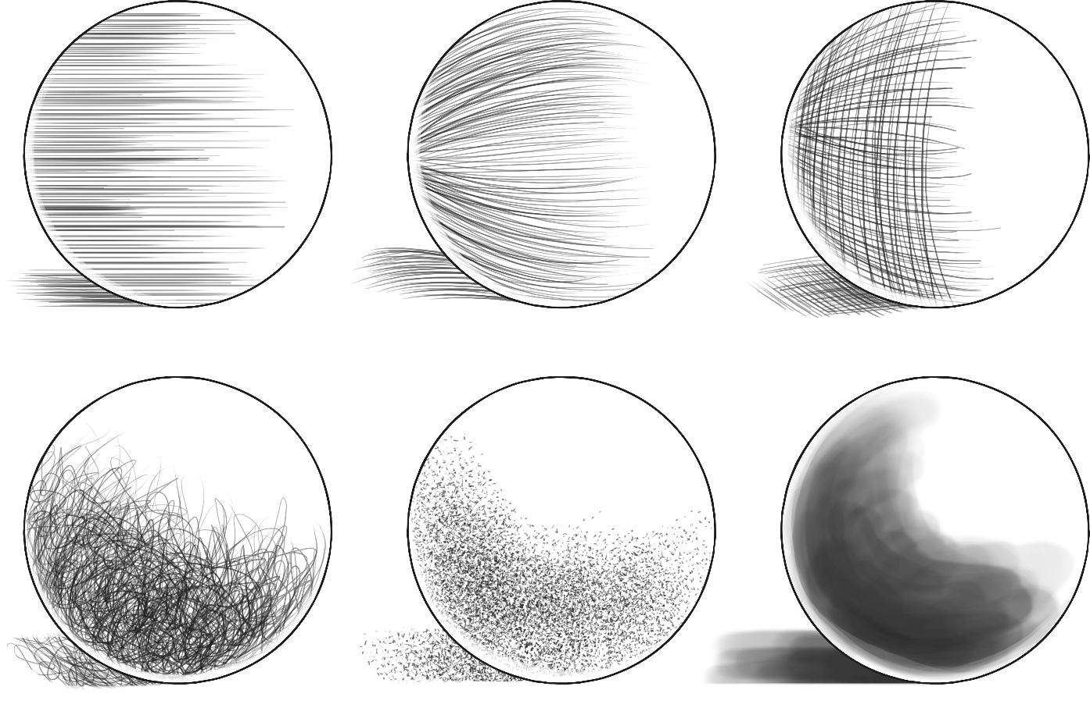
Drawing texture using line and tone
Hatching
Contour Hatching
Cross Hatching
Random Hatching
Stippling
Ink Wash

Slide 7
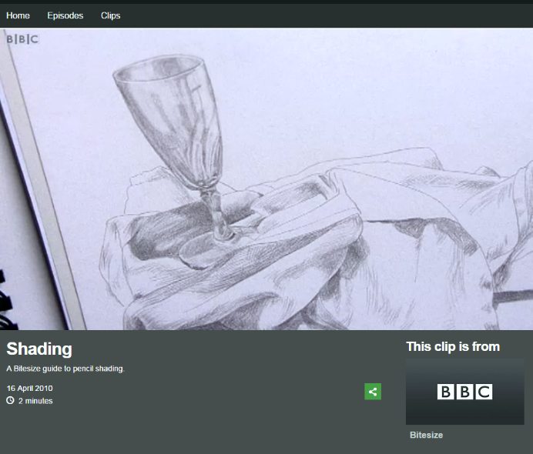
Shading
Watch the video to find out more about shading.
Click on the image to watch the clip:

Slide 8
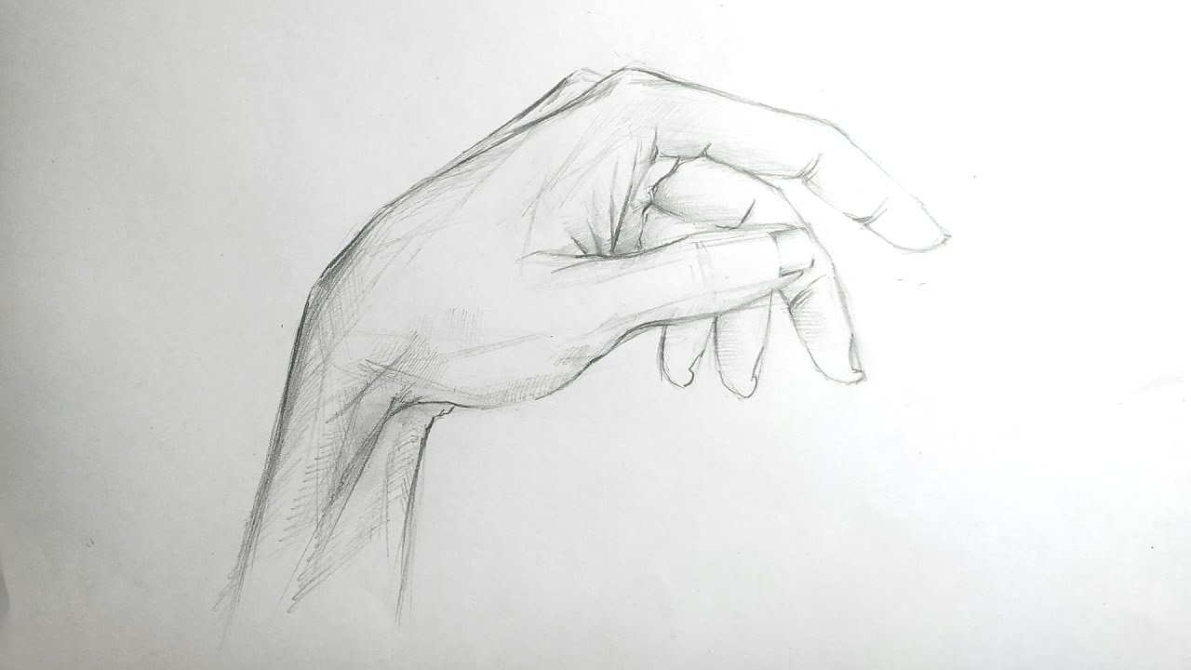
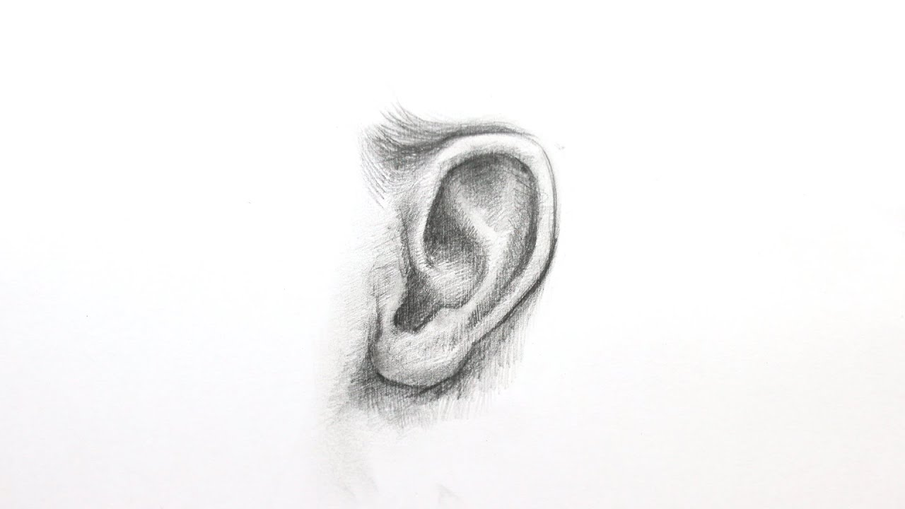
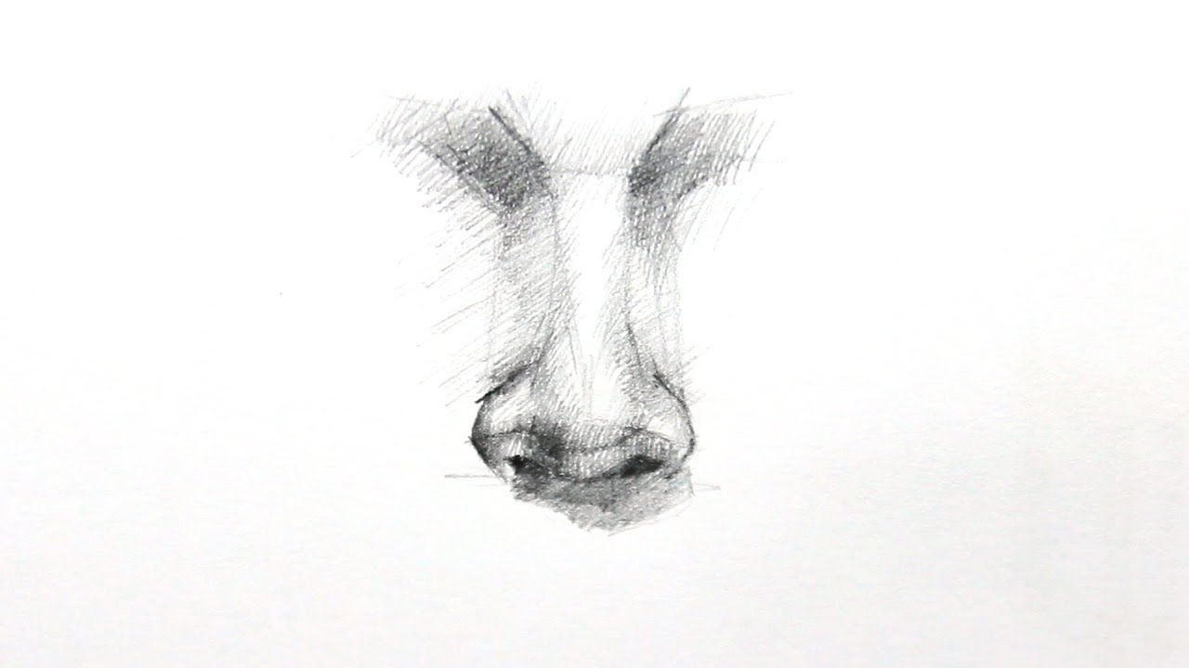
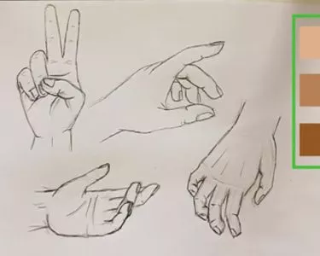
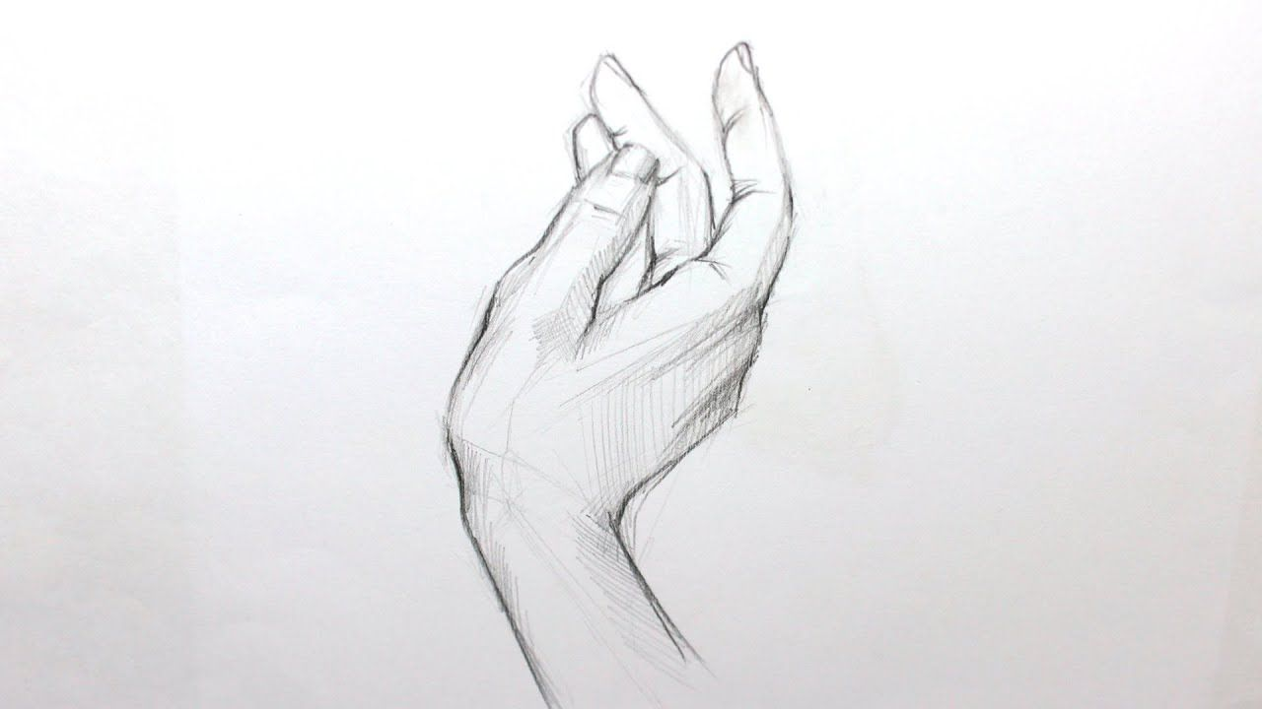
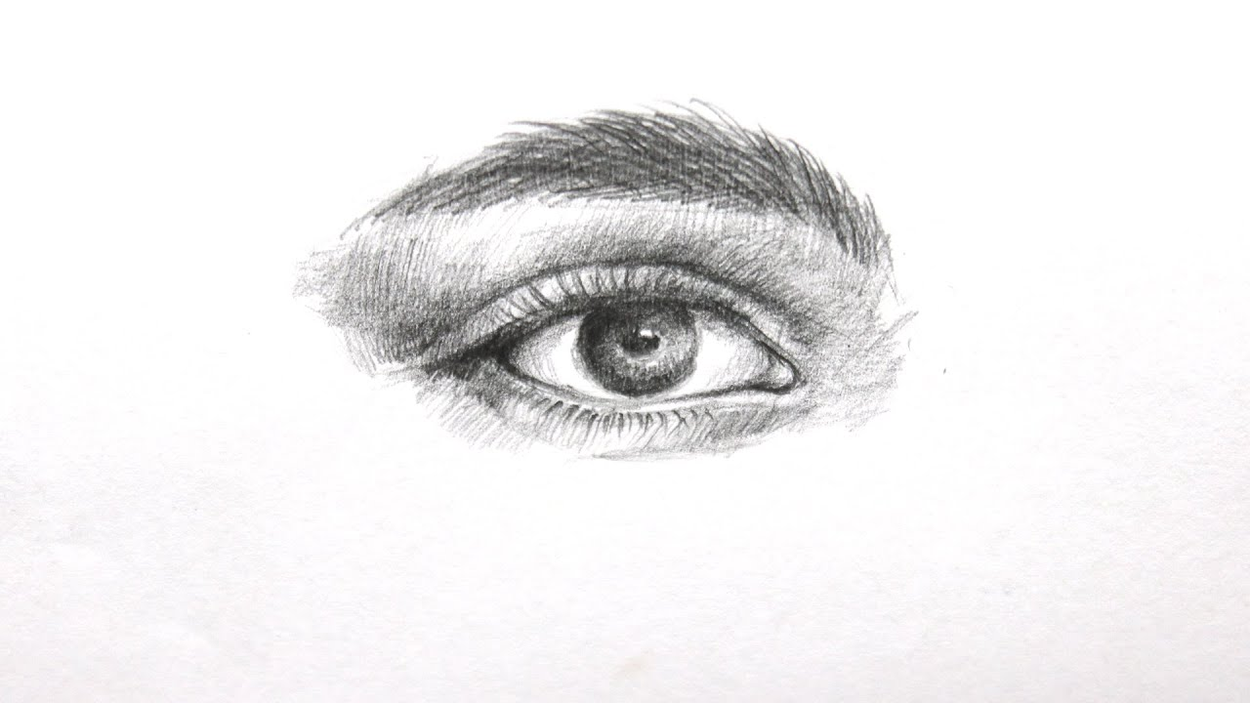

Slide 9
Activity
Can you look at the example pictures, and your own hands and try sketching them. Think about the detail and proportions.
Could you focus in on drawing your knuckle?

