Slide 2
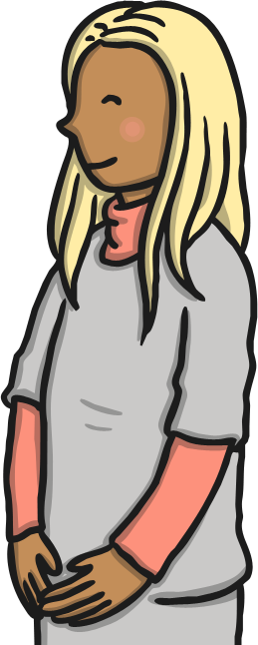
What Is a Stranger?
A stranger is someone that you or your family do not know.
Anyone can be a stranger until you get to know them.
Strangers do not always look scary.
Strangers can be nice and friendly.

Slide 3


What Are Strangers Like?
Strangers might be nice.
Strangers might be mean.
Discuss It!
Where and when do you think you might meet a lot of strangers?

Slide 4
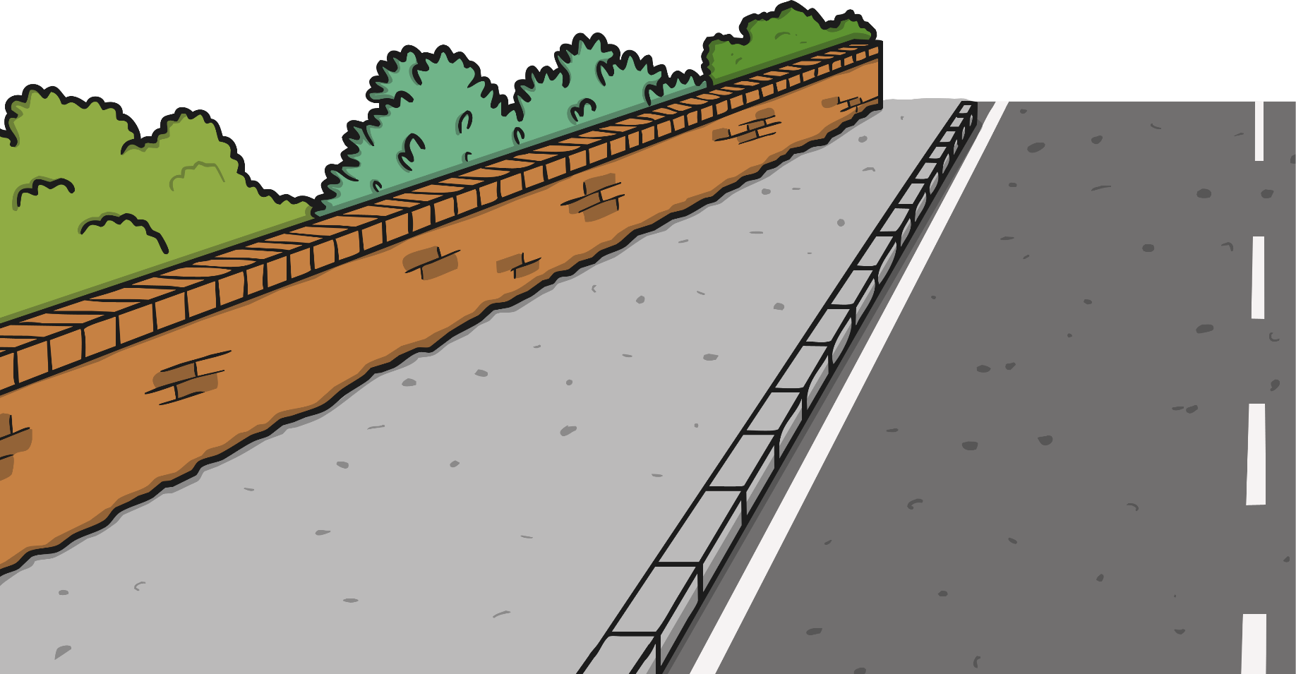
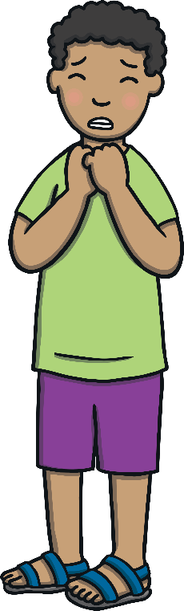
Staying Safe If You Are Lost
If you get lost or feel unsafe and your grown-up is not near you, look for a safer stranger to talk to for help.

Slide 5
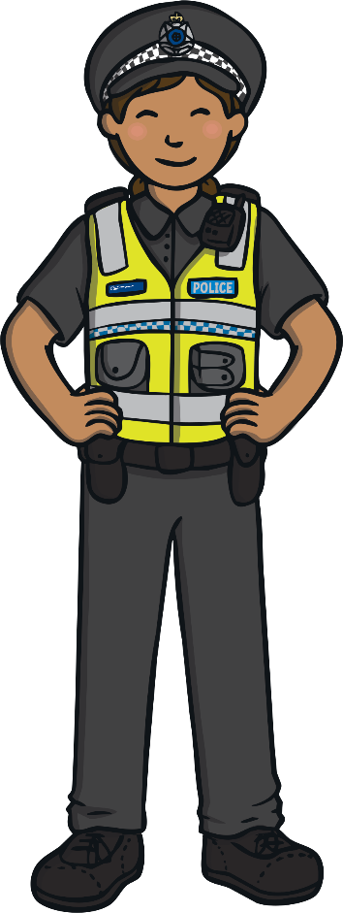
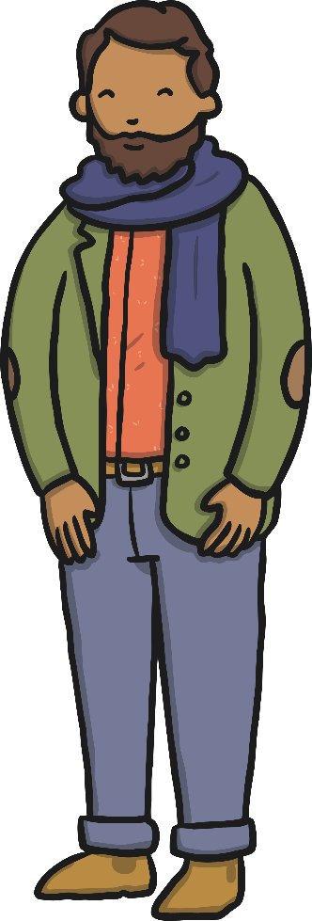
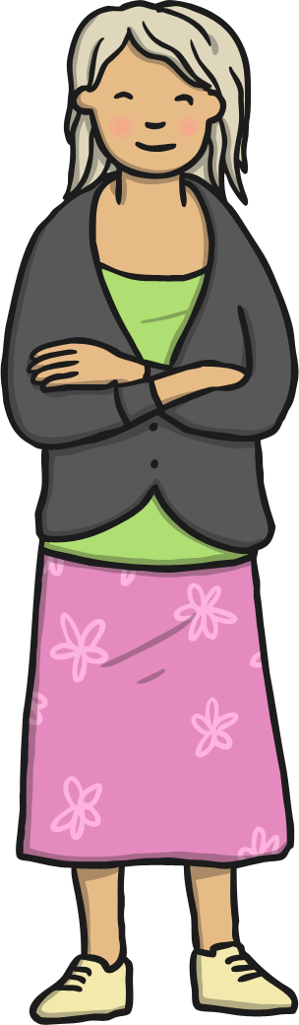
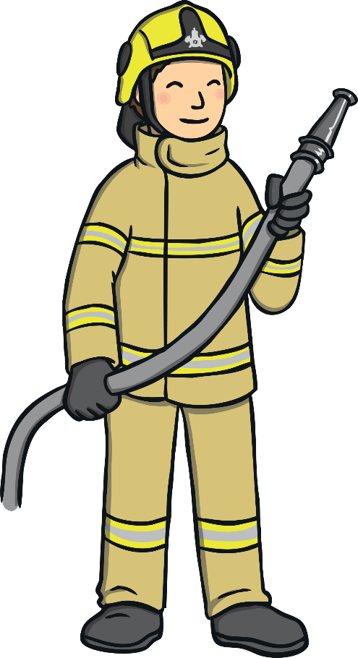
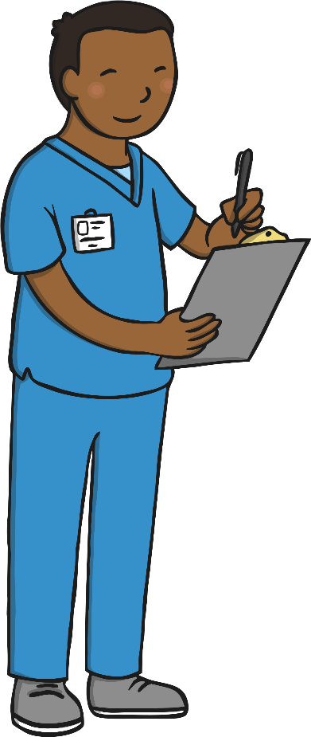
What Is A Safer Stranger?
Some strangers are ‘safer strangers’. Safer strangers are people who you can talk to and they will help you if you get lost. Safer strangers wear a uniform and a badge.
Do It!
How many safer strangers can you see in the picture? How do you know they are safe to talk to?

Slide 6
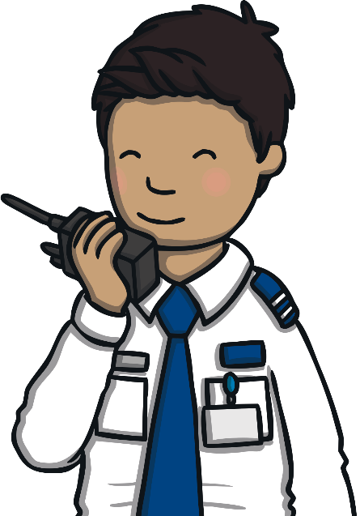
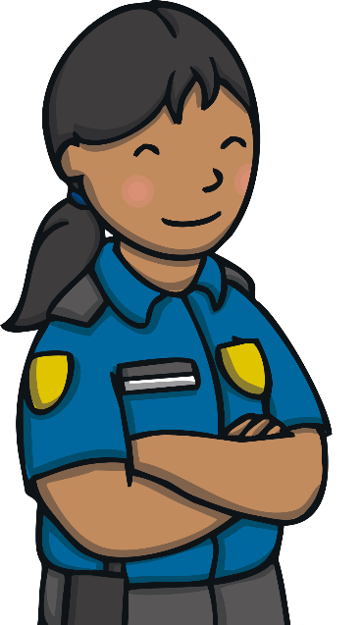
If you can’t see a safer stranger, look for a safer building to go into. Ask the people inside to help.
Tell the safer stranger your name.
You should also tell them the telephone number of the person who looks after you if you know it.
Do It!
Do you know your telephone number? Can you tell it to a friend?

Slide 7

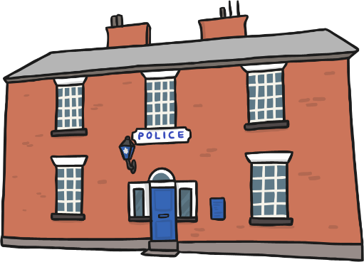
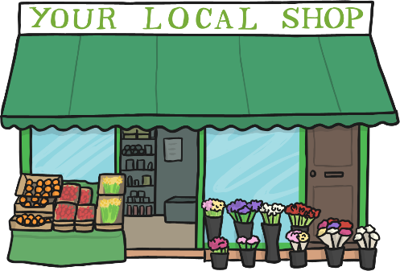
What Is A Safer Building?
Supermarkets, leisure centres and schools are safer buildings.
Discuss It!
Can you think of any other safer spaces?

Slide 8
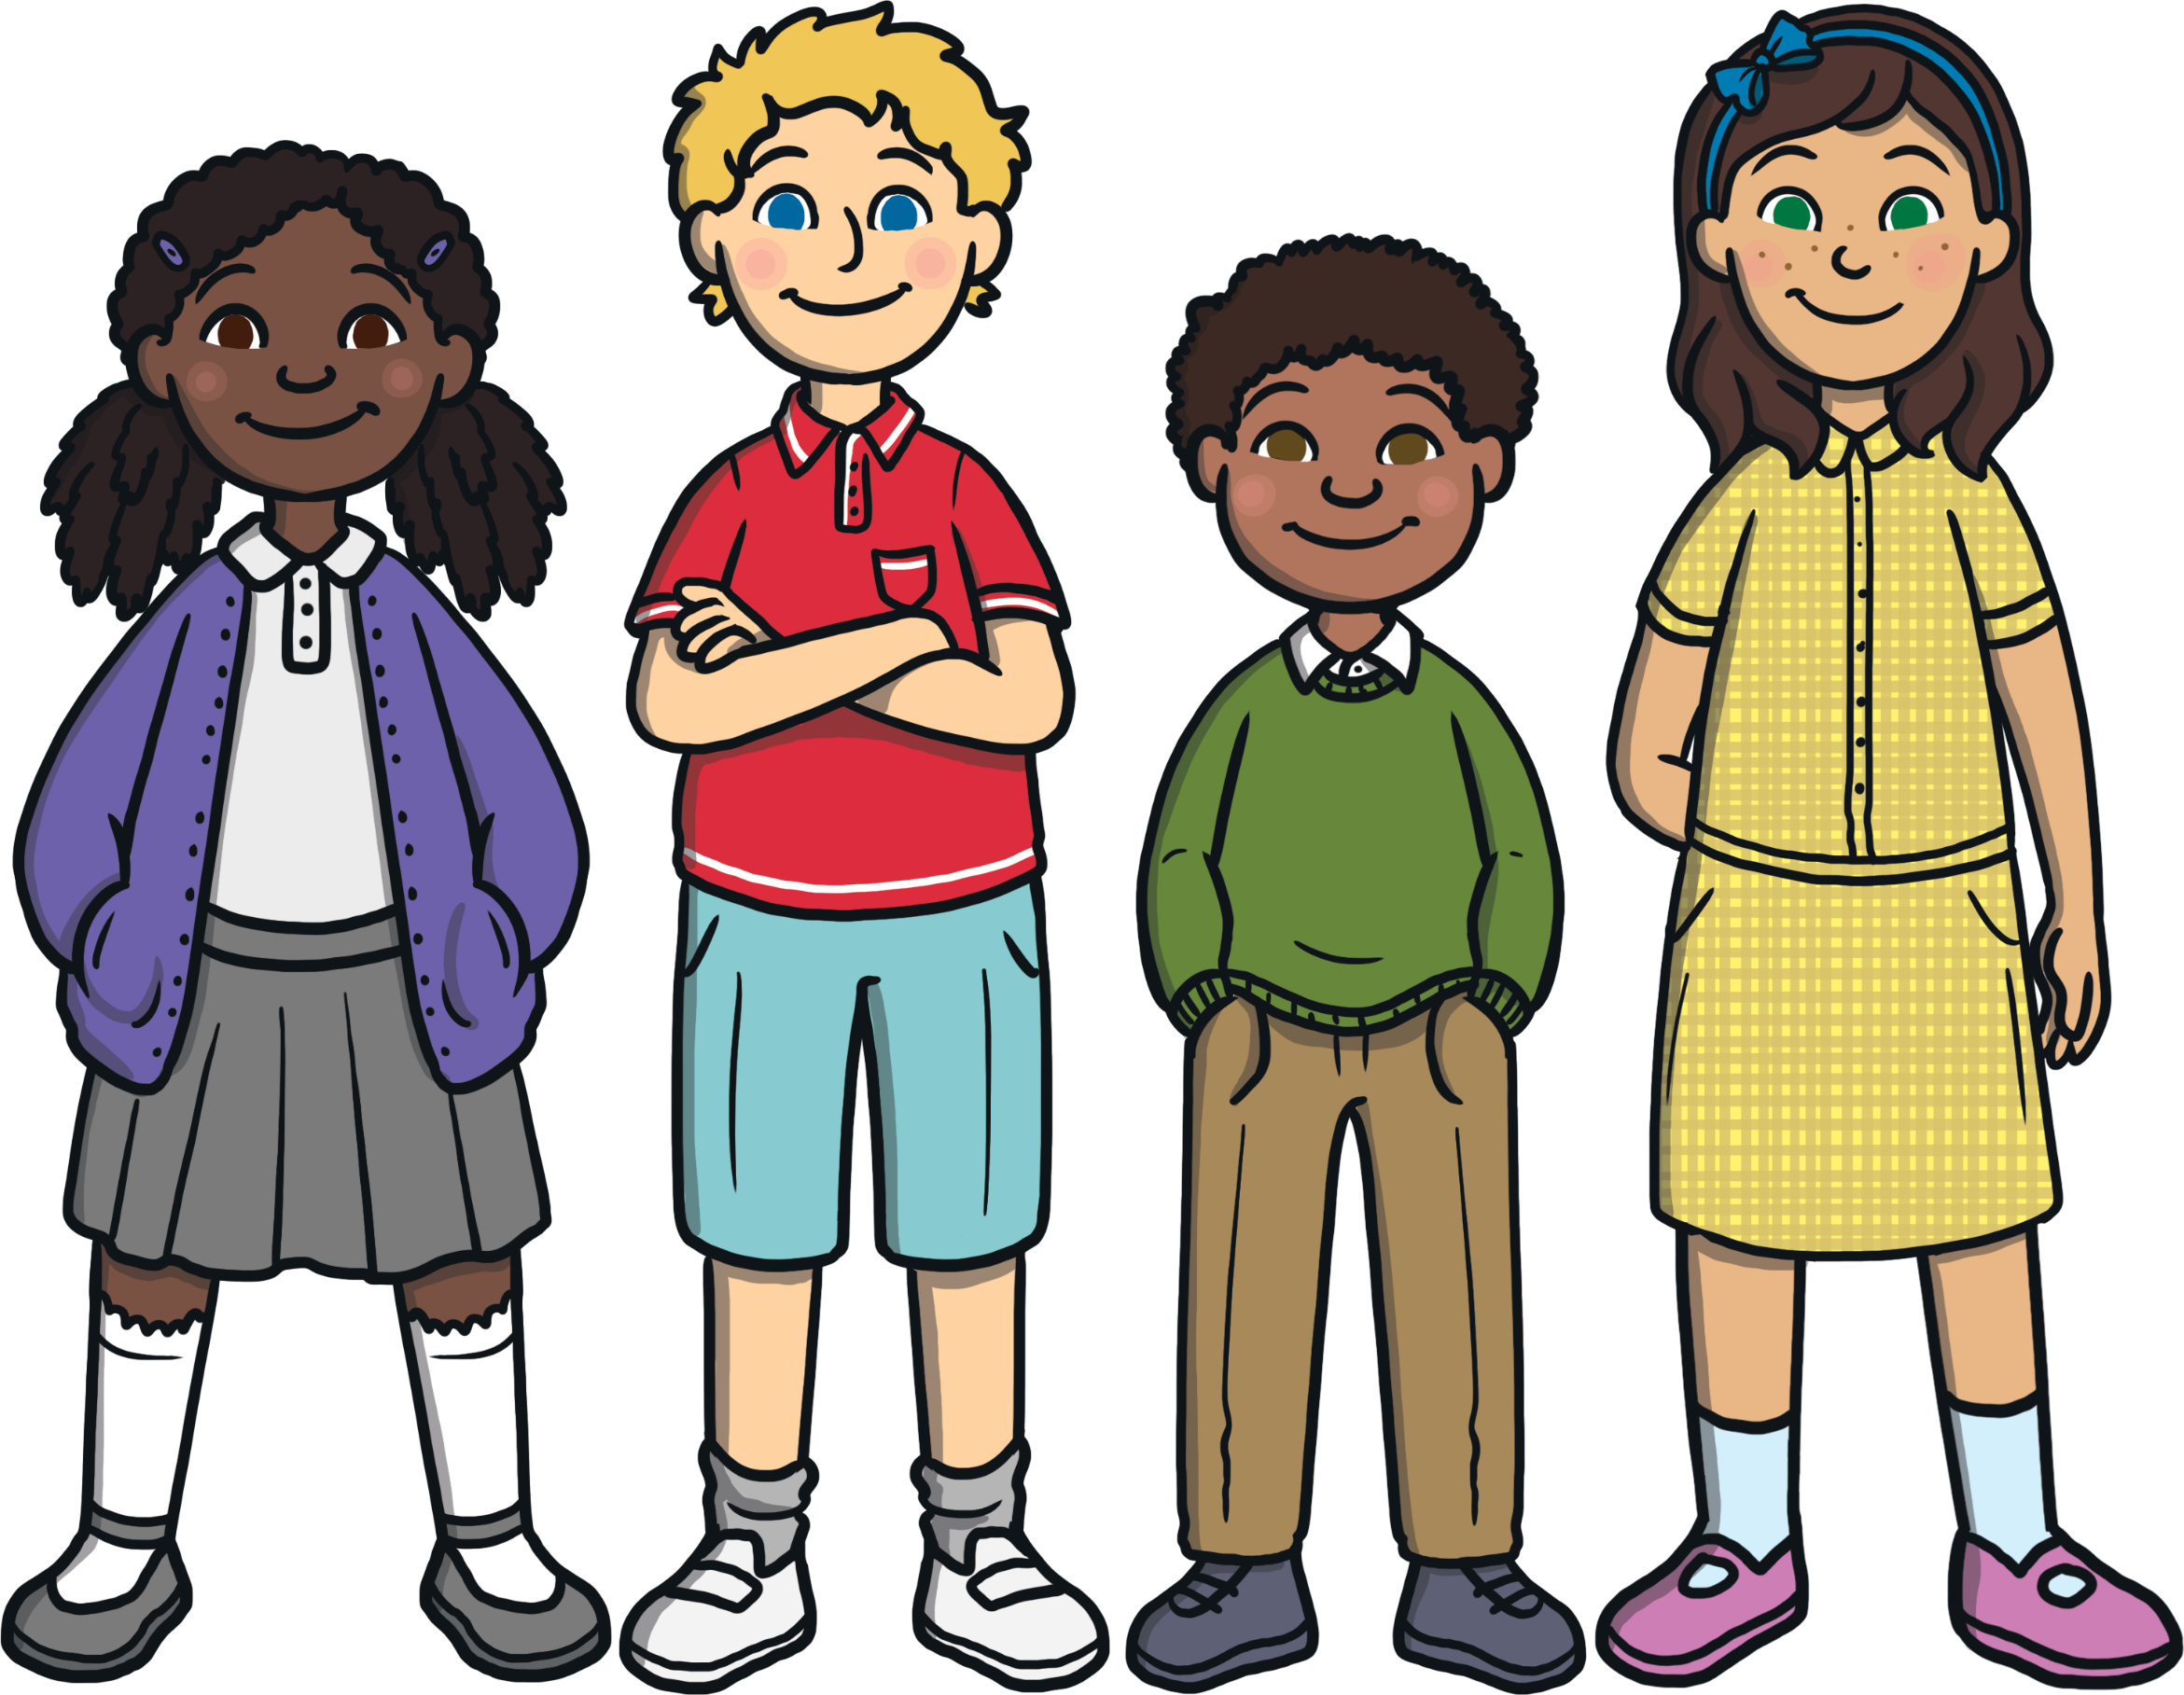
Keeping Safe Around Strangers
Sometimes people can seem nice, but they are trying to trick you.
Here are some more rules to help you to stay safe around strangers.
Remember, if anyone makes you feel sad, scared or uncomfortable, you should talk to your grown-ups at home and at school.

Slide 9
Keeping Safe Around Strangers
Never go anywhere on your own with a stranger.

Slide 10
Keeping Safe Around Strangers
Never get in a car with a stranger.

Slide 11
Keeping Safe Around Strangers
If a stranger offers you a present, say “NO” very loudly.

Slide 12
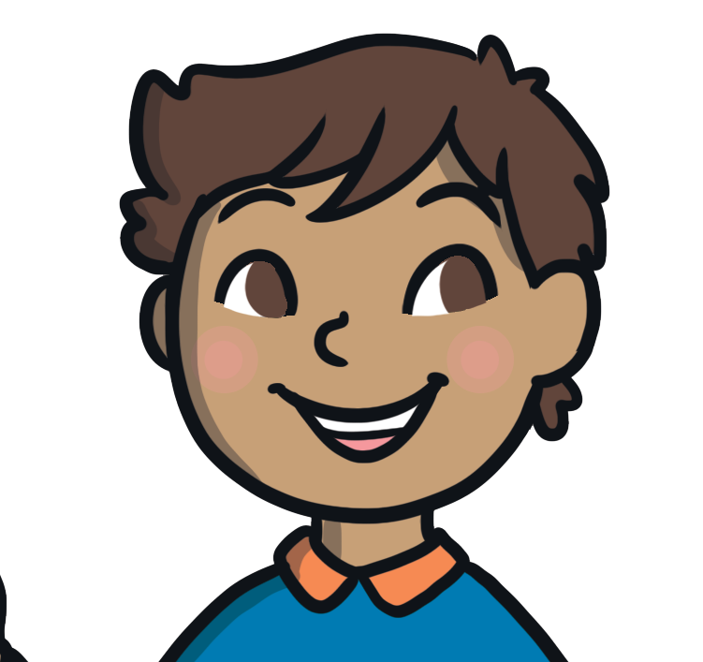
Keeping Safe Around Strangers
If someone scares you, go to a safer place, or tell a safer grown-up.
Yell. Run. Tell!

Slide 13
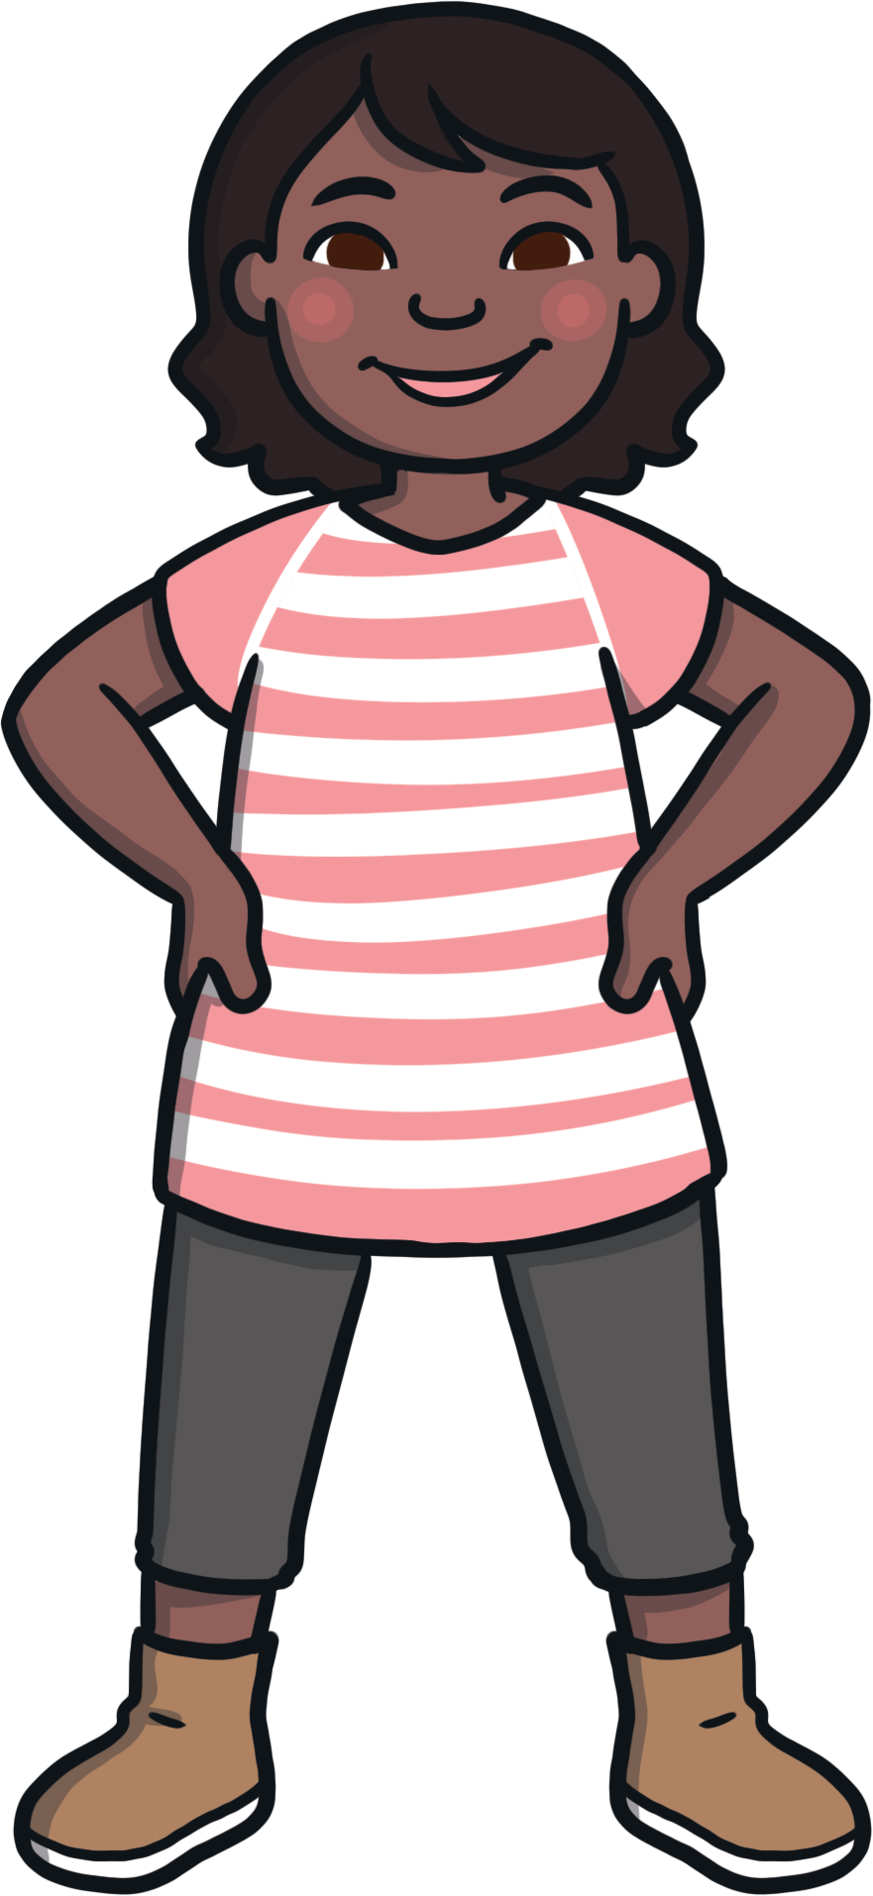
Keeping Safe Around Strangers
If a stranger asks you to keep something a secret, tell a trusted adult.

Slide 14
What Can You Remember About These Words?
safer stranger
safer building

Slide 15

What Should You Do?
A stranger says that they have come to take you home because your mum or dad is ill. They say that they are friends with your mum or dad.
Click on the smiley face to find the safe thing to do.

Slide 16

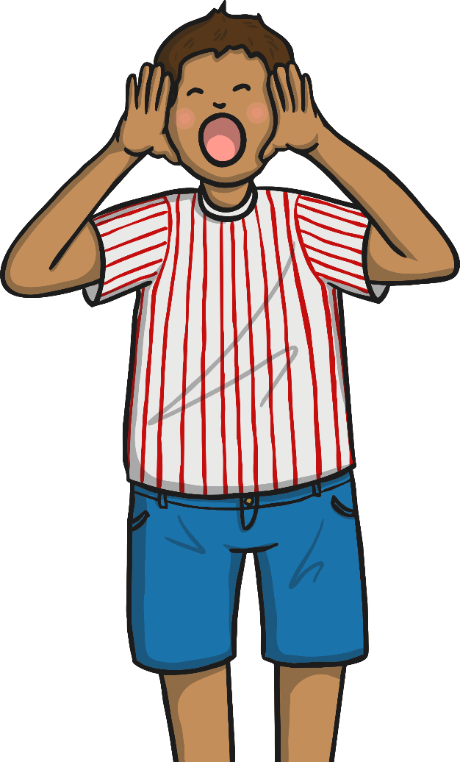
This Could Be A Trick
Say “No, I don’t know you” and stay with your teacher or safer adult.
Yell. Run. Tell!
Discuss It!
What would be a good thing to yell?

Slide 17
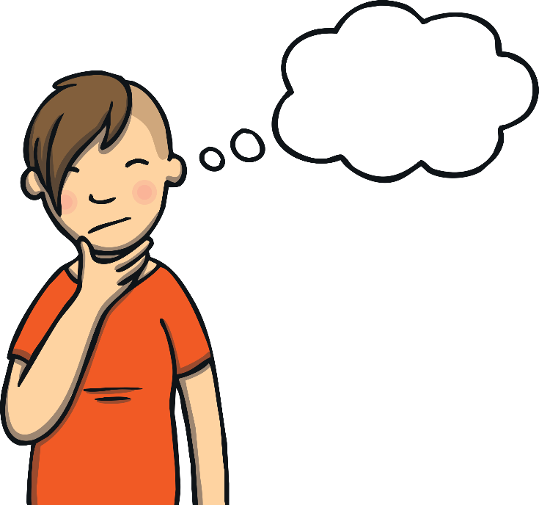
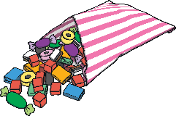
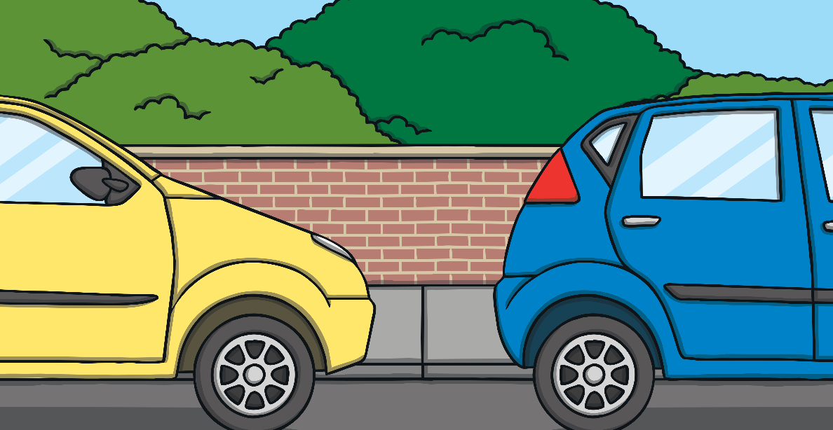
What Should You Do?
A stranger offers you some sweets and asks you to go with them to get the sweets from the car.
Click on the smiley face to find the safe thing to do.

Slide 18
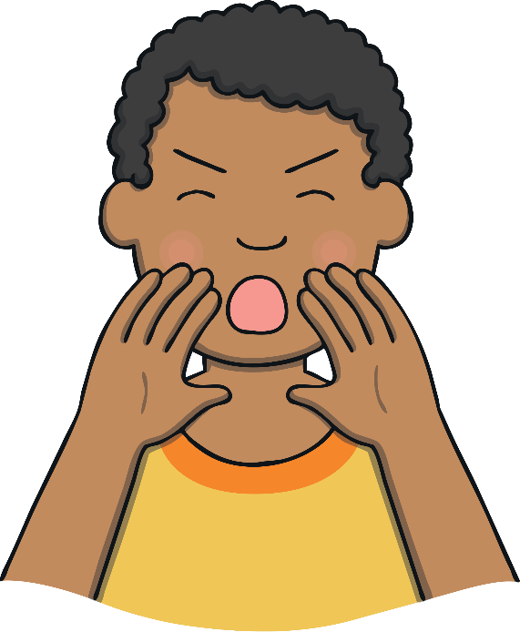
This Could Be A Trick
Say “No, I don’t know you,” in
a big loud voice.
Yell. Run. Tell!

