Slide 1
LO: To understand the story of Prophet Adam in the Quran.
I know what the Muslim holy book is called.
I know who Prophet Adam is.
I can understand what the moral of Prophet Adam’s story is.

Slide 2
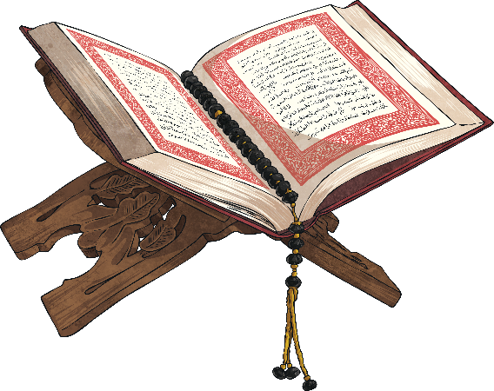
What is the Qur’an?
The Qur’an is the Islamic Holy book.
Muslims believe it is the direct word of Allah. Allah is the Arabic word
for God.
The word of God was revealed to the prophet Muhammed (pbuh) through the angel Jibril (Gabriel).
What Does the Qur’an Do?
The Qur’an teaches Muslims how to worship God.
It teaches Muslims how to live good lives.
It teaches Muslims how to treat other people.
It does this through stories just like the bible.

Slide 3
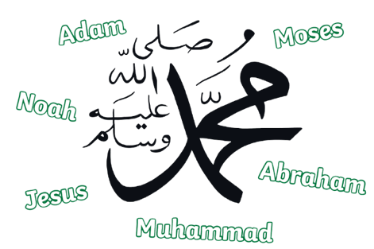

Who Are the Prophets?
Prophets are good people sent by Allah (Glory be to Him). They were very kind and had the best manners.
Allah sent many Prophets to teach people about Allah.
The Prophets told people to be good and to try their best not to do anything bad.

Slide 4
Who Are the Prophets?
Muslims believe in all the Prophets sent by Allah such as Adam, Abraham, Noah, Moses, Jesus and Muhammad.
The first Prophet sent by Allah was Adam.
The last Prophet sent by Allah was Prophet Muhammad.

Slide 5

Before Adam (Peace Be upon Him)
A long time ago, before Allah created anything, there was only Him. No one was with Allah (Glory be to Him), no one was before Him.
There was no sky, no earth, no sun, no moon, no mountains, no animals and no trees.

Slide 6
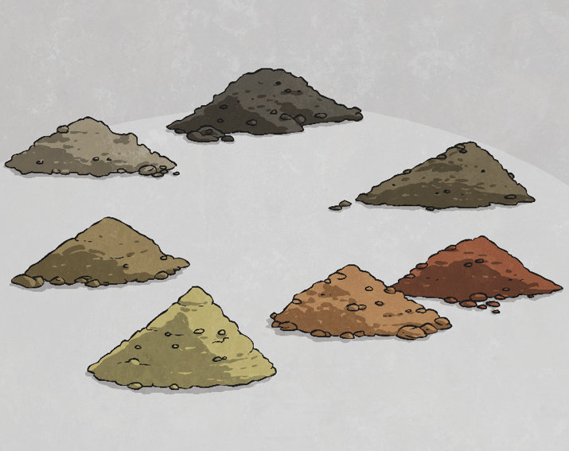
How Did Allah Create Prophet Adam (Peace Be Upon Him)?
Next, Allah created Adam (peace be upon him).
Allah (Glory be to Him) gathered soil from all over Earth. Some of the soil was fine and soft, some was not. Some was white, black, red and in between.
Allah mixed the soil with water to make a human shape from sticky clay.

Slide 7

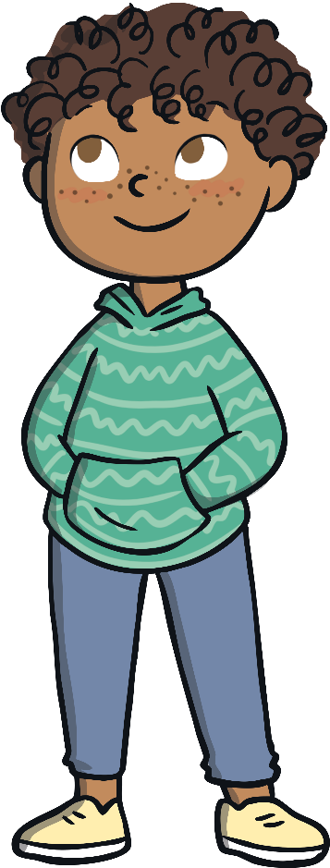

How Did Allah Create Prophet Adam (Peace Be Upon Him)?
Allah used different colours of soil to create Adam. Because all humans come from Adam, we can see that people all over the world look different!
After Allah (Glory be to Him) made the shape of Adam from clay He breathed life/soul into Adam!
We know this because Allah and Prophet Muhammad (peace and blessings be upon him) told us about this in the Qur’an and Hadith.

Slide 8






Angels and Jinns
All angels were good, they always obeyed Allah (Glory be to Him) and they thought Adam was amazing!
Angels
Jinns were both good and bad. There was one jinn who obeyed Allah and worshipped Him so much that Allah allowed him to be with the angels in heaven. This jinn was called Iblis. He also has other names, Shaytan, Satan and the Devil in English.
Jinns
Iblis was very jealous of Adam and he did not like him at all!

Slide 9

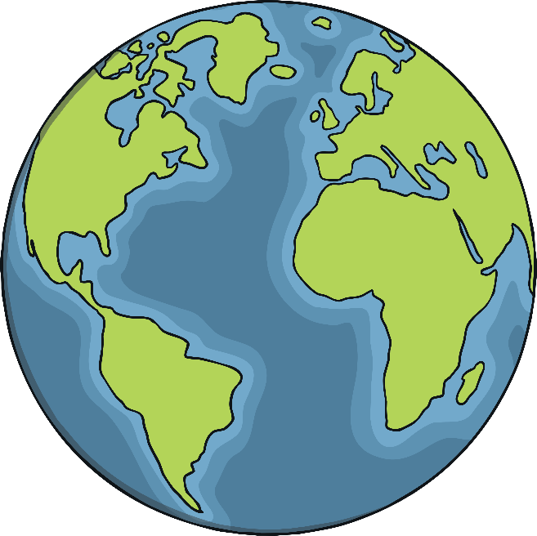

Respect for Adam
One day, Allah told the angels that He was going to create a human and that He will place him on earth to build it and make it a beautiful place.
After Allah created Adam He taught him all the names of all things such as sun, star, cloud and tree.
The angels were so amazed that Adam knew the names of everything! They knew that Adam was very special.

Slide 10

Bowing to Adam
Allah ordered everyone in heaven to bow to Adam to show respect.
All the angels bowed down to Adam as they were told.
But guess who was very jealous of Adam and did not do as Allah said?

Slide 11
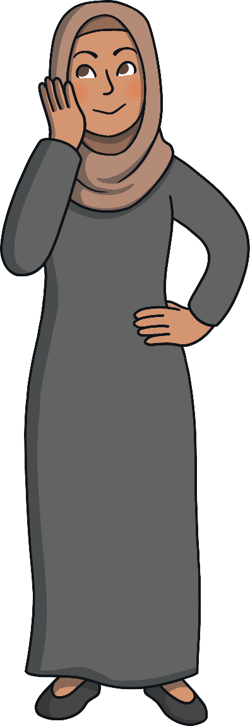
Jealousy and Pride
Iblis!
The jinn Iblis/Shaytan was very jealous of Adam he was too proud.
Iblis said to Allah, “I am better than him. You created me from fire and created him from clay”. Qur’an 38:76
Because of this, Iblis became a bad jinn and he was not allowed to stay in heaven with the angels anymore because he did not listen to Allah’s order.
Allah sent Iblis down to Earth and Adam lived happily in paradise.

Slide 12

Paradise
Paradise is a wonderful place. It is called Jannah in Arabic.
Jannah is a wonderful place. It has rivers flowing with water, honey and milk.
In Jannah your every wish comes true!
Adam (peace be upon him) stayed in Jannah for a while and he enjoyed all the beautiful things in it.

Slide 13
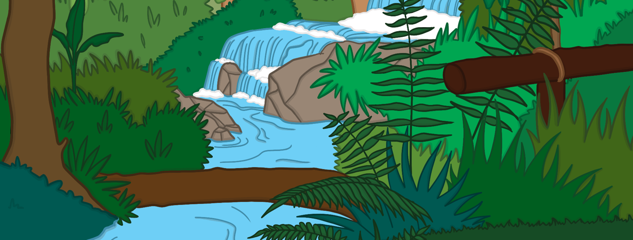

A Wife for Adam
Allah made a wife for Adam in paradise. Her name was Eve/Hawwa.
Adam and Eve lived happily in paradise and they had everything that they wanted.
Adam
Eve

Slide 14


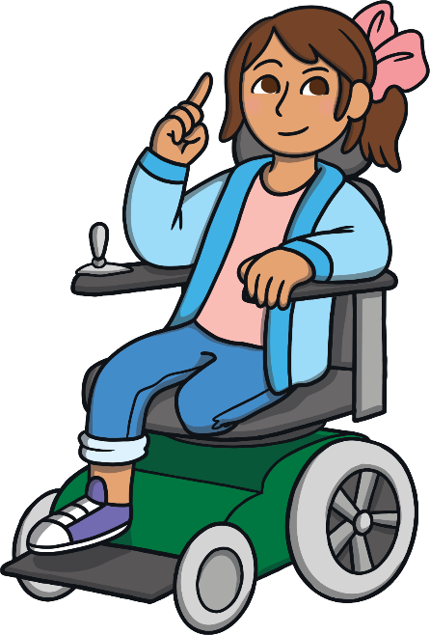
Jannah
Did Adam (peace be upon him) and Eve stay in
Jannah forever?
No! The Shaytan had a plan...

Slide 15

An Evil Plan
Shaytan made a plan to stop Adam and Eve from doing anything that Allah asked them to do.
He decided that his only mission would be to trick Adam and Eve and make them disobey Allah. This is still his plan to this day.
Allah told Adam and Eve to be aware of the Shaytan and not to fall for his tricks.

Slide 16

The Forbidden Tree
Allah told Adam and Eve they could have all that they could ever wish for in paradise except for one tree!
Allah told them to never go near this particular tree and that they were not allowed to eat the fruit from it.
It was only this one tree. There were so many other lovely trees in paradise.

Slide 17




The Shaytan's Trick
Jinn
This was the Shaytan’s plan!
Shaytan wanted Adam and Eve to fail and not to listen to Allah.
He did not like Adam and Eve and was very jealous of them.
Adam
Eve
One day Shaytan came to Adam and Eve and tricked them!

Slide 18


The First Lie
He whispered to Adam and said, “Shall I show you a tree that will make you live forever and a kingdom that will never end?” - Qur’an 20:120
Jinn
That was a lie! But the Shaytan did not care. He kept whispering and whispering this same thing to Adam, he never gave up!
Adam
Eve
After lying and lying, finally, the Shaytan got what he wanted.
Adam and Eve ate from the tree!

Slide 19

Forgiveness
Adam and Eve knew that what they did was wrong and they felt sorry for this mistake.
Allah is the All-Forgiving and the Most Merciful. He forgave them for this mistake and told them that they would have to live on Earth. However, they would return to paradise after they died. This is what will happen to all of us.
On Earth, Allah told Adam that he was a Prophet. He should teach people about Allah and this would be Adam’s job on Earth.

Slide 20

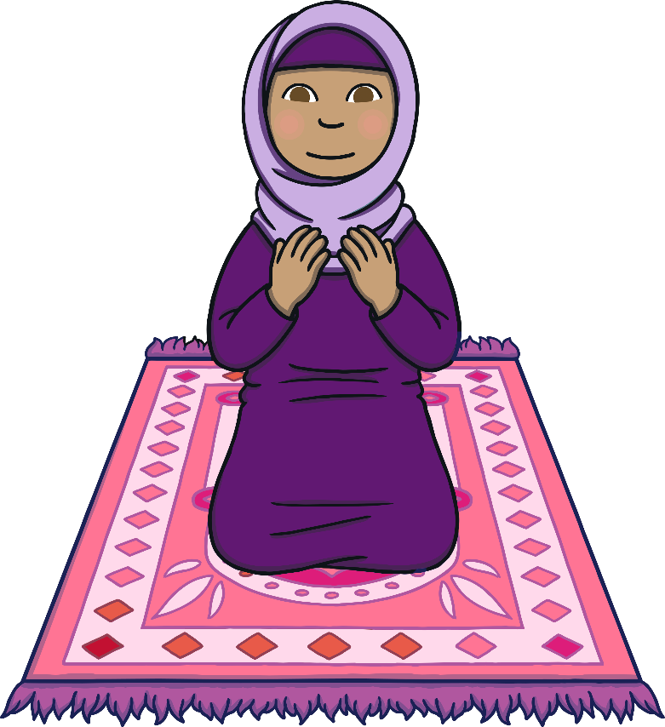
The End
Adam and Eve had many children. Shaytan continued to try to trick them all as he did before with Adam and Eve, but he did not always win.
As Adam was the first Prophet, he always reminded his children to be aware of the Shaytan and to do their best to obey Allah.
If they made a mistake, they should ask Allah for forgiveness. Allah loves to forgive.

Slide 21
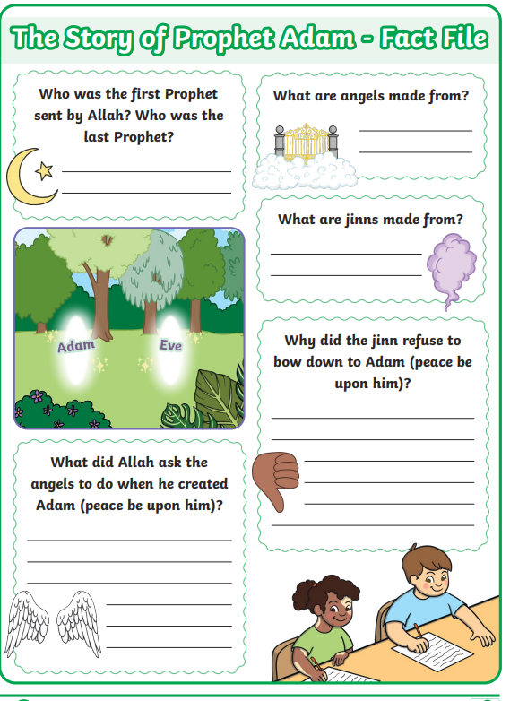
Your Task
Using the information that we have read in this PowerPoint, can you complete a fact file for the story of Prophet Muhammed.
You can use the flashcards to help you too. Remember capital letters for names!

