Slide 1
Islam
Notes:
Recapping information that we have already learnt. Are there any questions that the chn have that we want to find out the answers to in another lesson. Make notes.

Slide 2
Aim
To answer the enquiry question ‘What makes Islam special?’
Success Criteria
I can recall key information about Islam.
I can link my understanding of Islam to another religion.
I can answer the question ‘What makes Islam special?’

Slide 3
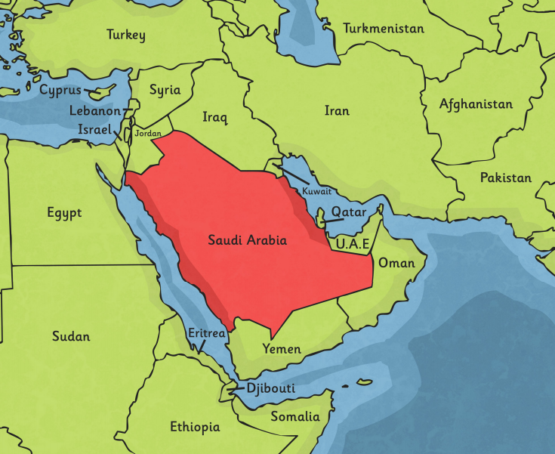
Who and Where
Islam was founded in ______ ______ by _______ ________ around _______ years ago.
Notes:
Do we remember the answers to the blanks?
Saudi Arabia, prophet Muhammed, 700.
Saudi Arabia is in Asia – there are Muslims all over the world but especially around Asia.

Slide 4
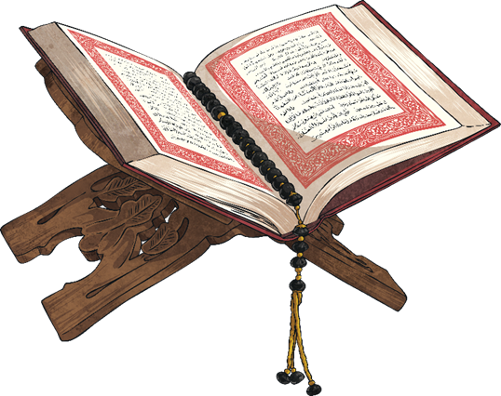
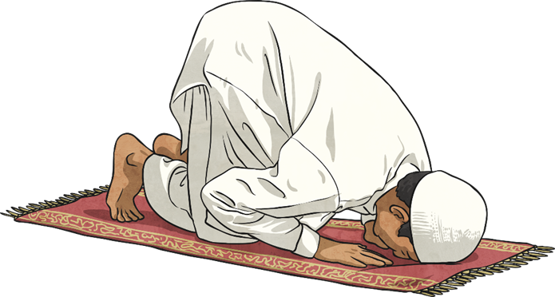
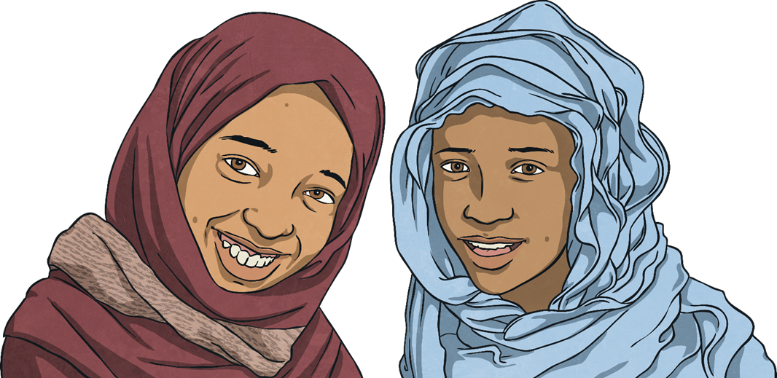
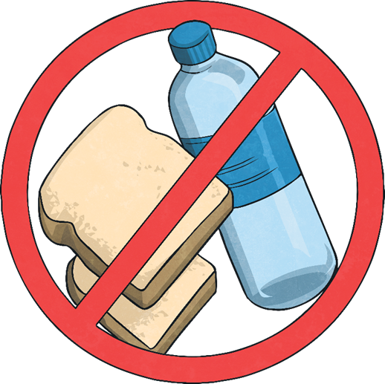
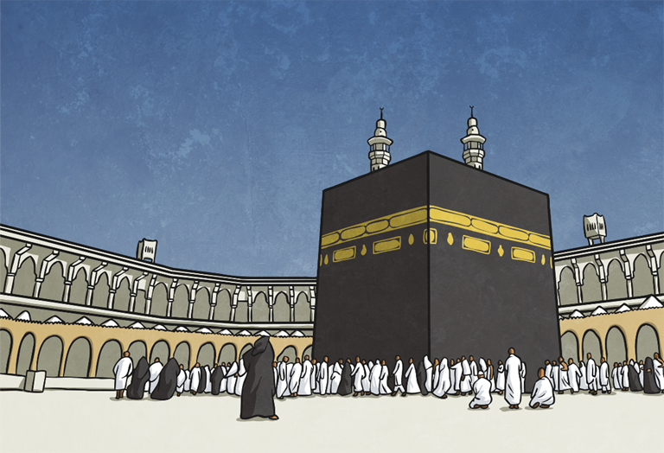
Main Beliefs
Muslims then have 6 main beliefs.
Belief in Allah as the one and only God.
Belief in angels.
Belief in the holy books. (the Quran)
Belief in the prophets (special messengers) and that Muhammad was the final prophet.
Belief in the Day of Judgement (the day when Allah decides if a person goes to Heaven or Hell).
Belief in predestination (the belief that Allah has already planned out what will happen).
Muslims follow the 5 pillars.
Shahada - Belief in Allah as the one and only God.
Salah – Praying 5 times a day.
Zakat – giving to charity.
Sawm – Fasting for 30 days during Ramadan.
Hajj – The duty to make pilgrimage to Mecca once in your life.

Slide 5

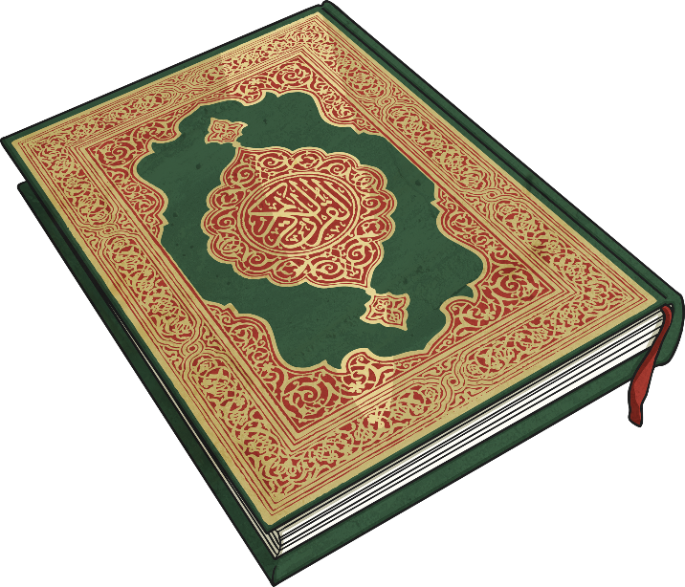
Archangel Gabriel
The Qur’an is the name of the Muslim holy book. Muslims believe that it is a record of the exact words revealed by Allah through the Archangel Gabriel to Prophet Muhammad in the early 7th Century (601-700AD).
Muhammad memorised the words and wrote them down.
Muhammad used these words to live his daily life and in the words he spoke.
Therefore, lots of the things Muhammad did and said were remembered and recorded carefully.
As well as the Qur’an, the other sacred sources in Islam are the Sunnah (soo-n-uh), which contains the practises and examples of the Prophet Muhammad and Hadith (hah-deeth), which reports of the Prophet Muhammad said or approved.

Slide 6

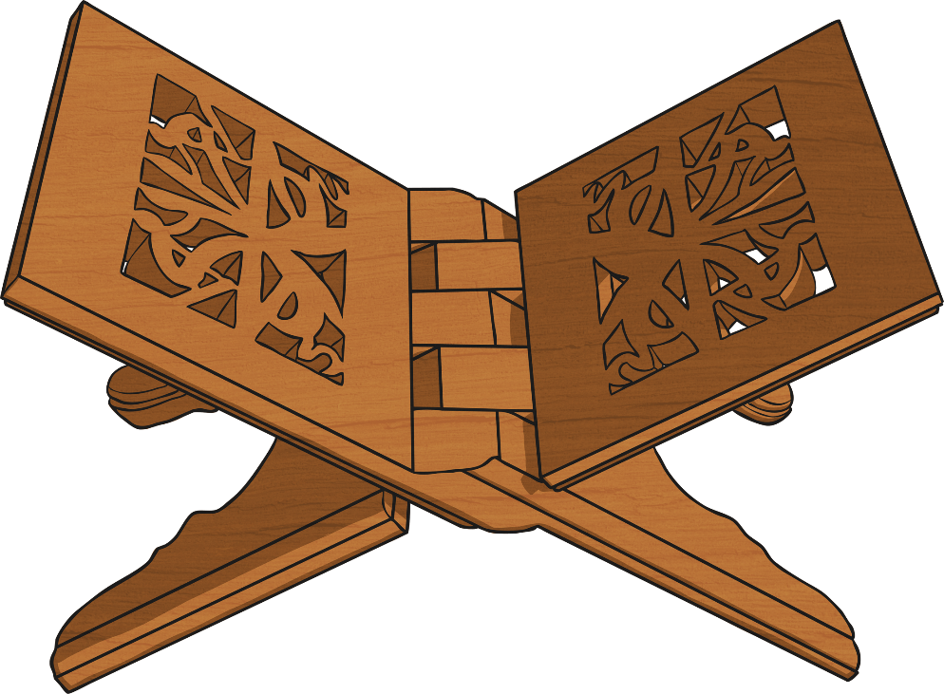
The Qur’an
Muslims treat the Qur’an with a huge amount of respect, as they believe it is literally from Allah and therefore every word is sacred.
The Qur’an is usually placed on a special wooden stand, called the rehal, to be read.
Muslims believe that the Qur’an is the unaltered words of Allah.
In pairs, discuss how the Qur’an is similar to holy books in other religions.
Is it different in any way?
Write down your ideas on your whiteboard for us all to share together as a class.

Slide 7
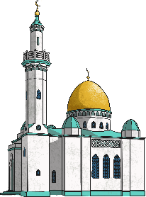
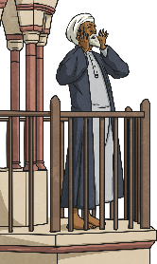
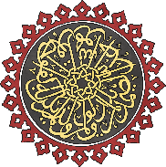
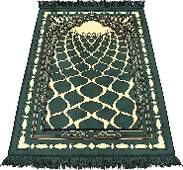
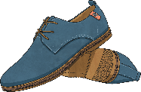
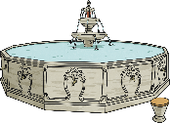
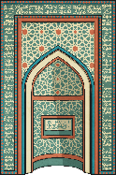
Key Features of the Mosque
Domed Roof: Mosques often have a domed roof.
Minaret (min-uh-ret): This is a tall tower. A man called a muezzin will come here to call Muslims to pray (this is not allowed in Britain, so instead Muslims are often called to prayer through radio stations).
Patterns: In Islam, images of special people and animals are not allowed. Therefore, mosques are often decorated with patterns and words from the Qur’an.
Prayer Mats: There is little furniture inside a mosque, as Muslims pray on the floor using a prayer mat.
Shoes: Muslims take off their shoes before entering the mosque to pray. They do this to keep it clean for prayer.
Fountain: Muslims use the fountain to wash before they pray, to symbolise spiritual cleansing and purity ready to pray before Allah.
Quibla (kib-luh) Wall: The wall of the mosque which faces Mecca is called the Quibla wall. It has an empty arch to show the direction.

Slide 8
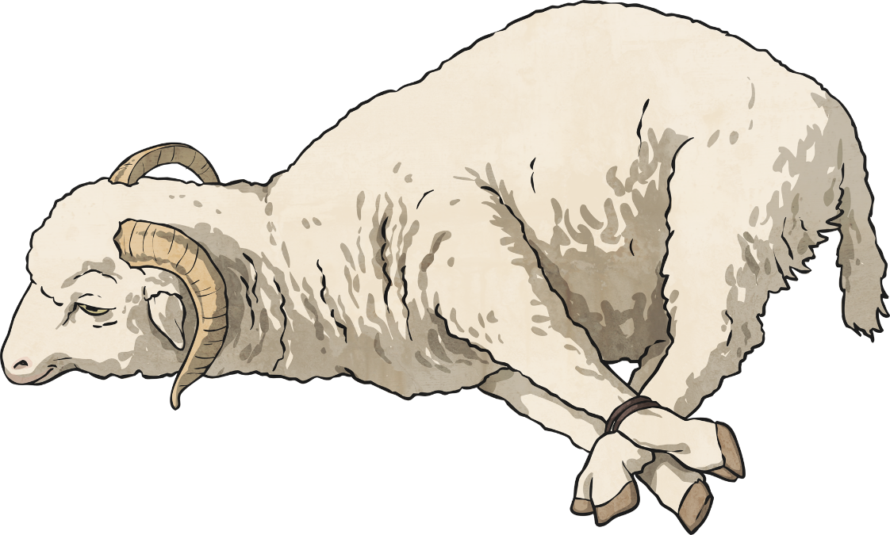
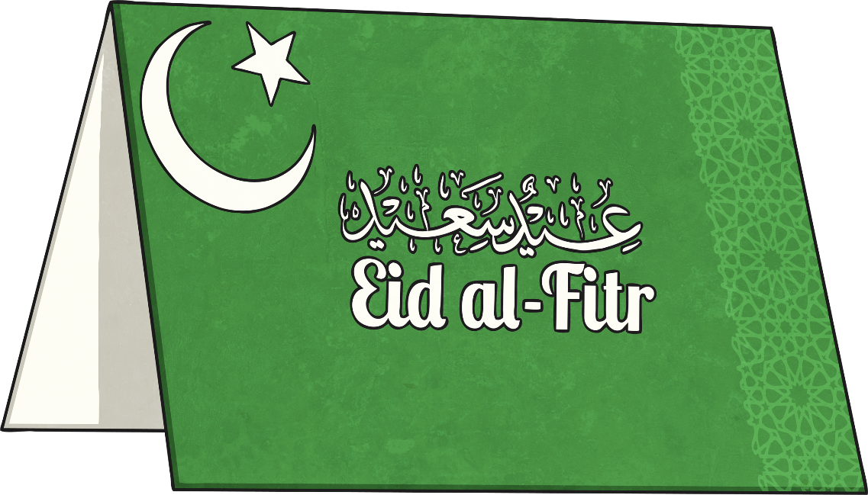
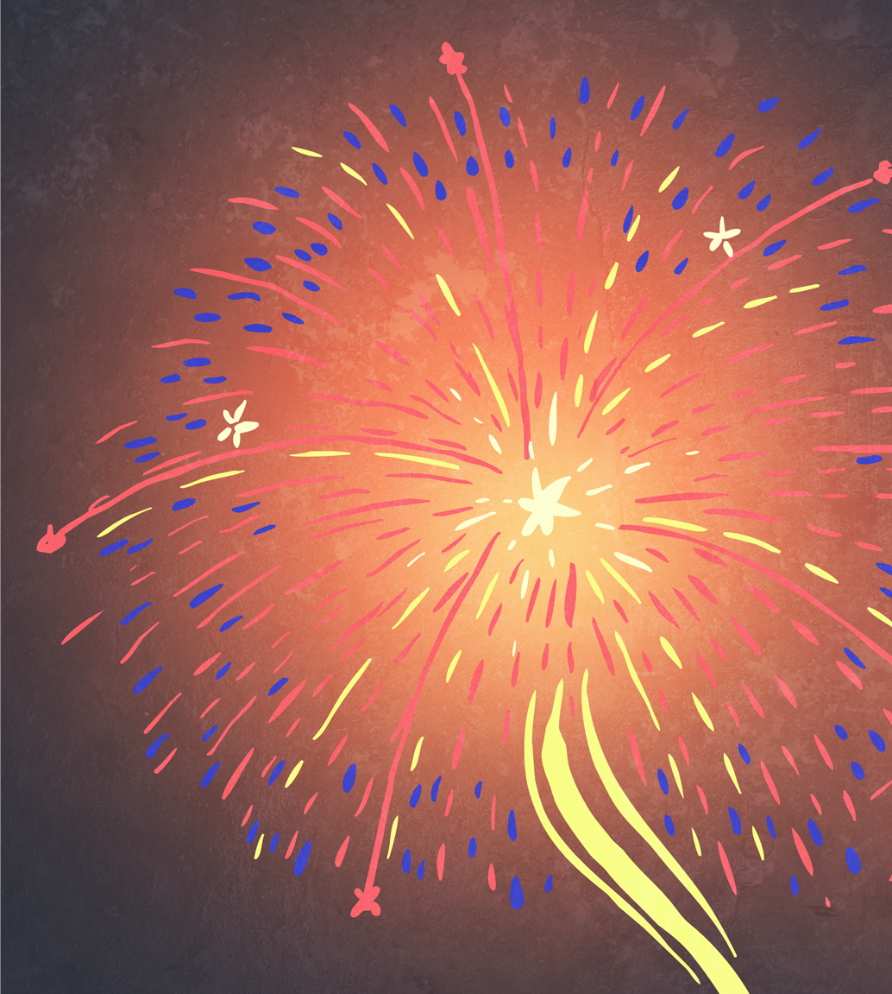
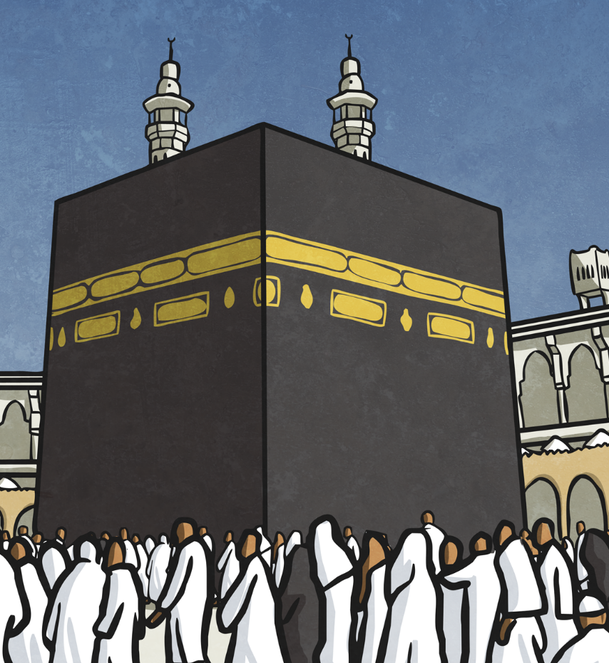
Festivals
Ramadan: The 9th month in the Islamic calendar. Muslims fast during the hours of daylight for 30 days.
Eid-ul-Adha: 70 days after Eid-ul-Fitr, Muslims celebrate The Festival of Sacrifice. This festival remembers when Abraham was going to sacrifice his son to show his obedience to Allah.
Eid-ul-fitr: The first day after Ramadan. Muslims celebrate this festival at the end of the fast of Ramadan. Family and friends all get together to eat good food, share presents and give to charity.
Al Hijra: This is the Islamic New Year. It begins on the day Muhammad left Mecca to travel to Medina which is the second holiest city in Islam and is the capital of the Medina Province of Saudi Arabia.
Dhu-Al-Hijja: This is the month of pilgrimage and is the 12th month in the Islamic calendar. It is when all Muslims, at least once in their life, should try and make the pilgrimage to Mecca.

Slide 9
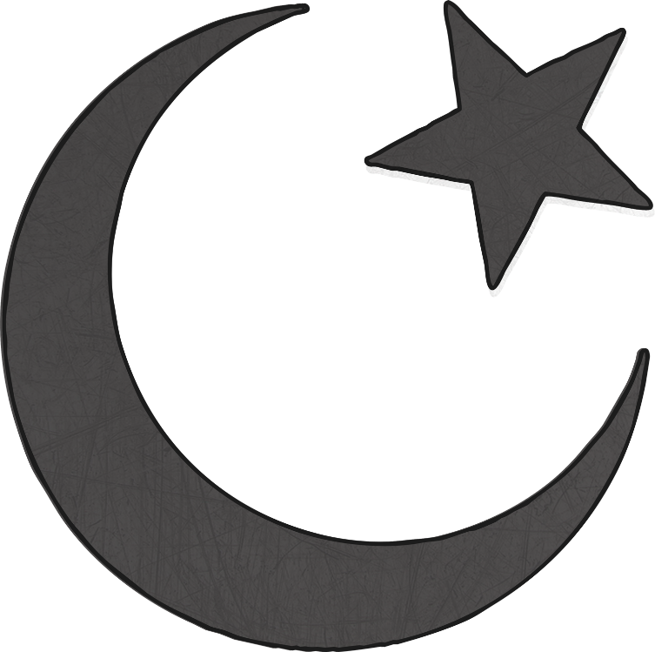
Symbols
The star and crescent symbol is the symbol most commonly associated with Islam. It has little to do with the actual faith and its origins are unclear.
The symbol used to be on the flag of the Ottoman Empire, which was the dominant Muslim power for nearly 700 years. It is now linked with Islam, but is not an official symbol of Islam.

Slide 10
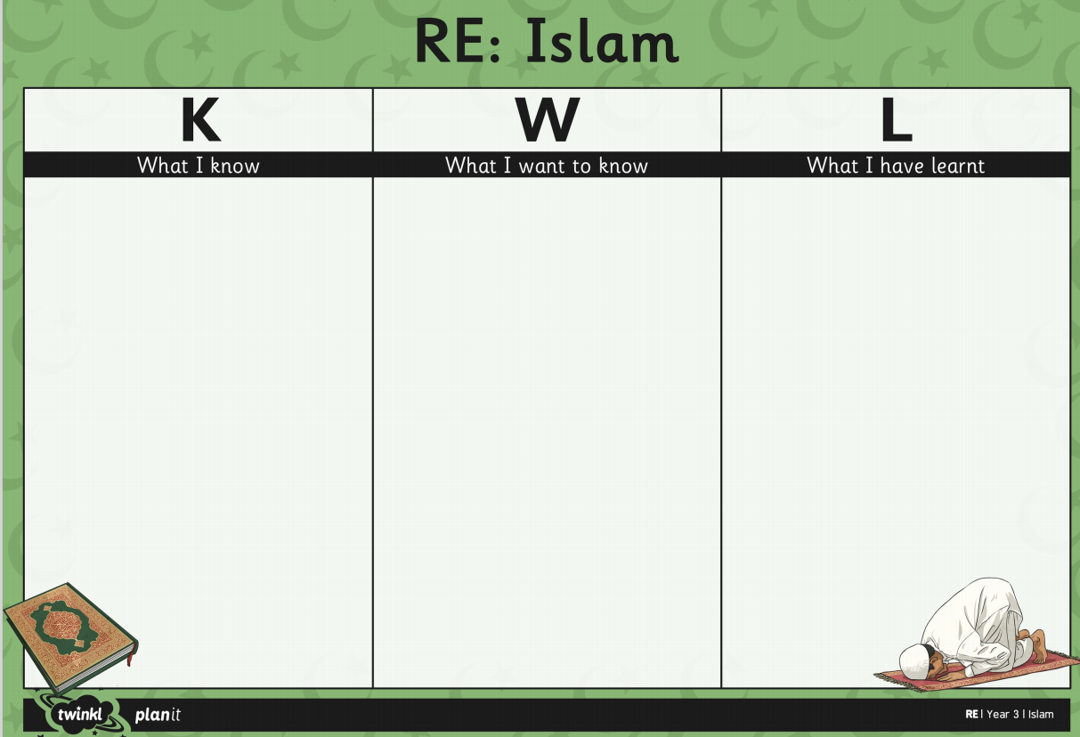
KWL Grid – What you have learnt
Notes:
Now ask the chn to fill in their KWL grid. Encourage to use small handwriting because it won’t all fit.

Slide 11
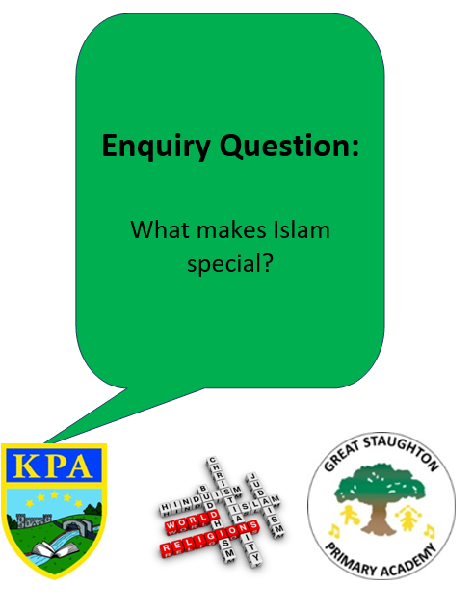
Now, we are going to answer our enquiry question ‘What makes Islam special?’
You need to use the knowledge that we have learnt from this unit to answer the question as independently as you can. You should try to compare Islam with another religion that we have looked at such as Christianity or Sikhism.

Slide 12
Sentence starter ideas:
Islam is special because of the way that Muslim’s read the Quran…
Islam is special because of their symbol…
Islam is special because of their festivals…

