Slide 2
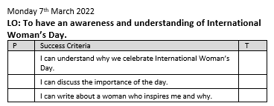

Slide 3
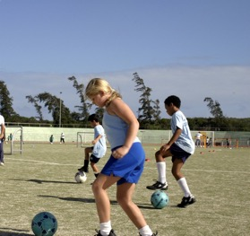
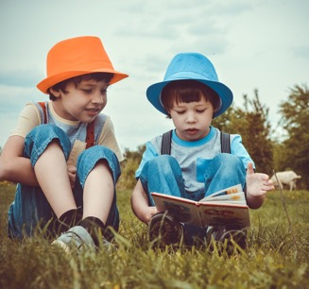
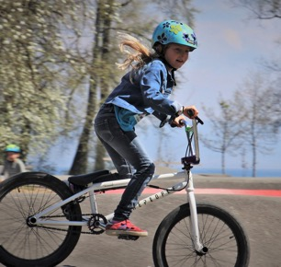
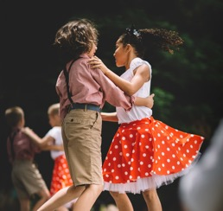
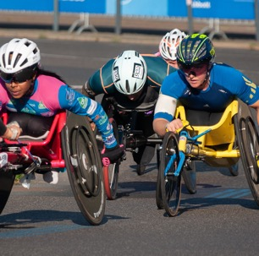
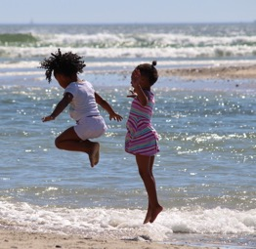
Achievement
What are you good at?
Think About It
Do you have to be a male to be good at some things and a female to be good at others?

Slide 4
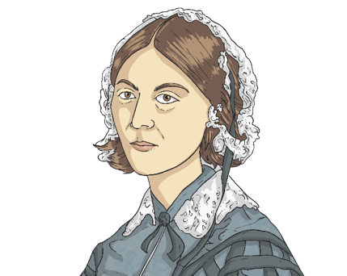
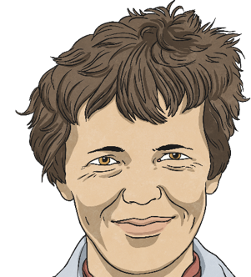
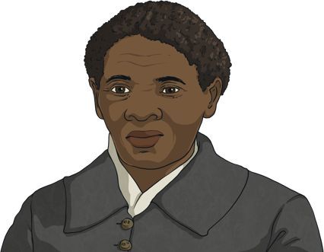
Achievement
What do you know about these famous women?
Harriet Tubman
Florence Nightingale
Amelia Earhart
Did You Know…?
All these women had to fight against injustice and work hard because they had ambitions to take up roles that were uncommon for women in the societies in which they lived. We remember such women and their achievements on International Women’s Day.

Slide 5
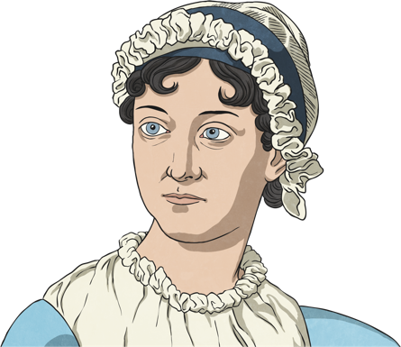
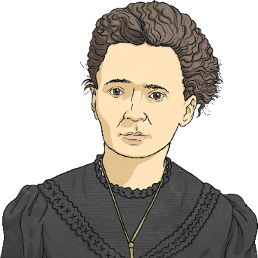
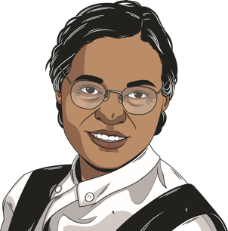
Jane Austen
Marie Curie
Rosa Parks
I wrote books in a time when people thought it wasn’t right for women to work.
I did groundbreaking research on radioactivity that led to the treatment of many illnesses.
I campaigned against segregation and for equal rights for Black people in America.

Slide 6
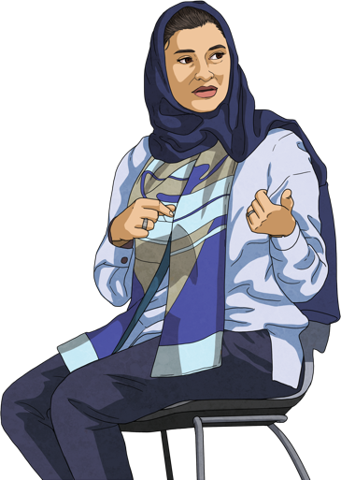
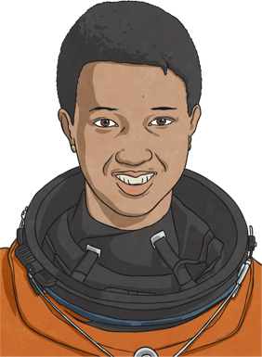
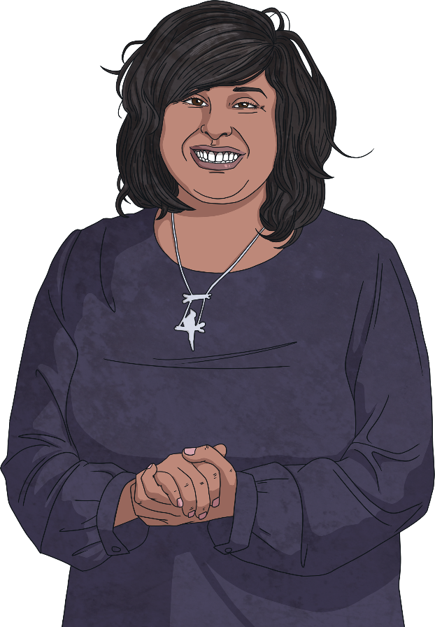
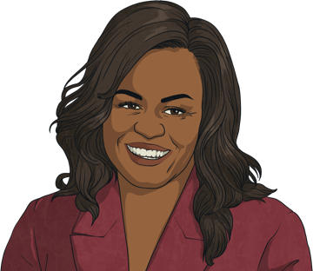
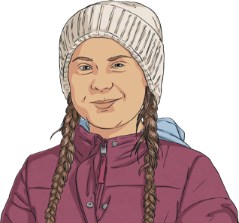
Sarah Al-Amiri
Saima Razaaq
Mae Jemison
Michelle Obama
Greta Thunberg
I am the Minister of State for Advanced Technology and Chairwoman of the Space Agency in the United Arab Emirates. I have been internationally recognised for my contributions to science, technology and engineering.
I am a British political activist and educator and I campaign for LGBTQ+ inclusive education in schools. I was the first Muslim woman to lead a Pride parade in Britain.
I’m an engineer, doctor and astronaut. I was the first Black woman to go into space.
I am a lawyer and author. I was the first Black First Lady of the United States.
I am a climate change activist and have led international campaigns to help the environment.

Slide 7
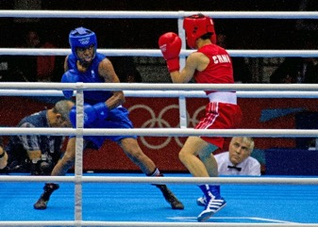
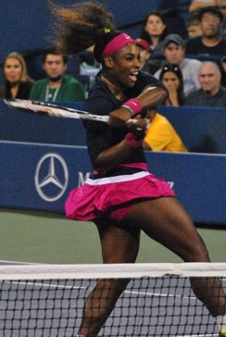
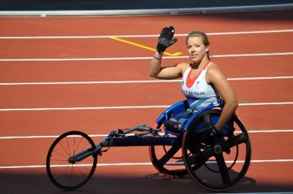
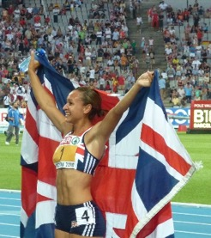
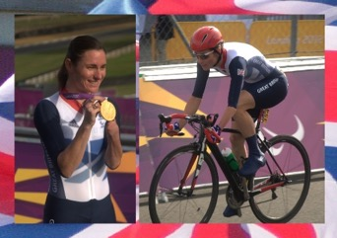
Famous Sports Stars
What do you know about these famous women?
Nicola Adams – boxer
Dame Jessica Ennis-Hill - Olympic athlete
Serena Williams – tennis player
Hannah Cockroft – wheelchair racer
Dame Sarah Storey - Paralympic athlete

Slide 8

Introduction
Girls and women and boys and men are not always treated the same.
In the past, women in many countries (including the UK) were treated differently from men. They did not have the same opportunities and weren’t allowed to do the same things as men. Sometimes, they were seen as less important.
Although the lives of many women have got better, this can unfortunately still happen today in some places.
International Women’s Day is a day to think about how we can make the world a fairer place for all people.

Slide 9
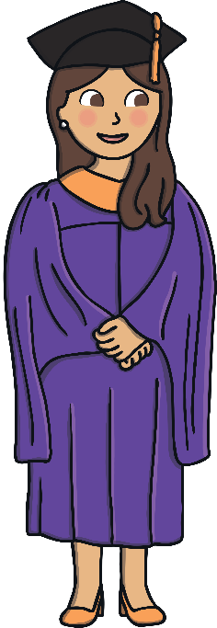
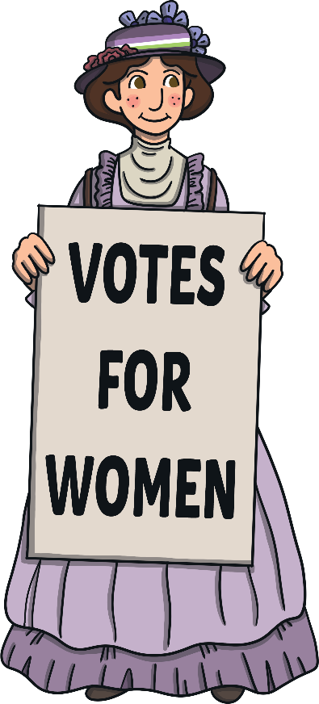
In the Past
In the past, women were not always allowed to:
choose to get married or not;
have a job or be paid fairly for it;
vote in elections;
go to school or university;
choose to not have children;
make important decisions about their lives or their families.

Slide 10
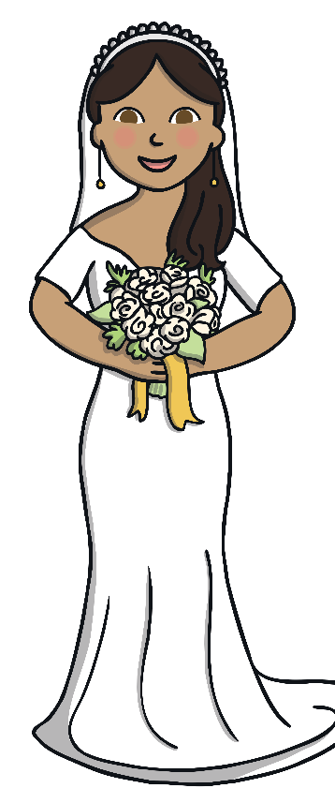
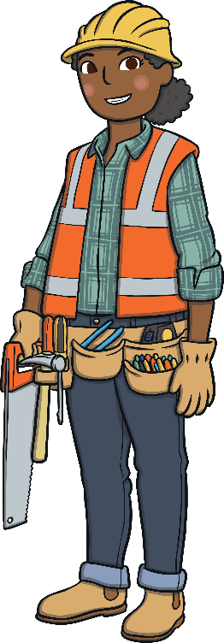

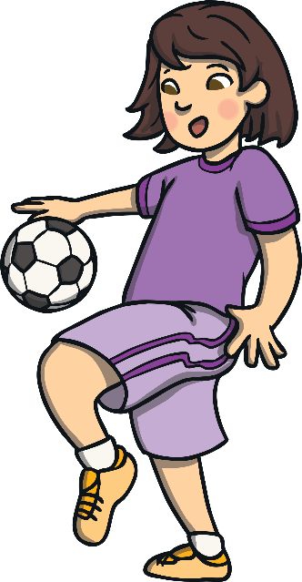
In the Past
Women were not able to work in certain jobs because they were seen as ‘men’s jobs’.
Many women were expected to get married at a young age and start a family.
Some cultures thought that girls were not as smart as boys.
Boys were seen as more valued than girls.

Slide 11
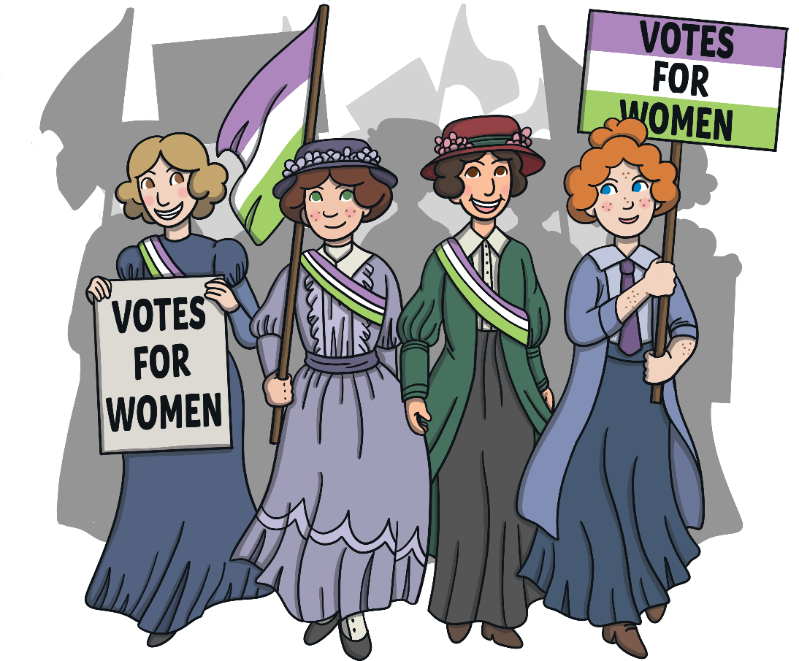
What Has Changed?
Many people have worked, or are still working, to make things better for women across the world.
During the Victorian era, the Suffragettes campaigned for women to have the right to vote in elections. As a result, in the UK in 1928, all women over age 21 were finally allowed to have a say in who governed their country.
Current role models for women’s equality include Alexandria Ocasio-Cortez and Malala Yousafzai.

Slide 12
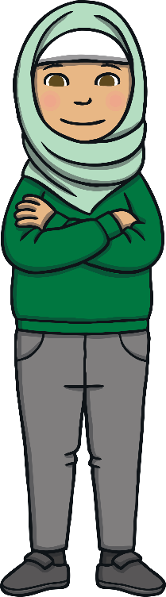
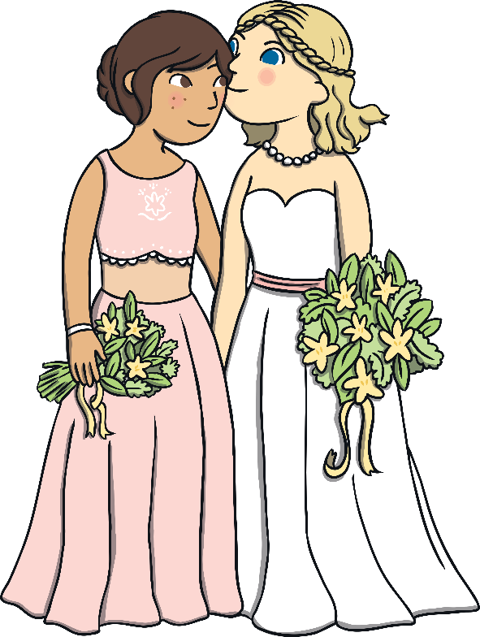
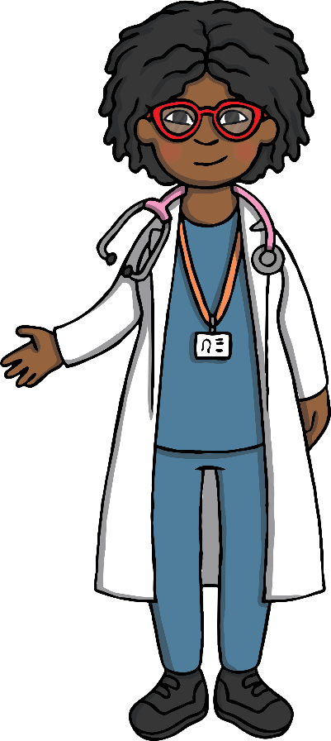
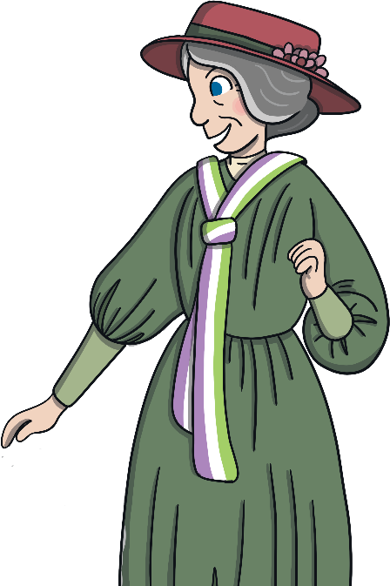
What Has Changed?
Women have the right to make their own decisions about their lives and family.
Women have the right to be educated.
Women work in every kind of job.
Women vote in elections.

Slide 13
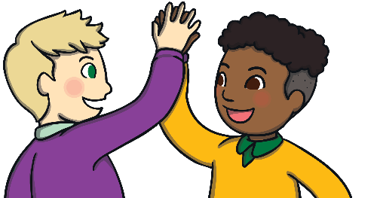
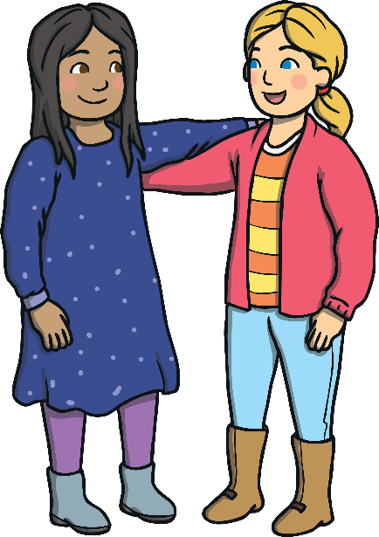
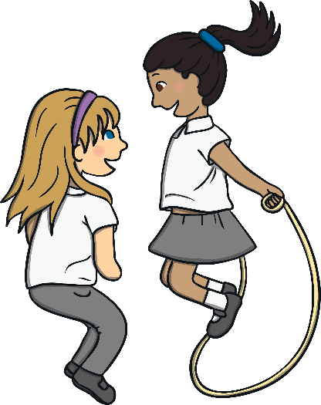
International Women’s Day
International Women’s Day is held every year on the 8th of March.
We remember those who have done or are doing incredible things to make life fairer for women.
Some women still need to fight for their opinions to be heard or to do what they want to do with their lives.
What could you do to make the world a more equal place for all people?

Slide 14
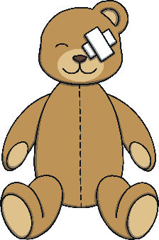
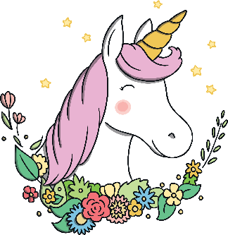
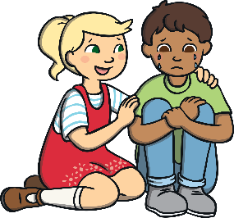

What Can We Do Now?
How can we make the world a fairer place?
Share your answers to these questions.
Does it matter if toys say ‘for boys’ or ‘for girls’?
Does it matter if girls like football or boys like unicorns?
Is it OK for boys to cry when they’re sad?
Is it OK for girls to carry chairs or books around school?

Slide 15
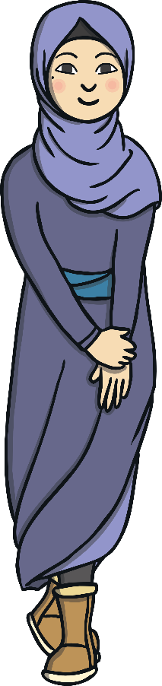
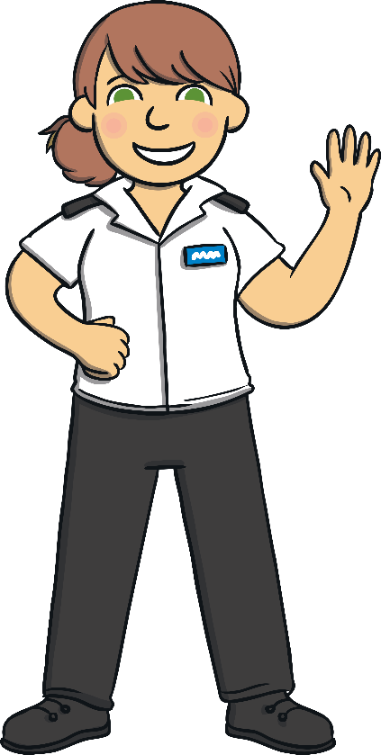
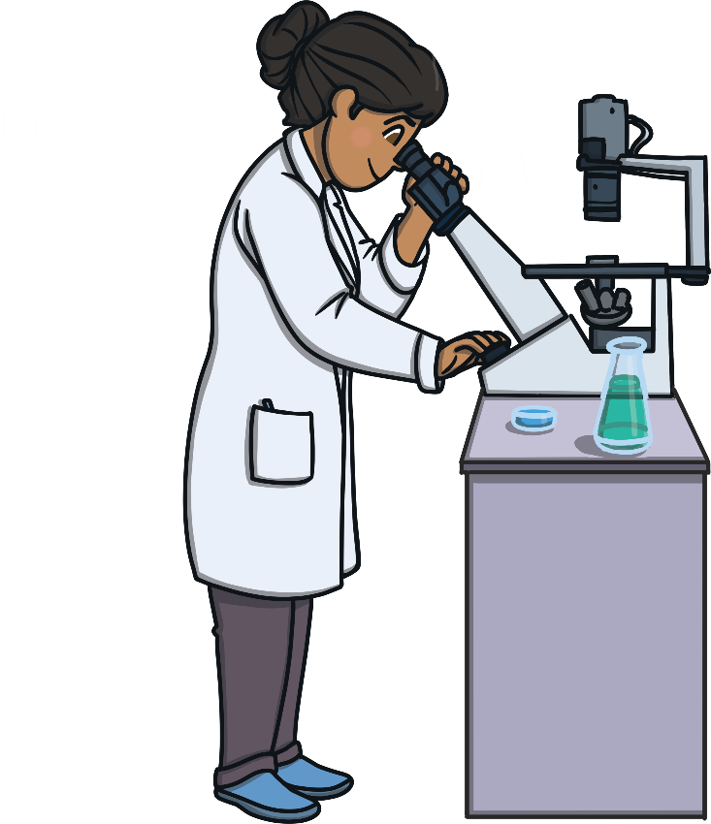
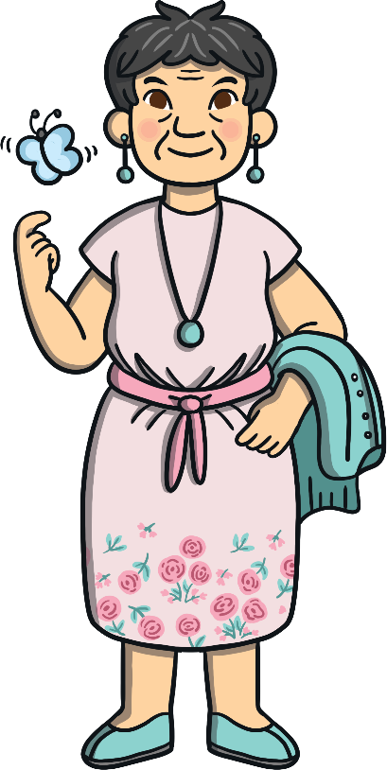
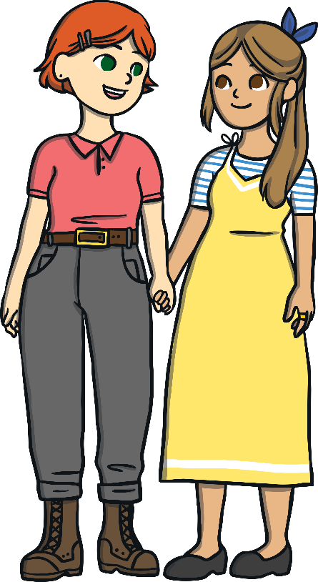
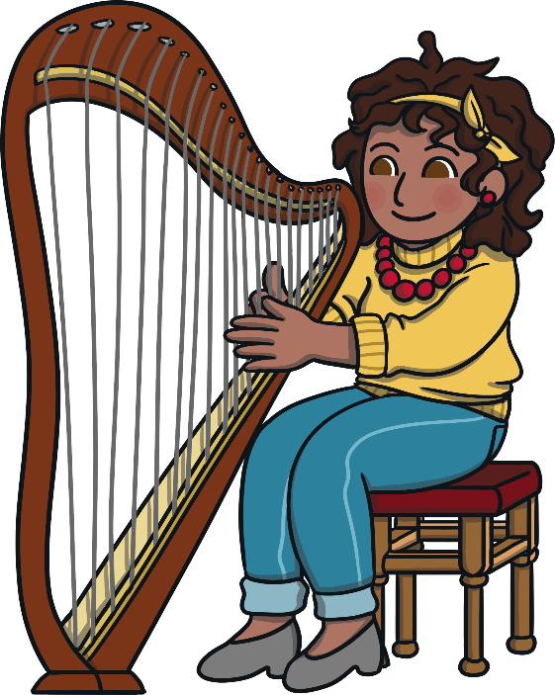
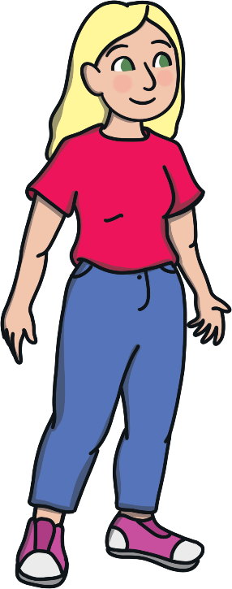
Finally…
All of us can work together to create a world where everyone is equal.
On 8th March, we celebrate women’s achievements and we challenge unfairness and inequality.

