Slide 2
Aim
To learn about the purpose of Inter Faith Week.
To learn about the importance of diversity.

Slide 3
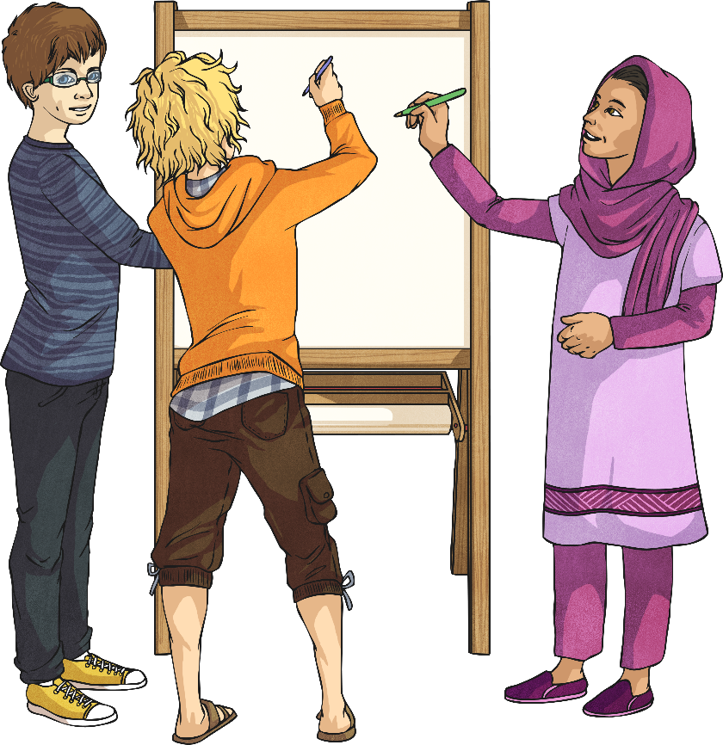
What Is Inter Faith Week?
Inter Faith Week is an opportunity to bring people with different beliefs closer together. It is a chance to learn about one another and build positive relationships. Events will take place all over the country.

Slide 4

It’s Good to Be Different
Within society, people don’t always get along, and sometimes people forget that it is other people’s differences that make them unique and special. It is diversity that makes our world more interesting.

Slide 5
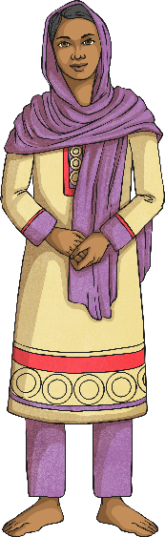



Fascinating Religious Facts!
Sikhism
Three Duties of a Sikh
Pray
Nam Japna – keeping God in mind at all times
Work
Kirt Karna – earning an honest living and avoiding crime
Give
Vand Chhakna – giving to charity and caring for others

Slide 6
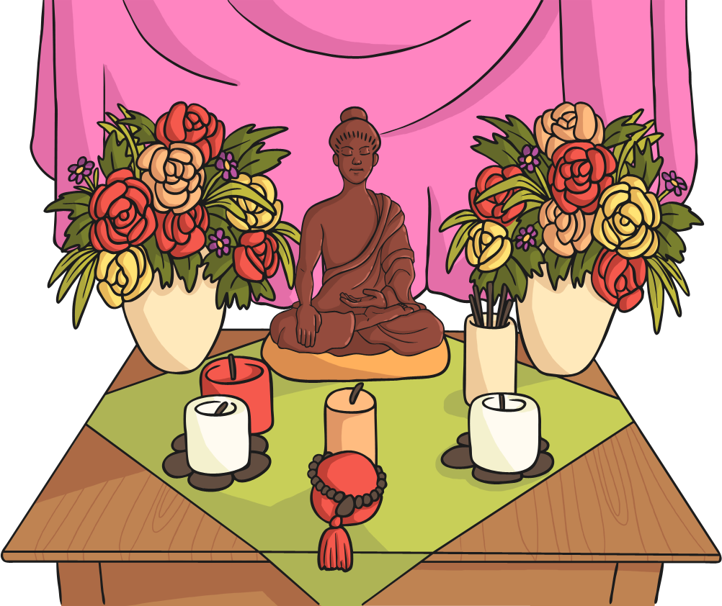
Fascinating Religious Facts!
Buddhism
The Five Buddhist Morals
Do not take the life of anything living.
Do not drink alcohol.
Be faithful to your partner.
Do not steal.
Do not lie.

Slide 7
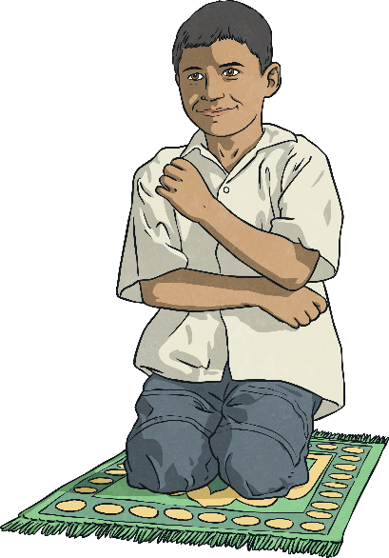
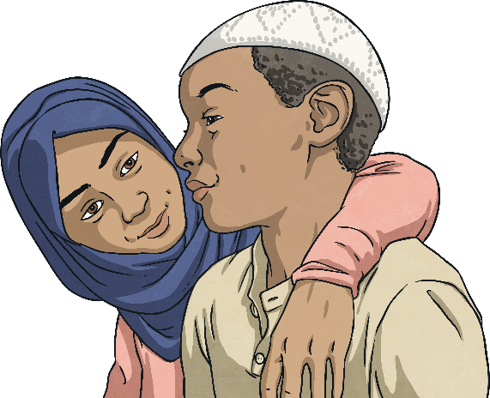
Fascinating Religious Facts!
Islam
The Five Pillars of Islam
Shahada:
Faith
Salat:
Prayer
Zakāt:
Charity
Sawn:
Fasting
Hajj:
Pilgrimage

Slide 8
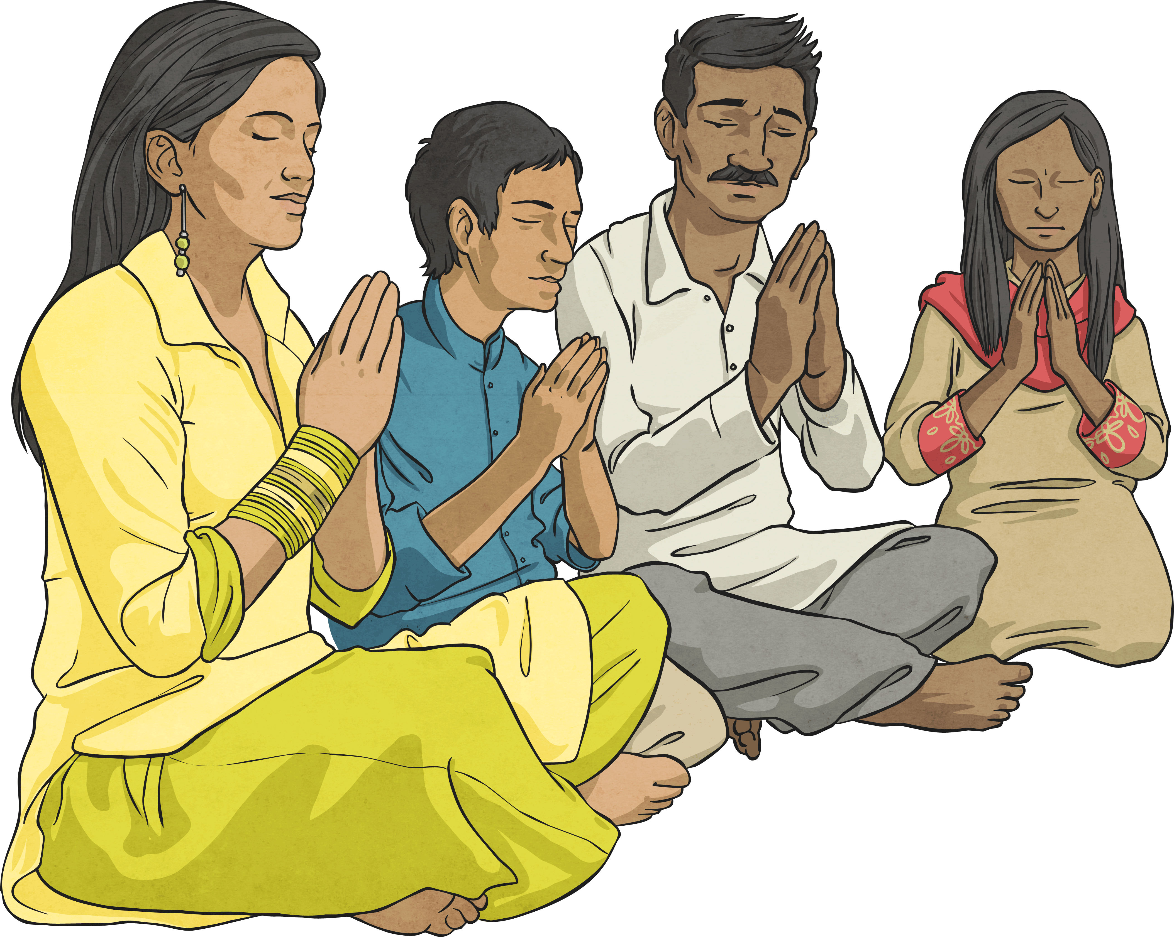
Fascinating Religious Facts!
Hinduism
Dharma – Hindus believe that they must always do the right thing.
Reincarnation – They believe that all living things have a soul and that soul can’t be destroyed when the living thing dies. They believe that the soul (the bit that makes you, you) enters a new living thing.
Moksha – This is the ultimate goal for Hindus. It means that the soul becomes free from the cycle of birth, death and reincarnation and reunites with the god Brahma. It can be achieved in different ways.

Slide 9

Fascinating Religious Facts!
Judaism
Jewish people live by 10 important rules, known as the Ten Commandments.
The first commandment is: Put God first.
The second commandment is: Worship only God.
The third commandment is: Use God’s name with respect.
The fourth commandment is: Remember God's Sabbath.
The fifth commandment is: Respect our parents.
The sixth commandment is: Don't hurt others.
The seventh commandment is: Be faithful in marriage.
The eighth commandment is: Don't steal.
The ninth commandment is: Don't lie.
The tenth commandment is: Don't be envious of others.

Slide 10
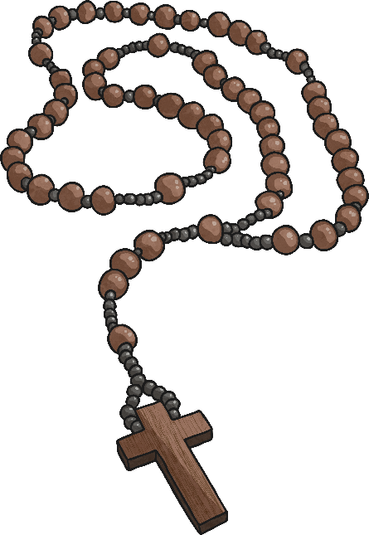

Fascinating Religious Facts!
Christianity
Christians believe: that God gave the people the Ten Commandments to live by; that Jesus is the Son of God; in the Trinity.
Christians believe that God is Father, Son and Holy Spirit quite separately but all at the same time. This is called the Trinity.

Slide 11
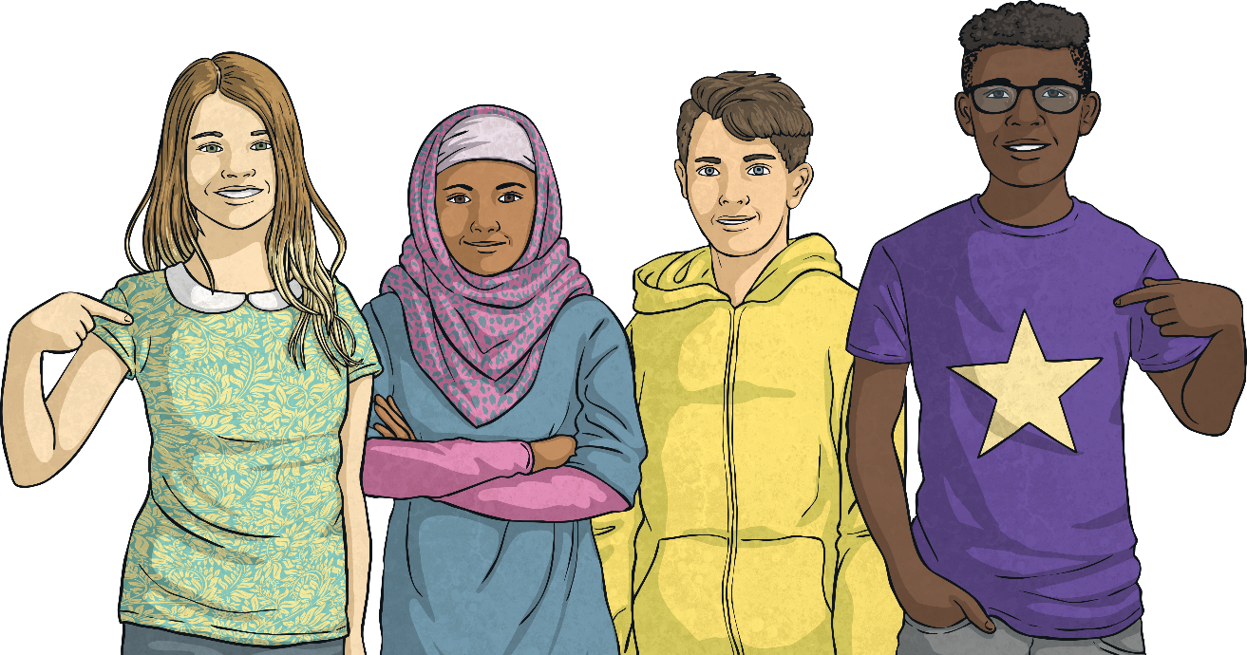
Discrimination
When a person or group of people treats someone differently because of their beliefs, age or gender, this is called discrimination.
Inter Faith Week aims to reduce discrimination by celebrating diversity and teaching people to respect other people’s beliefs.

Slide 12
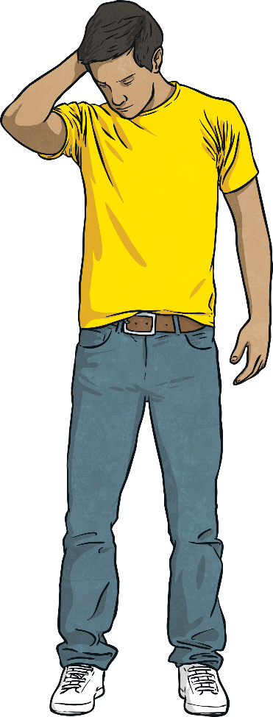
How Might People Discriminate against Others within School?
People might deliberately leave someone out of a group/game.
Tell another person that their personal beliefs and opinions are wrong.
Talk about a person’s beliefs in an unkind way.
Say something mean about a person’s religion, skin colour, disability or other personal difference.

Slide 13
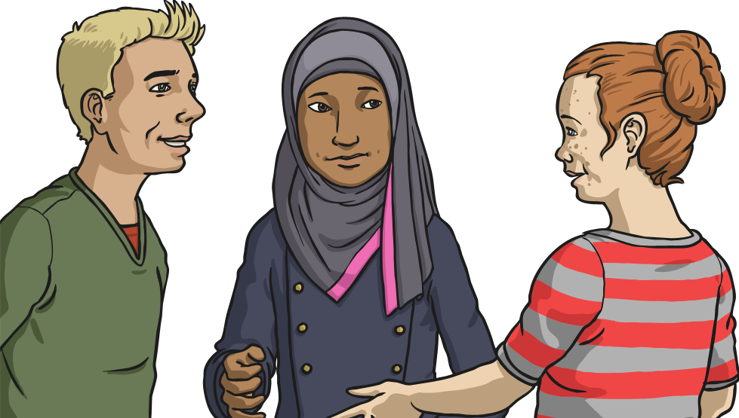
Dealing with Discrimination
If you thought you were being bullied or discriminated against at school, what would you do?

Slide 14
Reflection
What have you learnt today that you didn’t know yesterday?
Remember…
If someone looks, acts, behaves or sounds different to you, embrace their differences! Diversity is what makes our world interesting.
We are all the same and different in many ways.
We all have the right to our own opinions and beliefs and this is what makes our school, and our world, a special place.

