Slide 1
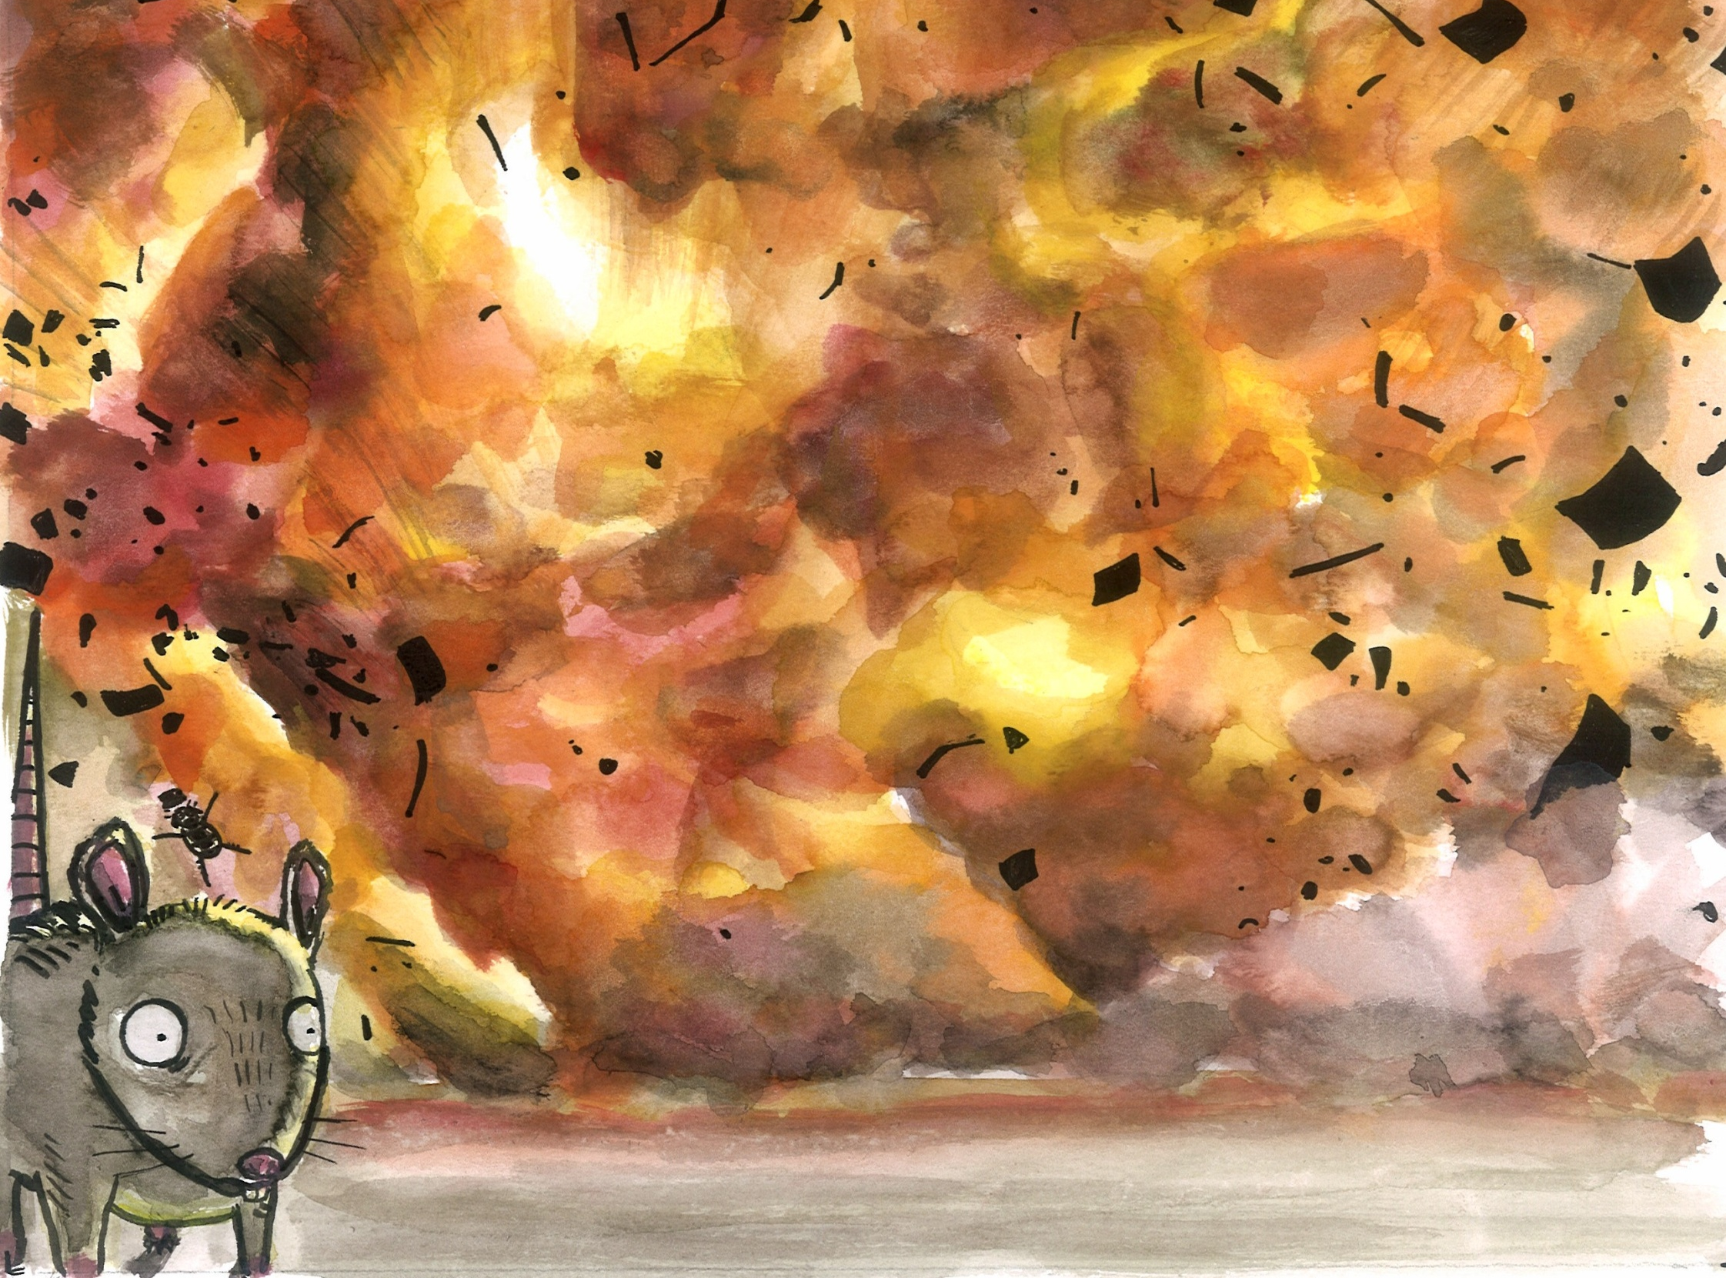
Why is the Great Fire of London significant?
We are going to find out what impact the Great Fire of London had, and why it was an important event in our history.

Slide 2
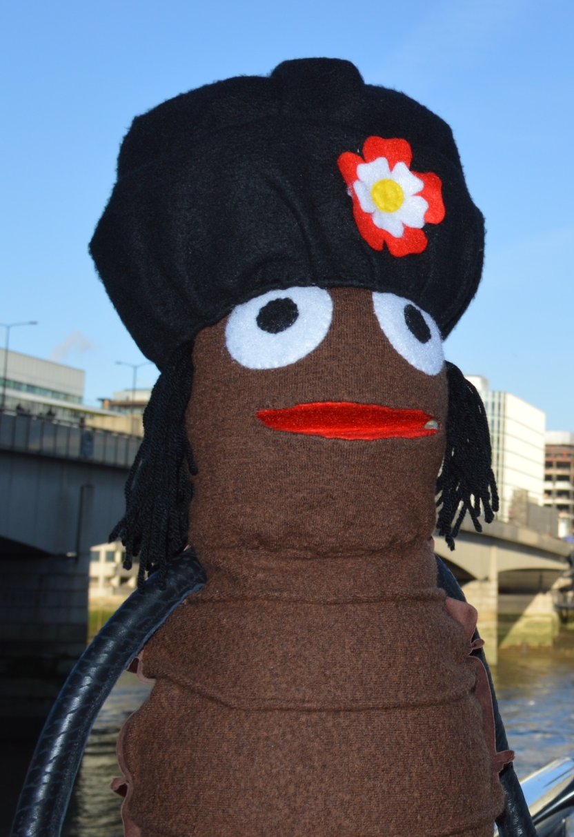
Hi, I’m Vlad the flea.
I’m going to tell you about something that happened over 350 years ago.

Slide 3
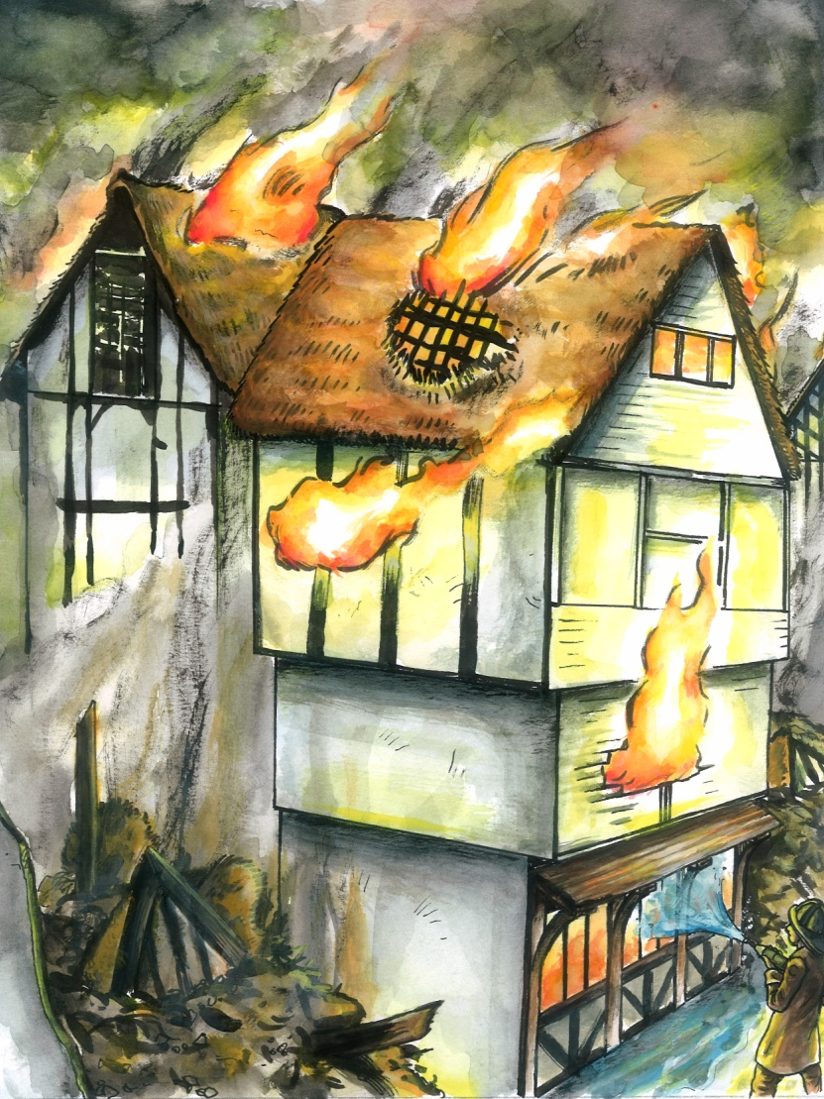

In 1666, London was almost destroyed by a huge fire.
This has become known as the Great Fire of London.

Slide 4
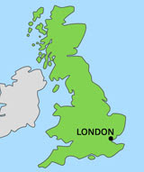
This is a map of Britain showing where London is.
Where do you live on the map?

Slide 5
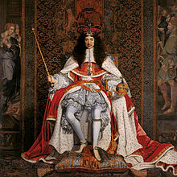
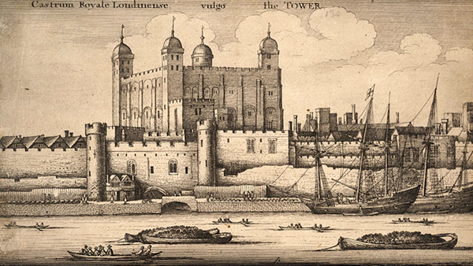
In the west of London was the Parliament and the court of King Charles II. It was where important decisions and new laws were made.
In the east was the Tower of London(where a huge store of gunpowder was kept), The Royal Mint (where the money was made) and a large port for ships from around the world.
500,000 people lived and worked in the capital of England. It was essential that the fire was stopped before London was obliterated.

Slide 6
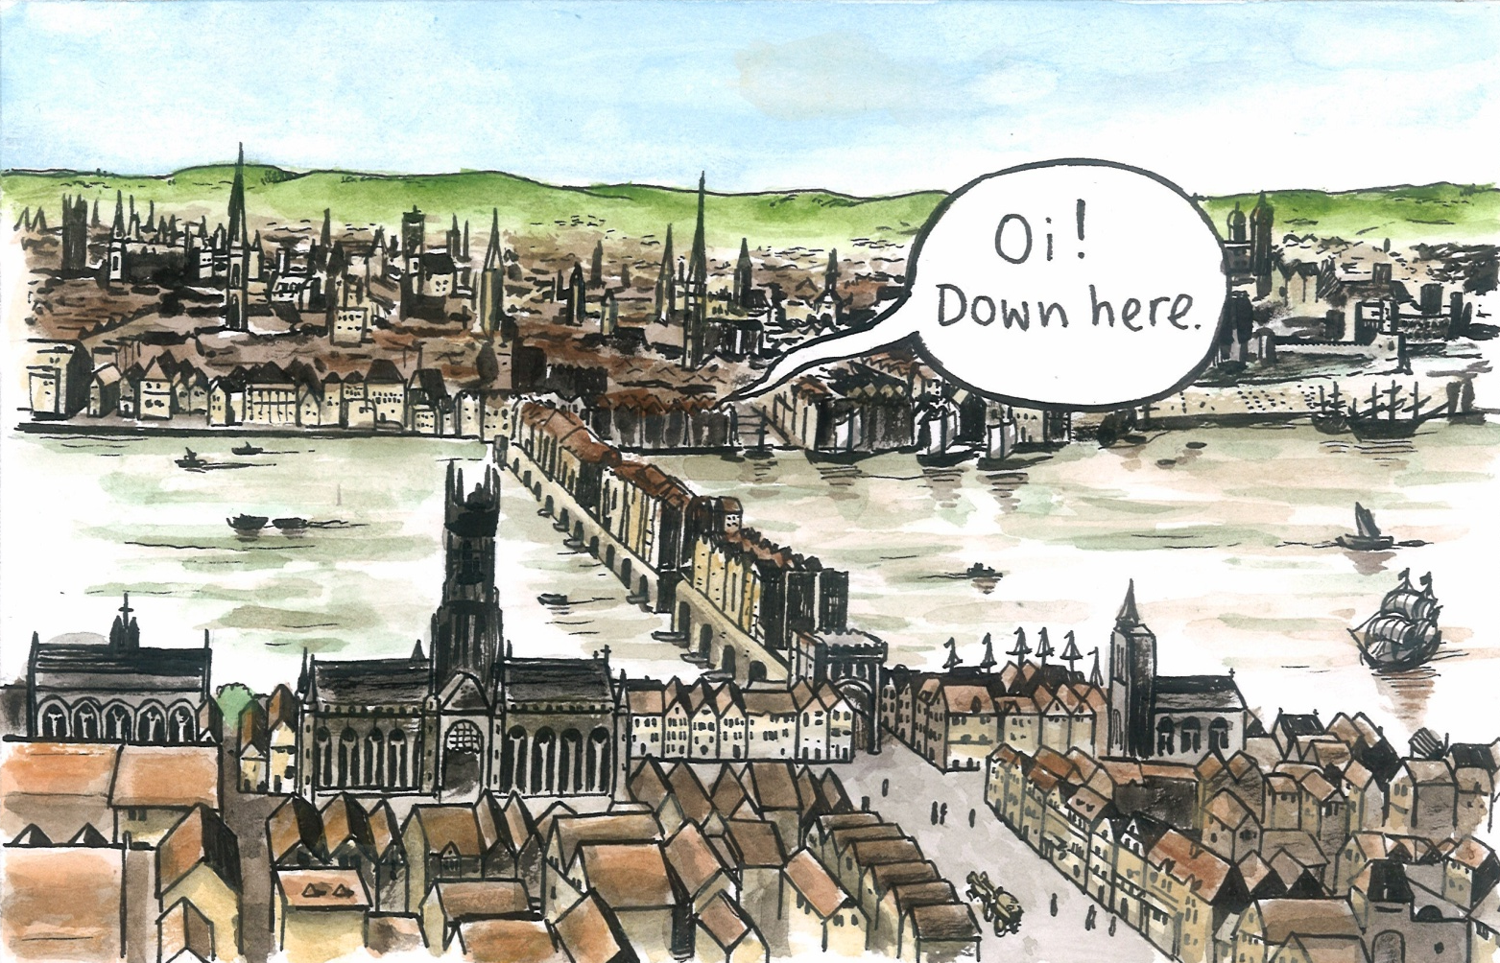
Before the fire London looked very different
For an animation by Pudding Lane Productions of London in 1666 click here

Slide 7
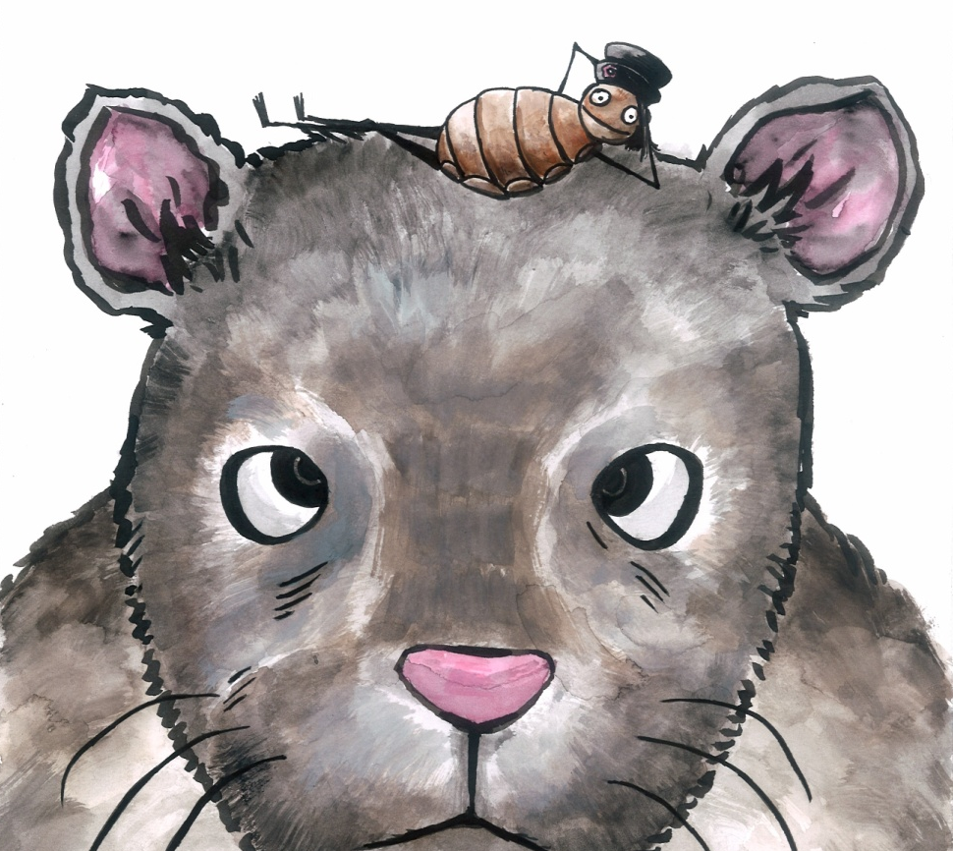
Let’s look at parts of London and how they have changed.

Slide 8
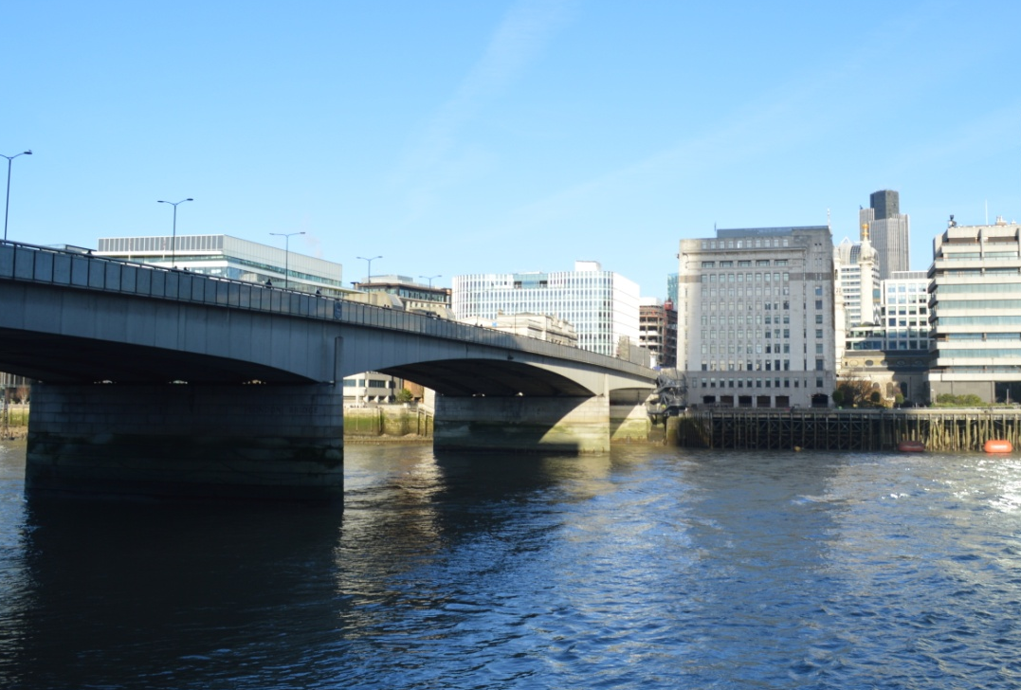

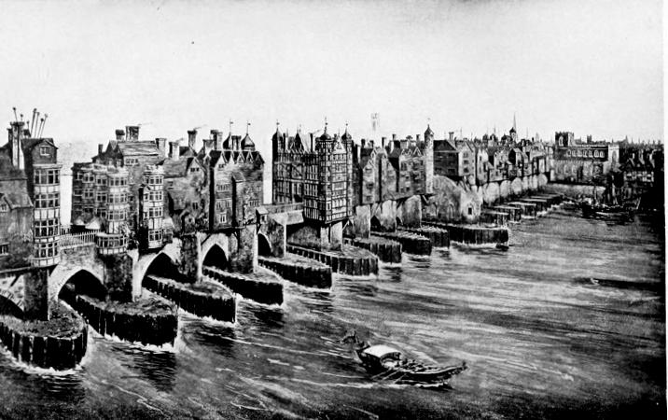
The Monument
The fire started close to London Bridge. You can see the golden top of the Monument marking the spot.
2017
In 1666 London Bridge had houses on it.
1666

Slide 9
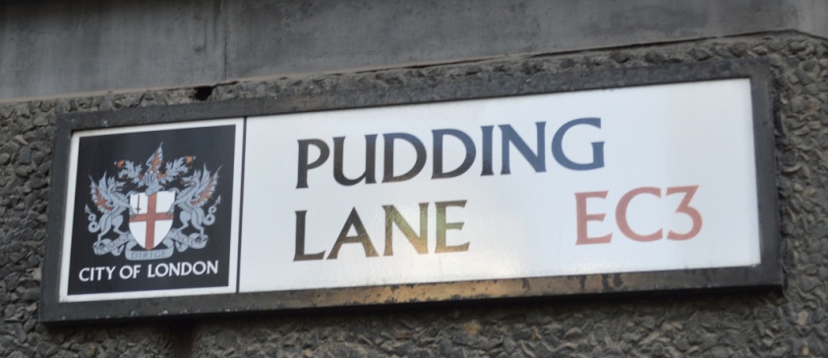
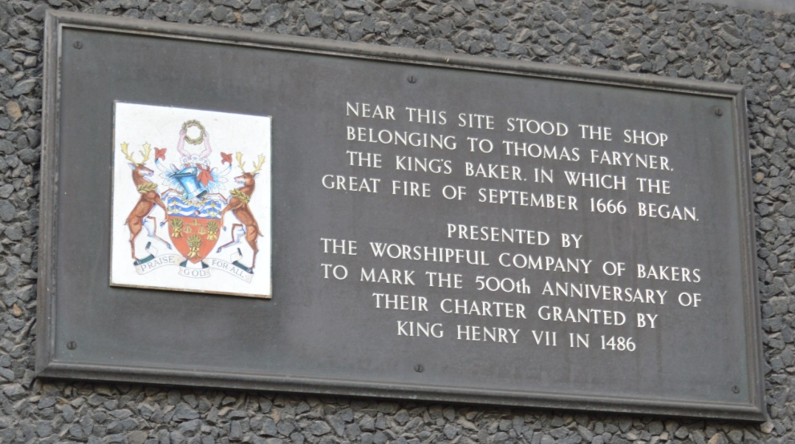
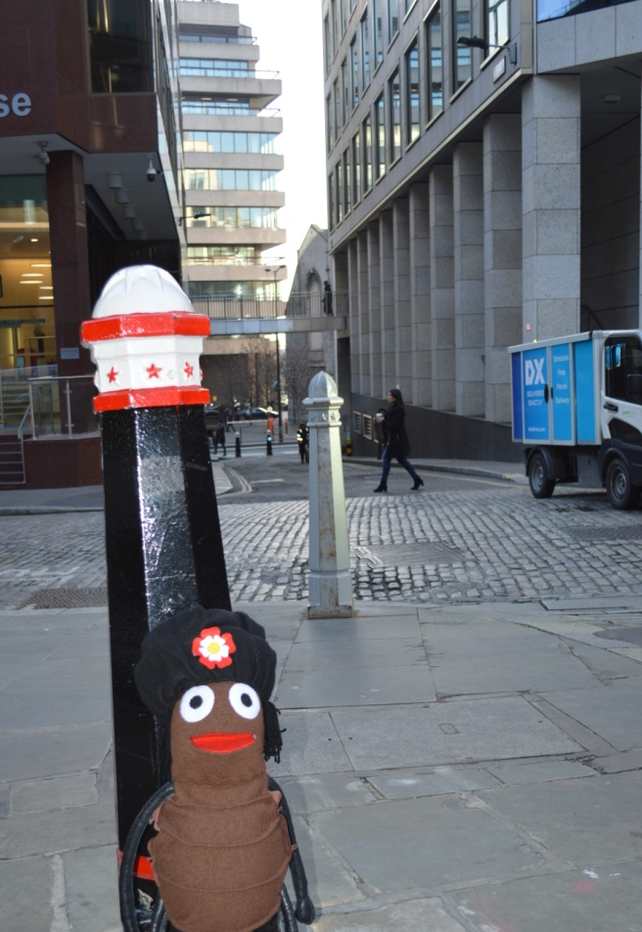
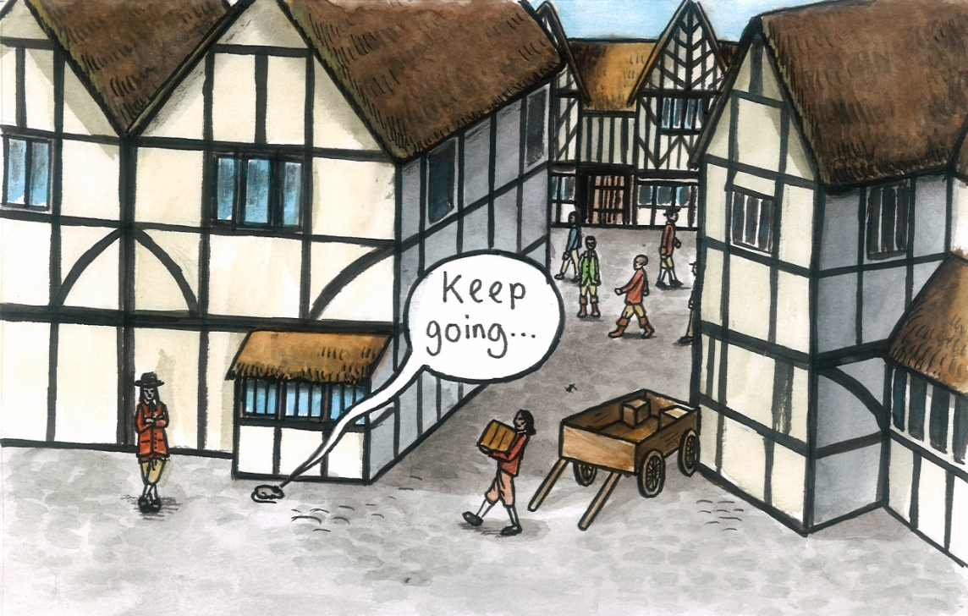
It all began in a bakery in Pudding Lane. Now there are only offices in the modern street.
2017
1666

Slide 10
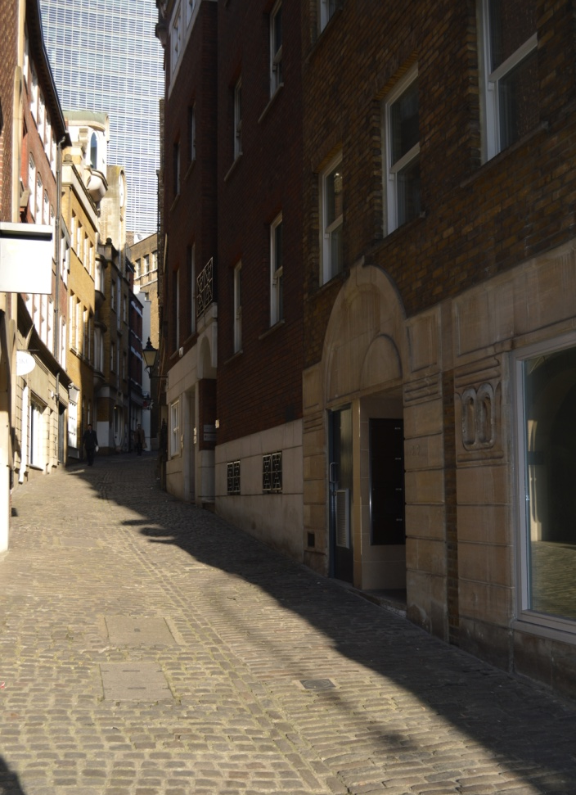
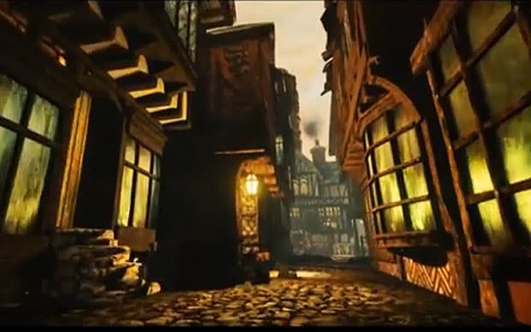
The streets were narrow and cobbled with small stones. Some roads still have cobbles.
2017
What is different about the streets in these pictures?
1666

Slide 11
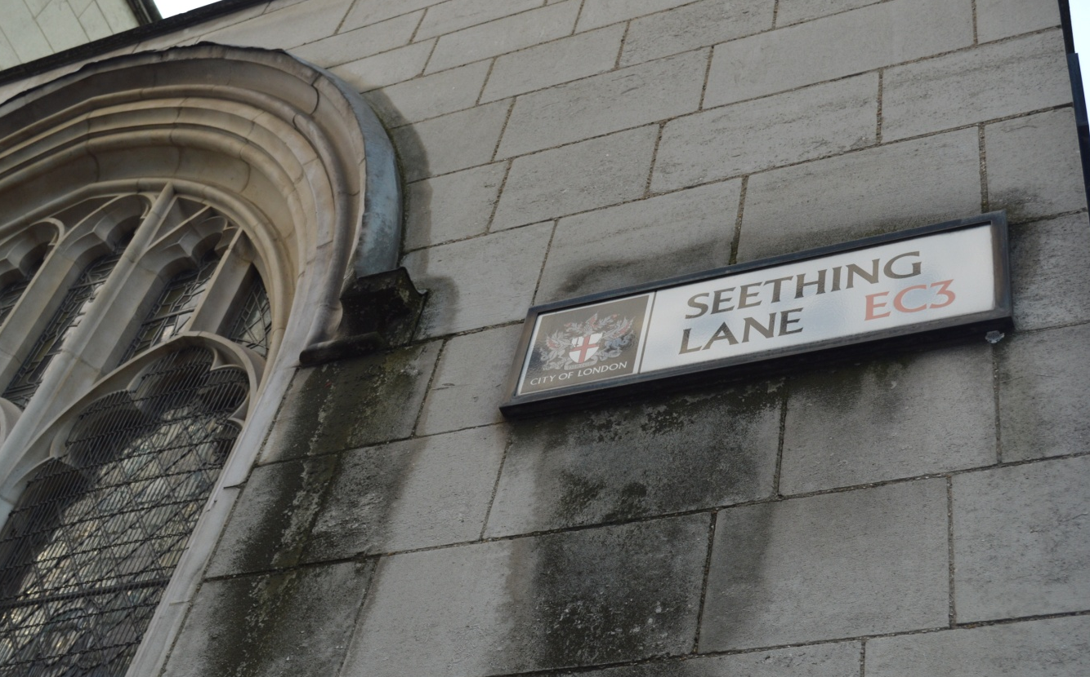
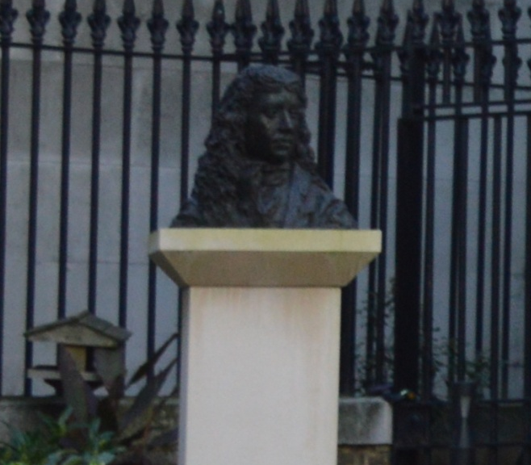
2017
Some people living in London wrote about what happened. Samuel Pepys lived in Seething Lane and he recorded his feelings during the fire.

Slide 12
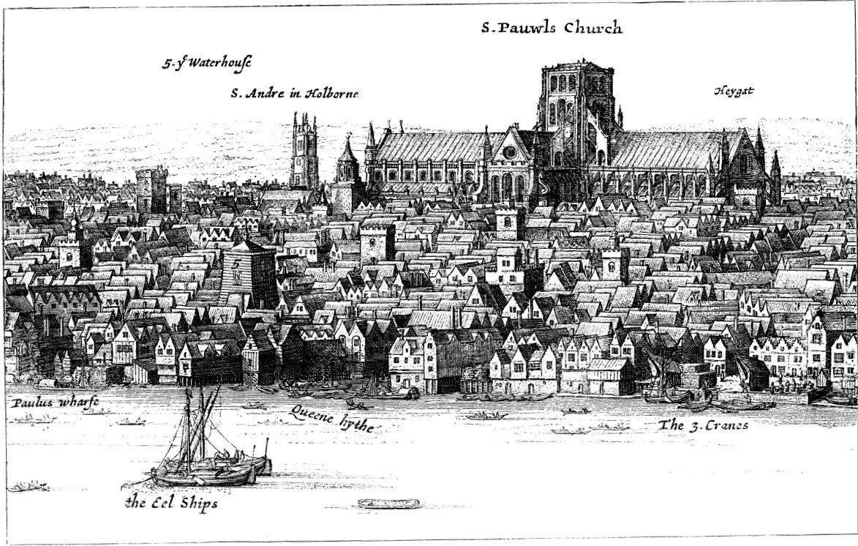
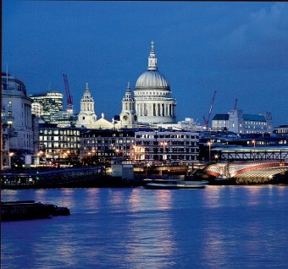
St Paul’s Cathedral
1666
2017
In 1666 the cathedral was the tallest building in London. It was completely ruined in the fire. Sir Christopher Wren designed the new cathedral, but it took 55 years to build it.

Slide 13
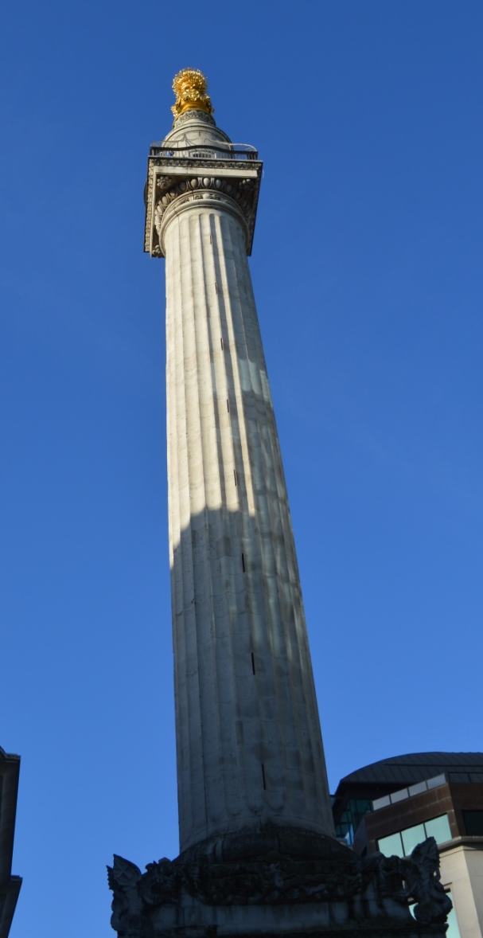
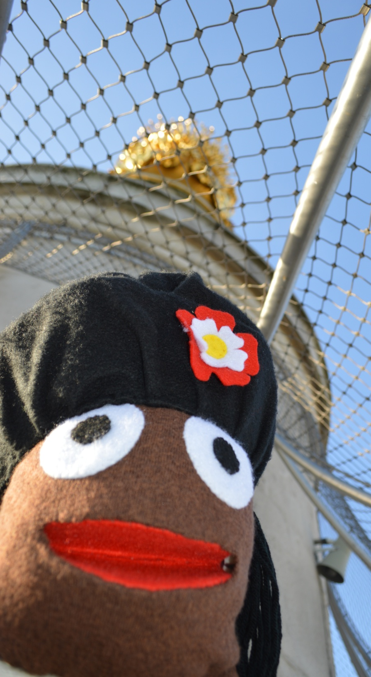
2017
Four years after the fire, construction was started on this memorial.
The Monument was finished and opened by 1677.

Slide 14
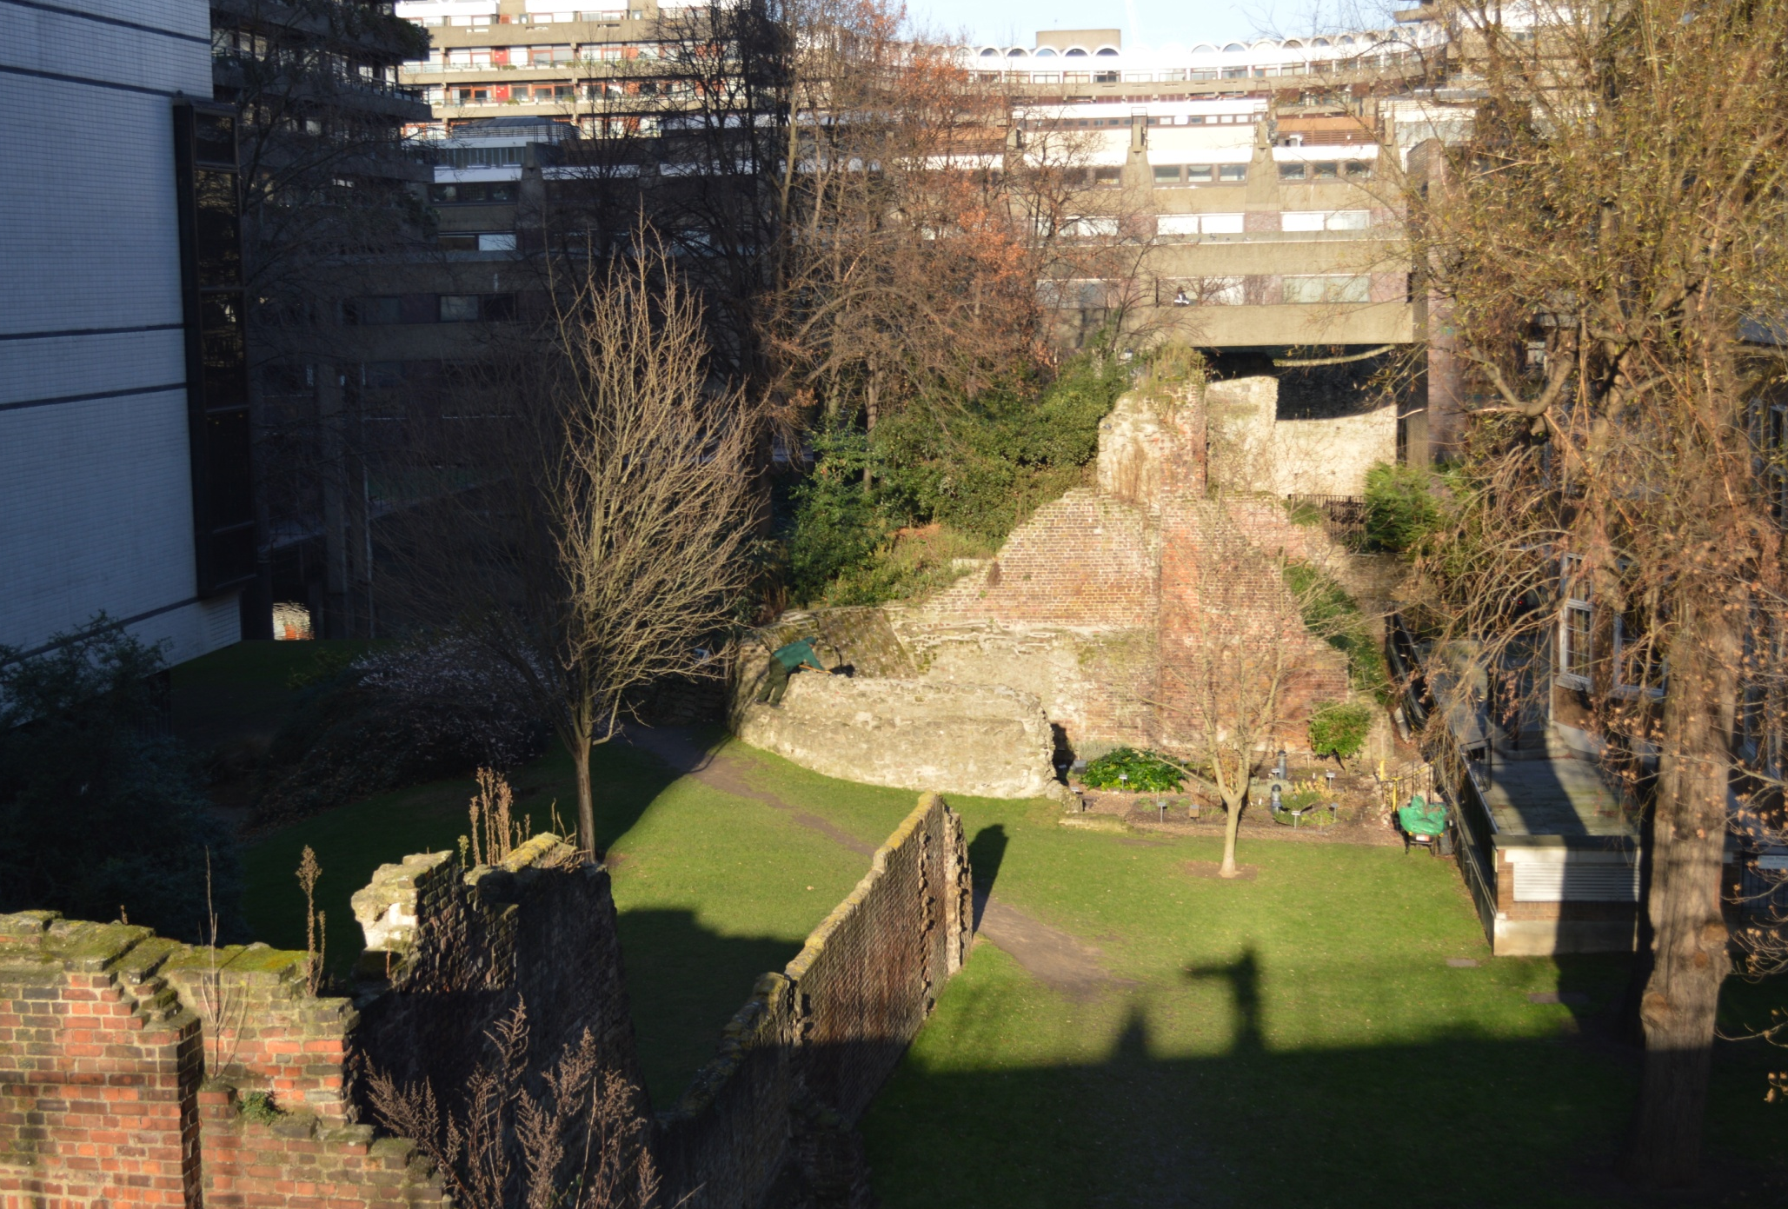
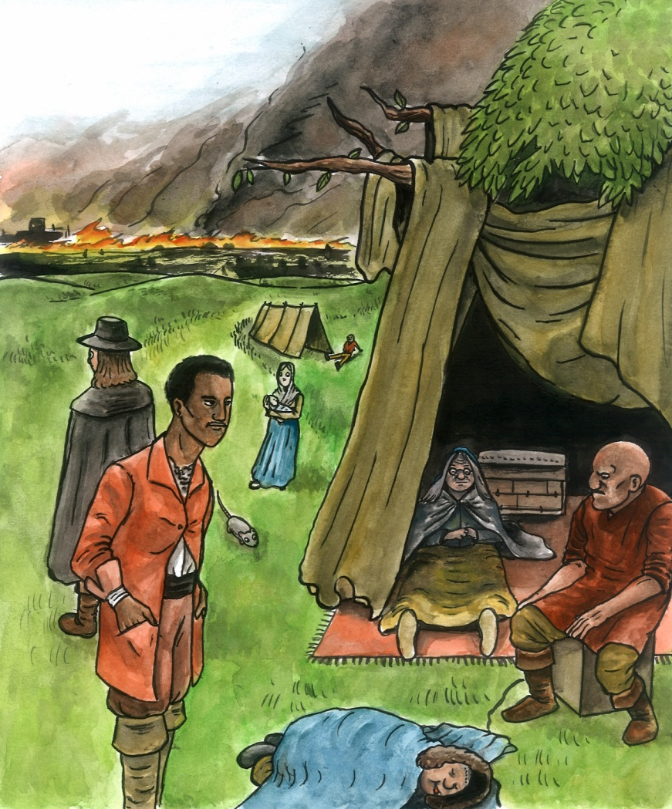
Londoners escaped the fire and went to the fields around London city wall.
2017
1666
10,000 people had no home after the fire. Many had to live in tents for years whilst their houses were rebuilt. Now the fields have buildings on them as London has got bigger.

Slide 15
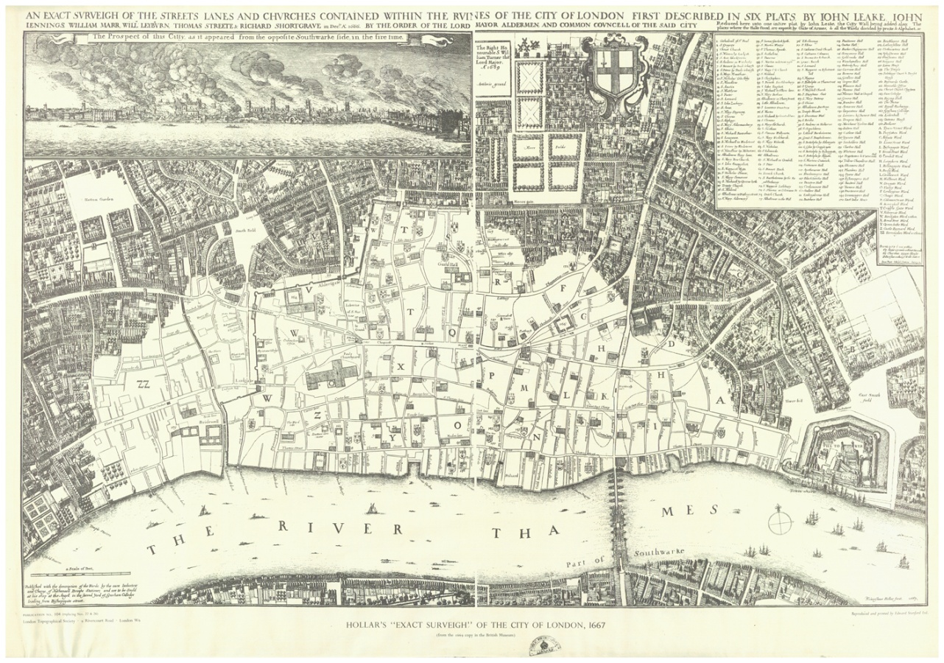
By the time the fire was brought under control it had burned 13,200 houses and 87 churches. Homes, shops and businesses were gone. The area in white on the map below shows the area that was destroyed.
1666
Wenceslaus Hollar’s map
The National Archives
London had changed forever, and it took a long time to rebuild. By the end of 1667 they had only built 150 new houses.

Slide 16
London was a very important city and for a time it was unclear if it would survive the fire. It was badly damaged and it took a lot of time and money to rebuild.
Despite this London grew back stronger and cleaner. The rebuilt city included new sewers and wider streets.
The Great Fire of London changed what the city looked like, and how future fires would be fought.

