Slide 1
Barriers to learning
Year 6 Growth Mindset

Slide 2
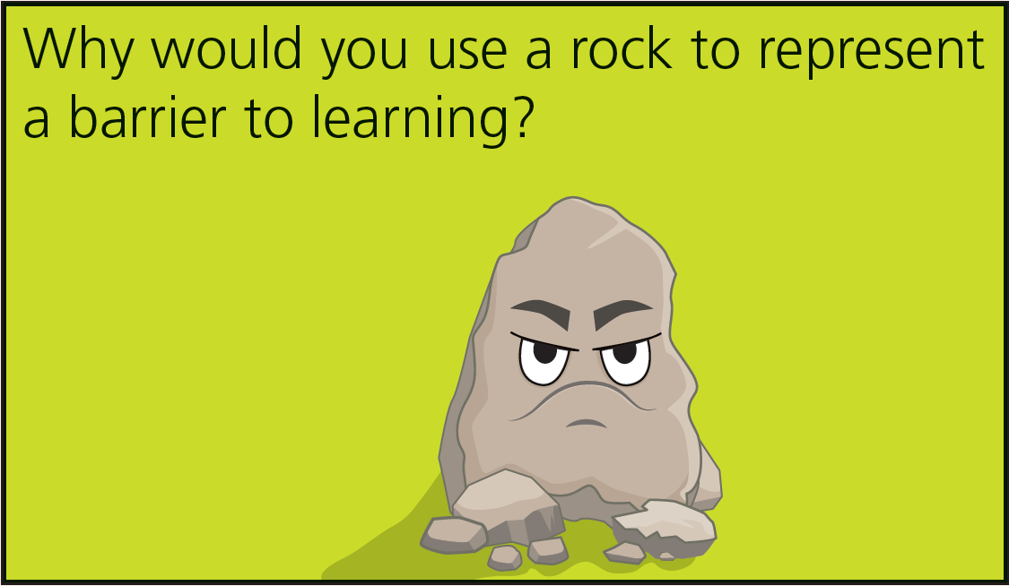
Reflect on this question

Slide 3
What might be a personal barrier to your own learning?
Is the barrier related to a specific subject?
What strategies have you tried to overcome it?
Why do you think it’s a barrier?
What other strategies could you try?
Is it an internal or external barrier?
An external barrier might be other people talking.
An internal barrier might be reluctance to ask for help when you’re stuck.

Slide 4
Barriers to my learning
Create a comic strip to illustrate a barrier to your learning and ways you can overcome it. Below are some ideas for ways to overcome barriers. Think carefully about the ones that can help you.
Don’t give up
Ask for help (partner or teacher)
Try again
Learn a new strategy
Revisit your learning
Understand that it’s part of the learning process
Practise

