Slide 1
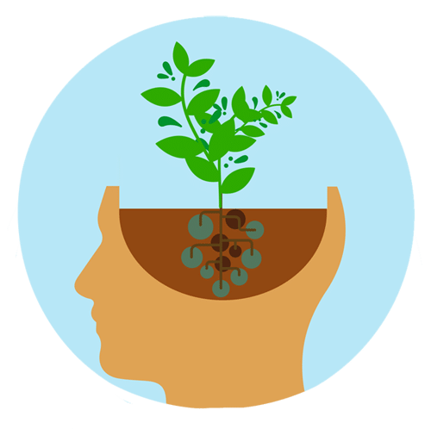
Growth Mindset
Year 6 – Friday 18th June
LO: To give opinions on what we mean by the term ‘learning’
LO: To create a way of explaining learning to younger children

Slide 2
Starter Activity
Think of something you are good at – something that you know you do well. Can you explain how you became good at this?
Think of something that you did in fact learn successfully, but at the time you did not want to learn it. Maybe it is something that you are now glad you learned. What kept you at it?
Can you explain what happens to the brain when we are learning?

Slide 3
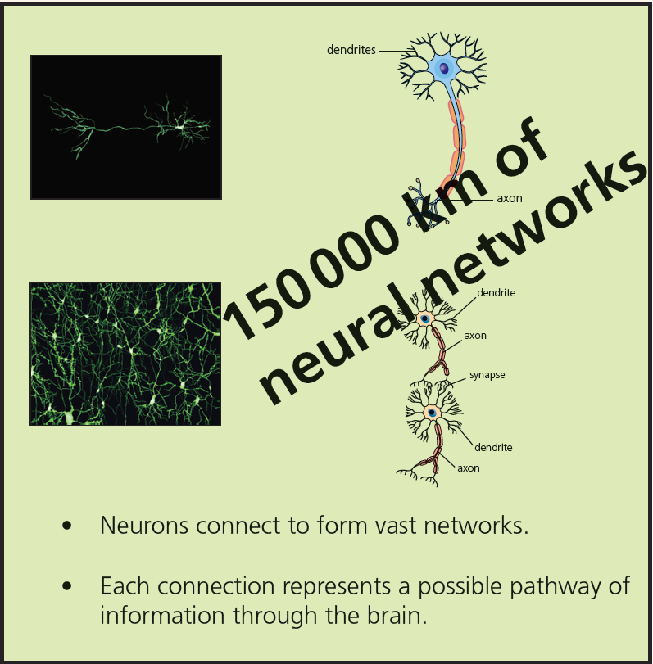
Main Activity
There are roughly 150000km (or more) of neural networks in the human brain and 150000km is similar to travelling approximately four times around the Earth, as it is approximately 40000km to travel around it once.

Slide 4
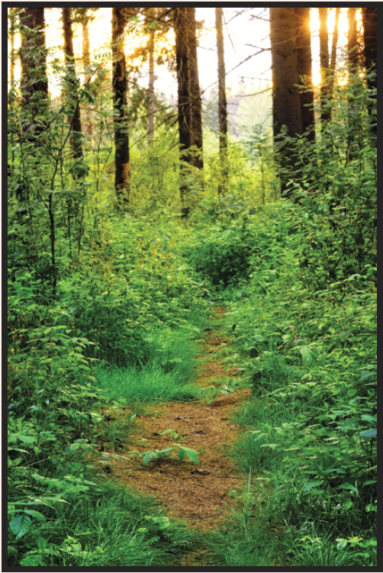
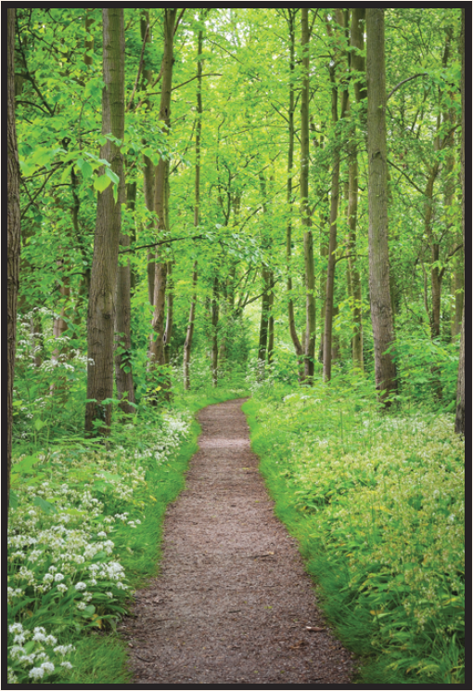

Do you think these images reflect learning effectively?
Why do the images represent learning effectively?
Is there anything you would add to illustrate learning more effectively?
Children discussing image
http://myrs.risingstars-uk.com/Growth%20Mindset%20Lessons/Year%206%20Lesson%206%20-%20video%20of%20children%20discussing%20the%20creation%20of%20the%20forest.mp4
These three images show the creation of a pathway through the wood over time.

Slide 5
Task
Can you create a way of illustrating and explaining learning to younger children?

