Slide 1
What makes a great teacher?
Year 5 Growth Mindset

Slide 2
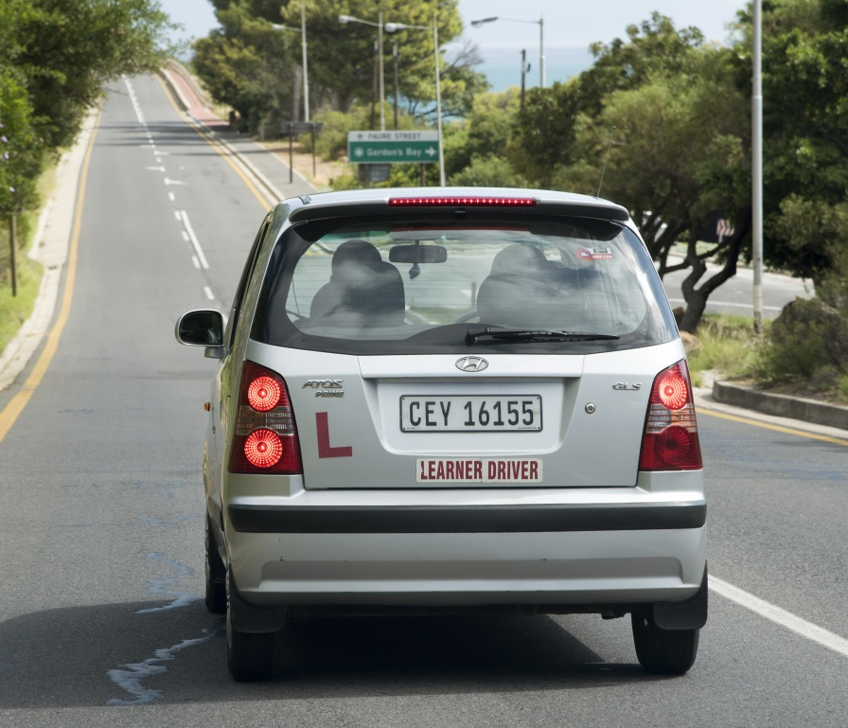
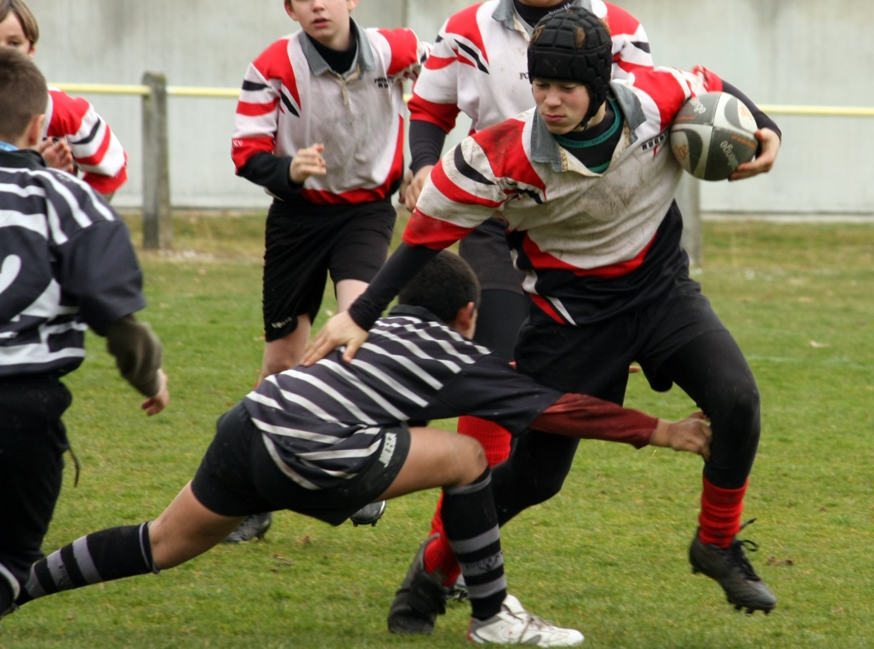
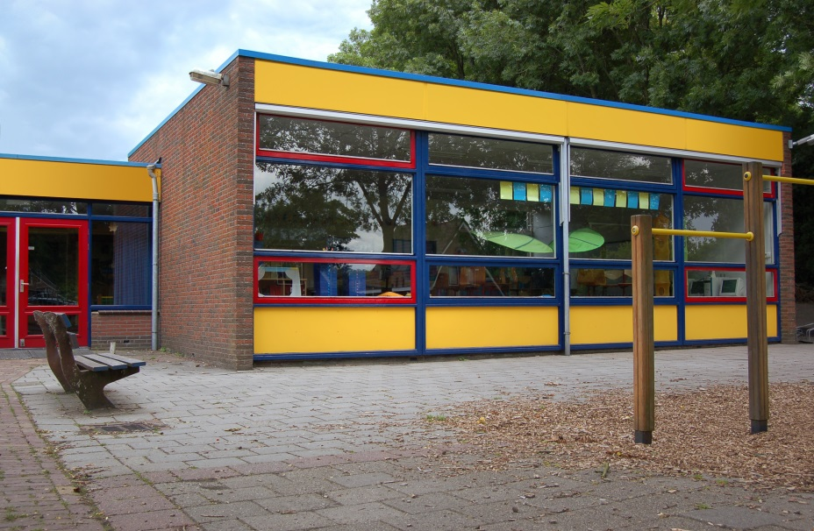
Which is the odd one out? Why? Can you identify a different odd one out?
© Peter Titmuss / Shutterstock
© emanelda / Fotolia
© KK Art and Photography / Shutterstock

Slide 3
A great teacher?
Think about a film you have seen that has a teacher in it; perhaps Matilda or one of the Harry Potter films. They might be good at being a teacher or not so good!
How does the teacher behave?
Why do you think they behave in that way?
Do you think their behaviour was a good idea?
Do they help their students to learn?
Are they a great teacher? Why/why not?

Slide 4
Think about a teacher who would help you to be the best learner you can be.
What are the characteristics of an effective teacher?
Why are these important?
How can they help you to learn?
What does a good teacher need to know?
How does a good teacher behave?
What kinds of things do they say?
Your task is to design a great teacher. You might choose to create a poster or write a paragraph. Remember to use the questions above to help you to describe them.

Slide 5
Final thoughts
Are all effective teachers the same?
Do all learners need the same type of teacher?
Why does a teacher need a growth mindset?
Could you be an effective teacher?
How can this growth mindest lesson help you to work and communicate more effectively with others in the classroom?

