Slide 1

Growth Mindset
Year 5 – Friday 18th June
LO: To explain what happens when you are learning
LO: To create images to illustrate the learning process

Slide 2
Starter Activity
Think about the process you go through when learning something new for the first time.
How do you start?
Do you get annoyed if you cannot complete the task straight away?
What skills might you be able to use to complete the task?
Is there anyone to help you?
How do you know how/when you have been successful?

Slide 3
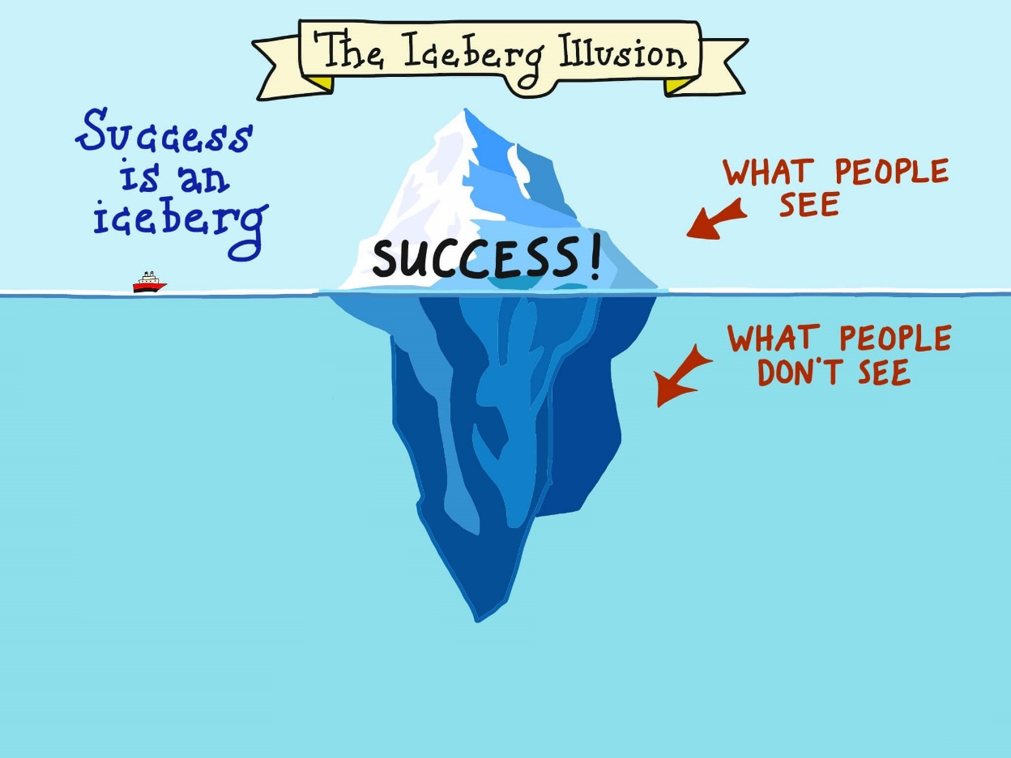
Main Activity
Use this iceberg illustration to show all the aspects of learning that people do not see.
Examples:
- determination
- discipline
- persistence
- failure
Write words in the sea and add an image to represent your word.

Slide 4

Extension
Think about how we could make the invisible aspects of learning (that is, the ones people do not always see such as persistence) more visible in the classroom.
Think about how people can be helped to understand how important they are.

