Slide 1
Growth Mindset

Slide 2
LO: To debate whether we are born to be good at something.

Slide 3
Debate
What do we think this word means?
How should you behave when debating?

Slide 4
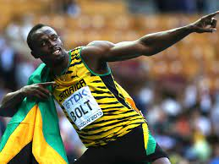
Who is this?
What do you know about him?

Slide 5
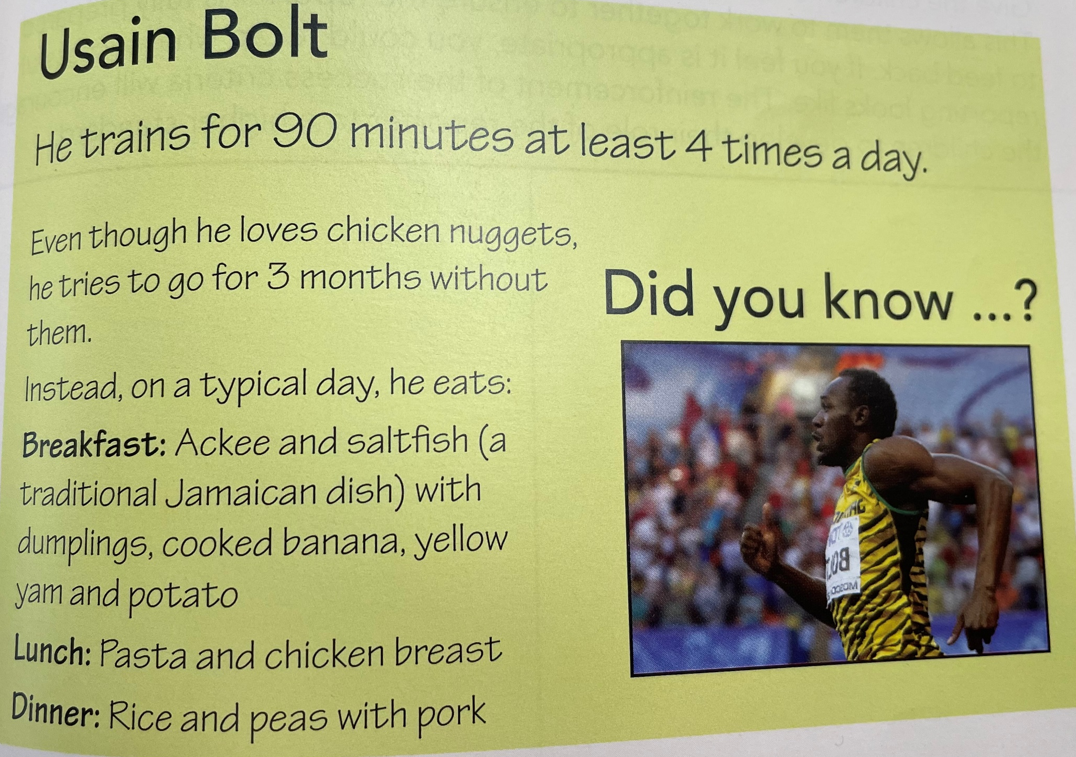

Slide 6
Lets debate!
Was Usain Bolt born to be a runner?
Do you think that you can be born to be good at something? Why?
How did Usain Bolt become an athlete and win medals for running?
What has helped him to improve?

Slide 7
