Slide 1
What is a good learner?
LO: To have an understanding of what makes a ‘good learner’.

Slide 2
Lets think…
What do we think makes a good learner?
Notes:
Discuss with a partner

Slide 3
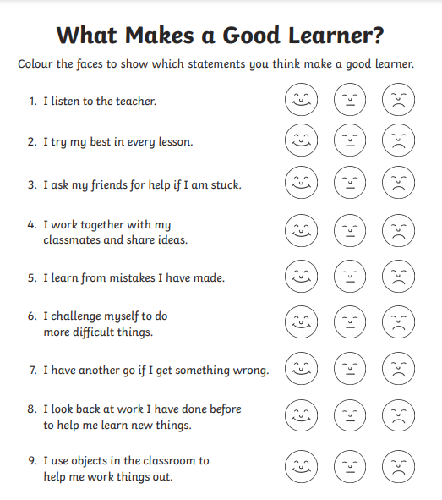
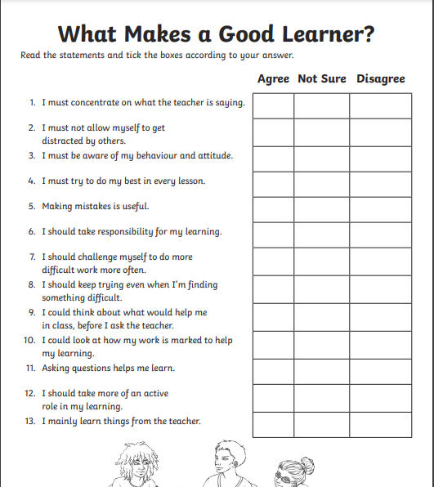
Lets complete this survey to find out what we think makes a good learner.
Notes:
Share answers after/ create class mind map

Slide 4
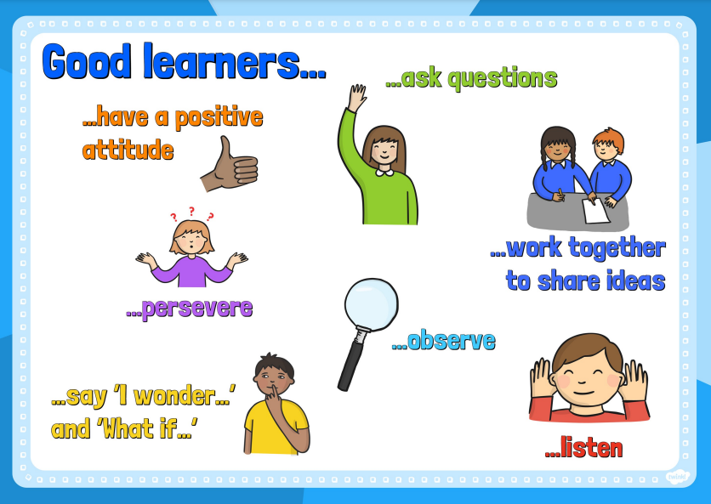

Slide 5
Lets think…
What does it mean to have a growth mindset?
Can you give me an example of growth mindset and fixed mindset?
Notes:
Create class mind map

Slide 6
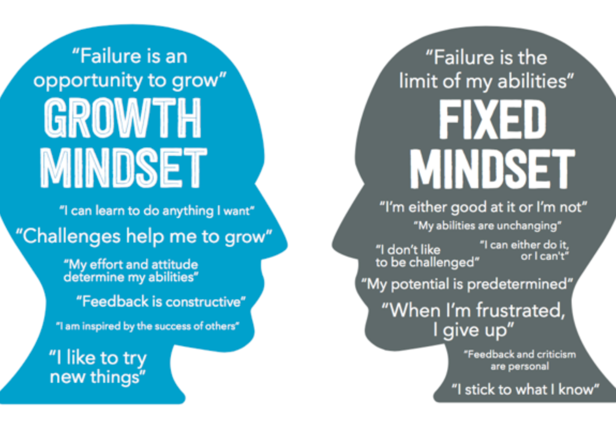

Slide 7
Who can remember our class rules?
Clue: There are 10!
How many can you remember?

Slide 8
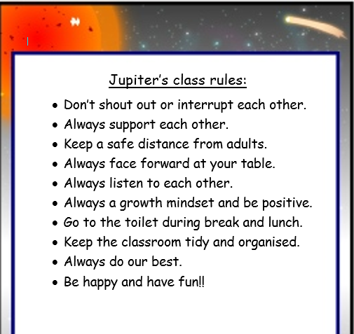

Slide 9
What do we need to do?
So thinking about everything we have discussed so far- what is a good learner, growth mindset and our class rules.
Think about how you should be acting everyday.
What is something that you will demonstrate in class?

Slide 10
Activity:
Can you create a class poster with our class rules, and how we act in our class to show that we are all ‘good learners’ and we have a growth mindset.

Slide 11
