Slide 1

Evaluating our clay pots
WB 07.03.22

Slide 2
LO: To evaluate my clay pot.
P | I can | CT
 | I can evaluate what worked well when making my pottery.
 | I can evaluate what I found difficult and how I could improve this next time.
 | I can evaluate my product based on a design criteria.

Slide 3
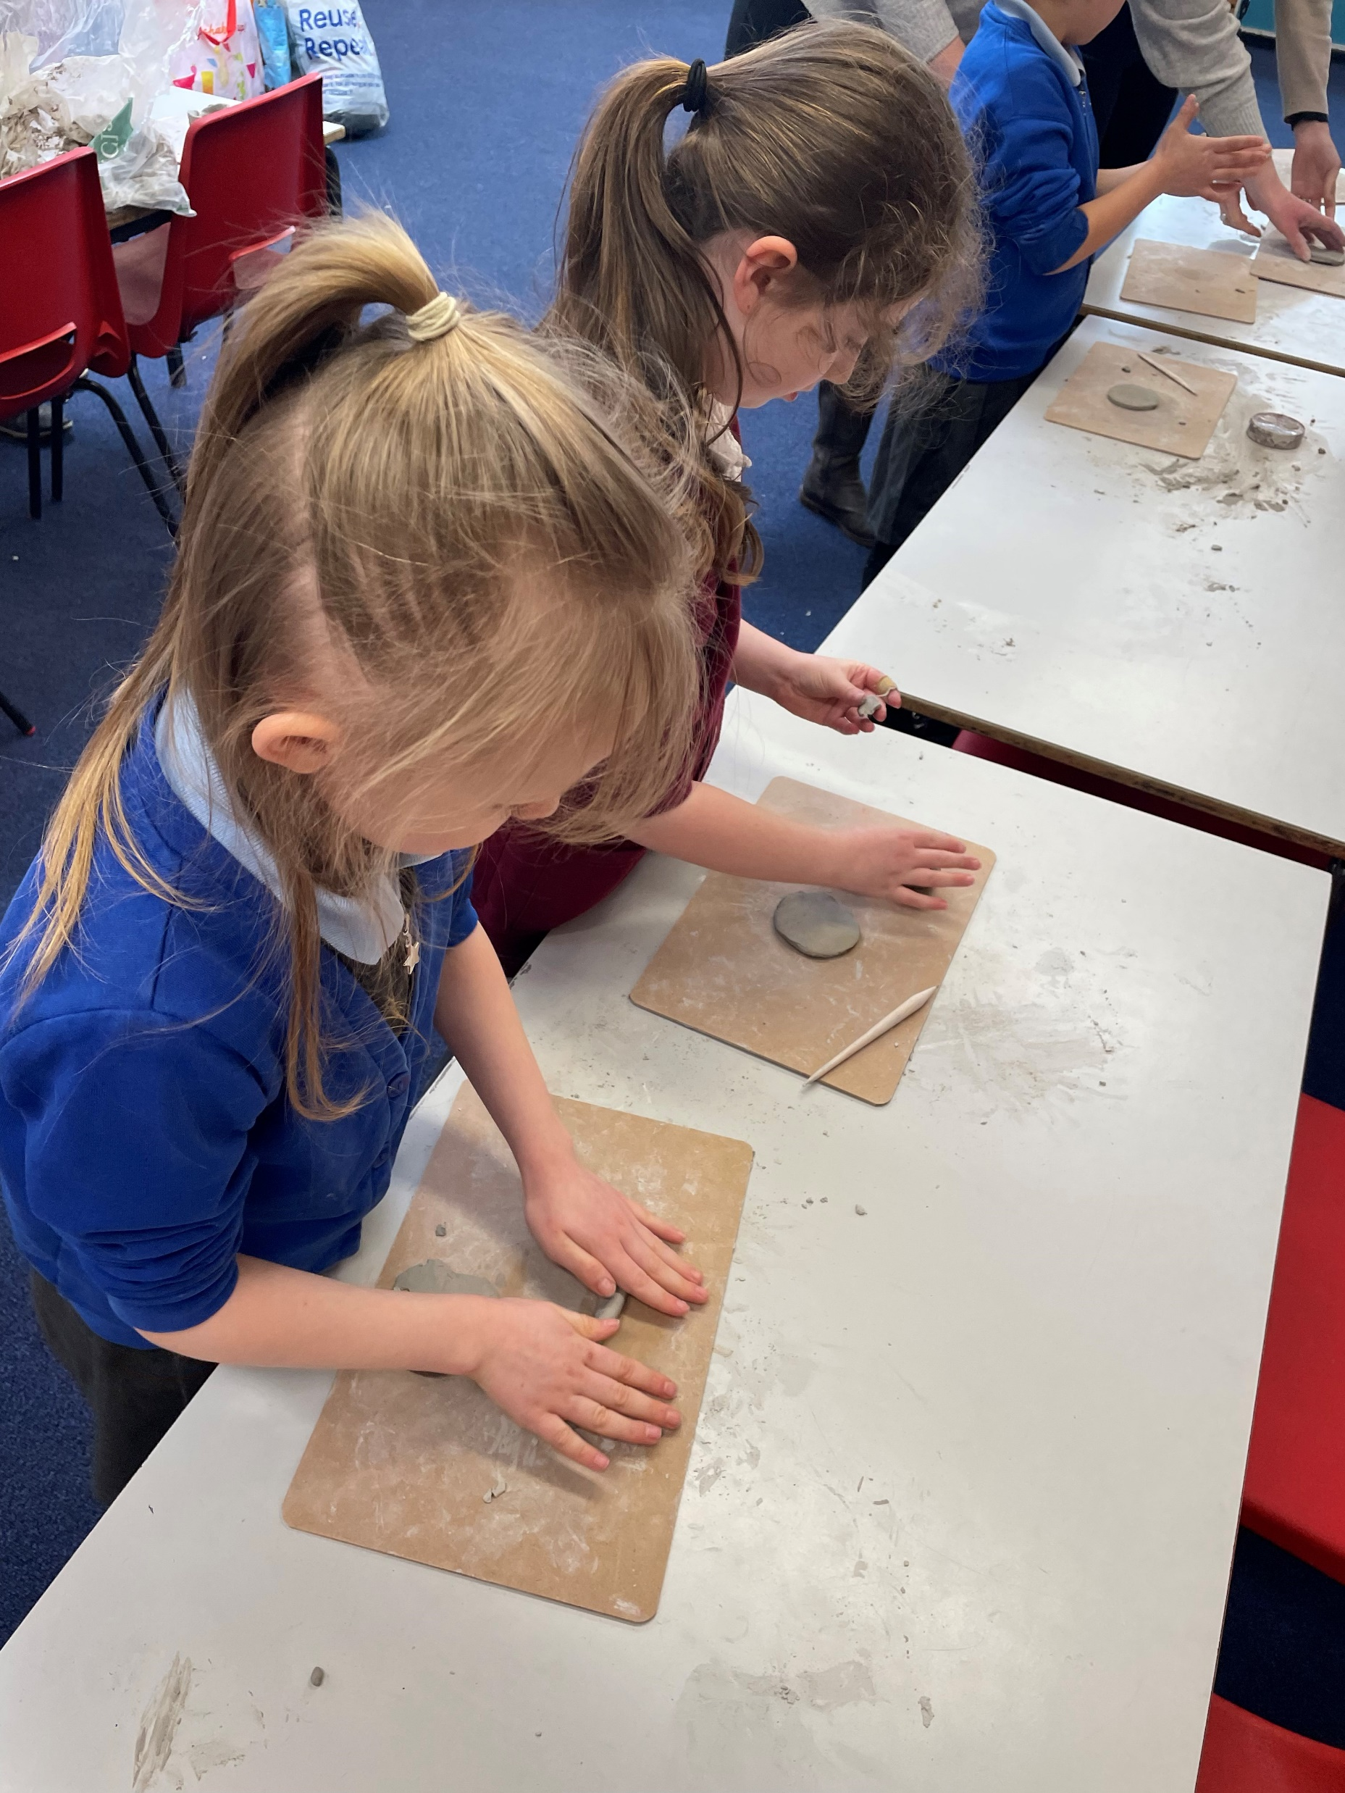
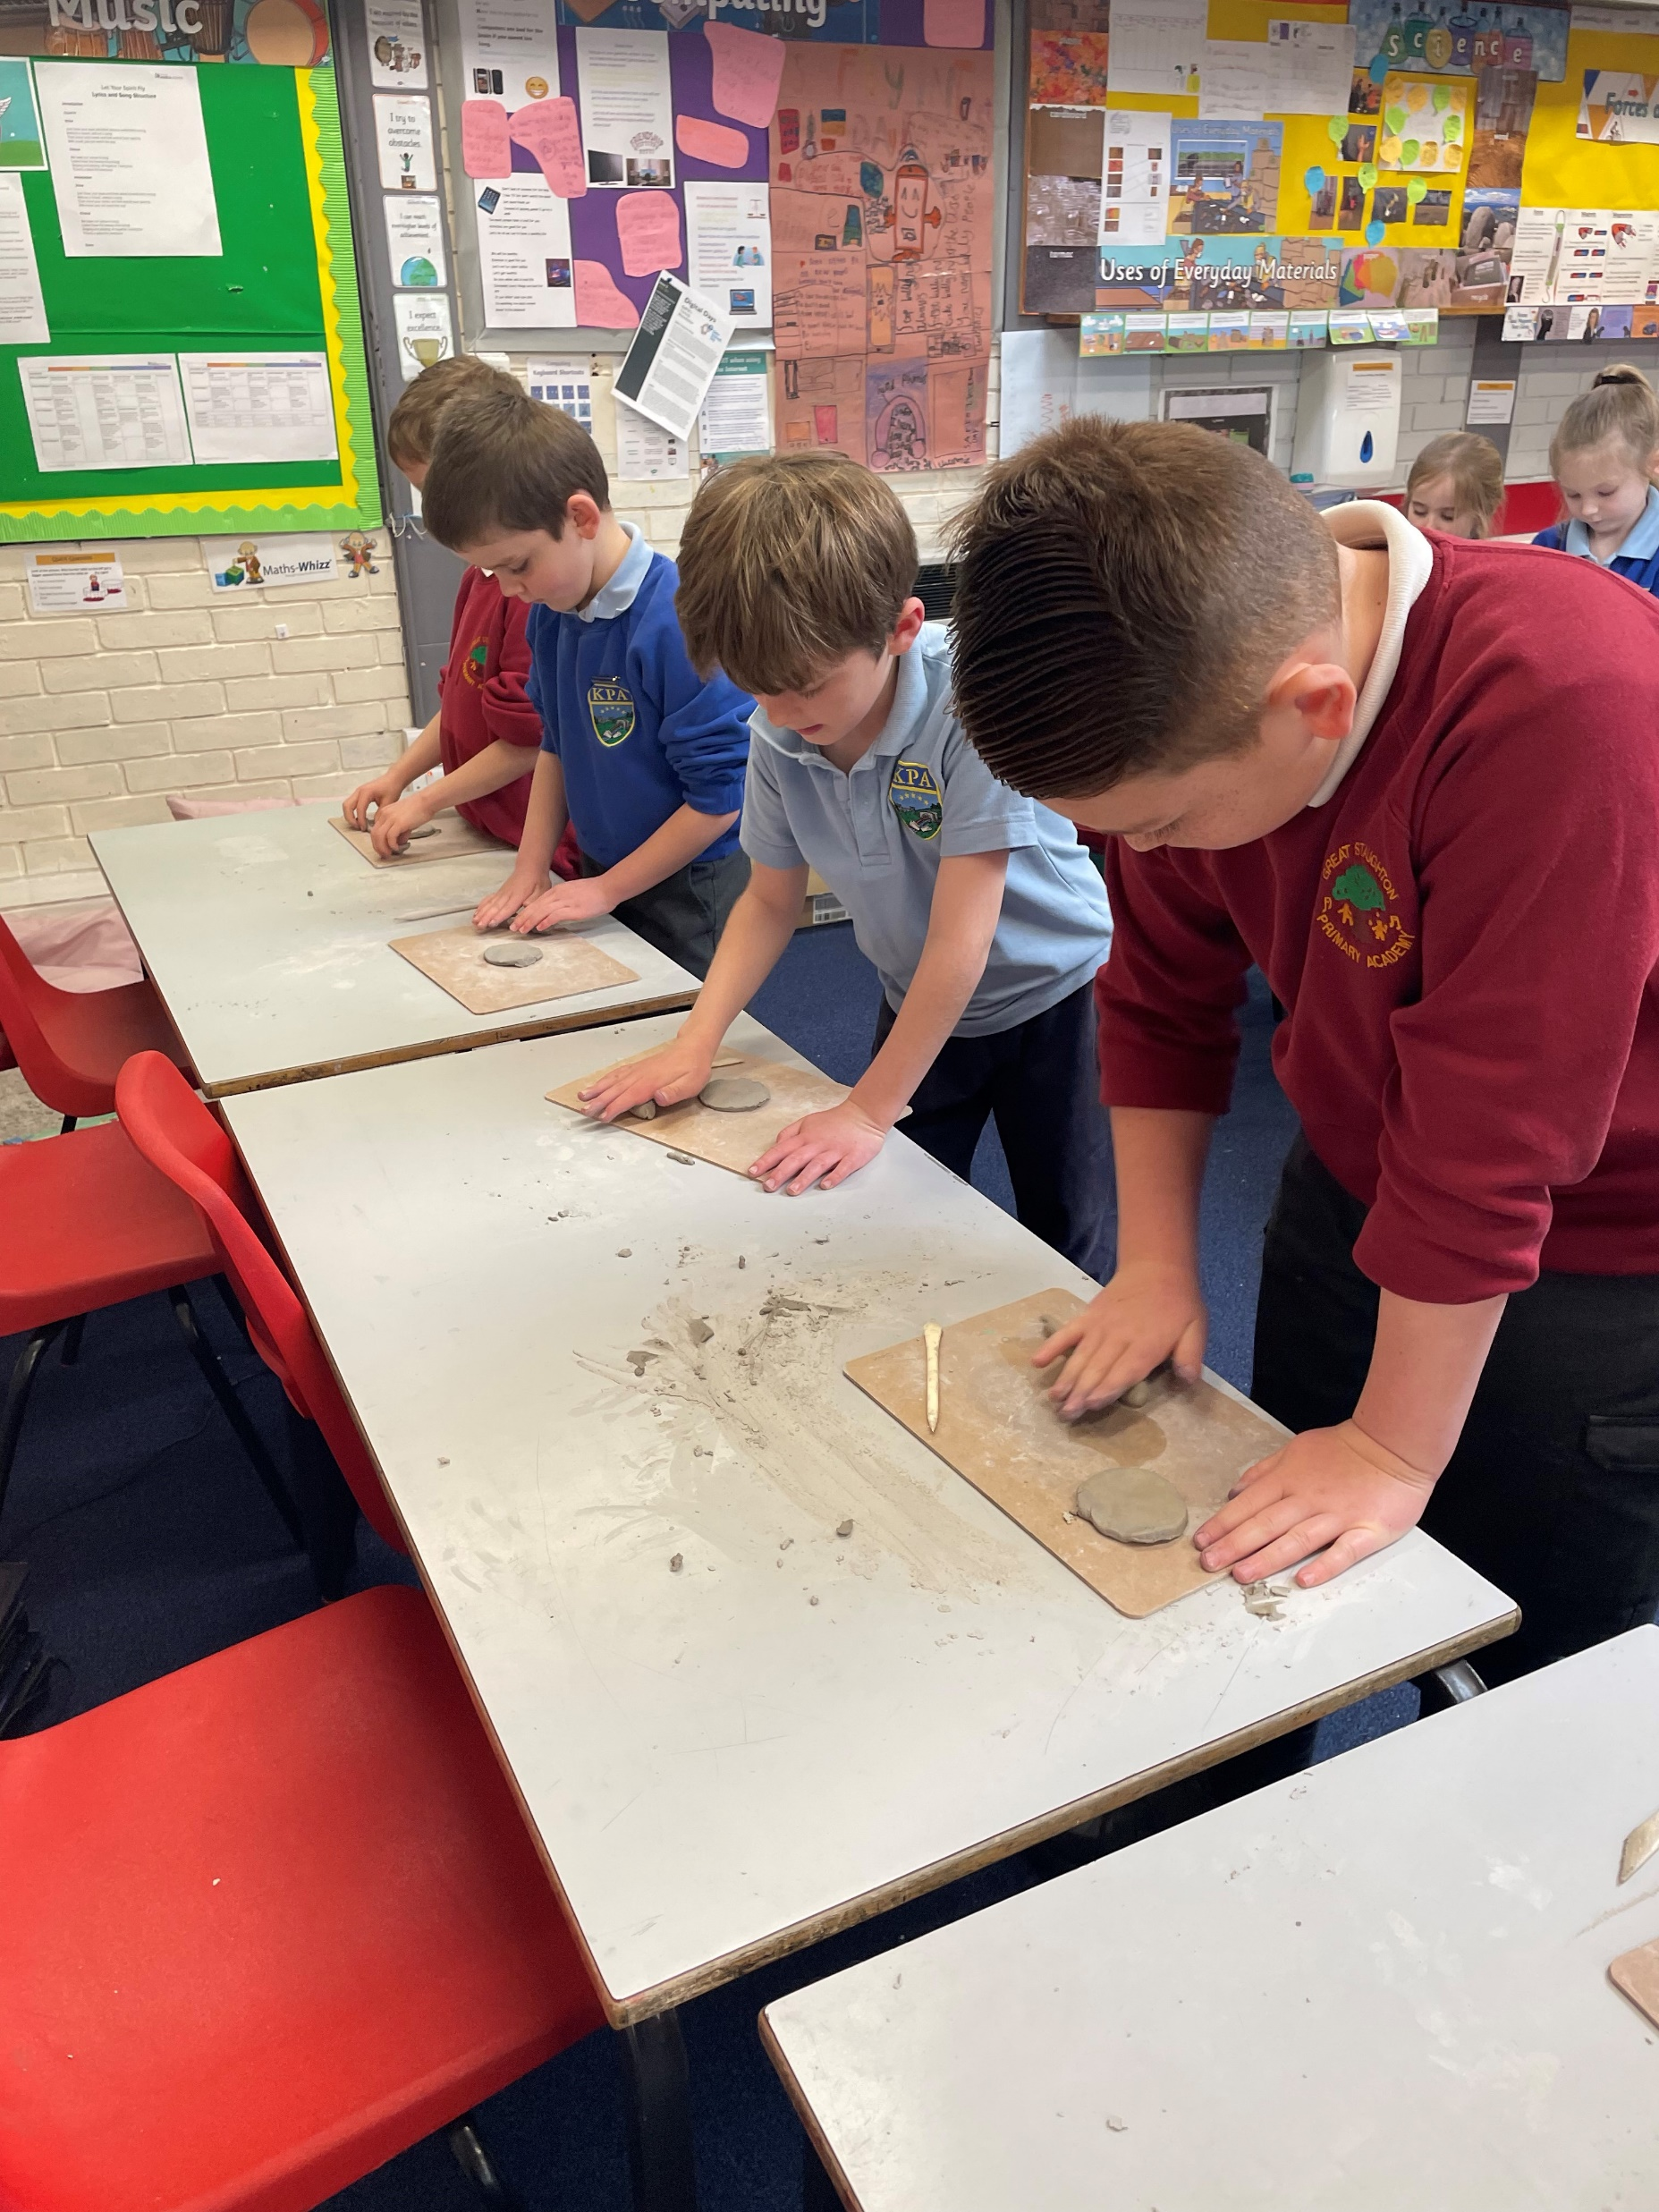
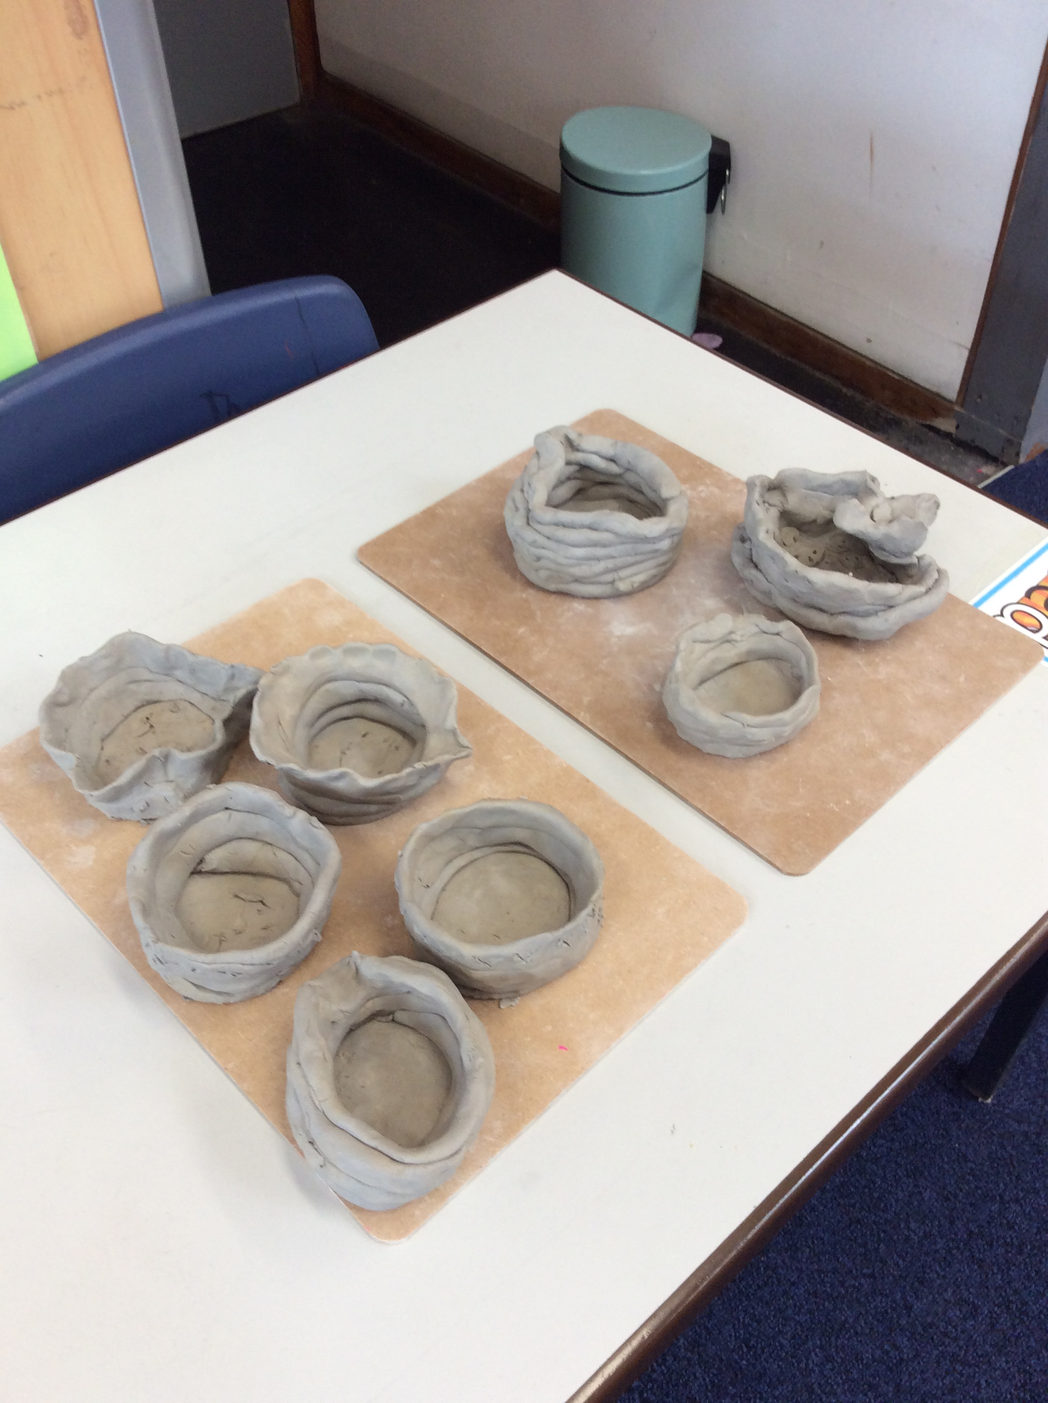
Who can remember how we made our pots?

Slide 4
Evaluation part 1
What did you find easy?
What did you find tricky?
Notes:
Talk to the person next to you. Get chn to talk to a partner about what they would do differently next time. Ask chn to fill in first page of evaluation. Type ideas that chn provide on the PowerPoint.

Slide 5
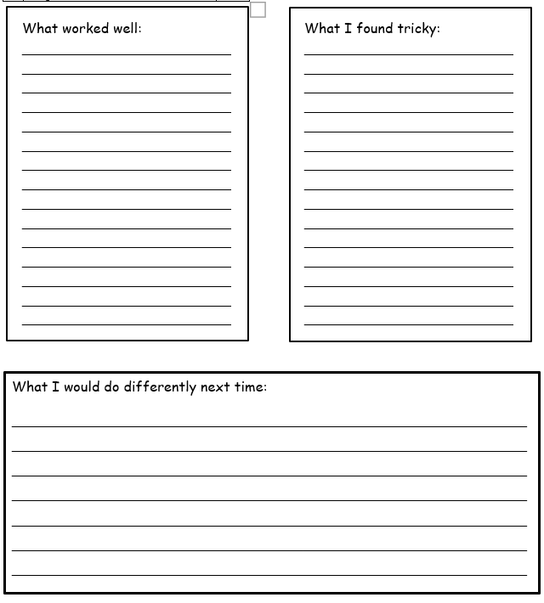
Using your own ideas or some of the ones given on the board, complete the first page of your evaluation sheet.

Slide 6
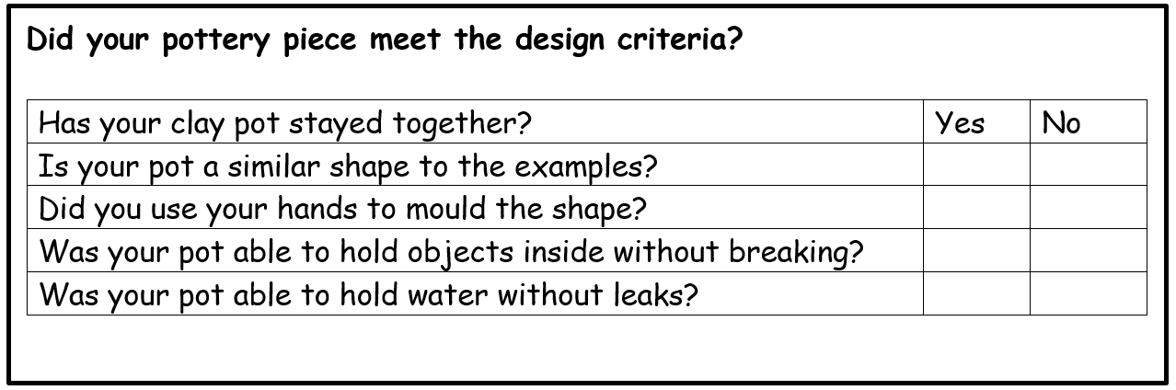
To test our clay pots, we need to see if they can do two things:
Can they hold an object inside without breaking?
Can they hold water inside without leaking?
We are going to test our pots using water and maths cubes.
Notes:
Explain to chn that we are going to use either 25ml or 50ml of water and place a tissue underneath our pots. We will be able to see if the pot is leaking if there is any water on the tissues.
We are going to place a few maths blocks in the pot and hold it up. We will see if it can hold objects because the bottom will not fall off.

Slide 7
Word bank:
mold shape create squash roll fingers between make difficult easy would clay test leaking water cubes break water tools examples shape wind around base attach

